Slide 1
Discussion on Overhead Reduction on Co-BF/Co-SR Signalling
Date: 2025-06-30
Authors:
Name | Affiliation | Address | Phone | email
Ke Zhong | Ruijie Networks Co., Ltd. |  |  | zhongke@ruijie.com.cn
Fachang Guo

Slide 2
Abstract
Introduction
Discussion on Overhead Reduction on Co-BF/Co-SR Signalling
Conclusion

Slide 3
Introduction
In PAR of P802.11bn, the Ultra High Reliability (UHR) capability has been defined to improve Rate-vs-Range enhancement, reduce latency, and reduce power consumption for AP, compared to Extremely High Throughput (EHT) MAC/PHY operation [1].
The multi-AP coordination framework includes a set of schemes (Co-BF, Co-SR, Co-TDMA, and Co-RTWT) and procedures in which APs operating their BSSs on the same primary 20 MHz channel coordinate to reduce interference levels and to improve network performance such as medium utilization efficiency, communication reliability, and latency.
Co-BF [2]
The objective of coordinated beamforming (Co-BF) is to allow more efficient medium usage by enabling concurrent transmissions of two APs with multiple transmit chains to each AP’s associated STAs while minimizing interference to OBSS STAs by using the CSI of the channels between each AP and the recipient STAs of the other AP of the Co-BF transmission.
The number of participating APs in a Co-BF transmission shall be 2.
Co-SR [2]
The objective of coordinated spatial reuse (Co-SR) is to allow more efficient medium usage by concurrent transmissions of multiple APs using transmit power control.
The number of participating APs in Co-SR transmission shall be 2.
U-SIG in UHR MU PPDU [2]
The U-SIG field carries information necessary to interpret UHR PPDUs.
The U-SIG field in the UHR preamble is designed for backward and forward compatibility. It includes 5 version independent fields (i.e., PHY Version Identifier, Bandwidth, UL/DL, BSS Color, and TXOP) in the beginning.

Slide 4
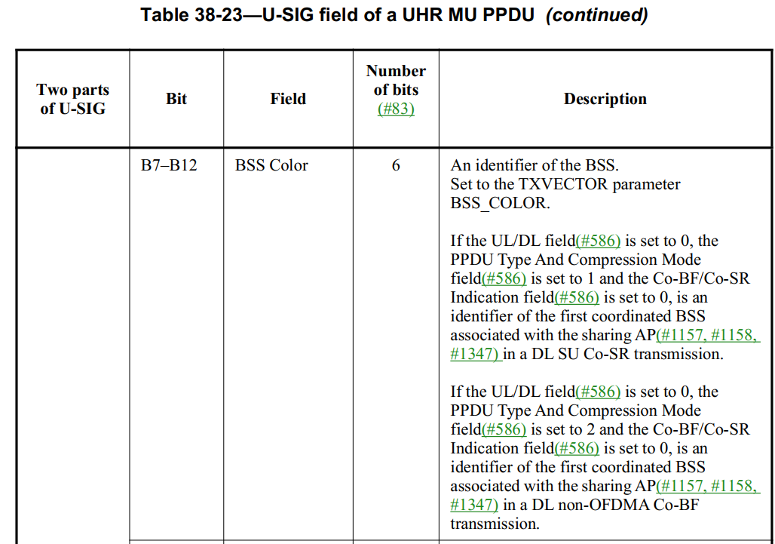
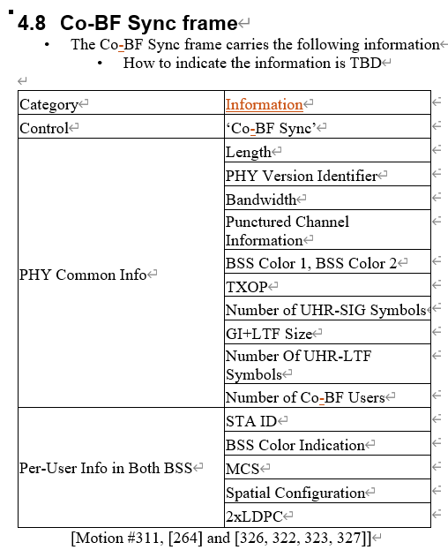
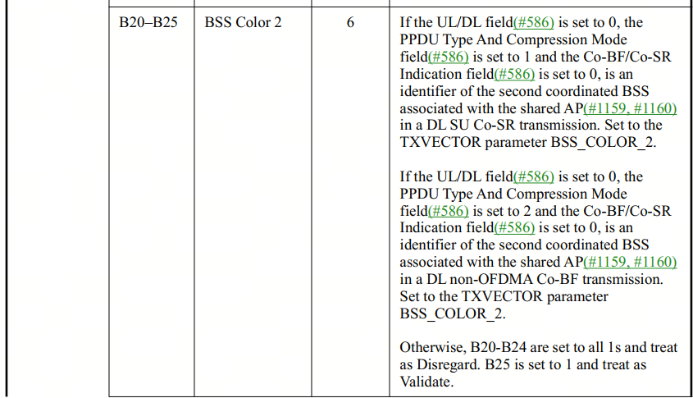
Current Signalling on Co-BF/Co-SR – Recap [2],[3]
BSS color 1 and 2 are the BSS color of the two Coordinated BSSs in Co-BF or Co-SR.
BSS Color:
The BSS color is a numerical identifier of the BSS.
BSS color information is communicated at both the PHY layer and the MAC sublayer.
In the preamble of an 802.11ax PHY header, the SIG-A field contains a 6-bit BSS color field. This field can identify as many as 63 BSSs.
Six bits can be used to identify as many as 63 different colors and represent 63 different BSSs.

Slide 5
Discussion on Overhead Reduction on Co-BF/Co-SR Signalling
The system currently dedicates six bits to represent BSS Color 1 and another six bits for BSS Color 2.
Propose a differential indication method for BSS Color 1 and BSS Color 2:
One BSS Color retains the conventional six-bit indication, while the other BSS Color uses differential indication.
B0
B1
B2
B3
B4
B5
BSS Color 1
B0
B1
B2
B3
B4
B5
BSS Color 1
B0
B1
B2
B3
B4
B5
BSS Color 1
Five bits can be saved
Four bits can be saved
Three bits can be saved
B0
B1
B2
B3
B4
B5
BSS Color 2
B0
B1
B2
B3
B4
B5
BSS Color 2
B0
B1
B2
B3
B4
B5
BSS Color 2
A single bit is used to indicate that the difference between the two BSS Colors is either 0 or 1
Two bits are used to indicate the difference between two BSS Colors falls within the range 0 ~ 3
Three bits are used to indicate the difference between two BSS Colors falls within the range 0 ~ 7
B0
B1
B2
B3
B4
B5
BSS Color 1
B0
B1
B2
B3
B4
B5
BSS Color 1
B0
B1
B2
B3
B4
B5
BSS Color 1
Two bits can be saved
One bit can be saved
B0
B1
B2
B3
B4
B5
BSS Color 2
B0
B1
B2
B3
B4
B5
BSS Color 2
B0
B1
B2
B3
B4
B5
BSS Color 2
Four bits are used to indicate the difference between two BSS Colors falls within the range 0 ~ 15
Five bits are used to indicate the difference between two BSS Colors falls within the range 0 ~ 31
Six bits are used to indicate BSS Colors 2 if the difference between two BSS Colors falls within the range 32 ~ 63, i.e. no bit can be saved

Slide 6
Conclusion
To reduce signaling overhead, a differential indication method for BSS Color 1 and BSS Color 2 in Co-BF/Co-SR was proposed in this presentation.
One BSS Color retains the conventional six-bit indication, while the other BSS Color uses differential indication.
The proposed method can potentially yield between one and five bits savings depending on the range of differential indication.
The trade-offs between the range of differential indication and bit savings is inverse: a larger range yields less bit savings, while a smaller range yields more.
If consideration for the current TGbn standard is no longer feasible, it might be considered for future Wi-Fi systems like Wi-Fi 9, particularly within multi-AP coordination schemes.

Slide 7
References
[1] IEEE 802.11-23/0480r3, UHR proposed PAR, Laurent Cariou (Intel)
[2] Draft IEEE P802.11bn D0.3
[3] IEEE 802.11-24/0209r15, Specification framework for TGBn, Ross Jian Yu (Huawei)

