Slide 1
Low-Complexity Provisioning Methods for Low-Complexity Secure AMP Communications – Follow Up
Date: 2025-6-16
Authors:

Slide 2
Background
Motion 64, 65, 66 specified a secure AMP communication method using PMK, SNonce, ANonce, and PTK (11-24/1998, 11-24/2112, 11-25/0860, 11-24/1203). The method has low computation complexity (only hash and symmetric cryptography algorithms are used), requiring a high-entropy shared secret (PMK) as the authentication credential between an AMP AP and an AMP non-AP STA for preventing offline brute force attacks. Provisioning methods are needed to configure the high-entropy shared secret into both devices.
  The AMP non-AP STA is most likely a headless device without UI and can only communicate using 11bp PHY/MAC, so 11bp-based in-band provisioning protocol is needed for provisioning a PMK into the AMP non-AP STA.
  The AMP AP may need to be provisioned too (configuring a high-entropy PMK is not as simple as entering a password).
11-25/0831 proposed a set of low-complexity provisioning methods for this purpose, focused on AMP non-AP STAs incapable of saving PMK into non-volatile memory due to extreme energy constraints.
This contribution proposes a set of low-complexity provisioning methods in a more general form, supporting different implementations for AMP non-AP STAs under different energy constraints, including those having sufficient energy to save PMK into non-volatile memory and those lacking energy to save entire PMK into non-volatile memory.
Notes:
https://unit42.paloaltonetworks.com/iot-threat-report-2020/

Slide 3
Constraints
AMP non-AP STAs solely relying on harvesting RF energy have difficulty to write even very small amount of data into non-volatile memory.
  Writing 32 bits into non-volatile memory can consume 50-500uJ (11/23-1140).
  Harvesting 1uJ needs 1s or 0.1s at -20dbm or -10dbm (11/23-1232).
Existing Wi-Fi provisioning methods heavily rely on public key algorithms. It had better avoid using public key-based algorithms on AMP non-AP STAs, per concerns that quantum computing could soon break RSA-based and ECC-based public key algorithms, but AMP non-AP STAs won’t have sufficient power and storage to run PQC public key algorithms.
  The public key (encapsulation key) size for the least complicated PQC algorithm ML-KEM-512 is 800 bytes. The corresponding private key (decapsulation key) size is 1632 bytes (FIPS 203).
Low-complexity secure AMP communication energy consumption ballpark numbers.
  SHA-256: 0.018uJ per 32B [13].
  AES128 GCM: 12 bits per cycle; 0.98uJ per 16B block [14].
Notes:
https://unit42.paloaltonetworks.com/iot-threat-report-2020/

Slide 4
Direct provisioning
Provisioning model
  Three logic roles: C = a configurator (a special AMP AP, most likely a smartphone); R = an AMP reader (AMP AP); A = an AMP device (AMP non-AP STA); C and R could be the same device or different devices.
Provisioning an AMP non-AP STA
  Use case: a user bought an AMP device A and downloaded an app to his smart phone C. C obtains A’s ID (A_ID) and a device-specific secret A_K by scanning the QR code of A (or through some other OOB method), then runs the direct provisioning protocol with A to send a proposed PMK or some data for generating a PMK to A and to receive a generated PMK or some data for generating a PMK from A if needed.
    If A cannot write entire PMK into non-volatile memory due to extreme energy constraint, the PMK can be derived from a permanent secret P built in A, without the need of saving a proposed/generated PMK into non-volatile memory (11/25-0831).
    If A has sufficient energy to save a proposed/generated PMK into its non-volatile memory, it can take a PMK proposed by C or take the PMK input data provided by C to generate a PMK, then save the PMK into its non-volatile memory.
  The user must guard A_K as a secret. A can increase the protection by only allowing reprovisioning after being provisioned.
Provisioning an AMP AP
  If C and R are the same device, C saves the A_ID and the PMK agreed by A in its permanent memory. Done.
  If C and R are separate devices, C has a variety of methods to pass the PMK agreed by A to R because C and R are not AMP devices subject to extreme energy constraint. It is not needed to define 11bp-based protocol for C to configure R.
    DPP or USD-based commissioning method or other methods can be used.
    Why C and R could be separate devices? C could be a more capable device than R, e.g., capable of scanning a QR code to get A_K; C is only device accessing A_Ks for better protection on A_Ks, configuring PMKs between many AMP devices and many AMP readers then passing PMKs to those AMP readers in batch mode for scalability.
Notes:
https://unit42.paloaltonetworks.com/iot-threat-report-2020/

Slide 5
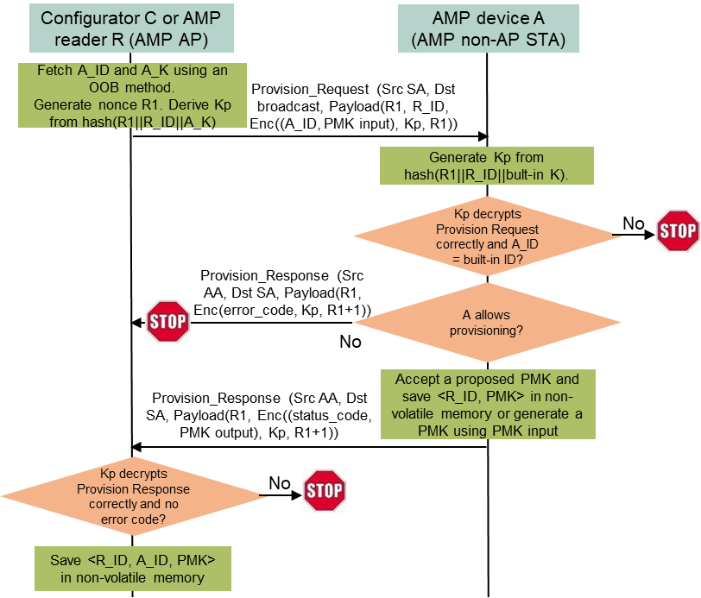
Direct provisioning protocol
Provisioning protocol (between C and A)
  C fetches the confidential A_ID and A_K using an OOB method.
  C broadcasts a Provisioning Request frame, containing an incremental random nonce R1, R_ID, encrypted A_ID and PMK input data denoted as Enc((A_ID, PMK input), Kp, R1). PMK input is either a proposed PMK or some input for generating a PMK. Kp is an encryption key derived from hash(R1 || R_ID || A_K). R1 is a nonce used by AES-128.
  Every AMP device received the broadcast Provision Request frame derives its own version of Kp from hash(R1 || R_ID || built-in provisioning key), then checks if it can authenticate and decrypt the payload using Kp and if the decrypted A_ID matches its built-in ID. Only A finds a match and responds.
  A checks if it allows provisioning. If not, A returns an error code (e.g., A already has a PMK with R_ID); otherwise, A sends back an OK status code and some PMK output data if needed (e.g., PMK output data could be a PMK generated by A if A lacks energy to save entire PMK in non-volatile memory). The returned content is encrypted using Kp and sent in a Provisioning Response frame.
  C checks if it can authenticate and decrypt the payload using Kp. If everything is OK, C saves <R_ID, A_ID, PMK> in its permanent memory for future use.
Complexity
  2 frame exchanges: 64B DL and 48B DL, then A can power off. 1 hash (0.02uJ), 9 AES-128 GCM 16B blocks (including AEAD; 8.8uJ) on A.
If C and R are separate devices, C passes <R_ID, A_ID, PMK> to R using a method out of scope of 11bp
Notes:
https://unit42.paloaltonetworks.com/iot-threat-report-2020/

Slide 6
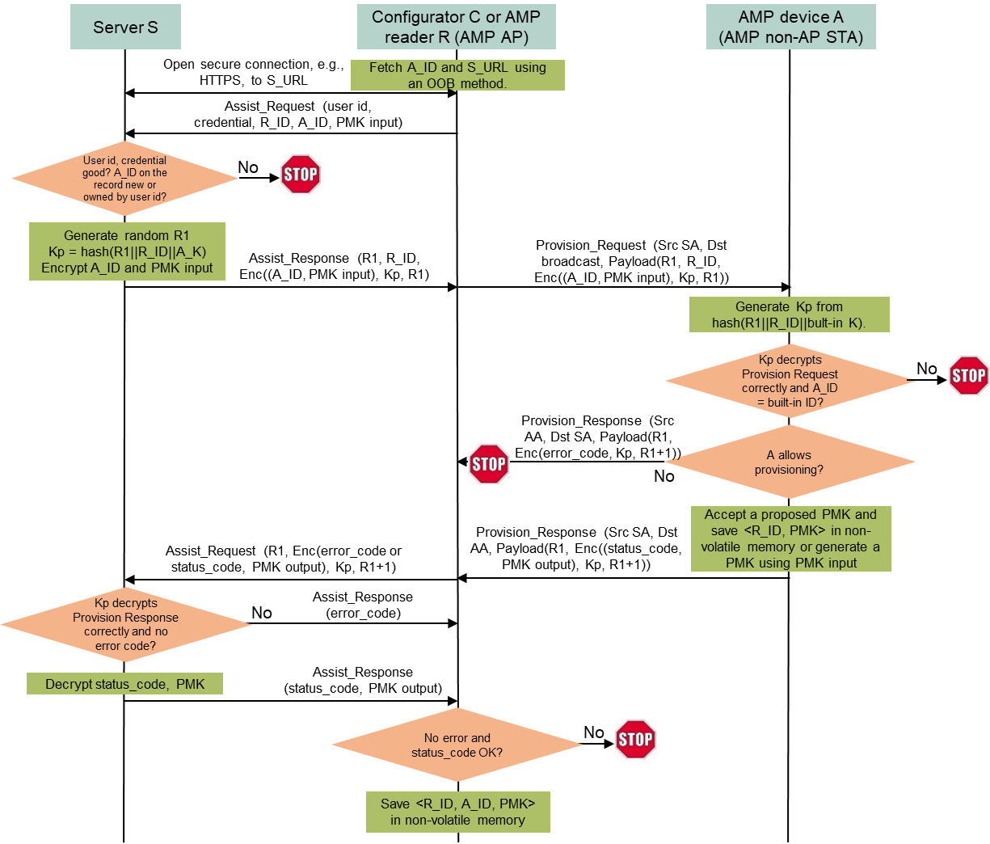
Assisted provisioning method
Provisioning model
  Four logic roles: C = a configurator (a special AMP AP, most likely a smartphone); R = an AMP reader (AMP AP); A = an AMP device (AMP non-AP STA); C and R could be the same device; S = a server storing <A_ID, A_K> for all AMP devices. S never reveals A_K.
  No new protocol is needed in 11bp for this method. C and A re-uses direct provisioning protocol.
Assisted provisioning protocol (between C and A)
  C fetches A_ID and S_URL from A using an OOB method, opens a secure connection to S, then sends an Assist_Request message to S, containing owner’s user ID and credential, A_ID, R_ID, and PMK input.
  After validating the user ID and credential and verifying A_ID is not registered to any other user, S generates a random number R1, encrypts A_ID and PMK input using a key Kp derived from hash(R1 || R_ID || A_K), and sends R1 and Enc((A_ID, PMK input), Kp, R1) to C.
  C broadcasts a Provisioning Request frame, containing R1, R_ID, and Enc((A_ID, PMK input), Kp, R1).
  Every AMP device received the broadcast Provision Request frame derives its own version of Kp from hash(R1 || R_ID || built-in provisioning key), then checks if it can authenticate and decrypt the payload using Kp and if the decrypted A_ID matches its built-in ID. Only A finds a match and responds.
  A checks if it allows provisioning. If not, A returns an error code; otherwise, A sends back an OK status code and PMK output if needed. The returned content is encrypted using Kp and sent in a Provisioning Response frame.
  C forwards R1 and Enc(error_code) or Enc(status_code, PMK output) to S.
  S decrypts the error code or status code and PMK output and forwards them to C. If the status is OK, S registers A_ID as a device owned by the user ID.
  If the status is OK, C saves <R_ID, A_ID, PMK> in its permanent memory for future use.
A_K is well guarded by S. Same complexity on A as direct provisioning protocol.
Notes:
https://unit42.paloaltonetworks.com/iot-threat-report-2020/

Slide 7
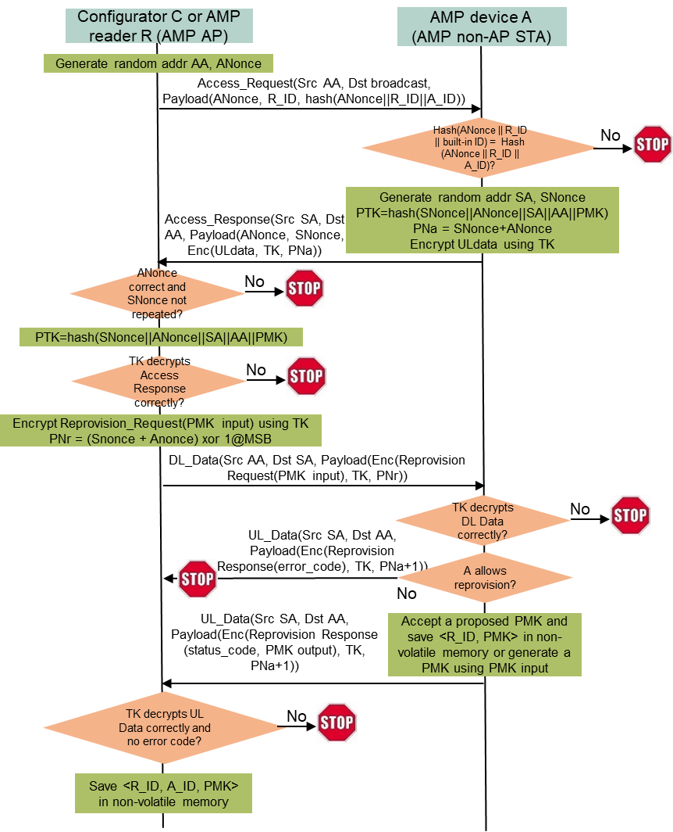
Reprovisioning
Use case
  A deployed AMP device could be used for years. It is a safe practice to update the PMK once a while, and an 11bp in-band method (reprovisioning protocol) is preferred because the deployed AMP device may not be physically accessible.
  Reprovisioning is done between a configurator (or an AMP reader) and an AMP device after they are mutually authenticated using the PMK. The secure AMP communication protocol can be re-used.
Reprovisioning protocol (between C and A; C=R possible)
  C generates a random MAC address AA and ANonce, broadcasts an Access Request frame containing ANonce, R_ID, and hash(ANonce||R_ID||A_ID).
  Every AMP device received the broadcast Access Request frame checks if hash(ANonce||R_ID||built-in ID) matches the received hash(ANonce||R_ID||A_ID). Only A finds a match and responds.
  A generates a random MAC address SA and SNonce, computes PTK from hash(SNonce||ANonce||SA||AA||PMK), sets some UL data if needed, encrypted the UL data using TK derived from PTK, and sends back SNonce, ANonce, and Enc(UL data, TK, SNonce+ANonce) in an Access Response frame.
  C generates PTK from hash(SNonce||ANonce||SA||AA||PMK), verifies if the payload can be decrypted correctly, then sends an encrypted DL Data frame containing a Reprovision Request message with PMK input.
  A carries out and sends back a Reprovisioning Response message with a status code (OK or error) and PMK output if needed in an encrypted UL Data frame.
  If the status is OK, C overwrites <R_ID, A_ID, current PMK> by <R_ID, A_ID, new PMK> in its permanent memory for future use.
Complexity
  4 frame exchanges: 72B DL, 80B UL, 48B DL, 48B UL.
  2 hashes (0.04uJ), 14 AES128 GCM 16B blocks (including AEAD; 13.7uJ) on A.
Notes:
https://unit42.paloaltonetworks.com/iot-threat-report-2020/

Slide 8
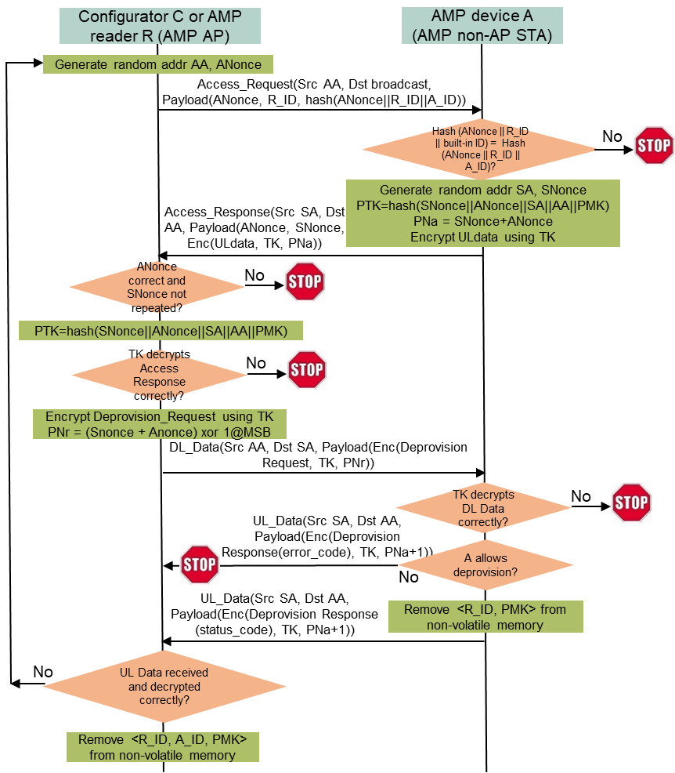
Deprovisioning
Use case
  An AMP device’s ownership could be transferred from one user to another user. The current user that has been provisioned with a PMK can run the deprovisioning protocol to make its PMK invalid. The new user can follow the provisioning protocol to set a new PMK.
  Deprovisioning is done between a configurator (or an AMP reader) and an AMP device after they are mutually authenticated using the PMK. The secure AMP communication protocol can be re-used.
Deprovisioning protocol (between C and A; C=R possible)
  C generates a random MAC address AA and ANonce, broadcasts an Access Request frame containing ANonce, R_ID, and hash(ANonce||R_ID||A_ID).
  Every AMP device received the broadcast Access Request frame checks if hash(ANonce||R_ID||built-in ID) matches the received hash(ANonce||R_ID||A_ID). Only A finds a match and responds.
  A generates a random MAC address SA and SNonce, computes PTK from hash(SNonce||ANonce||SA||AA||PMK), sets some UL data if needed, encrypted the UL data using TK derived from PTK, and sends back SNonce, ANonce, and Enc(UL data, TK, SNonce+ANonce) in an Access Response frame.
  C generates PTK from hash(SNonce||ANonce||SA||AA||PMK), verifies if the payload can be decrypted correctly, then sends an encrypted DL Data frame containing a Deprovision Request message.
  A carries out and sends back a Deprovisioning Response message with a status code (OK or error) in an encrypted UL Data frame.
  If the status is OK, C removes <R_ID, A_ID, PMK> from its permanent memory. Exception: if C cannot receive the expected UL Data frame or cannot authenticate and decrypt the received UL Data Frame, C should re-run the deprovisioning protocol until it receives an UL Data frame with an OK status code or it cannot authenticate and decrypt the received Access Response frame.
Deprovisioning protocol from C to R is not needed.
Complexity
  4 frame exchanges: 72B DL, 80B UL, 16B DL, 16B UL.
  2 hashes (0.04uJ), 10 AES128 16B blocks (including AEAD; 9.8uJ) on A.
Notes:
https://unit42.paloaltonetworks.com/iot-threat-report-2020/

Slide 9
Summary
A set of low-complexity provisioning methods are presented for provisioning a PMK into an AMP AP and an AMP non-AP STA so that they can conduct low-complexity secure communication using the PMK for mutual authentication and PTK generation.
The proposed provisioning protocols can support different PMK generation methods suitable for AMP non-AP STAs with different energy constraints.
The ballpark numbers of DL data size, UL data size, and energy needed by AMP non-AP STAs are provided.
Notes:
https://unit42.paloaltonetworks.com/iot-threat-report-2020/

Slide 10
SP1
Do you support to specify a provisioning protocol that a configurator (a special AMP AP) can configure a PMK into an AMP AP and an AMP non-AP STA for secure AMP communications between them by doing the following?
  The configurator obtains an ID and a device-specific secret from the AMP non-AP STA using an OOB method, generates an encryption key from the device-specific secret, sends an encrypted AMP frame containing the to-be-paired AMP AP’s ID and PMK input data to the AMP non-AP STA, and receives an encrypted AMP frame containing a status code and PMK output data (if needed) from the AMP non-AP STA.
Note:
  If the configurator and the to-be-paired AMP AP are separate devices, the configurator sends the AMP non-AP STA’s ID and the PMK to the to-be-paired AMP AP using a method out of scope of 11bp.
  Whether to include backscatter non-AP STAs in this protocol is TBD.
Reference: 11-25/1086, 11-25/0831
Notes:
https://unit42.paloaltonetworks.com/iot-threat-report-2020/

Slide 11
SP2
Do you support to specify a reprovisioning protocol that a configurator (a special AMP AP) can update a PMK shared by an AMP AP and an AMP non-AP STA for secure AMP communications between them by doing the following?
  The configurator follows the PMK, ANonce, SNonce, PTK-based secure AMP communication method to finish mutual authentication and PTK generation using the current PMK, send an encrypted DL AMP data frame containing the paired AMP AP’s ID and new PMK generation data to the AMP non-AP STA, and receive an encrypted UL AMP data frame containing a status code and a new PMK (if needed) from the AMP non-AP STA.
Note:
  If the configurator and the to-be-paired AMP AP are separate devices, the configurator sends the AMP non-AP STA’s ID and the PMK to the to-be-paired AMP AP using a method out of scope of 11bp.
  Whether to include backscatter non-AP STAs in this protocol is TBD.
Reference: 11-25/1086, 11-25/0831
Notes:
https://unit42.paloaltonetworks.com/iot-threat-report-2020/

Slide 12
SP3
Do you support to specify a deprovisioning protocol that a configurator (a special AMP AP) can invalidate a PMK shared by an AMP AP and an AMP non-AP STA by doing the following?
  The configurator follows the PMK, ANonce, SNonce, PTK-based secure AMP communication protocol to finish mutual authentication and PTK generation using the current PMK, send an encrypted DL AMP data frame containing the paired AMP AP’s ID and an instruction for invalidating the current PMK to the AMP non-AP STA, and receive an encrypted UL AMP data frame containing a status code from the AMP non-AP STA.
Note: whether to include backscatter non-AP STAs in this procedure is TBD.
Reference: 11-25/1086, 11-25/0831
Notes:
https://unit42.paloaltonetworks.com/iot-threat-report-2020/

Slide 13
Reference
Amichai Sanderovich, Sagi Kupferman, Yuval Amran, “Considerations for AMP Devices”, doc: IEEE 802.11-23/1140r0, July 10, 2023.
Joerg Robert, Clemens Korn, “Power Consumption Calculation”, doc: IEEE 802.11-23/1232r0, July 11, 2023.
Chuangfeng He, “Authentication and Security transaction for AMP”, doc: IEEE 802.11-24/1203r0, July 12, 2024.
Hui Luo, Rakesh Taori, “Secure transaction methods with low computation complexity for AMP”, doc: IEEE 802.11-24/1998r1, Jan 7, 2025.
Sanket Kalamkar, George Cherian, Alfred Asterjadhi, “Secure E2E Operation for AMP”, doc: IEEE 802.11-24/2112r0, Dec. 16, 2024.
Hui Luo, Rakesh Taori, Guy-Armand Kamendje, Nelson Costa, “Low-Complexity Provisioning Methods for Low-Complexity Secure AMP Communications”, doc: IEEE 802.11-25/0831r1, May 14, 2025.
Chuangfeng He, “Thoughts on security for AMP”, doc: IEEE 802.11-25/0860r0, May 2, 2025.
NIST, FIPS 203 “Module-Lattice-Based Key-Encapsulation Mechanism Standard”, https://nvlpubs.nist.gov/nistpubs/fips/nist.fips.203.pdf, August 13, 2024.
Luke E. Kane, Jiaming James Chen, Rebecca Thomas, Vicky Liu, Matthew McKague, “Security and Performance in IoT: A Balancing Act”, IEEE Access, vol. 8, pp. 121969-121986, July 6, 2020.
Levent Ertaul, Anup Mudan, Nausheen Sarfaraz, “Performance Comparison of AES-CCM and AES-GCM Authenticated Encryption Methods”, 2018, https://mcs.csueastbay.edu/~lertaul/AESCCMCAMREADY.pdf
Bekbolat Medetov, Tansaule Serikov, Aray Tolegenova, Zhexebay Dauren, Comparative Analysis of the Performance of Generating Cryptographic Ciphers on CPU and FPGA, 2022, https://www.jatit.org/volumes/Vol100No15/24Vol100No15.pdf
B. Kieu-Do-Nguyen, T. -T. Hoang, C. -K. Pham and C. Pham-Quoc, "A Power-efficient Implementation of SHA-256 Hash Function for Embedded Applications," 2021 International Conference on Advanced Technologies for Communications (ATC), Ho Chi Minh City, Vietnam, 2021, pp. 39-44, doi: 10.1109/ATC52653.2021.9598264. (0.018uJ per 32B by SHA256)
Mark D. Aagaard, Nusa Zidaric, “ASIC Benchmarking of Round 2 Candidates in the NIST Lightweight Cryptography Standardization Process”, 2021, https://eprint.iacr.org/2021/049.pdf (AES128 GCM: 12 bits per cycle; 0.28uJ/0.98uJ per 16B block by ASCON/AES128)
Notes:
https://unit42.paloaltonetworks.com/iot-threat-report-2020/

