Slide 1
Low-Complexity Provisioning Methods for Low-Complexity Secure AMP Communications – Follow Up
Date: 2025-6-16
Authors:

Slide 2
Background
Motion 64, 65, 66 specified a secure AMP communication method using PMK, SNonce, ANonce, and PTK (11-24/1998, 11-24/2112, 11-25/0860, 11-24/1203). The method has low computation complexity (only hash and symmetric cryptography algorithms are used), requiring a high-entropy shared secret (PMK) as the authentication credential between an AMP AP and an AMP non-AP STA. Provisioning methods are needed to configure the high-entropy shared secret into both devices.
The AMP non-AP STA is most likely a headless device without UI. Provisioning is needed.
The AMP AP may still need to be provisioned (configuring a high-entropy PMK is not as simple as entering a password).
11-25/0831 proposed a set of low-complexity provisioning methods for this purpose, suitable for AMP devices incapable of saving PMK into non-volatile memory due to extreme energy constraints.
This contribution proposes a set of low-complexity provisioning methods in a more general form, supporting different implementations for AMP devices under different energy constraints, including AMP devices that have sufficient energy to save PMK into non-volatile memory and that do not have energy to save entire PMK into non-volatile memory.
Notes:
https://unit42.paloaltonetworks.com/iot-threat-report-2020/

Slide 3
Constraints
AMP devices with battery or equivalent energy supply can save PMKs into non-volatile memory, but AMP devices solely relying on harvesting RF energy have difficulty to write even very small amount of data into non-volatile memory.
Writing 32 bits into non-volatile memory can consume 50-500uJ (11/23-1140).
Harvesting 1uJ needs 1s or 0.1s at -20dbm or -10dbm (11/23-1232).
Existing Wi-Fi provisioning methods heavily rely on public key algorithms. It had better avoid using public key-based algorithms on AMP devices, per concerns that quantum computing will soon break RSA-based and ECC-based public key algorithms and AMP devices won’t have sufficient power and storage to run PQC public key algorithms.
The public key (encapsulation key) size for the least complicated PQC algorithm ML-KEM-512 is 800 bytes. The corresponding private key (decapsulation key) size is 1632 bytes (FIPS 203).
Low-complexity secure AMP communication energy consumption ballpark numbers.
SHA-256: 0.018uJ per 32B [13].
AES128 GCM: 12 bits per cycle; 0.98uJ per 16B block [14].
Notes:
https://unit42.paloaltonetworks.com/iot-threat-report-2020/

Slide 4
Direct provisioning
Provisioning model
Three roles: C = a configurator (a special AMP AP, most likely a smartphone); R = an AMP reader (AMP AP); A = an AMP device (AMP non-AP STA); C and R could be the same device.
Use case --- provisioning an AMP device
A user bought an AMP device A and downloaded an app to his smart phone C. C obtains A’s ID (A_ID) and a device-specific secret A_K by scanning the QR code of A (or through some other OOB method), then runs the direct provisioning protocol with A to send a proposed PMK or some data for generating a PMK to A and to receive a generated PMK from A if needed.
If A cannot write entire PMK into non-volatile memory due to extreme energy constraint, the PMK can be derived from a permanent secret P built in A, without the need of saving a proposed/generated PMK into non-volatile memory (11/25-0831).
If A has sufficient energy to save a proposed/generated PMK into its non-volatile memory, it can take a PMK proposed by C or take the PMK data provided by C to generate a PMK, then save the PMK into its non-volatile memory.
The user must guard A_K as a secret. A can increase the protection by only allowing reprovisioning after being provisioned.
Use case --- provisioning an AMP reader
If C and R are the same device, C saves the A_ID and the PMK agreed by A in its permanent memory. Done.
If C and R are separate devices, C has a variety of methods to pass the PMK agreed by A to R because C and R are not AMP devices subject to extreme energy constraint.
DPP or USD-based pairing service can be used. Alternatively, the same direct provisioning protocol can be developed using a pair of IEEE 802.11 Action Frames.
C could accumulate A_IDs and PMKs from many AMP devices and provision all of them to R in one shot, if R needs to communicate with all these AMP devices.
Notes:
https://unit42.paloaltonetworks.com/iot-threat-report-2020/

Slide 5
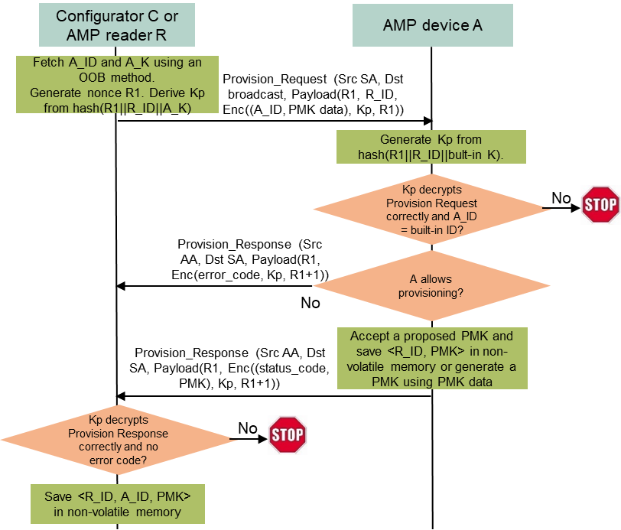
Direct provisioning protocol
Provisioning protocol (between configurator and AMP device)
C fetches the confidential A_ID and A_K using an OOB method.
C broadcasts a Provisioning Request frame, containing an incremental random nonce R1, R_ID, encrypted A_ID and PMK data denoted as Enc((A_ID, PMK data), Kp, R1). PMK data is either a proposed PMK or some input for generating a PMK. Kp is an encryption key derived from hash(R1 || R_ID || A_K). R1 is a nonce used by AES-128.
Every AMP device received the broadcast Provision Request frame derives its own version of Kp from hash(R1 || R_ID || built-in provisioning key), then checks if it can authenticate and decrypt the payload using Kp and if the decrypted A_ID matches its built-in ID. Only A finds a match and responds.
A checks if it allows provisioning. If not, A returns an error code (e.g., A already has a PMK with R_ID); otherwise, A sends back an OK status code and a generated PMK if the PMK data is not a proposed PMK. The returned content is encrypted using Kp and sent in a Provisioning Response frame.
C checks if it can authenticate and decrypt the payload using Kp. If everything is OK, C saves <R_ID, A_ID, PMK> in its permanent memory for future use.
Complexity
2 frame exchanges: 64B DL and 48B DL, then A can power off. 1 hash (0.02uJ), 9 AES-128 GCM 16B blocks (including AEAD; 8.8uJ) on A.
Notes:
https://unit42.paloaltonetworks.com/iot-threat-report-2020/

Slide 6
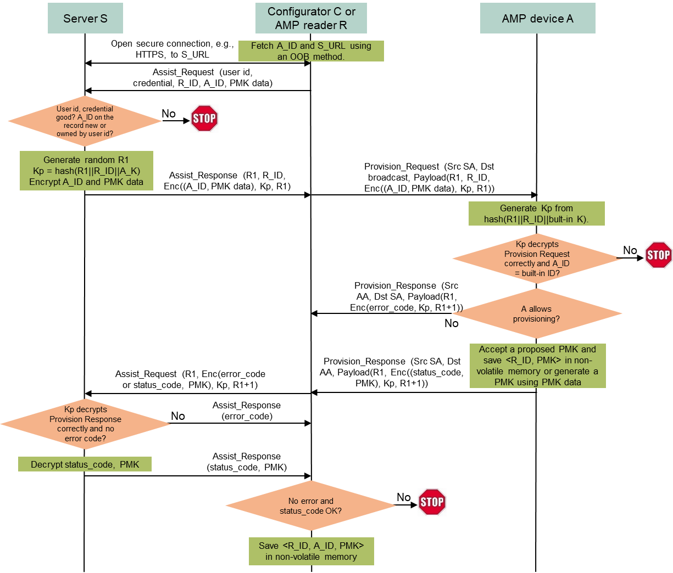
Assisted provisioning method
Provisioning model
Four roles: C = a configurator (a special AMP AP, most likely a smartphone); R = an AMP reader (AMP AP); A = an AMP device (AMP non-AP STA); C and R could be the same device; S = a server storing <A_ID, A_K> for all AMP devices. S never reveals A_K.
Assisted provisioning protocol (between C and A)
C fetches A_ID and S_URL from A using an OOB method, opens a secure connection to S, then sends an Assist_Request message to S, containing owner’s user ID and credential, A_ID, R_ID, and PMK data (a proposed PMK or some input for generating a PMK).
After validating the user ID and credential and verifying A_ID is not registered to any other user, S generates a random number R1, encrypts A_ID and PMK data using a key Kp derived from hash(R1 || R_ID || A_K), and sends R1 and Enc((A_ID, PMK data), Kp, R1) to C.
C broadcasts a Provisioning Request frame, containing R1, R_ID, and Enc((A_ID, PMK data), Kp, R1).
Every AMP device received the broadcast Provision Request frame derives its own version of Kp from hash(R1 || R_ID || built-in provisioning key), then checks if it can authenticate and decrypt the payload using Kp and if the decrypted A_ID matches its built-in ID. Only A finds a match and responds.
A checks if it allows provisioning. If not, A returns an error code; otherwise, A sends back an OK status code and a generated PMK if needed. The returned content is encrypted using Kp and sent in a Provisioning Response frame.
C forwards R1 and Enc(error_code) or Enc(status_code, PMK) to S.
S decrypts the error code or status code and PMK and forwards them to C. If the status is OK, S registers A_ID as a device owned by the user ID.
If the status is OK, C saves <R_ID, A_ID, PMK> in its permanent memory for future use.
If C and R are separate devices, direct provisioning protocol can be used to pass PMK to R
A_K is well guarded by S. Same complexity on A as direct provisioning protocol.
Notes:
https://unit42.paloaltonetworks.com/iot-threat-report-2020/

Slide 7
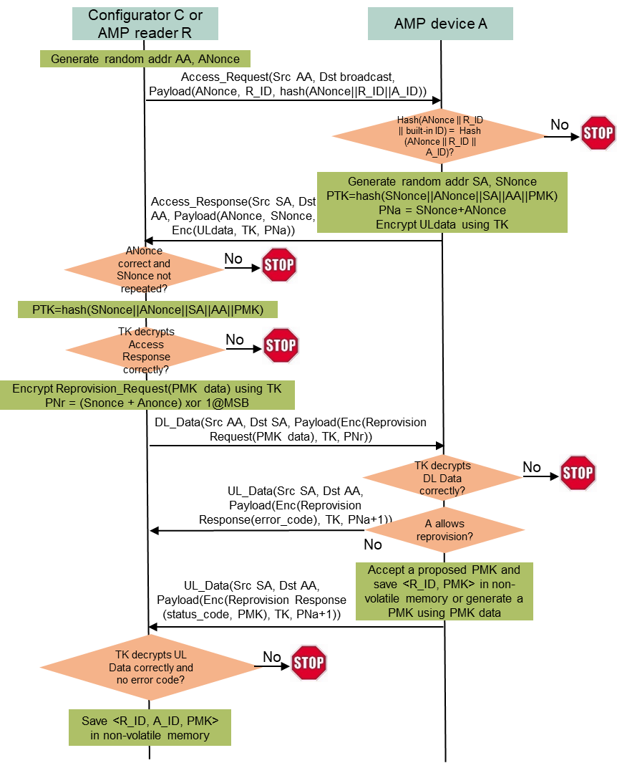
Reprovisioning
Use case
A deployed AMP device could be used for years. It is a safe practice to update the PMK once a while, and an in-band method (reprovisioning protocol) is preferred because the deployed AMP device may not be physically accessible.
Reprovisioning is done between a configurator (or an AMP reader) and an AMP device after they are mutually authenticated using the PMK. The secure AMP communication protocol can be re-used.
Reprovisioning protocol (between C and A; C=R possible)
C generates a random MAC address AA and ANonce, broadcasts an Access Request frame containing ANonce, R_ID, and hash(ANonce||R_ID||A_ID).
Every AMP device received the broadcast Access Request frame checks if hash(ANonce||R_ID||built-in ID) matches the received hash(ANonce||R_ID||A_ID). Only A finds a match and responds.
A generates a random MAC address SA and SNonce, computes PTK from hash(SNonce||ANonce||SA||AA||PMK), sets some UL data if needed, encrypted the UL data using TK derived from PTK, and sends back SNonce, ANonce, and Enc(UL data, TK, SNonce+ANonce) in an Access Response frame.
C generates PTK from hash(SNonce||ANonce||SA||AA||PMK), verifies if the payload can be decrypted correctly, then sends an encrypted DL Data frame containing a Reprovision Request message with a proposed new PMK or data for generating a new PMK.
A carries out and sends back a Reprovisioning Response message with a status code (OK or error) and a generated PMK if needed in an encrypted UL Data frame.
If the status is OK, C overwrites <R_ID, A_ID, current PMK> by <R_ID, A_ID, new PMK> in its permanent memory for future use.
Reprovisioning protocol from C to R reuses provisioning protocol from C to R
Complexity
4 frame exchanges: 72B DL, 80B UL, 48B DL, 48B UL.
2 hashes (0.04uJ), 14 AES128 GCM 16B blocks (including AEAD; 13.7uJ) on A.
Notes:
https://unit42.paloaltonetworks.com/iot-threat-report-2020/

Slide 8
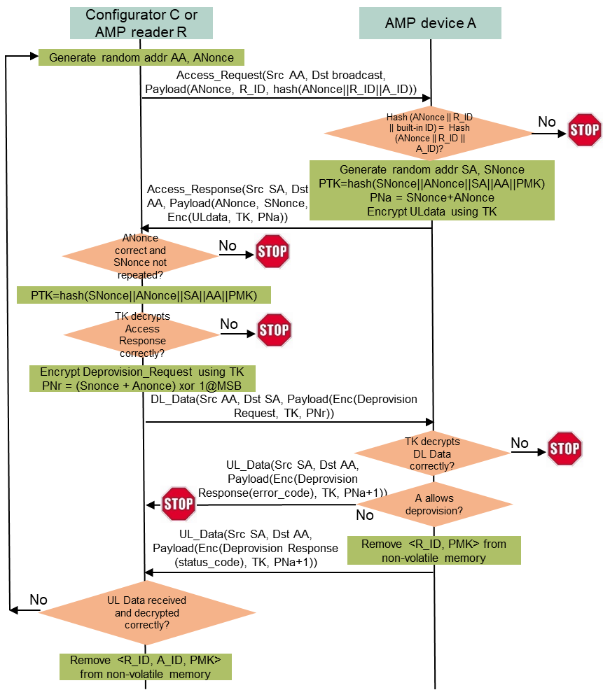
Deprovisioning
Use case
An AMP device’s ownership could be transferred from one user to another user. The current user that has been provisioned with a PMK can run the deprovisioning protocol to make its PMK invalid. The new user can follow the provisioning protocol to set a new PMK.
Deprovisioning is done between a configurator (or an AMP reader) and an AMP device after they are mutually authenticated using the PMK. The secure AMP communication protocol can be re-used.
Deprovisioning protocol (between C and A; C=R possible)
C generates a random MAC address AA and ANonce, broadcasts an Access Request frame containing ANonce, R_ID, and hash(ANonce||R_ID||A_ID).
Every AMP device received the broadcast Access Request frame checks if hash(ANonce||R_ID||built-in ID) matches the received hash(ANonce||R_ID||A_ID). Only A finds a match and responds.
A generates a random MAC address SA and SNonce, computes PTK from hash(SNonce||ANonce||SA||AA||PMK), sets some UL data if needed, encrypted the UL data using TK derived from PTK, and sends back SNonce, ANonce, and Enc(UL data, TK, SNonce+ANonce) in an Access Response frame.
C generates PTK from hash(SNonce||ANonce||SA||AA||PMK), verifies if the payload can be decrypted correctly, then sends an encrypted DL Data frame containing a Deprovision Request message.
A carries out and sends back a Deprovisioning Response message with a status code (OK or error) in an encrypted UL Data frame.
If the status is OK, C removes <R_ID, A_ID, PMK> from its permanent memory. Exception: if C cannot receive the expected UL Data frame or cannot authenticate and decrypt the received UL Data Frame, C should re-run the deprovisioning protocol until it receives an UL Data frame with an OK status code or it cannot authenticate and decrypt the received Access Response frame.
Deprovisioning protocol from C to R is not needed.
Complexity
4 frame exchanges: 72B DL, 80B UL, 16B DL, 16B UL.
2 hashes (0.04uJ), 10 AES128 16B blocks (including AEAD; 9.8uJ) on A.
Notes:
https://unit42.paloaltonetworks.com/iot-threat-report-2020/

Slide 9
Summary
A set of low-complexity provisioning methods are presented for provisioning a PMK into an AMP AP and an AMP non-AP STA so that they can conduct low-complexity secure communication using the PMK as the mutual authentication credential.
The proposed provisioning protocols can support different PMK generation methods suitable for AMP devices with different energy constraints.
The ballpark numbers of DL data size, UL data size, and energy needed by AMP non-AP STAs are provided.
Notes:
https://unit42.paloaltonetworks.com/iot-threat-report-2020/

Slide 10
SP1
Do you support to specify a direct provisioning protocol that a configurator (a special AMP AP) can configure a PMK into an AMP AP and an AMP non-AP STA for secure AMP communications between them by doing the following?
The configurator obtains an ID and a device-specific secret from the AMP non-AP STA using an OOB method, generates an encryption key from the device-specific secret, sends an encrypted AMP frame containing the to-be-paired AMP AP’s ID and PMK data to the AMP non-AP STA, and receives an encrypted AMP frame containing a status code and a generated PMK (if needed) from the AMP non-AP STA.
If the configurator and the to-be-paired AMP AP are separate devices, the configurator sends the AMP non-AP STA’s ID and the PMK to the to-be-paired AMP AP using a method out of scope of 11bp.
Reference: 11-25/1086, 11-25/0831
Notes:
https://unit42.paloaltonetworks.com/iot-threat-report-2020/

Slide 11
SP2
Do you support to specify an assisted provisioning protocol that a configurator (a special AMP AP) can configure a PMK into an AMP AP and an AMP non-AP STA for secure AMP communications between them by doing the following?
The configurator obtains an ID and a server’s URL from the AMP non-AP STA using an OOB method, sends an encrypted AMP frame containing the to-be-paired AMP AP’s ID and PMK data to the AMP non-AP STA, and receives an encrypted AMP frame containing a status code and a generated PMK (if needed) from the AMP non-AP STA, with the assistance from the server on encryption and decryption using a device-specific secret of the AMP non-AP STA known only by the server.
If the configurator and the to-be-paired AMP AP are separate devices, the configurator sends the AMP non-AP STA’s ID and the PMK to the to-be-paired AMP AP using a method out of scope of 11bp.
Reference: 11-25/1086, 11-25/0831
Notes:
https://unit42.paloaltonetworks.com/iot-threat-report-2020/

Slide 12
SP3
Do you support to specify a reprovisioning protocol that a configurator (a special AMP AP) can update a PMK shared by an AMP AP and an AMP non-AP STA for secure AMP communications between them by doing the following?
The configurator follows the PMK, ANonce, SNonce, PTK-based secure AMP communication method to finish mutual authentication and PTK generation using the current PMK, send an encrypted DL AMP data frame containing the paired AMP AP’s ID and new PMK generation data to the AMP non-AP STA, and receive an encrypted UL AMP data frame containing a status code and a new PMK (if needed) from the AMP non-AP STA.
If the configurator and the to-be-paired AMP AP are separate devices, the configurator sends the AMP non-AP STA’s ID and the PMK to the to-be-paired AMP AP using a method out of scope of 11bp.
Reference: 11-25/1086, 11-25/0831
Notes:
https://unit42.paloaltonetworks.com/iot-threat-report-2020/

Slide 13
SP4
Do you support to specify a deprovisioning protocol that a configurator (a special AMP AP) can invalidate a PMK shared by an AMP AP and an AMP non-AP STA by doing the following?
The configurator follows the PMK, ANonce, SNonce, PTK-based secure AMP communication protocol to finish mutual authentication and PTK generation using the current PMK, send an encrypted DL AMP data frame containing the paired AMP AP’s ID and an instruction for invalidating the current PMK to the AMP non-AP STA, and receive an encrypted UL AMP data frame containing a status code from the AMP non-AP STA.
Reference: 11-25/1086, 11-25/0831
Notes:
https://unit42.paloaltonetworks.com/iot-threat-report-2020/

Slide 14
Reference
Amichai Sanderovich, Sagi Kupferman, Yuval Amran, “Considerations for AMP Devices”, doc: IEEE 802.11-23/1140r0, July 10, 2023.
Joerg Robert, Clemens Korn, “Power Consumption Calculation”, doc: IEEE 802.11-23/1232r0, July 11, 2023.
Chuangfeng He, “Authentication and Security transaction for AMP”, doc: IEEE 802.11-24/1203r0, July 12, 2024.
Hui Luo, Rakesh Taori, “Secure transaction methods with low computation complexity for AMP”, doc: IEEE 802.11-24/1998r1, Jan 7, 2025.
Sanket Kalamkar, George Cherian, Alfred Asterjadhi, “Secure E2E Operation for AMP”, doc: IEEE 802.11-24/2112r0, Dec. 16, 2024.
Hui Luo, Rakesh Taori, Guy-Armand Kamendje, Nelson Costa, “Low-Complexity Provisioning Methods for Low-Complexity Secure AMP Communications”, doc: IEEE 802.11-25/0831r1, May 14, 2025.
Chuangfeng He, “Thoughts on security for AMP”, doc: IEEE 802.11-25/0860r0, May 2, 2025.
NIST, FIPS 203 “Module-Lattice-Based Key-Encapsulation Mechanism Standard”, https://nvlpubs.nist.gov/nistpubs/fips/nist.fips.203.pdf, August 13, 2024.
Luke E. Kane, Jiaming James Chen, Rebecca Thomas, Vicky Liu, Matthew McKague, “Security and Performance in IoT: A Balancing Act”, IEEE Access, vol. 8, pp. 121969-121986, July 6, 2020.
Levent Ertaul, Anup Mudan, Nausheen Sarfaraz, “Performance Comparison of AES-CCM and AES-GCM Authenticated Encryption Methods”, 2018, https://mcs.csueastbay.edu/~lertaul/AESCCMCAMREADY.pdf
Bekbolat Medetov, Tansaule Serikov, Aray Tolegenova, Zhexebay Dauren, Comparative Analysis of the Performance of Generating Cryptographic Ciphers on CPU and FPGA, 2022, https://www.jatit.org/volumes/Vol100No15/24Vol100No15.pdf
B. Kieu-Do-Nguyen, T. -T. Hoang, C. -K. Pham and C. Pham-Quoc, "A Power-efficient Implementation of SHA-256 Hash Function for Embedded Applications," 2021 International Conference on Advanced Technologies for Communications (ATC), Ho Chi Minh City, Vietnam, 2021, pp. 39-44, doi: 10.1109/ATC52653.2021.9598264. (0.018uJ per 32B by SHA256)
Mark D. Aagaard, Nusa Zidaric, “ASIC Benchmarking of Round 2 Candidates in the NIST Lightweight Cryptography Standardization Process”, 2021, https://eprint.iacr.org/2021/049.pdf (AES128 GCM: 12 bits per cycle; 0.28uJ/0.98uJ per 16B block by ASCON/AES128)
Notes:
https://unit42.paloaltonetworks.com/iot-threat-report-2020/

