Slide 1
A proposal to ELC channelization into the upper part of 6 GHz band
Jul 2025
Date: 2025-07-28
Authors:
Name | Affiliations | Address | Phone | email
Janis Sperga | pureLiFi |  |  | Janis.Sperga@purelifi.com
Cheng Chen | pureLiFi |  |  | Cheng.Chen@purelifi.com
Mohamed Islim | pureLiFi |  |  | Mohamed.Islim@purelifi.com
Mostafa Afgani | pureLiFi |  |  | Mostafa.Afgani@purelifi.com
Stefan Videv | Kyocera SLD Laser |  |  | svidev@kyocera-sldlaser.com
Sovan Das | Kyocera SLD Laser |  |  | sdas@kyocera-sldlaser.com

Slide 2
Abstract
Jul 2025
This presentation proposes a new channelisation of enhanced light communication, which supports RF-to-IF mapping of the entire 6GHz RF band for three optical bands with different wavelength ranges.

Slide 3
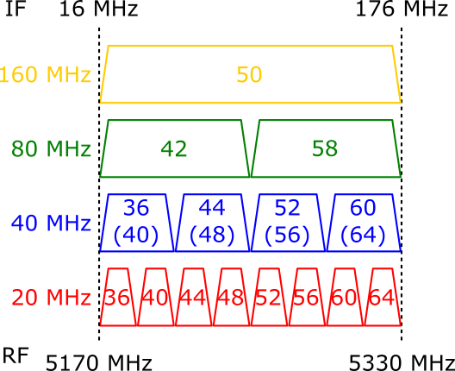
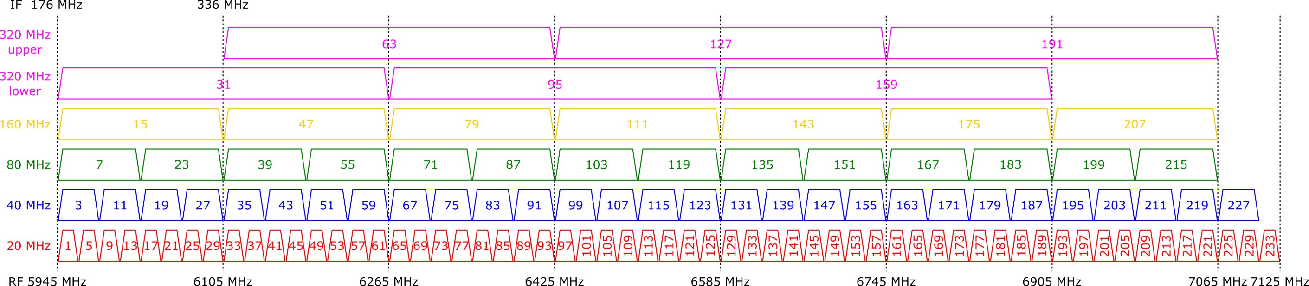
Extending into the 6GHz band
5GHz band 802.11bb
channelisation
6GHz band channels not included in 802.11bb channelisation
6GHz band
802.11bb
channelisation

Slide 4
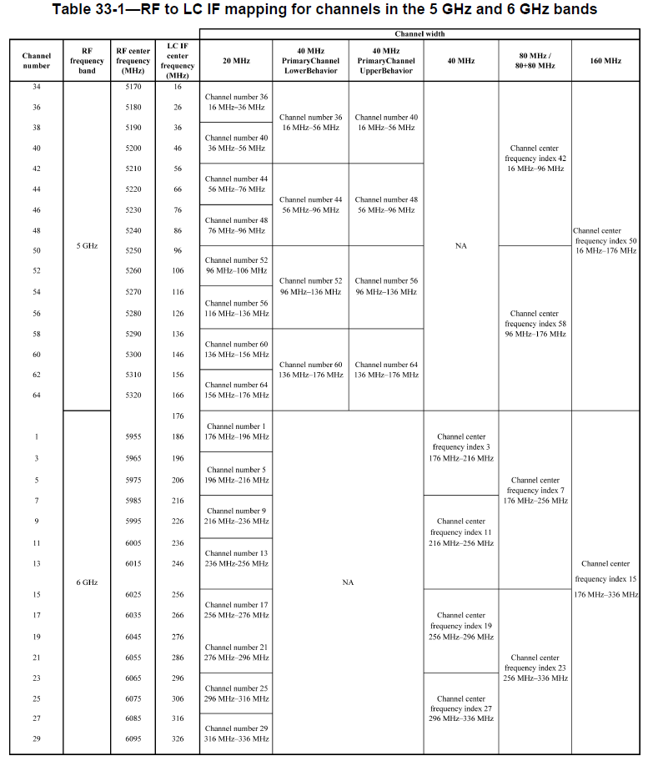
802.11bb 800 nm -1000 nm band channelization
Jul 2025
Supports the 5 GHz band and extends to the lower 6 GHz band (up to 6105 MHz)[1].
2 x160 MHz bands.
No 320 MHz bands.
With Wi-Fi 6E and Wi-Fi 7 the channelisation needs to be extended into the rest of 6 GHz band.
LC Bandwidth: 320 MHz.

Slide 5
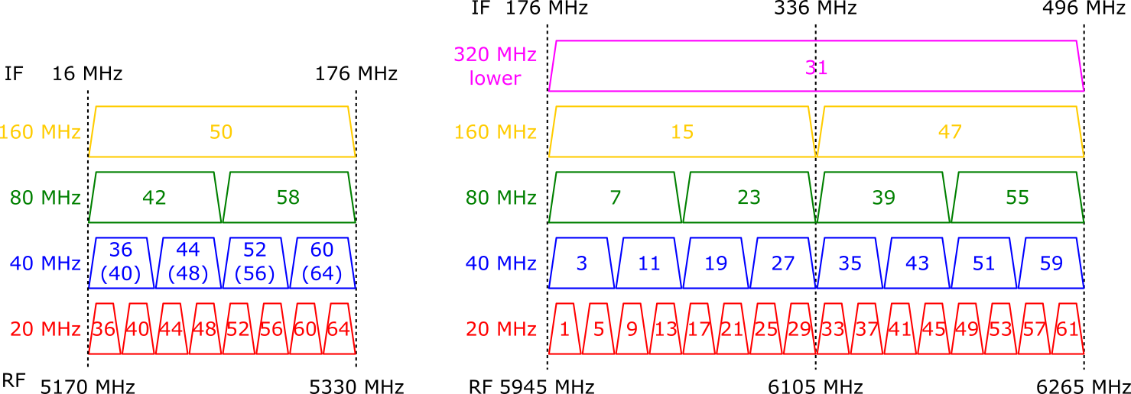
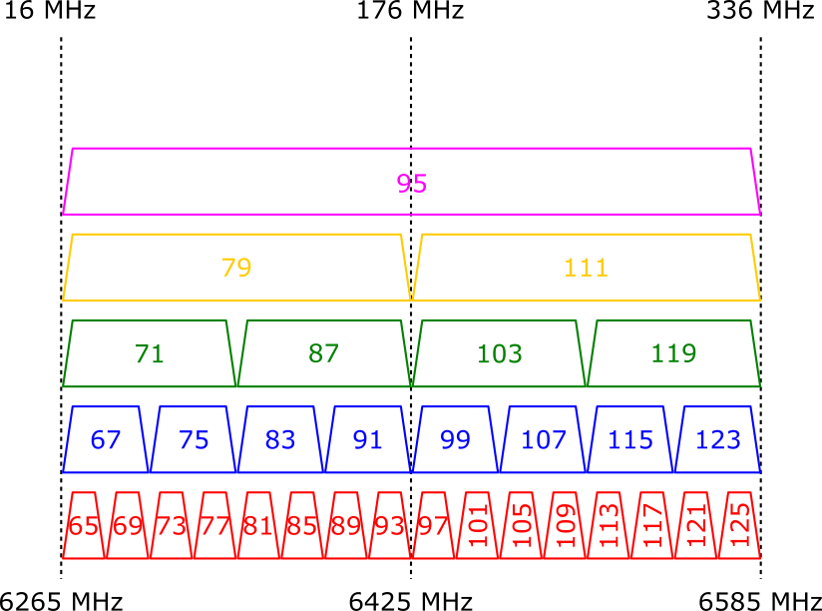
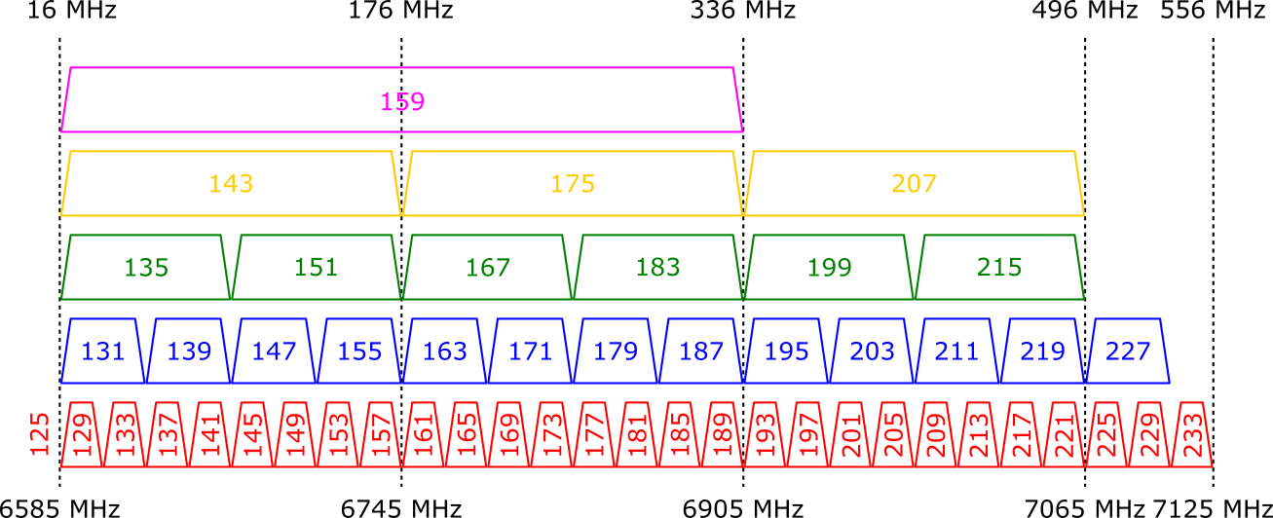
ELC channelisation proposal for 3 optical bands of different wavelength range
1200 nm - 1600 nm
800 nm
-1000 nm
400 nm
- 600 nm

Slide 6
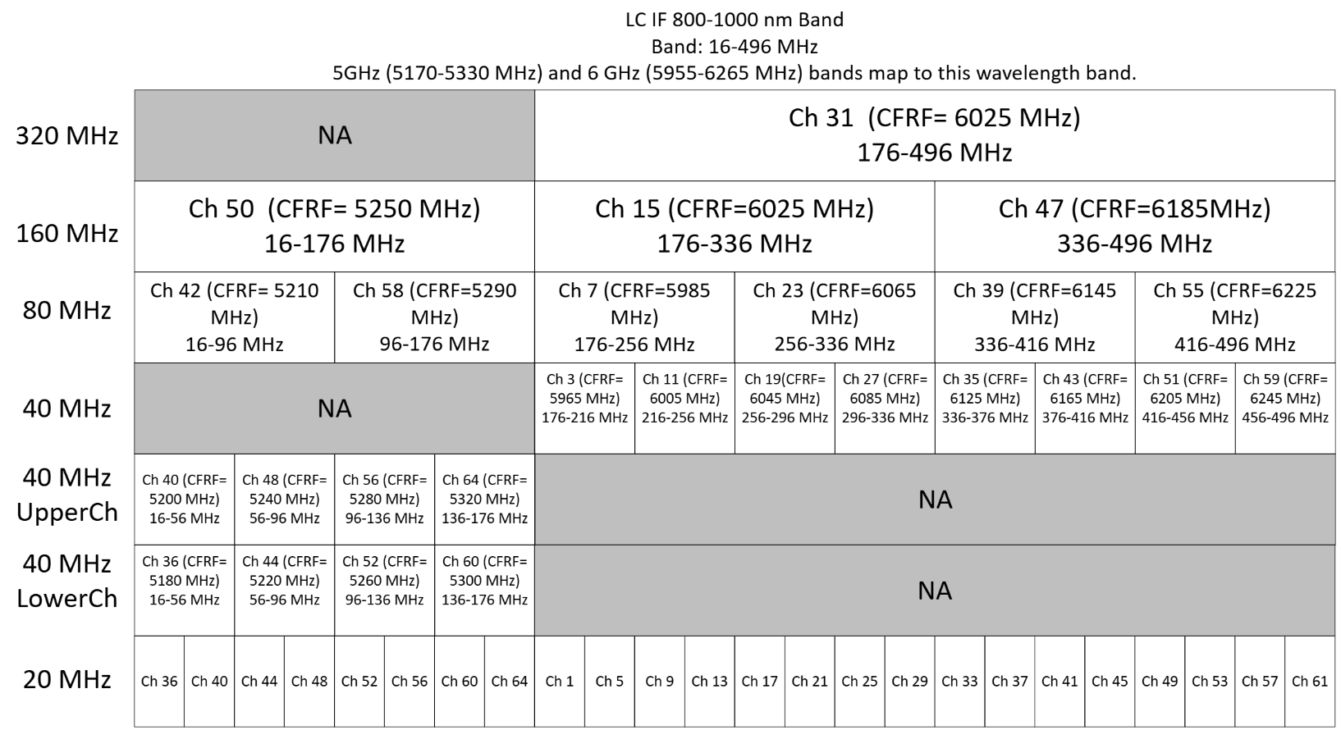
Extended 800 nm -1000 nm optical band channelisation
Extends the original 802.11bb channelisation from 6105 to 6265 MHz.
Backwards compatibility with the 802.11bb standard.
Supports one 320 MHz channel (Ch.31).
Supports 3 x160 MHz channels.
LC Bandwidth: 480 MHz.

Slide 7
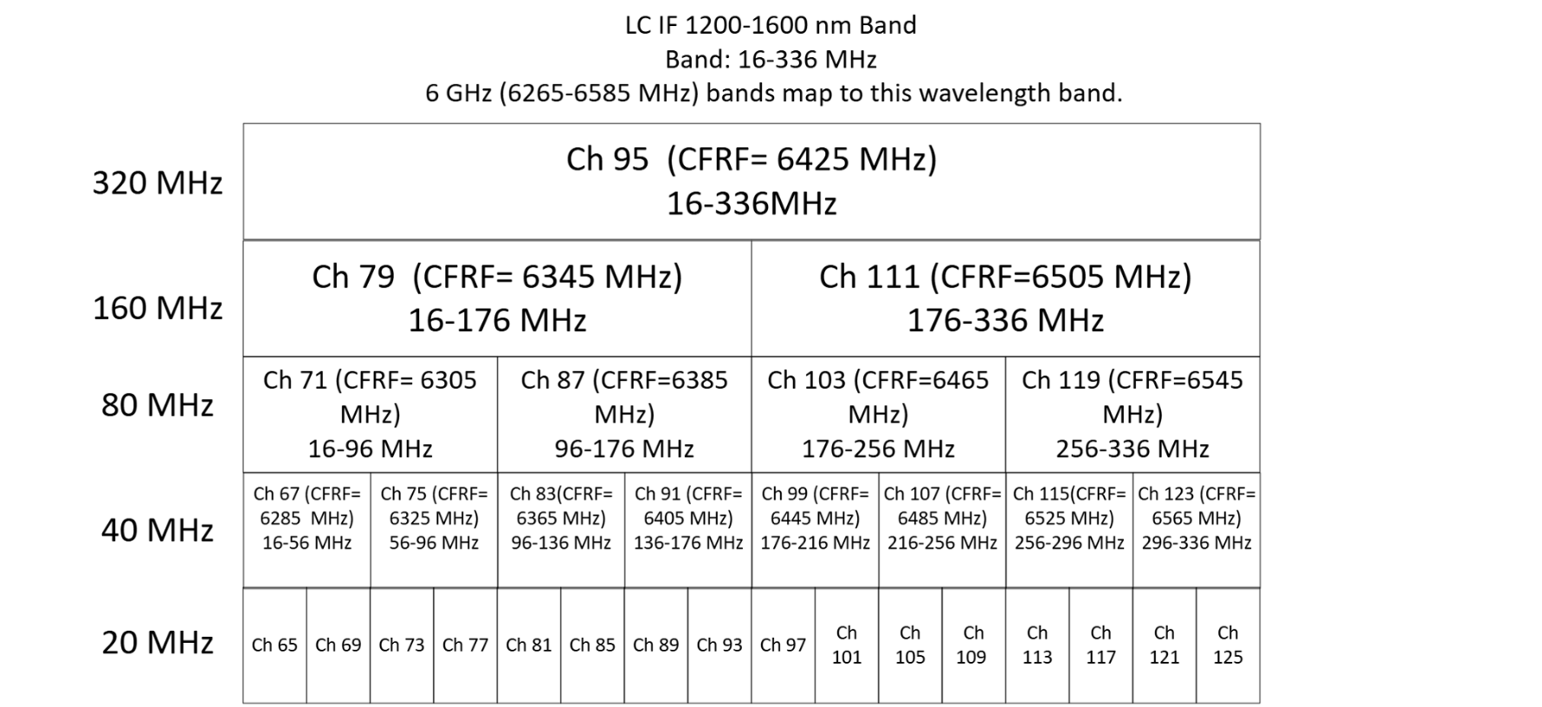
1200 nm -1600 nm optical band channelisation
New wavelength band for the near infrared operation (1200-1600 nm).
Maps Wi-Fi channels from 6265 to 6585 MHz to short-wave infrared wavelengths.
Supports one 320 MHz channel (Ch.95).
Supports 2 x160 MHz channels.
LC Bandwidth: 320 MHz.

Slide 8
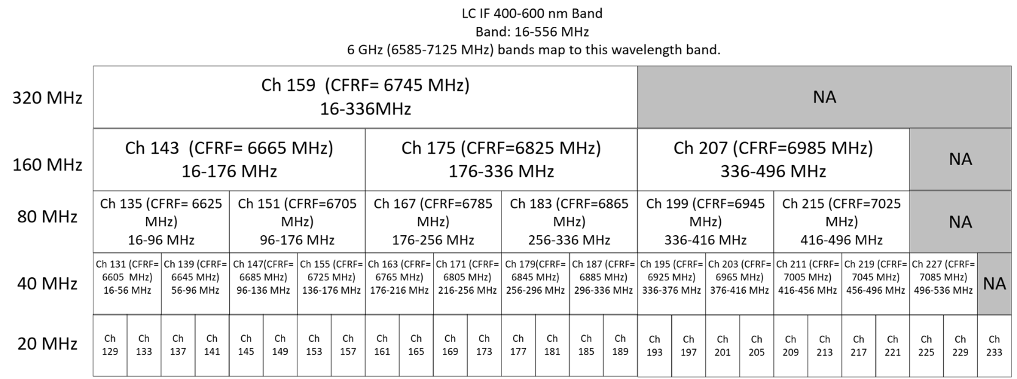
400 nm - 600 nm optical band channelisation
New wavelength band for the visible light operation (400-600 nm).
Maps Wi-Fi channels from 6585 to 7125 MHz to the Visible light wavelengths.
Supports one 320 MHz channel (Ch.159).
Supports 3 x160 MHz channels.
LC Bandwidth: 540 MHz.

Slide 9
Why map non-overlapping sets of RF channels to different optical bands?
Unique mappings between RF channels to the optical bands avoids ambiguity at the system level.
Allows the design of devices that supports operation in multiple optical bands.
Supports the future implementation of MLO across multiple optical bands.

Slide 10
Summary
Sept 2024
Expanded channelisation into the rest of 6 GHz band is proposed.
Proposal includes:
  Channelisation to be subdivided into 3 sets of mapping, which corresponds to optical bands of different wavelength ranges.
  Each optical band can use a 320 MHz channel.
  Such mapping supports operation in multiple optical bands.
  800 nm -1000 nm band to extend the original 802.11bb channelisation up to 6265 MHz, whilst retaining backward compatibility with 802.11bb standard [1].
  RF channels from 6265 to 6585 MHz to be mapped to the new 1200 nm -1600 nm optical band.
  RF channels from 6585 to 7125 MHz to be mapped to the new 400 nm -600 nm optical band.

Slide 11
Motion #10
Include the following text in the 802.11 TGbr SFD doc. 11-25/0941:
3.2 Definitions specific to IEEE Std 802.11
Insert the following definition in alphanumeric order as follows:
Enhanced light communications station (ELC STA): A station (STA) that operates in the light band with operation in one or more of the following bands:
• 800 nm – 1000 nm
• 400 nm – 600 nm
• 1200 nm – 1600 nm
Mover:
Second:
Results (Y/N/A) :

Slide 12
Motion #11
ELC PHY follows the RF to IF mapping defined in 33.2.3.4 for the wavelength band 800 nm to 1000 nm. In addition, it extends the frequency mapping to map RF channels from 6105 MHz to 6265 MHz to the IF range from 336 MHz to 496 MHz.
The range includes channels with channel center frequency numbers from 33 to 61 in the U-NII-5 part of 6 GHz band.
It also contains a 320 MHz channel with a channel center frequency numbered 31 in the 6 GHz band mapped to IF frequencies in the range 176 MHz to 496 MHz from RF frequencies in the range 5945 MHz to 6265 MHz.
Mover:
Second:
Results (Y/N/A) :

Slide 13
Motion #12
ELC PHY maps non-overlapping RF channels for the new ELC wavelength bands as follows:
  RF channels from 6265 to 6585 MHz to be mapped to the new 1200 nm -1600 nm wavelength band from IF 16 MHz to 336 MHz.
  RF channels from 6585 to 7125 MHz to be mapped to the new 400 nm -600 nm wavelength band.
Mover:
Second:
Results (Y/N/A) :

Slide 14
References
[1] Slides 4 and 10, IEEE Standard for Information Technology--Telecommunications and Information Exchange between Systems Local and Metropolitan Area Networks--Specific Requirements Part 11: Wireless LAN Medium Access Control (MAC) and Physical Layer (PHY) Specifications Amendment 6: Light Communications," in IEEE Std 802.11bb-2023 (Amendment to IEEE Std 802.11-2020 as amended by IEEE Std 802.11ax-2021, IEEE Std 802.11ay-2021, IEEE Std 802.11ba-2021, IEEE Std 802.11az-2022, IEEE Std 802.11-2020/Cor 1-2022, and IEEE Std 802.11bd-2023) , vol., no., pp.1-37, 10 Nov. 2023, doi: 10.1109/IEEESTD.2024.10315104.

