Slide 1
Considerations on SMD BSS transition
Date: September 10, 2025
Authors:
Name | Affiliations | Address | Phone | Email
Pei Zhou | TCL | Building G1, TCL International-E City, Shenzhen, Guangdong, China. |  | zhoupei36@gmail.com
 | TCL

Slide 2
Recap of SMD BSS transition
In 802.11bn D1.0 [1], SMD BSS transition includes the following procedures:
  — SMD BSS transition discovery
  — Initial association to the SMD-ME
  — Target AP MLD selection
  — SMD BSS transition preparation (currently, we only have Through current AP)
  — SMD BSS transition execution
    • Through current AP
    • Through target AP
  A non-AP MLD prepares one or more candidate target AP MLDs within an SMD by sending a separate ST preparation request for each candidate target AP MLD. If a SMD BSS transition preparation was successful with one or more candidate target AP MLDs, then the non-AP MLD shall attempt SMD BSS transition execution with only one of those target AP MLDs at a time. If the attempted SMD BSS transition execution fails, the non-AP MLD may attempt SMD BSS transition execution with another prepared AP MLD. [1]

Slide 3
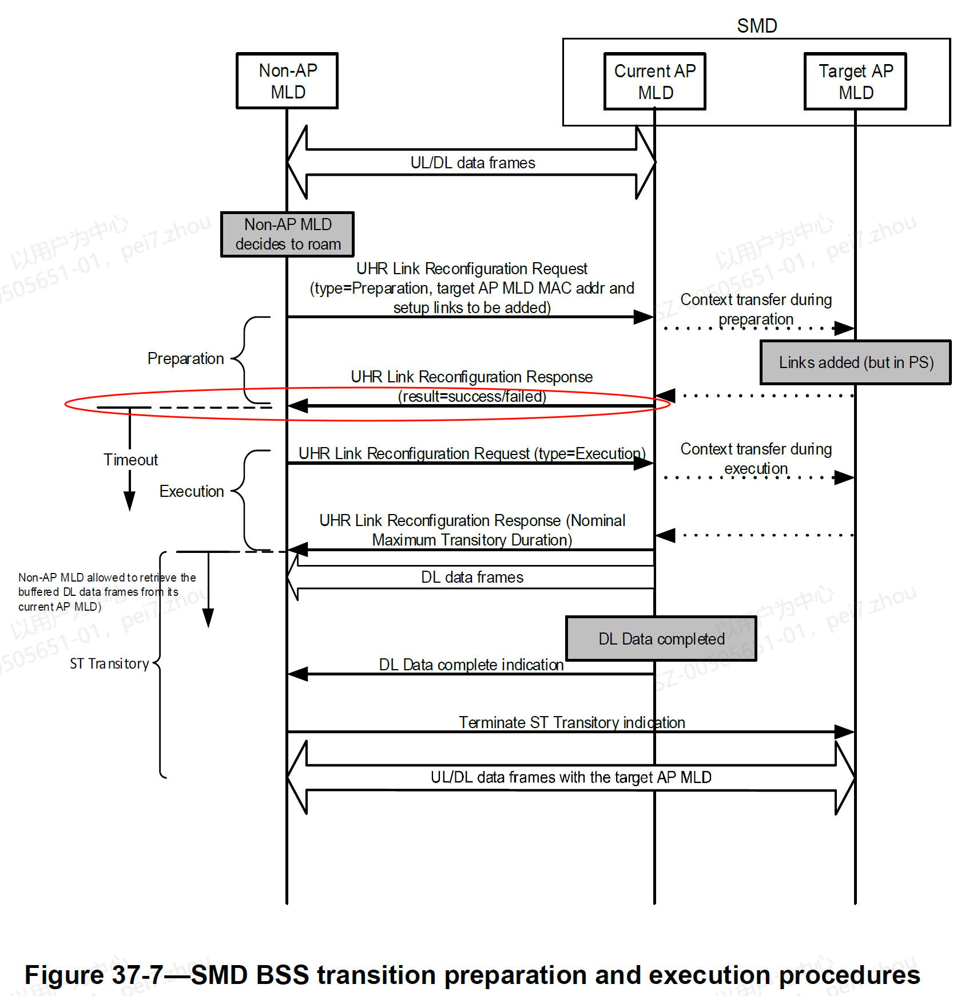
Issue 1
In reparation phase, ST preparation response from current AP MLD to non-AP MLD triggers the Timeout count down
SMD BSS transition works well only when non-AP MLD initiates ST execution request to current AP MLD (i.e., Through current AP) or target AP MLD (i.e., Through target AP) within the Timeout
Issue 1: If non-AP MLD prepares several candidate target AP MLDs by sending several ST preparation requests, how to determine the start time of Timeout?
  the 1st ST preparation response?
  or the last ST preparation response?
  or per target AP MLD?
This is unclear.

Slide 4
Solutions to Issue 1
Problem: If there is no (global) clear definition of when Timeout starts, current AP MLD and/or target AP MLD(s) will have different views of whether ST execution request is transmitted within the Timeout
  This will lead to the conclusion on SMD BSS transition failure
Solution 1: (preferred)
When a non-AP MLD prepares more than one candidate target AP MLDs in SMD BSS transition preparation phase, the next ST preparation response resets the Timeout value set by the previous ST preparation response
Therefore, the start time of Timeout is triggered by the last ST preparation response
This solution only maintains one Timeout
Solution 2:
When a non-AP MLD prepares more than one candidate target AP MLDs in SMD BSS transition preparation procedure, each ST preparation response triggers a separate Timeout value
Non-AP MLD and Current AP MLD need to maintain a specific Timeout for each prepared Target AP MLD
This solution maintains multiple Timeout

Slide 5
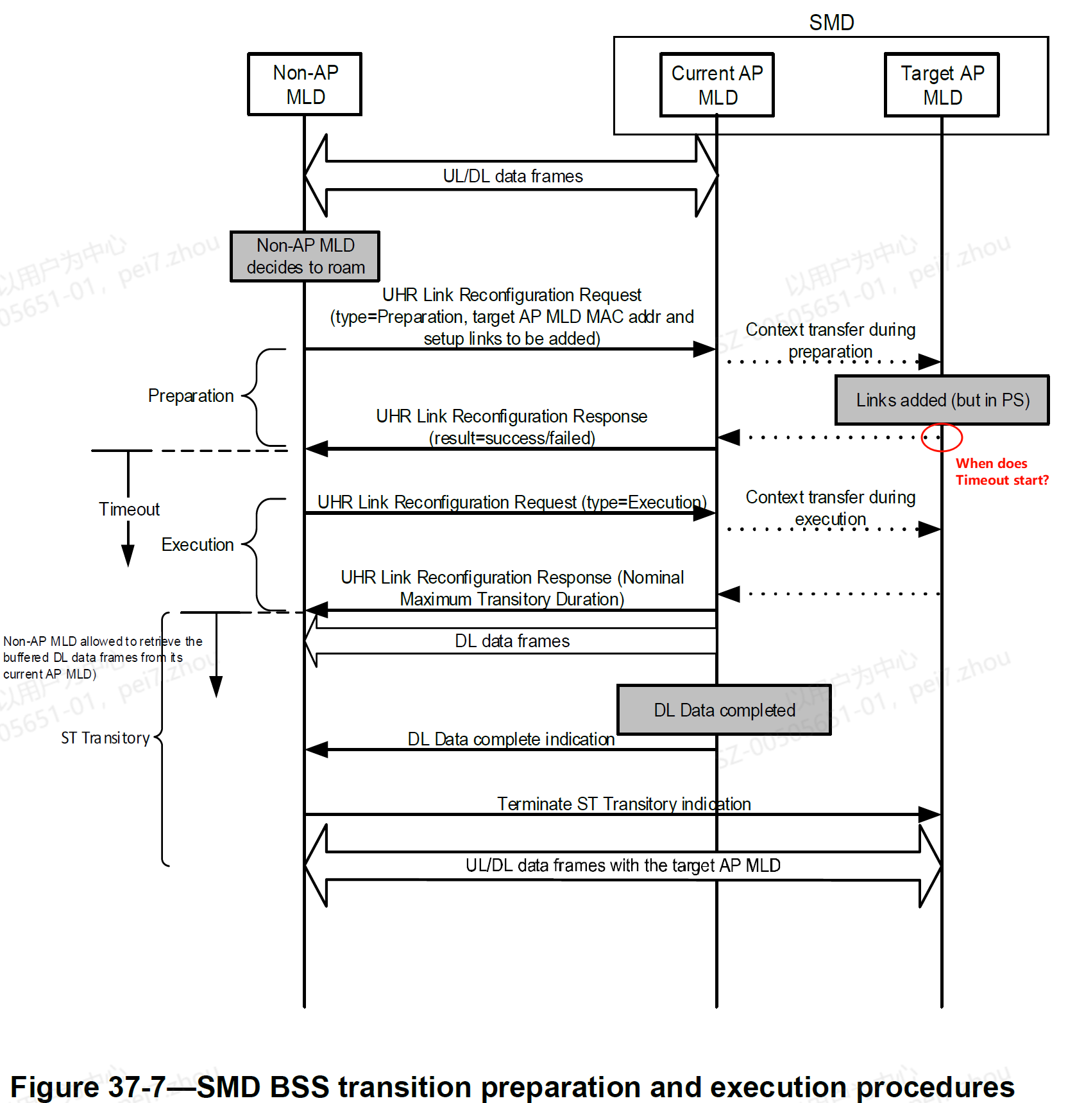
Issue 2
In preparation phase, ST preparation response from current AP MLD to non-AP MLD triggers the Timeout count down
Considering context and data transfer happens in Preparation phase. Preparation phase might not be done within SIFS time.
Issue 2: how does the target AP MLD know when the current AP MLD transmits the ST preparation response?
Similar issue happens in DLDrainTime
Execution through current AP MLD
  how does the target AP MLD know when the current AP MLD transmits the ST execution response
Execution through target AP MLD
  how does the current AP MLD know when the target AP MLD transmits the ST execution response

Slide 6
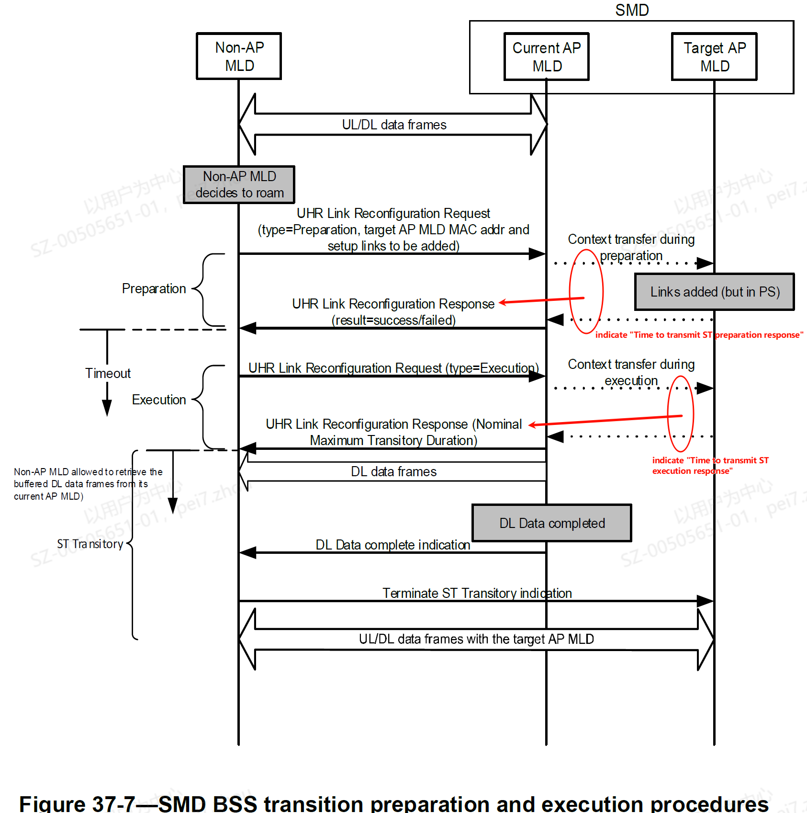
Solution to Issue 2
For Timeout: When performing context transfer between current AP MLD and target AP MLD(s) in preparation phase, current AP MLD and target AP MLD share the start time of transmitting ST preparation response.
For DLDrainTime: When performing context transfer between current AP MLD and target AP MLD(s) in execution phase, current AP MLD and target AP MLD share the start time of transmitting ST execution response.
Note: detailed methods TBD. For example, current AP MLD and target AP MLD share the expected time to transmit ST preparation/execution response.

Slide 7
Straw Poll 1
Do you agree with the following:
The latest 802.11bn draft (i.e., D1.0) needs more clear definition to determine the start time of Timeout when a non-AP MLD prepares one or more candidate target AP MLDs.
Note: Detailed definition is TBD. The SP result is used to determine whether it is necessary to submit a contribution (CR or PDT, etc.) to solve the issue mentioned in slide 3.
Y/N/A

Slide 8
Straw Poll 2
Do you agree with the following:
In order to make current AP MLD and target AP MLD(s) have the same start time of Timeout, time related information needs to be shared or indicated in the context transfer of Preparation phase.
Note: Time related information is TBD. The SP result is used to determine whether it is necessary to submit a contribution (CR or PDT, etc.) to solve the issues mentioned in slide 5.
Y/N/A

Slide 9
Straw Poll 3
Do you agree with the following:
In order to make current AP MLD and target AP MLD(s) have the same start time of ST Transitory, time related information needs to be shared or indicated in the context transfer of Execution phase.
Note: Time related information is TBD. The SP result is used to determine whether it is necessary to submit a contribution (CR or PDT, etc.) to solve the issues mentioned in slide 5.
Y/N/A

Slide 10
Reference
[1] Draft P802.11bn_D1.0

