Slide 1
Unified channel model for 802.11
Date: 2025-07-29
Authors:

Slide 2
Abstract
Motivation
Multilink operation across sub‑7 GHz, mmWave, and optical bands create the need for a multi‑band channel models in IEEE 802.11
Intended Use
Channel models enable fair performance comparisons between individual proposals.
They help to demonstrate the potential of next‑generation 802.11 technologies to end users
Contribution
Unified model to generate spatially consistent channels across all targeted bands
Built on already available models (e.g., models for sub-7 GHz / 60 GHz / optical)

Slide 3
Motivation
Wi-Fi 7 (IEEE Std 802.11be-2024) introduced multi-link operation (MLO) enabling devices to utilize multiple bands (2.4, 5, 6 GHz) concurrently to facilitate higher throughput, improved reliability and reduced latency.
Multi-AP coordination is currently developed by TGbn to reduce interference and support advanced use cases (Industry 4.0, TSN).
In addition, new bands are being introduced in mm-wave (TGbq) and optical spectrum (TGbr), all reusing sub-7 GHz baseband technology.
Current Wi-Fi channel models do not support sub-7 GHz, mm-wave and optical bands at the same location.
Channels for different APs are generated independently, leading to potentially less realistic results for MLO, and using MU-MIMO, Coordinated Multi-AP etc..
There is a fundamental lack of spatial consistency.

Slide 4
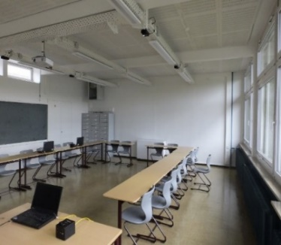
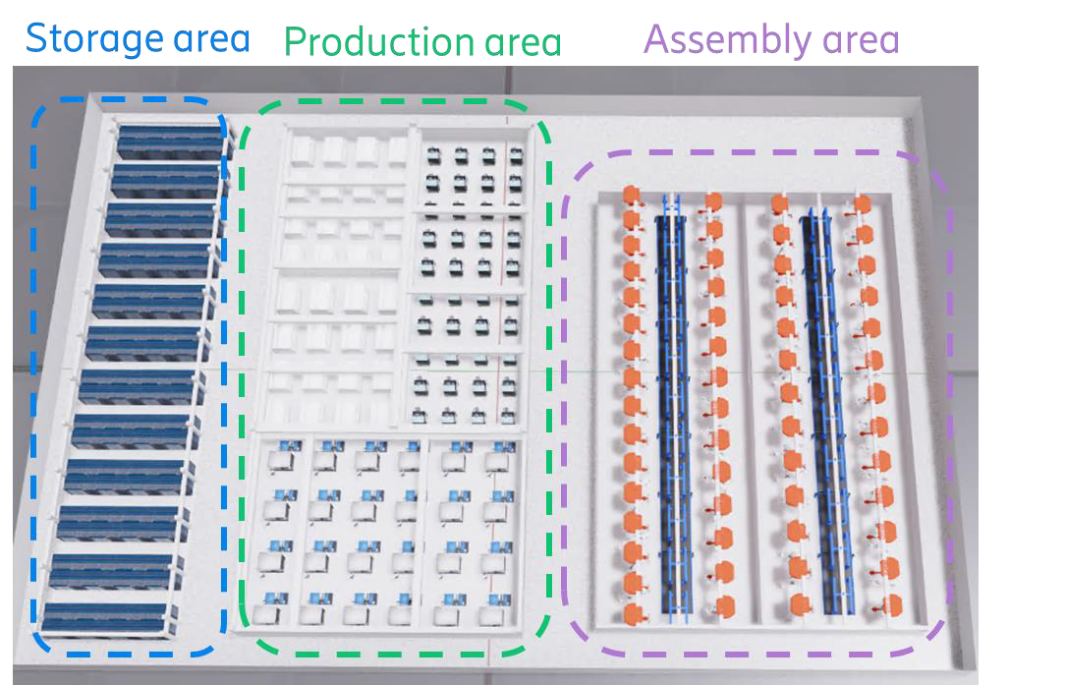
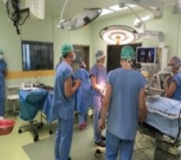
Use cases and scenarios
Hotspot scenarios
  in conference-/classrooms
  dual 5/60 GHz coverage in industry [12]
  hospital (4K video from endoscope to screen)
  others tbd.
Can be addressed by network densification: Embedded high-band APs
  below-7 GHz APs (every 10-20 m) plus mm-wave/optical APs (every room)
Demonstrate the performance gain
  offloading synergy: enhanced rates for both, below-7 GHz and high-band STAs
  low latency: higher bands are less congested

Slide 5
Recap of existing models:
TGn/ac/ax model (2.4 or 5 GHz) [1] – [4]
Extension of traditional single-input single-output (SISO) channel models (Medbo, 1998)
  Multiple antenna (MIMO) models are based on cluster model (Saleh, Valenzuela, 1987)
Channel is modelled by 2 to 6 clusters each having:
  Power and delay of each tap in a particular cluster
  Angular spread (AS), angle-of-arrival (AoA), and angle of departure (AoD) values
  “Bell” shaped Doppler spectrum
Channel matrix H fully describes propagation channel between TX and RX antennas
  Besides i.i.d. matrix, uses correlation matrix based on the power angular spectrum (PAS)
  Additional model for cross-polarization discrimination (XPD) for antennas with different polarizations
Model parameters customize channel models for various scenarios (e.g. office, open space, etc.)

Slide 6
Recap of existing models:
TGad/ay model (60 GHz) [5]
Provides accurate space-time characteristics of the propagation channel at 60 GHz
  Support beamforming with steerable directional antennas on both TX and RX, no limitation on antennas
  Account for polarization characteristics of antennas and signals
  Support non-stationarity characteristics of the propagation channel due to people moving in the area
  Proper description of SU- and MU-MIMO modes
Ultra Short Range (USR) mmWave communication (TGay)
  Based on existing TGad models for 60 GHz
  ray-tracing simulations and measurements provided by the MiWEBA EU-Japan joint project
TGad covers conference room and living room scenarios
TGay covers a very wide variety of indoor and outdoor applications

Slide 7
Recap of existing models:
QuaDRiGa (0.1 - 100 GHz) [6] – [8]
Active development since 2010 (based on WINNER+ code)
  Open-source: http://quadriga-channel-model.de (incl. regular updates)
  Reference implementation for various 3GPP and ETSI models
3D modeling approach (placement of scatterers in 3D coordinate system, 3D antennas)
  Geometric polarization propagation model for co-/cross-polarized antenna arrays
  Spatially correlated large and small-scale fading
  Deterministic time evolution of impulse response incl. dual-mobility
Support for multiple frequency bands up to 100 GHz
  Up to 300 MHz bandwidth from 0.45-6 GHz carrier frequency
  Up to 2 GHz bandwidth at mm-wave frequencies
Wide range of propagation scenarios: indoor, outdoor, macro, pico, femto, relay, industrial and satellite
Extensively tested against measurements in indoor and outdoor environments

Slide 8
Recap of existing models:
TGbb model for optical bands [9]
TGbb channel models
Link level model (11-18/1582r3)
  scenarios are manually defined in 3D, CIR are created by ray tracing (using Zemax)
  realistic 3D models are not considered, complex due to ray tracing in time domain
  support of MIMO and mobility, but just single snapshots at a given configuration
  tradeoff between model accuracy and computational complexity
  validated by preliminary measurements (11-20/1234r0)
  used in simulations to compare PHY proposals (11-19/1054r2 and 11-19/1566r3)
System level model (11-19/0187r4)
  based on LOS only, NLOS is considered negligible
  never been used since TGbb made no changes to the MAC

Slide 9
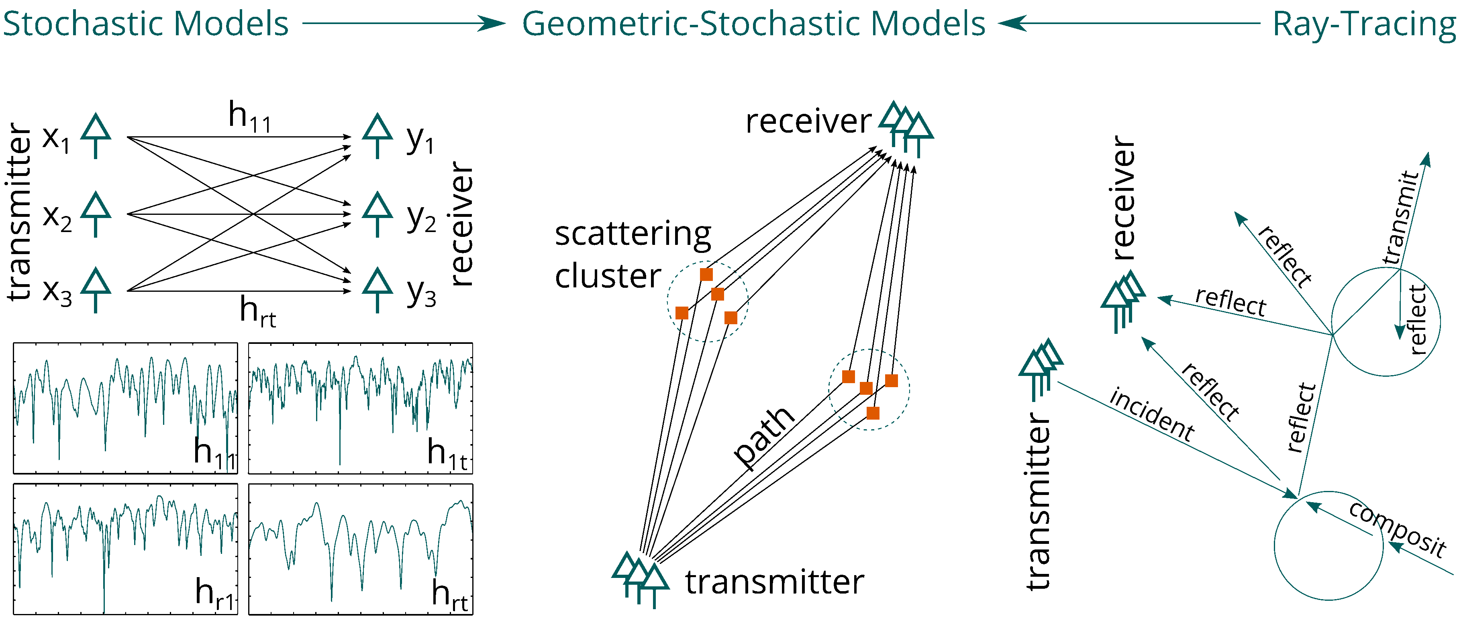
Summary on existing models:
Types of Channel Models
TGn/ac/ax
TGad/ay/QuaDRiGa
TGbb

Slide 10
Limitations of existing 802.11 models
Lack on integration of features
  tapped-delay line models for TGn vs. accurate space-time characteristics in Tgay, TGbb
Multi-band operation is not foreseen
  i.e. there are different models for different bands
  use cases/scenarios cannot be easily combined
TGn/ac/ax models do not natively support system-level simulations
  has to be agreed upon/added on top of the model
Models are not spatially consistent
  not suitable for site-specific simulations (e.g., for multi-AP operation)
  do not reflect correlation between different bands
  do not correctly model the MIMO correlation for different user positions

Slide 11


Examples of modern modelling approaches
QuaDRiGa (https://quadriga-channel-model.de)
Large-Scale Parameters (Shadow Fading, Delay-Spread etc.)
Position of scatterers
Strength of the multipath signals (path power)
Impact of multipath propagation to polarization
Site-Specific LOS component (optional)
Site-Specific NLOS components (e.g. Ray Tracing, optional)
Antenna effects
  patterns, polarization, distance between antenna elements
Time Evolution = Phase changes caused by movement („drifting“)
Path loss

Slide 12
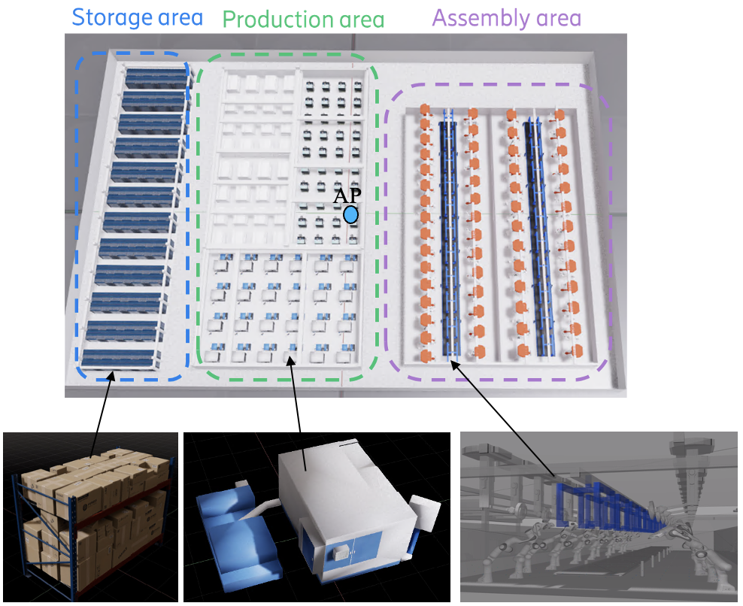
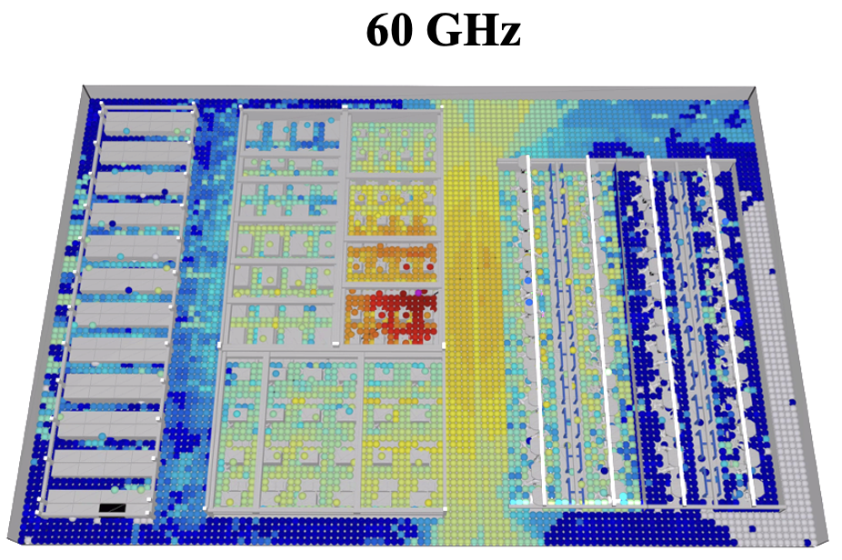
Examples of modern modelling approaches
Site-specific mm-wave model
In [12] a GPU-accelerated ray-tracing model based on experience in propagation research and site-specific path loss modeling were used for IMMW propagation in a factory scenario
The model has been validated against propagation measurements in a wide frequency range
Truly site-specific – good accuracy also non-tuned
Scenario agnostic: full 3D, supports outdoor, indoor and outdoor-to-indoor
Frequency support 0.5-100 GHz
Captures full spatial multipath with polarization

Slide 13
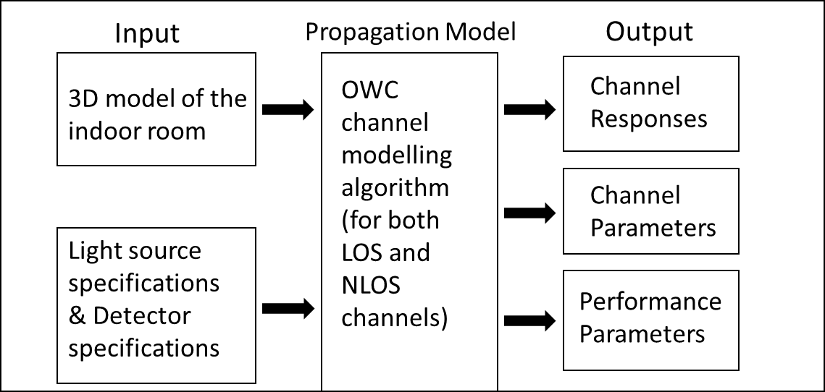
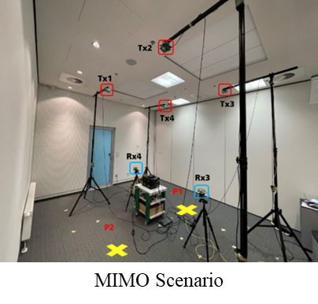
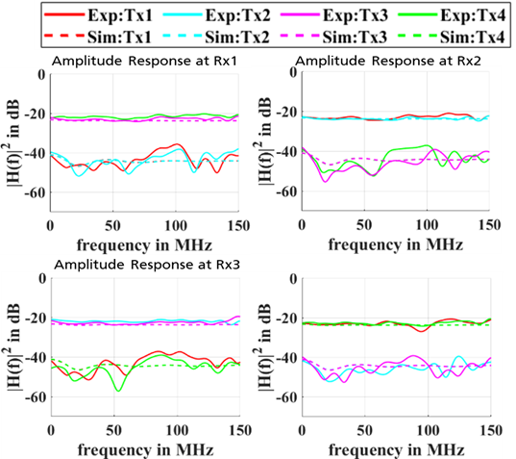
Examples of modern modelling approaches
New optical channel model
New ideas beyond TGbb
Use point cloud data for the 3D environment
  Can be modelled in Blender or generated from LIDAR scan/3D time-of-flight camera
More efficient modelling approach [10]
  Operate in frequency domain: CFR instead of CIR, computationally more efficient
  Combined approach for LOS, first and later diffuse reflections (based on Ulbricht's integrating sphere [13])
Experimentally validated
  Compared with measurements in several environments

Slide 14
Open software available
Standards validation and fair benchmarking:
  Open-source channel models enable all IEEE 802.11 members to validate performance claims and ensure fair, reproducible benchmarking across proposed technologies.
Accelerated consensus through agreed-upon models:
  Transparent models promote collaborative validation and faster decisions.
Following software is available:
  QuaDRiGa was developed at Fraunhofer HHI, written in MATLAB
  Source code is open: http://quadriga-channel-model.de
  Licence restricts commercial use (e.g., in products, but it is free for standardization)
  Quadriga-Lib is a C++ library implementing many channel-model tools using a free License:
  https://github.com/stjaeckel/quadriga-lib
  New optical wireless model (open approach like QuaDRiGa is intended, details to be discussed)

Slide 15
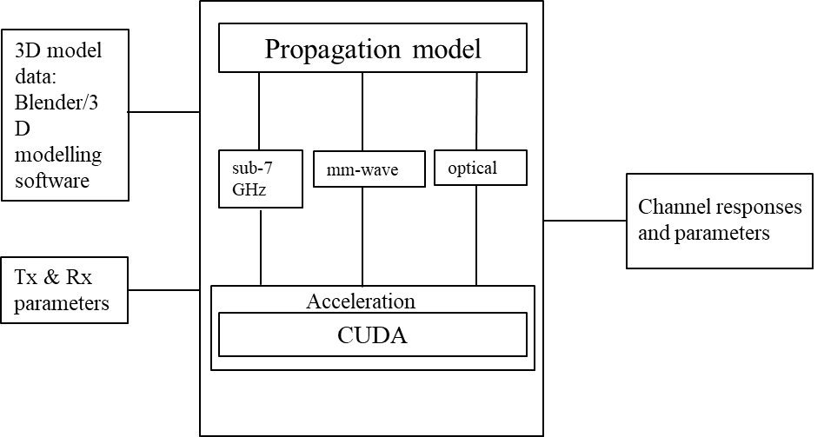
Develop a unified channel model
Update the 802.11 channel model so that it
can be used from 1 to 60 GHz and in optical bands
  support multi-link operation between an arbitrary choice of bands
  correctly model polarization in- and outdoors
is spatially consistent, i.e.,
  site-specific (e.g. for multi-AP operation)
  correctly reflects correlations between different bands
  correctly models MIMO correlations at different user positions

Slide 16
Proposal to form UCM TIG
Form Technical Interest Group (TIG) to create unified channel model (UCM)
Develop a report for the WG handling all related issues
  Use cases: Industrial, medical, residential, …
  Reference models: 3D scenarios, parameters, TX, RX for sub-7 GHz, mm-wave, optical bands
  Implementation aspects
Provide links to open-source software implementations

Slide 17
Conclusions
IEEE Std 802.11be-2024 developed multi-link operation as a main new feature.
  TGbn further develops sub-7GHz technology.
  TGbq develops integrated mm-wave
  TGbr develops enhanced light communications
This creates the need for a multi-band channel model in 802.11.
  upgrade the baseline used for sub-7GHz
  include new features (polarization, correlations, MIMO)
Spatial consistency can be reached in three steps.
  Common 3D scenario data base: Various sources
  Large-scale fading: Individual ray tracing for each band
  Small-scale fading: Using open state-of-the-art models

Slide 18
Straw Poll
Would you support the formation of a Technical Interest Group (TIG) to create a Unified Channel Model (UCM) for 802.11?
Yes / No / Abstain = Y / N / A

Slide 19
References
[1] V. Erceg, L. Schumacher, P. Kyritsi, et al., “TGn Channel Models,” doc. 11-03/940r4, May 2004.
[2] A. Maltsev, et al., “802.11ac Channel Model Addendum,” IEEE doc. 11-09/0308r12, Mar. 2010.
[3] G. Breit, H. Sampath, S. Vermani, et al., “TGac Channel Model Addendum,” doc. 11-09/0308r12, Mar. 2010.
[4] Jianhan Liu “TGbe Channel Model Document,” IEEE 802.11 Wireless LANs, doc. 11-21/0288r1, Mar. 2021.
[5] A. Lomayev, J. G. Andrews, D. F. O'Brien, D. S. Shum, and D. S. B. Weiss, “Channel Models for IEEE 802.11ay,” doc. 11-15/1150r0, Nov. 2015.
[6] S. Jaeckel, S., L. Raschkowski, F. Burkhardt, L. Thiele “Efficient Sum-of-Sinusoids based Spatial Consistency for the 3GPP New-Radio Channel Model” Proc. IEEE Globecom Workshops '18, 2018.
[7] S. Jaeckel, N. Turay, L. Raschkowski, L. Thiele, R. Vuohtoniemi, M. Sonkki, V. Hovinen, F. Burkhardt, P. Karunakaran, T. Heyn. “Industrial Indoor Measurements from 2-6 GHz for the 3GPP-NR and QuaDRiGa Channel Model” Proc. IEEE VTC'19 Fall, 2019.
[8] S. Jaeckel, L. Raschkowski, F. Burkhardt, L. Thiele “A Spatially Consistent Geometric D2D Small-Scale Fading Model for Multiple Frequencies” Proc. IEEE VTC Fall '19, 2019
[9] M. Uysal, F. Miramirkhani, T. Baykas, N. Serafimovski, and V. Jungnickel, “IEEE 802.11bb Reference Channel Models for Indoor Environments,” doc. 11-18/1582r2, Sept. 2018.
[10] S. M. Mana et al., "LIDAR-Assisted Channel Modelling for LiFi in Realistic Indoor Scenarios," in IEEE Access, vol. 10, pp. 59383-59399, 2022.
[11] QuaDRiGa Channel Model: https://quadriga-channel-model.de
[12] C. Petterson: IMMW Ray-Tracing Propagation in a Large Factory, doc. 11-25/0824r0
[13] V. Jungnickel, V. Pohl, S. Nonnig and C. von Helmolt, "A physical model of the wireless infrared communication channel," in IEEE JSAC , vol. 20, no. 3, pp. 631-640, April 2002
[14] S. M. Mana, P. Hellwig, J. Hilt, P. W. Berenguer and V. Jungnickel, "Experiments in Non-Line-of-Sight Li-Fi Channels," 2019 Global LIFI Congress (GLC), Paris, France, 2019.
[15] S. M. Mana, K. G. K. Gabra, S. M. Kouhini, P. Hellwig, J. Hilt and V. Jungnickel, "An Efficient Multi-Link Channel Model for LiFi," 2021 IEEE 32nd Annual International Symposium on Personal, Indoor and Mobile Radio Communications (PIMRC), Helsinki, Finland, 2021.

Slide 20
Appendix

Slide 21
Time plan (F2F meetings)
Session | Objective | # Slots | Target Duration | Prep/Notes
Plenary 212 – Madrid (27 Jul–1 Aug 2025) | Create TIG: motion, brief scope, trigger CfC | 1 | WNG | Org setup done off-line beforehand
Interim 213 – Waikoloa (14–19 Sep 2025) | Gap analysis & detailed work plan/data plan | 1 | 1 slot | Trim to 60 min if telecons resolve open items
Plenary 214 – Bangkok (9–14 Nov 2025) | Review draft model & TR structure (v0.2 status) | 1 | 1 slot | Freeze content list for v0.3
Interim 215 – Victoria, BC (11–16 Jan 2026) | Approve TR v1.0 & closing motion | 1 | 1 slot | Motion + summary

Slide 22
Bi-weekly teleconferences
Phase | Window (Weeks) | Focus | Est. Calls | Cadence / Length | Expected Outputs
Scope & Baseline | Aug–mid Sep (Wk 1–6) | Assign sections, finalize gap table | 2 | bi‑weekly 90 min | Goals & Work Plan, Gap analysis draft
Data & Model | late Sep–Oct (Wk 8–15) | Data format, parameters, scripts | 3 | bi‑weekly 90 min | Data format spec, draft model equations
Drafting & Validation | Oct–Dec (Wk 13–23) | TR iterations, KPI plots, comments | 3 | bi-weekly 90 min | TR v0.3, validation results
Review & Closure | Jan (Wk 24–25) | Comment resolution, motion text | 2 | ad-hoc 2-3 days | TR v1.0, closing package

Slide 23
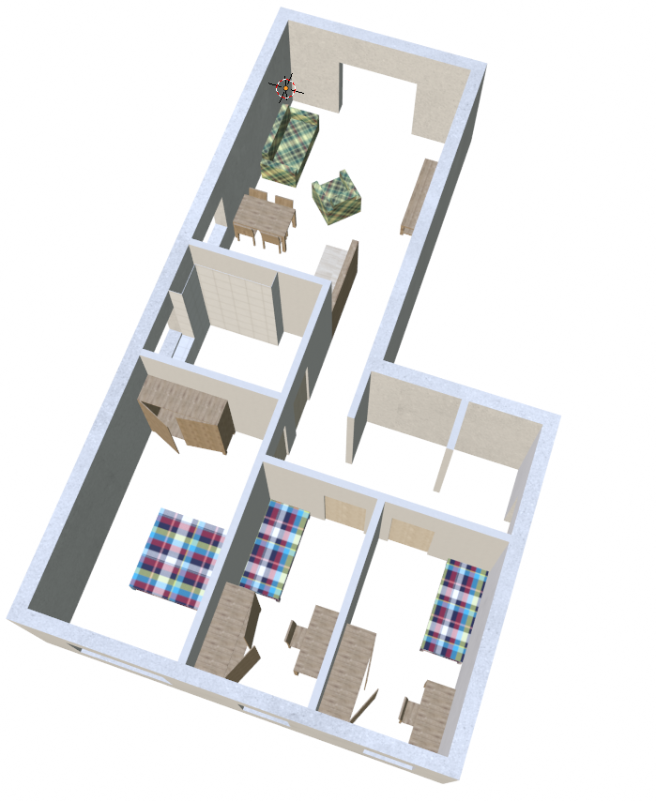
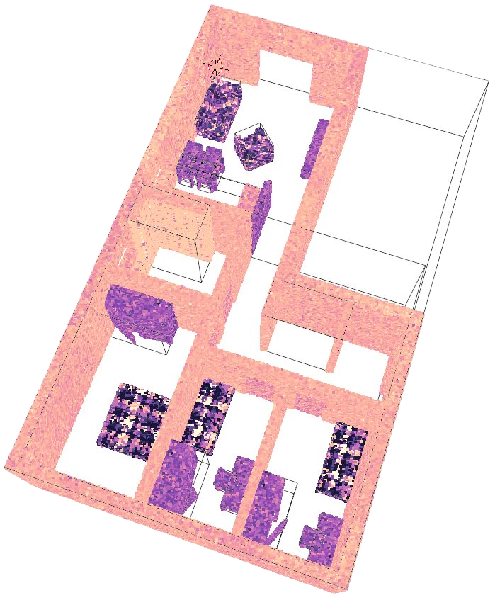
3D Environment Data
Environment data from different sources
  Lidar scan, 3D camera, photogrammetry, 3D assets/software
QuaDRiGa: needs subsurface material and defined as mesh data
OWC: needs surface material and defined as point cloud data
Idea: Use same 3D environment for RF (sub-7GHz, mm-wave) and optical links
  Environment data quality degrades slightly with conversion from mesh data to point cloud or vice versa
QuaDRiGa model:
3D surface data
OWC model:
point cloud data
distribute points on surface
mesh reconstruction

Slide 24
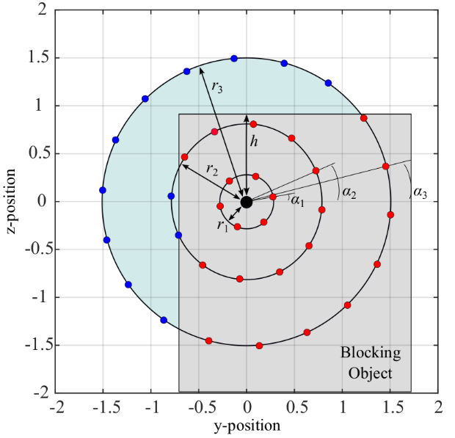
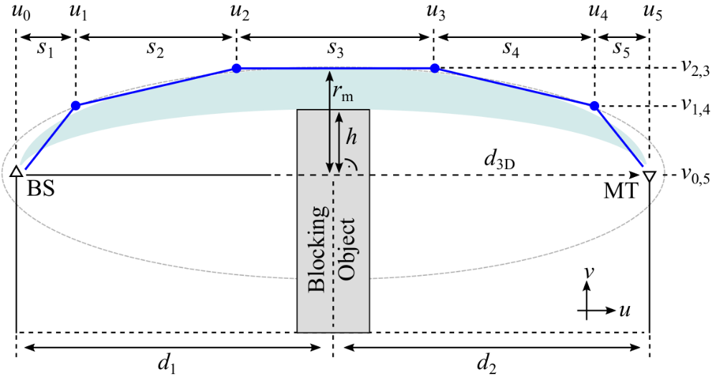
Spatially consistent framework
(1) Site-Specific LOS model (optional)
Geometric-Stochastic channel models such as TGad/ay or QuaDRiGa randomize the environment and cannot be used for network planning
LOS / NLOS / Outdoor-to-Indoor propagation have strong impact on radio performance
Solution: estimate the diffraction gain in 3D, by estimating how the Fresnel ellipsoid is obstructed by objects, and then evaluate the impact of this obstruction onto the received power

Slide 25
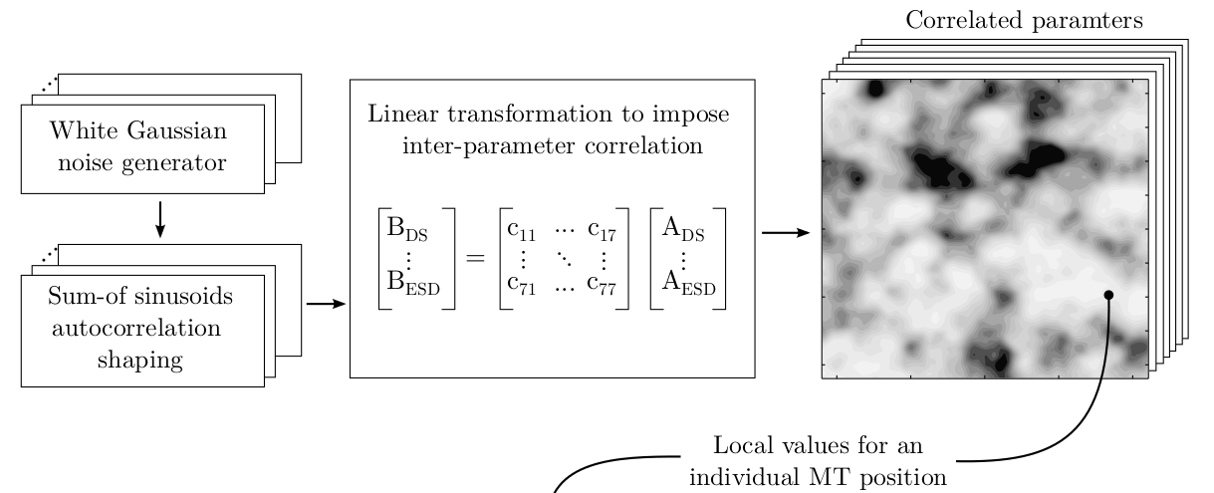
Spatially consistent framework
(2) Large-Scale-Fading Model
8 LSF-Parameters (LSPs):
  Delay-Spread (DS), K-factor (KF), Shadow fading (SF), Azimuth spread of departure (ASD), Azimuth spread of arrival (ASA), Elevation spread of departure (ESD), Elevation spread of arrival (ESA), Cross-polarization ratio (XPR)
  relatively constant for several meters, follow a log-normal distribution, are correlated with each other
Generation of correlated LSPs is done in tree steps:
  Generation of spatially correlated
  random variables in the log-domain
  Application of the inter-parameter
  correlations in the log-domain
  Linear scaling to account for
  additional dependencies

Slide 26
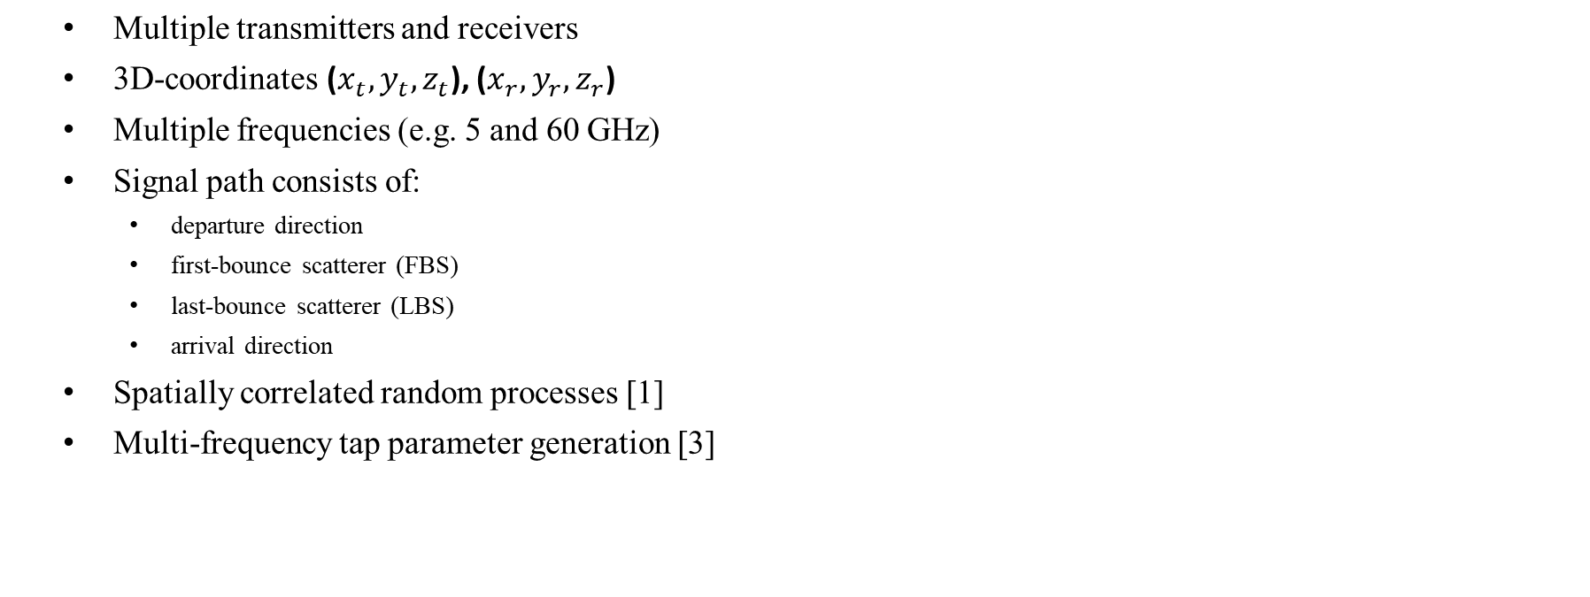
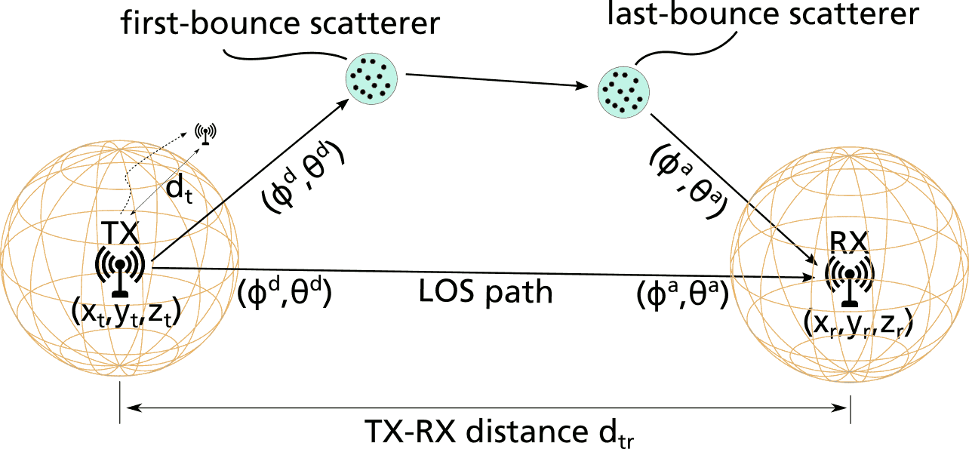
Spatially consistent framework
(3) Small-Scale Fading Model

Slide 27
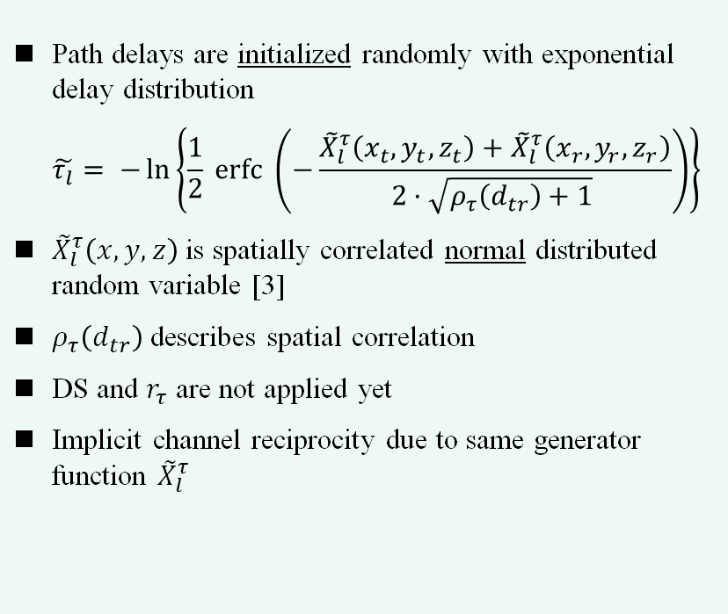
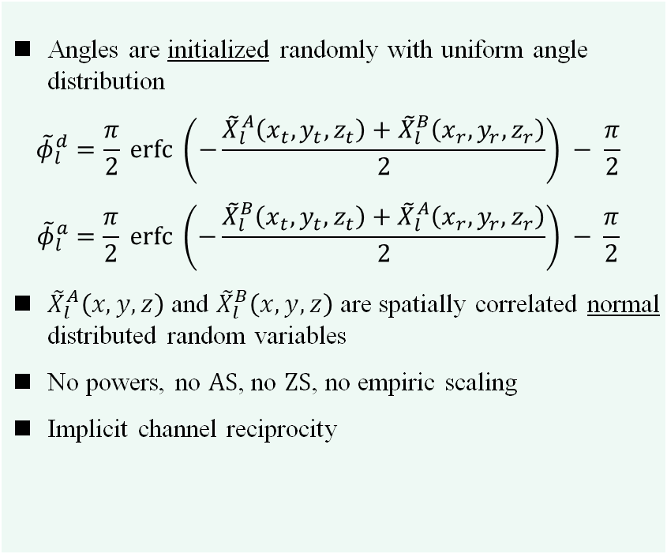
Spatially consistent framework
(3) Small-Scale Fading Model – Details 1/2
Delays
Angles

Slide 28
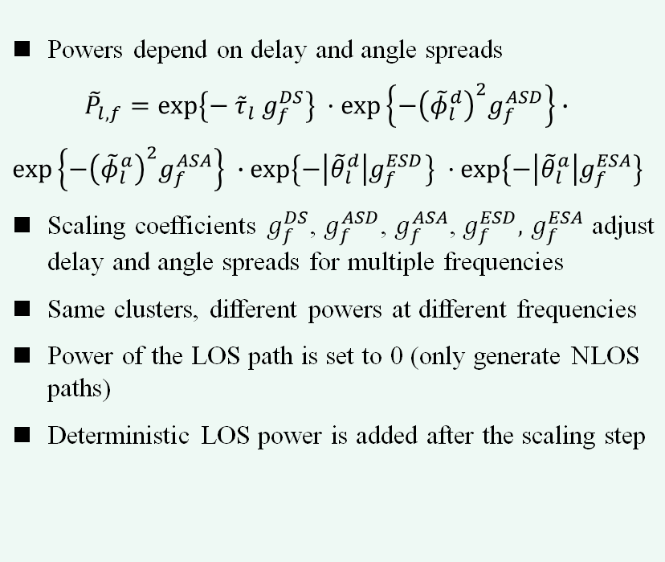
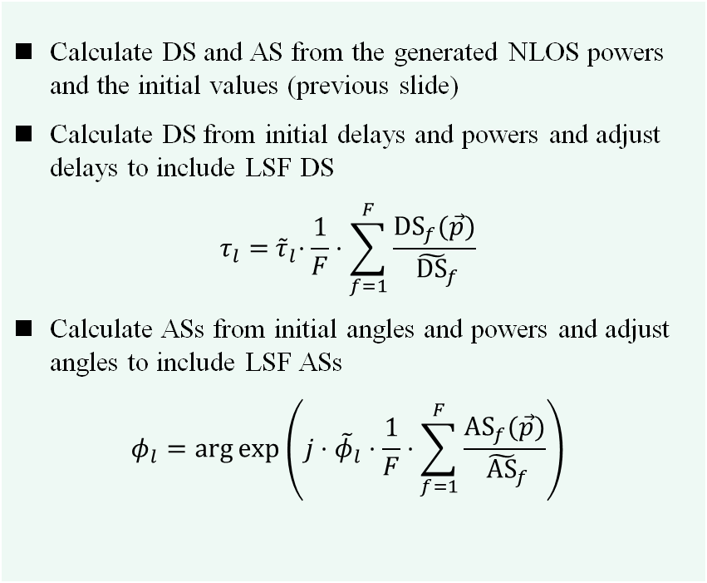
Spatially consistent framework
(3) Small-Scale Fading Model – Details 2/2
Powers
Scaling

Slide 29


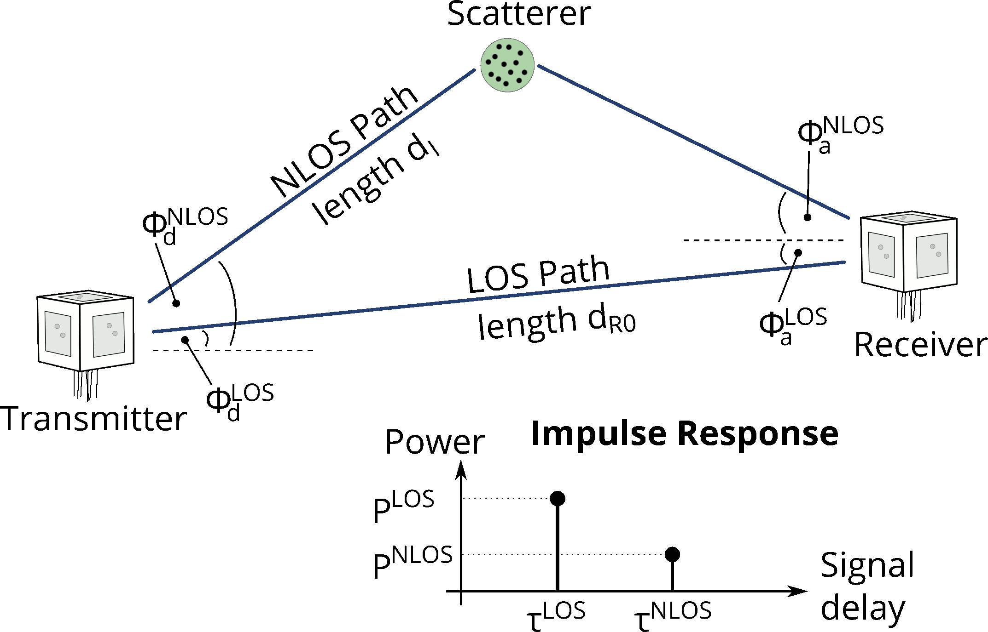
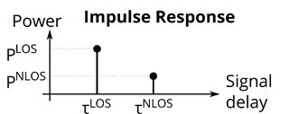
Spatially consistent framework
(4) MIMO Model
Polarization
Tap
Power
Receive
Antenna
Transmit
Antenna
Phase
Offset
Tap
Delay
MIMO Channel
Matrix H
L Taps
Frequency
Offset

Slide 30
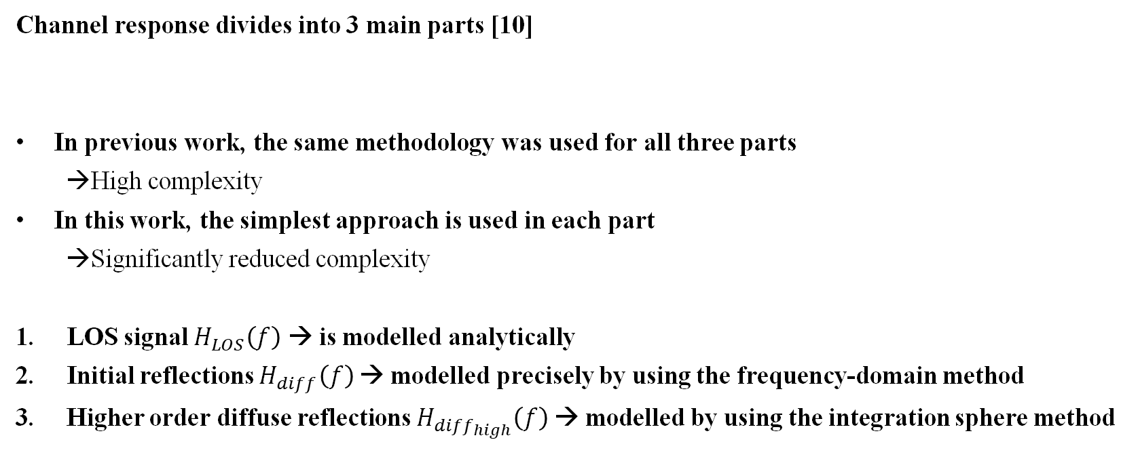
New optical channel model
(2) Methodology
Typical optical impulse response for single link [13]

Slide 31
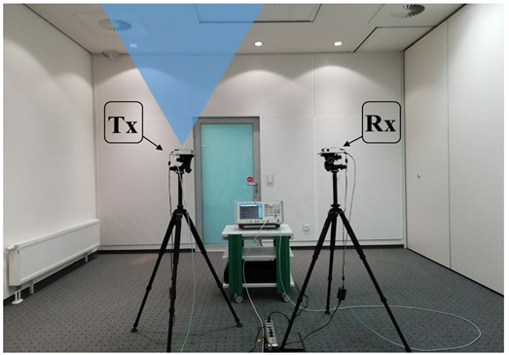
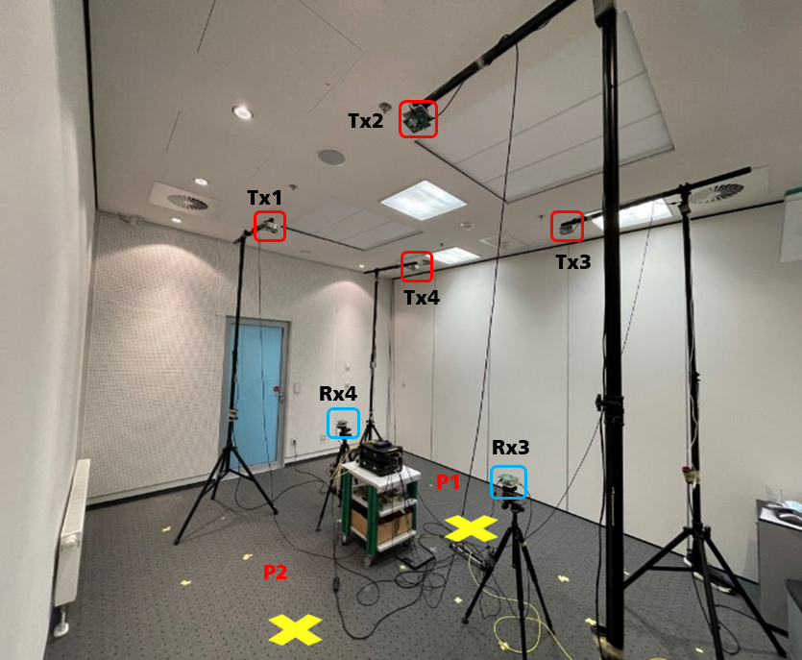
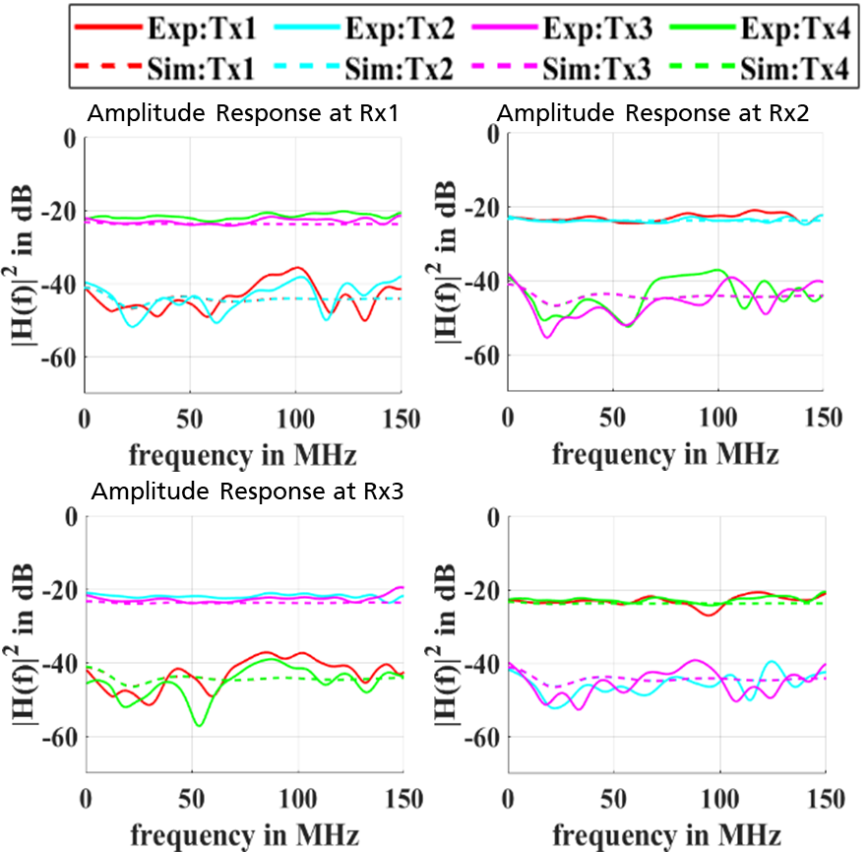
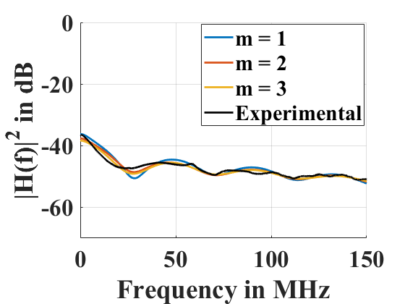
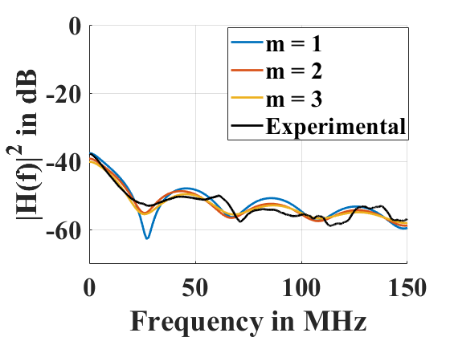
New optical channel model
(3) Validation by measurement
d
SISO Scenario
MIMO Scenario

Slide 32
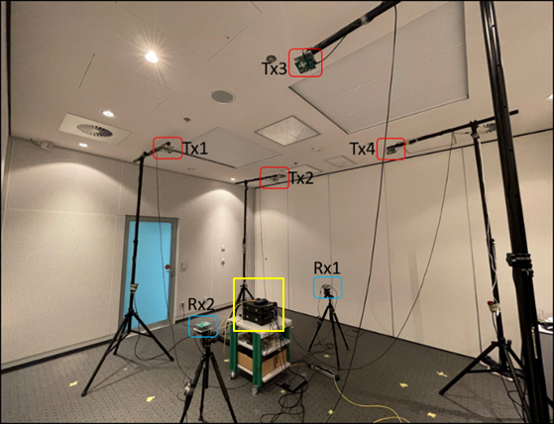
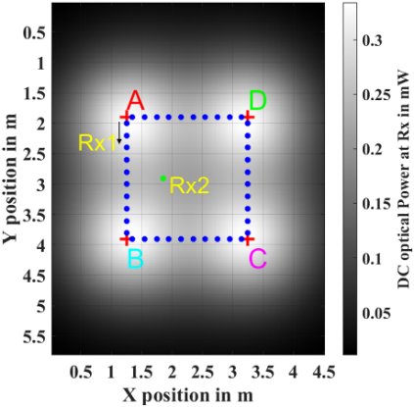
New optical channel model
(4) Performance Evaluation
Performance in mobile scenario
Throughput result
For more details, see doc. 11-25/1202r0 „Channel Model for Enhanced Light Communications”

