Slide 1
How to further minimize the duration of connectivity loss for SMD BSS transition
Date: 2025-6-27
Authors:

Slide 2
Abstract
In this contribution, we propose an approach to minimize further the duration for which the data connectivity is lost between the non-AP MLD and the DS.

Slide 3
Background
According to the following description in Draft 0.3 [1], SMD BSS transition minimizes the duration for which data connectivity between the non-AP MLD and the DS is lost.

Slide 4
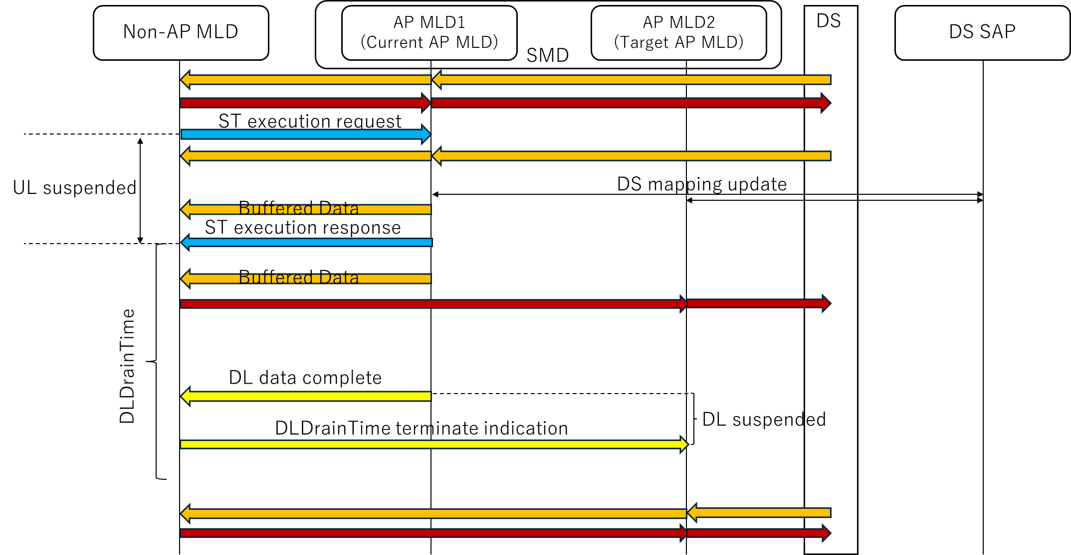
SMD BSS transition procedure
There can be the duration for the loss of the data connectivity for both UL and DL.
For UL, the current AP MLD cannot deliver the received data from the non-AP MLD to the DS.
For DL, the target AP MLD cannot transmit the delivered data from the DS to the non-AP MLD.

Slide 5
Time duration of data connectivity loss for UL (1/2)
For UL, there should be the duration of data connectivity loss between the non-AP MLD and the DS for some cases.
In the case of a separate MAC SAP per AP MLD, the DS mapping is updated during ST execution procedure.
In this case, the non-AP MLD does not know the timing when the DS mapping is updated.
Therefore, the non-AP MLD might transmit UL data frames to the current AP MLD after the DS mapping is updated and these UL data frames cannot be delivered to the DS which causes data loss.

Slide 6
Time duration of data connectivity loss for UL (2/2)
For UL, it is under discussion whether the non-AP MLD suspends UL transmission to the current AP MLD during ST execution request/response frame exchange.
According to Draft 0.3 [1], it is TBD if the non-AP MLD shall stop sending Data frames to its current AP MLD after sending the ST execution request frame.

Slide 7
Time duration of data connectivity loss for DL
For DL, the duration of data connectivity loss between the non-AP MLD and the DS can be almost zero.
The non-AP MLD can indicate the termination of DLDrainTime to the target AP MLD right after receiving the indication of DL data complete from the current AP MLD.
According to Draft 0.3 [1], the target AP MLD shall not transmit DL frames to the non-AP MLD, at least with SN above pre-determined value, until receiving an indication of termination of the DLDrainTime from the non-AP MLD.

Slide 8
Observation
For UL, there is a duration of data connectivity loss which both the non-AP MLD and the AP MLD within the SMD cannot control.
For DL, the non-AP MLD can minimize the duration of data connectivity loss.
Further minimization of the time duration is needed only for UL.

Slide 9
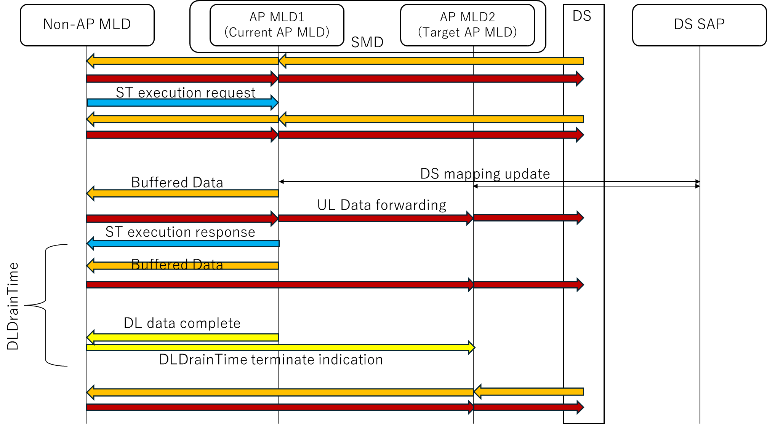
Proposal: UL Data forwarding
It should be supported that the current AP MLD forwards UL data frames to the target AP MLD for SMD BSS transition.
The non-AP MLD continues to transmit UL data frames to the current AP MLD during ST execution request/response frame exchange.
The target AP MLD delivers the forwarded UL data frames from the current AP MLD to the DS.
UL data loss at the current AP MLD does not occur in this case.

Slide 10
Conclusion
We discussed how to minimize further the duration of data connectivity loss between the non-AP MLD and the DS.
For UL, it is needed to minimize further the duration.
For DL, it is NOT needed to minimize further the duration.
We proposed UL Data forwarding between AP MLDs within the SMD to minimize further the duration of data connectivity loss.

Slide 11
References
[1] IEEE P802.11bn/D0.3

Slide 12
SP1
Do you agree to support that the non-AP MLD may continue to transmit UL data frames to the current AP MLD during ST execution request/response frame exchange?

Slide 13
SP2
Do you agree to support that the current AP MLD may forward UL data frames to the target AP MLD for SMD BSS transition?

