Slide 1
802.11 WG July 2025 Session Report
Date: 2025-07-31
Authors:

Slide 2
Abstract
This document is a digest of the closing reports of all 802.11 sub-groups for presentation at the July 2025 closing plenary meeting. Liaison reports (including liaison reports from the opening plenary) are also included.

Slide 3
Updated following May ’25 session
Robert Stacey, Intel

Slide 4
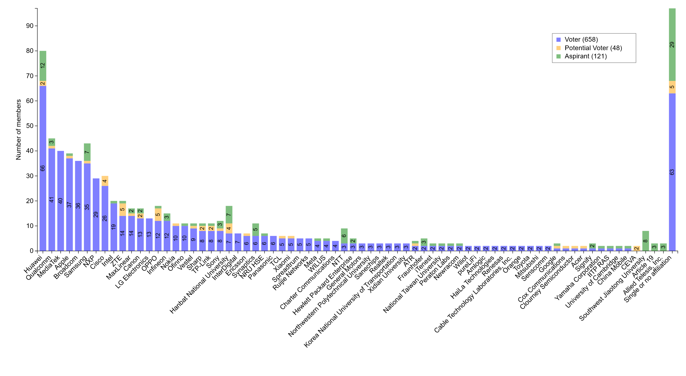
M4.1.7 Members by affiliation
Robert Stacey, Intel

Slide 5
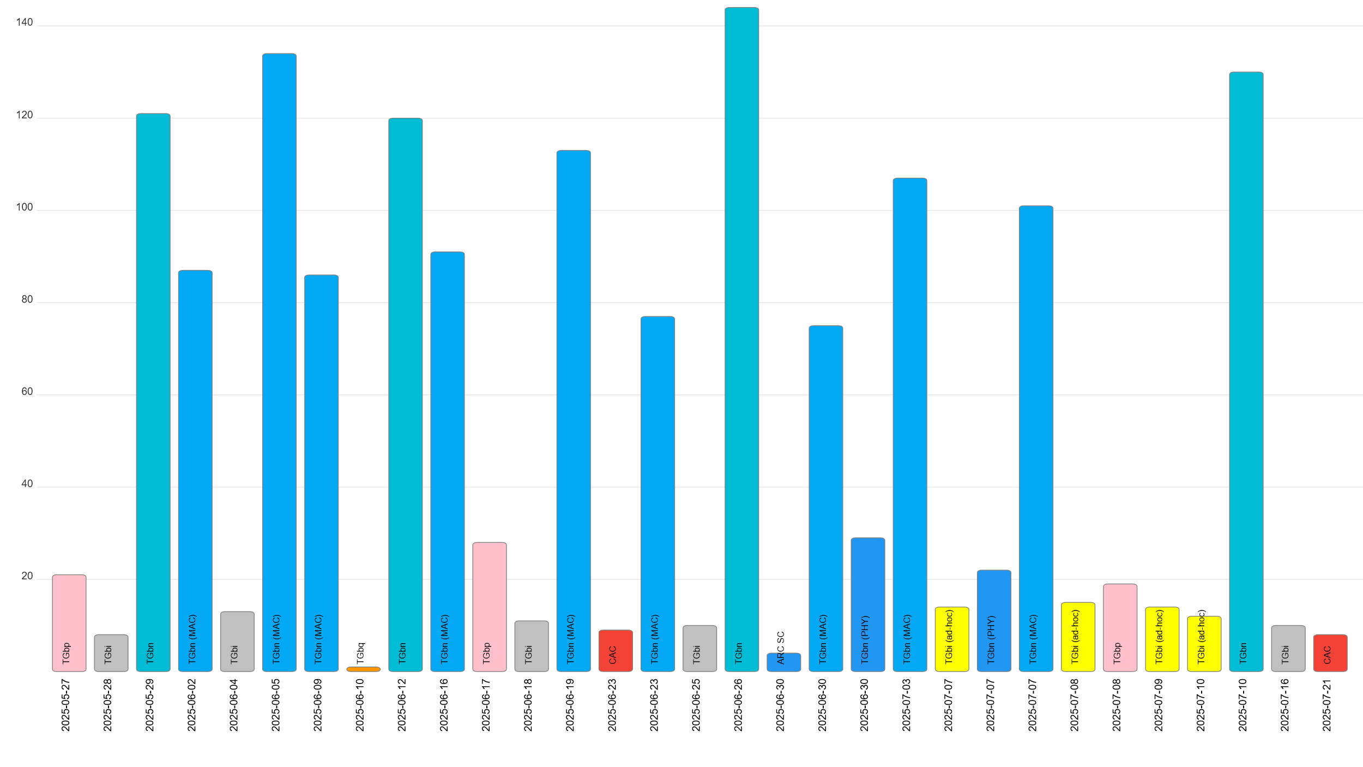
M4.1.7 Telecon attendance (May to July)
Robert Stacey, Intel

Slide 6
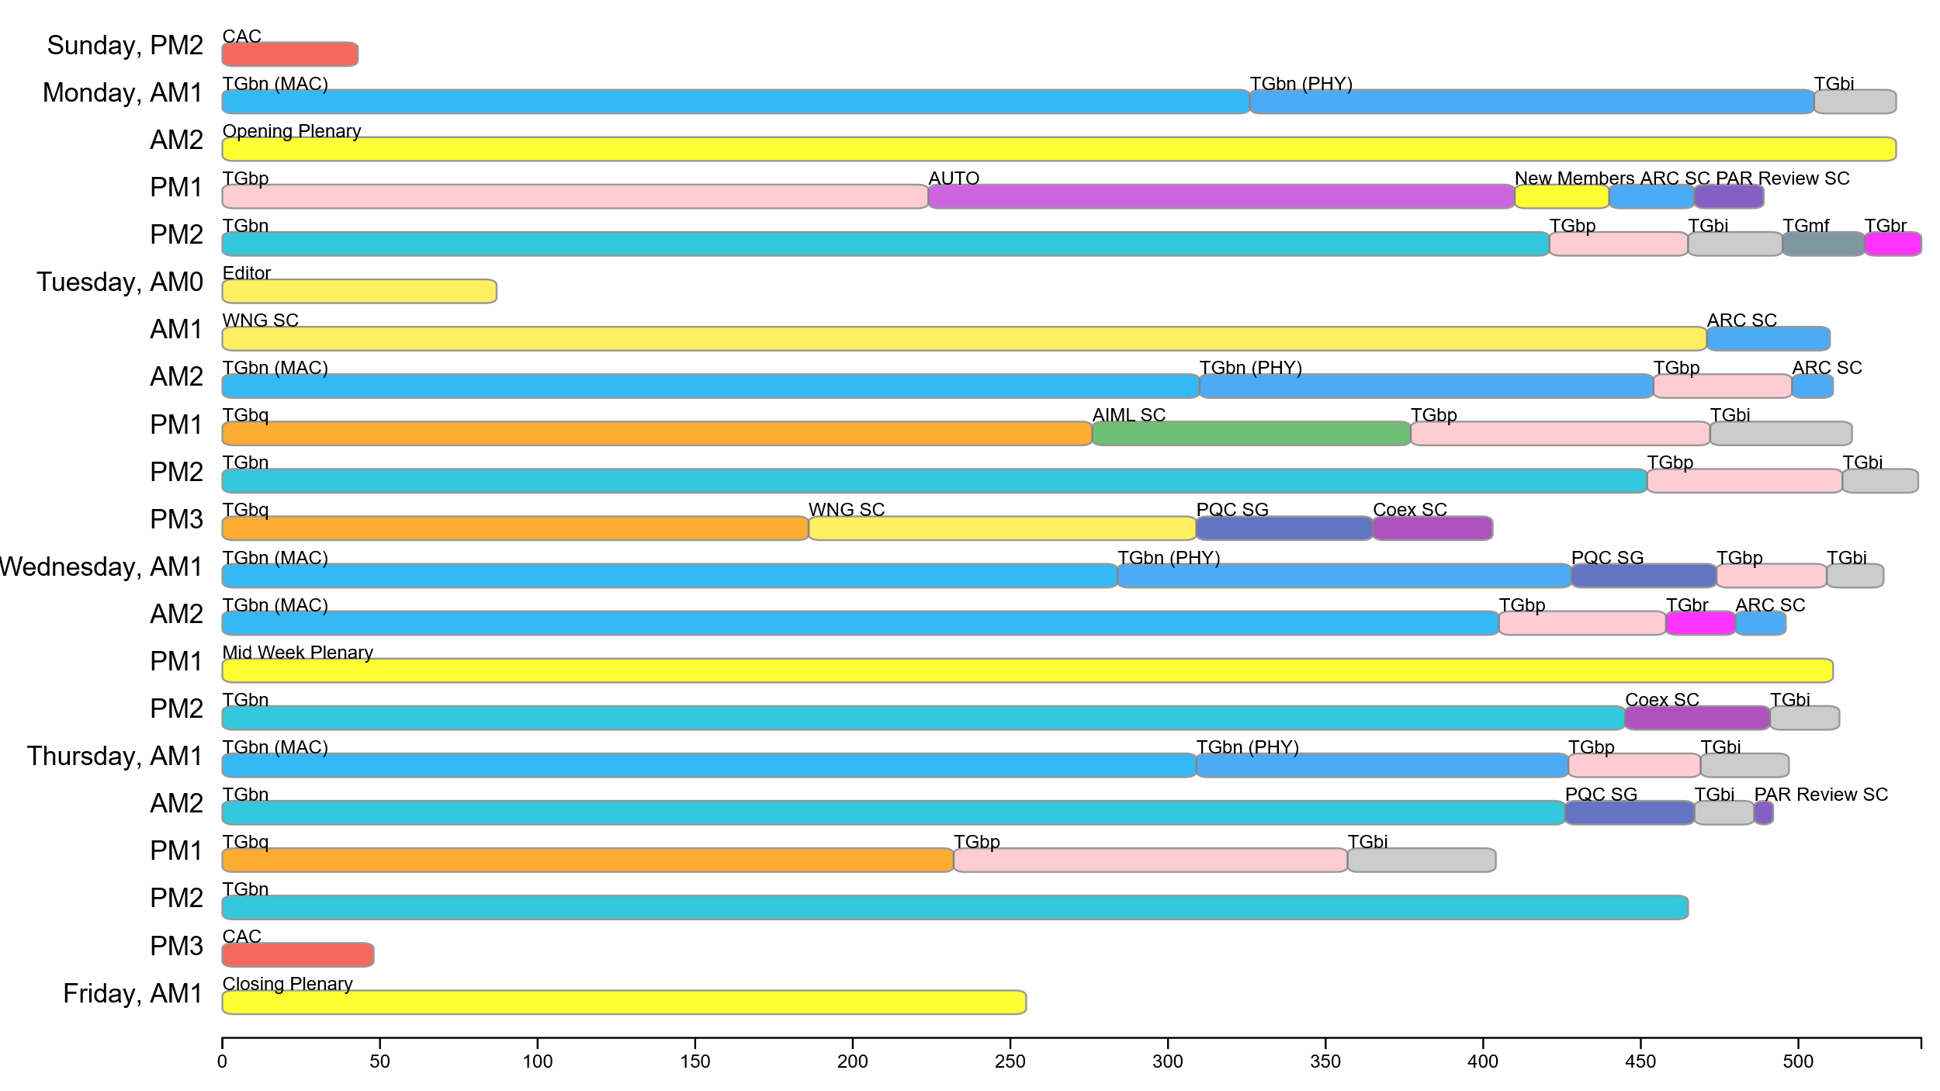
Attendance by breakout at the July session
Robert Stacey, Intel

Slide 7
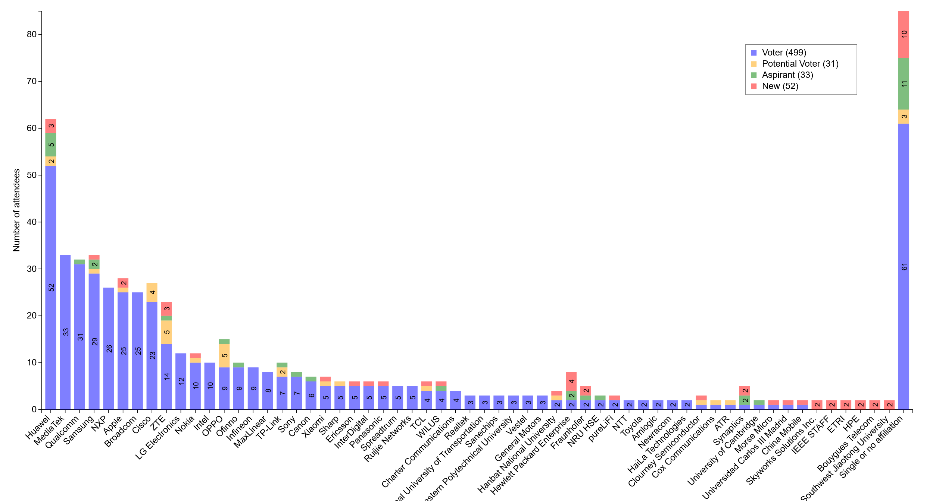
Attendance by affiliation at the July session
Robert Stacey, Intel

Slide 8
802.11 WG Editor’s Closing Report (July 2025)
Date: 2025-07-29
Authors:

Slide 9
Volunteer Editor Contacts
  WG – Robert Stacey – robert.stacey@intel.com, Emily Qi – emily.h.qi@gmail.com
  TGbk – Roy Want RoyWant@google.com
  TGbf – Claudio da Silva – wifi.phy@gmail.com
  TGbi – Po-kai Huang – po-kai.huang@intel.com
  TGbn- Ross Jian Yu - ross.yujian@huawei.com
  TGbp – Yinan Qi - v-qiyinan@oppo.com
  TGbq – Cheng Chen - cheng.chen@intel.com
  TGbr – Volker Jungnickel - volker.jungnickel@hhi.fraunhofer.de
  REVmf - Po-kai Huang – po-kai.huang@intel.com, Edward Au – edward.ks.au@gmail.com

Slide 10
July meeting roundtable status report
11bk – Approved for publication. Should see review pdf today!
11bf – Approved for publication.
11bi – 248 comments to resolve. Expect to resolve this week and generate D2.0 for recirc.
11bn – Released D0.3. Expect to approve D1.0 this week.
11bp – Start drafting D0.1, should be ready by September.
REVmf – Currently have D0.2 with 11bh. Working on 11be roll in. Generating D1.0 = 802.11-2024+11bh+11be+approved motions (except 11be related). Working to have initial ballot complete by September.

Slide 11
Editor Amendment Ordering
See http://grouper.ieee.org/groups/802/11/Reports/802.11_Timelines.htm
Changes are usually based on MDR readiness.
As discussed in July 2025
Amendment Number | Task Group | Page Count | Projected RevCom Date (submission)
802.11-2024 Amendment 3 | TGbk | 111 | May 2025
802.11-2024 Amendment 4 | TGbf | 220 | May 2025
802.11-2024 Amendment 5 | TGbi | 138 | May 2026
REVmf | TGm | 6000+ | Feb 2028
802.11-2028 Amendment 1 (?) | TGbn | 364 | May 2028
802.11-2028 Amendment 2 (?) | TGbp |  | May 2028

Slide 12
Draft Development Snapshot
Changes from last report shown in red.
July 2025
TG | Published or Draft Baseline Document |  |  |  |  |  |  |  |  | Source | MDR | Editor | Snapshot Date
 | Published | bh | be | bk | bf | bi | mf | bn | bp
bh | Y | 6.0 |  |  |  |  |  |  |  | FrameMaker | Yes | Carol Ansley | July 16, 2024
be | Y | 6.0 | 7.0 |  |  |  |  |  |  | FrameMaker (old) | Yes | Edward Au | July 15, 2024
bk | Y | 6.0 | 7.0 | 5.0 |  |  |  |  |  | Word | Yes | Roy Want | March 10, 2025
bf | Y | 6.0 | 7.0 | 3.0 | 8.0 |  |  |  |  | FrameMaker 2020 | Yes | Claudio da Silva | July 25, 2025
bi | Y | 6.0 | 7.0 | 5.0 | 8.0 | 1.2 |  |  |  | FrameMaker 2022 |  | Po-kai Huang | July 25, 2025
mf | Y |  |  |  |  |  | 0.2 |  |  |  |  | Po-kai Huang, Edward Au
bn | Y | 6.0 | 7.0 | 5.0 | 8.0 | 1.2 |  | 0.3 |  | FrameMaker 2020 |  | Ross Jian Yu | July 25, 2025
bp | N | 6.0 | 7.0 | 5.0 | 8.0 | 1.1 |  | 0.1 | 0.1 |  |  | Yinan Qi | May 7, 2025

Slide 13
802.11bk and 802.11bf publication review
802.11bk:
Jonathan Segev
Roy Want
Carol Ansley (ANA)
Edward Au
Joseph Levy
802.11bf
Tony Xiao Han
Claudio da Silva
Carol Ansley (ANA)
Edward Au
Joseph Levy

Slide 14
802.11bk and 802.11bf publication review
Proofs available: 30 July 2025
Proofs returned: 20 August 2025
Final proofs to you for two-day review: 27 August 2025
Publication date: 5 September 2025

Slide 15
ANA managed number spaces
Protocol Version subfield: 9.2.4.1.2
Frame types and subtypes: 9.2.4.1.3, Tables 9-1 and 9-2
Element ID and Element ID extension: Table 9-128
Capability Information field: 9.4.1.4
Extended Capabilities: 9.4.2.25, Table 9-190
Reason codes: 9.4.1.7, Table 9-77
Status codes: 9.4.1.9, Table 9-78
Action frame categories: 9.4.1.11, Table 9-79
Authentication algorithm: 9.4.1.1
RSNE: 9.4.2.23
Cypher suites: Table 9-186
AKM suites: Table 9-188
RSN Capabilities: Figure 9-345
RSNXE Capabilities: 9.4.2.240, Table 9-365
ANQP-element (Info ID): 9.4.5.1, Table 9-412
Neighbor Report subelements: 9.4.2.35, Table 9-210
FTE subelements: 9.4.2.46, Table 9-219
Public Action frames: 9.6.7.1, Table 9-450
WMN-Notification Types: 9.6.13.29, Table 9-516
Mesh Configuration Active Path: 9.4.2.96.2, Table 9-277
TLV encodings: 9.4.4
KDE Selector Data Type: 12.7.2
Operating classes: Annex E
global, USA, Europe, Japan
MIB objects: Annex C
ieee802dot11, dot11smt, dot11phy, dot11mac, dot11StationConfigEntry, dot11OperationEntry, dot11Compliances, dot11Groups

Slide 16
July 2025 AIML SC Closing Report
Date: 2025-07-29
Authors:

Slide 17
Work Completed
  1 Meeting Slot
    Tuesday PM1
    Agenda: 11-25/1058r0
    SP and Motion Booklet: 11-24/765r6
  Achievements
    One technical presentations
    One technical report draft
      SP/Motion delayed at the request of members
    Approved minutes of AIML SC for May 2025 Interim: 11-25/1013r0

Slide 18
Plans for September 2025
No teleconference planned
  May schedule one at request of members for reviewing technical report
Technical presentations
  Additional results, exploration and feasibility for existing use cases
  Additional AIML use cases
  Technical report drafts
Expect to complete 1st AIML SC Technical Report

Slide 19
ARC Closing Report
July 2025
Date: 2025-07-30
Authors:
Mark Hamilton, Commscope

Slide 20
Std 802 update impacts on 802.11
July 2025
Continued discussion (started on June telecon) based on: 11-25/0923r3. Still several concepts to discuss.
Also in queue:
  Review of 11-25/0150r4
  Generate specific proposal, to REVmf, for suggested changes.
Will continue in September
Mark Hamilton, Commscope

Slide 21
Annex G update/replacement
July 2025
  Continued discussion on the proposal to replace Annex G with tutorial/informational material on:
  “Frame exchange sequence” (and its relationship to/meaning for other behaviors like power save/doze, off-channel scanning, etc.)
  Relation of frame exchange sequence to medium protection (NAV, etc.)
  The definition/extent of an instance of the Wireless Medium
    Relation of wireless medium to beamforming, sectorization, MU operation, etc.
    11-23/0880r10, 11-25/0738r0, 11-25/0193r5
We are uncovering (subtle) gaps in the baseline spec, also
Will continue discussion in September.
Mark Hamilton, Commscope

Slide 22
(New topic added to agenda) Review MIB attribute conventions (and more)
July 2025
What does a feature is “implemented” mean? Is “supported” the same thing? How does it differ from “activated”?
  11-25/1351r0 - Follow-up 11-25/780, with two alternatives
  NOTE: After presentation and discussion, straw poll was evenly split on direction to go
How much should 802.11 describe management interactions (beyond/sideways from over-the-air interoperability)?
  General agreement this is (mostly) out of scope
Relates to discussion on MLME-RESET, MLME-START versus MLME-JOIN, MLME-END
Maybe even the scope/use of the PICS is related
Will continue this discussion in September, also.
Mark Hamilton, Commscope

Slide 23
Organizational and Plans
July 2025
Agenda is here: 11-25/1062r4
No teleconferences planned. Could schedule with 10 days’ notice if a contribution needs review before September
Plans for September:
Continue Annex G replacement
Continue MIB conventions discussion
Continue EPD/LPD clean-up, other Std 802 alignment
Pick up MLME “state machine” topic?
Four meeting slots requested in September
Mark Hamilton, Commscope

Slide 24
Coex SC Closing Report
Date: 2025-07-31
Authors:

Slide 25
Coex SC’s week at a glance
Coex SC met twice this week
One Coex SC meeting and
One Joint meeting with 802.15.4
Updates & Discussion topics
ETSI BRAN Update
BT SIG Update
Thoughts on managing coexistence between sensing and communication
Proposed PAR for an 802.19 project similar to 802.19.3a to address coexistence in 6 GHz

Slide 26
ETSI BRAN Update to 802.11 (1/2)
TR 104 893: Wireless Access System including Radio Local Area Networks (WAS/RLAN) coexistence challenges with emerging solid-state weather radars
New work item; expected to be completed end of 2025
Investigate coexistence between Wireless Access Systems including Radio Local Area Network (WAS/RLAN) systems and the next generation of weather radar systems operating in particular in the frequency band 5600 MHz to 5650 MHz using solid-state power amplifiers (SSPAs) in their transmitters
Check 11-25/1040r0 for additional information

Slide 27
ETSI BRAN Update to 802.11 (2/2)
EN 303 687 (Wireless Access System/Radio Local Area Network (WAS/RLAN) in the license-exempt 6 GHz band)
EN 303 687 only active work item
Draft 1.1.7 published version
Discussion on:
  Client-to-Client (C2C) operation
  Requirements for narrowband frequency hopping
  Potential use of directional (external) antennas for low power indoor access points for dense, small cell deployments →propose to permit to use self-identifying antennas (informing AP about gain → limit TX power to maintain EIRP)

Slide 28
Bluetooth SIG Update to 802.11
  Continued work on technical proposal for ETSI BRAN
  Develop a channel access mechanism for Narrowband Frequency Hopping equipment operation
  Working towards having a revised technical proposal for presentation at ETSI BRAN #131 in September
  The SC thanked Rich Kennedy for his years-long, outstanding service to Coex and 802.11 in general
  BT SIG is aware of potential candidates who might continue reporting to Coex SC on the ongoing work items in BT SIG.

Slide 29
Technical submissions
  Thoughts on managing coexistence between sensing and communication
  Ongoing communication may delay the time until devices collecting sensing information can access the channel for sensing
  Impacts safety critical applications
  Simulation-based details available → Coex SC expressed interest to receive a presentation on the findings
  Proposed PAR for an 802.19 project similar to 802.19.3a to address coexistence in 6 GHz
  Discussion of potential ”places / groups” to build consensus on friendly coexistence: .19 vs. within, e.g., .15 and .11 and directly engaging
  Work to be done in 802.xx vs ETSI BRAN

Slide 30
Announcements
  Review of Coex SC scope
  Scope references “old” amendments, e.g.: 11ax
  Should be “cleaned” up – as scope is stated on SCs’ web pages
  Request of chair to indicate interest in participating in the clean up (send Coes SC Chair directly an e-mail) → prepare input for review by Coex SC in September

Slide 31
Plans for September
One dot11 Coex (only) slots
Wed PM 2
One joint session with 802.15.4ab Tuesday PM3/EVE
Attention: if there are no announced submissions for the joint slot by Sunday 14.00h local meeting time (right before the session week), the slot will be cancelled
Topics:
Scope review
Update on ETSI BRAN (tbc)
Technical submissions (tba)
Note: coexistence-related topics are welcome. Please contact the Chair

Slide 32
Telcos
No telco scheduled.
May be announced with 10-day notice. Member feeling the need for telco and have submissions ready for discussion are asked to approach the Chair.

Slide 33
References for this week
Agenda for this week: 11-25/0980
Snapshot Slide: 11-25/0981
Meeting / Chair’s Slide Deck: 11-25/0982
Closing report: 11-25/0983
Meeting minutes: 11-25/1392

Slide 34
PAR Review SC
Jon Rosdahl, Chair
4 PARs and CSDs were considered on 28 July 2025 13:30-15:30
See the list here: https://ieee802.org/PARs.shtml
  Comments were posted to the EC reflector doc:
Feedback from WGs was due Tuesday 29 July 2025
Feedback was reviewed on Thursday 31 July 2025 10:30-12:30 PDT
A Final report was sent out prior to the Closing 802 LMSC Plenary Meeting.
Notes:
Monday 13:30-15:30 a
Feedback to be reviewed on Thursday, 10:30-12:30

Slide 35
WNG SC Closing Report
Date: 2025-08-01
Authors:

Slide 36
Summary (1/2)
Final Agenda
  https://mentor.ieee.org/802.11/dcn/25/11-25-1053-01-0wng-agenda-for-wng-sc-2025-july.pptx
Minutes
  11-25/1381
Presentations at the July 2025 meeting
  AM1 (0900-1100)
  Openwifi and sub-20 MHz Co-OFDMA, Robbe Gaeremynck (Ghent Univ)
    https://mentor.ieee.org/802.11/dcn/25/11-25-1039-00-0wng-openwifi-and-sub-20-mhz-co-ofdma.pptx
  Signal Design for Sensing Security/Privacy in ISAC, Christos Masouros (Univ College London)
    https://mentor.ieee.org/802.11/dcn/25/11-25-1198-00-0wng-signal-design-for-sensing-security-privacy-in-isac.pptx
  Rate Splitting Multiple Access for 802.11, Bruno Clerckx (Imperial College)
    https://mentor.ieee.org/802.11/dcn/25/11-25-1200-02-0wng-rate-splitting-multiple-access-for-802-11.pptx
  Multiband Channel Model for 802.11, Volker Jungnickel, et al (Fraunhofer)
    https://mentor.ieee.org/802.11/dcn/25/11-25-1067-02-0wng-unified-channel-model-for-802-11.pptx

Slide 37
Summary (2/2)
Presentations (cont)
  PM3 (1930-2130)
  High-resolution sensing with multiband communication signals, Jacopo Pegoraro (Univ of Padova), Joerg Widmer (IMDEA Networks Institute)
    https://mentor.ieee.org/802.11/dcn/25/11-25-1319-00-0wng-high-resolution-sensing-with-multiband-communication-signals.pptx
  AI-driven Dirty Paper Coding for Multiuser MIMO, Mathini Sellathurai (Heriot-Watt University)
    https://mentor.ieee.org/802.11/dcn/25/11-25-1197-00-0wng-ai-driven-dirty-paper-coding-for-multiuser-mimo.pptx
  Status update: ns-3 WiFi Simulations, Muyuan Shen, Sumit Roy (University of Washington)
    https://mentor.ieee.org/802.11/dcn/25/11-25-1270-01-0wng-status-update-ns-3-wifi-simulations.pptx
Plans for September
  TBD: call for presentations will be sent out in August
No motions in the SC, One straw poll
  Majority support the formation of a Technical Interest Group (TIG) to create a Unified Channel Model (UCM) for 802.11

Slide 38
The IEEE 802 JTC1 SC reviewed the PSDO process status, including IPR issues holding up 802.11
Agenda - ec-25/0126r00; Minutes – ec-25/0161
WG | Completed | In-process
802.1 | 58 | 9
802.3 | 32 | 8
802.11 | 13 | 0
802.15 | 5 | 6
802.16 | 0 | 0
802.19 | 0 | 1
802.21 | 3 | 0
802.22 | 4 | 0
All | 111 | 29
802.11 IPR issue
We will be submitting IEEE 802 standards with negative LoAs under IEEE policy to see if different LoAs are submitted under ISO’s policy.
Next steps:
  Send IEEE 802.11-2024 to JTC 1/SC 6 for information
  Received a non-response to LMSC letter sent to IEEE SA President expressing the impacts of ISO/IEC IPR impasse and requesting closer coordination. Trying again for real info.
  IEEE 802.3 succeeded in its adoption process in ITU-T SG15.

Slide 39
The IEEE 802 JTC1 SC will undertake its usual work at its mixed-mode meeting in Waikoloa in September ’25
IEEE 802 JTC1 SC plans for September 2025 …
  Execute PSDO process
    The following standards are currently in ballot: IEEE 802.1DC (FDIS), IEEE 802.1Qdj (FDIS), IEEE 802.1DG (60-day pre-ballot) and IEEE 802.15.7-2018 (FDIS).
  Monitor ISO/IEC JTC 1/SC 6 activities
  Review real responses to IEEE 802 LMSC chair’s letter from IEEE SA President, if any

Slide 40
TGmf Closing Report – July 2025
Date: 2025-07-29
Authors:

Slide 41
Work Completed
Agenda doc: https://mentor.ieee.org/802.11/dcn/25/11-25-0590-04-000m-revmf-agenda-may-2025-session.pptx
Obtained feedback for contributions on proposed changes to D1.0
TG approval for an Adhoc meeting on Sept 30, Oct 1, and Oct 2 in Cambridge, UK. (WG motion to follow)

Slide 42
Plans for September
Teleconferences scheduled
  None
September: 5 sessions
Objectives:
  Begin comment resolution on comments received from the initial letter ballot on D1.0.

Slide 43
TGmf Timeline
Nov 2024 – PAR Approval
Nov 2024 – Initial meeting, contributions on REVme D7.0
Jan - Mar 2025 – Contributions on REVme D7.0/IEEE 802.11-2024
Jan - May 2025 – Publication of 802.11-2024 and roll-in of TGbh and TGbe
May 2025 – Initial D1.0 WG Letter ballot
May-Nov 2025 – Roll-in TGbf and TGbk
Jan 2026 – D2.0 Recirculation LB
Jul 2026 – D3.0 Recirculation
Jan 2027 – D4.0 Initial SA Ballot – Roll-in TGbi
Jul 2027 – D5.0 Recirculation SA Ballot
Nov 2027 – D6.0 Recirculation SA Ballot
Jan 2028 – D6.0 Recirculation SA Ballot (clean recirculation)
Feb 2028 – RevCom/SASB Approval

Slide 44
TGbi Closing Report
Date: 2025-07-31
Authors:
Name | Affiliation | Address | Phone | Email
Carol Ansley | Cox Communications |  | +1 404 229 1672 | carol@ansley.com

Slide 45
TGbi
TGbi met 9 times during this plenary session.
We worked through all of the remaining comment resolutions and motioned creation of a new draft for a WG recirculation ballot.
We have no teleconferences planned before the September meeting, but will have email traffic on comment assignments once the ballot results are available.

Slide 46
Timeline – No change
TG use case start: March 2021
Use case completion: February 2022
Features identified: September 2022
Comment collection: May 2024
LB initial: January 2025
LB re-circ: August 2025
MDR: August 2025
Ballot Pool: September 2025
SA ballot: January 2026
SA re-circ: March 2026
802.11/LMSC approval: May 2026
RevCom/SASB approval: July 2026

Slide 47
TGbn July Closing Report
Date: 2025-07-31
Authors:

Slide 48
TGbn (Ultra High Reliability)
TGbn had scheduled 10 sessions during the July plenary
  Discussed proposed draft texts (PDTs), comment resolution (CR) docs
    Resolved around 1200 comments from CC50
  Approved around 65 motions, among which several added concepts to the TGbn SFD, and text to the TGbn draft
  Approved the generation of TGbn D1.0 and the initiation of a 45-day WG technical letter ballot.
  Approved 11-25/0847r3 as the P802.11bn Coexistence Assessment document
  Approved a TGbn MAC/PHY ad-hoc (mixed mode) meeting in Asia (location TBD) between 5-7 Nov. 2025
Agenda is available in 11-25/1064r14,
Motions are available in 11-25/0014r35.
Goals for September 2025:
  Discuss technical submissions

Slide 49
Teleconference Plan
The usual TGbn weekly schedule except that:
  No default PHY telcos and no default Joint telcos are planned
    Plan to add on demand with 10-day advanced notice when needed
Post-IEEE F2F week after and pre-ad hoc week are allocated as holiday

Slide 50
TGbn Timeline And Status
  PAR approved July 2023
  First TG meeting Nov 2023
  D0.1 Jan 2025
  D1.0 Letter Ballot July 2025
  D2.0 LB May 2026
  D3.0 LB Jan 2027
  Initial SA ballot (D4.0) May 2027
  Final 802.11 WG approval Mar 2028
  802 EC approval Mar 2028
  RevCom and SASB approval May 2028

Slide 51
IEEE 802.11 Jul 2025 Plenary
TGbp Closing Report
Chair: Bo Sun (Sanechips)
Elected Vice Chairs: Steve Shellhammer (Qualcomm)
Rakesh Taori (Infineon)
Secretary : Sebastian Max (Ericsson)
Tech Editor: Yinan Qi (OPPO)

Slide 52
TGbp’s Progress during this week
9 TGbp meetings were planned and held during Jul plenary session, with the agenda include in 11-25/0990r5.
TGbp approved the updated SFD documents incorporating approved motions in May 2025.
Nearly 50 tech contributions were presented and discussed, on PHY/MAC solutions, Wireless Power Transmission and security.
Lots of technical Motions for SFD were approved.
  Consensus on duty-cycle, sync field design, S1G communication, channel access, WPT, etc.
  Still lots of SPs are pending due to lack of time, which will be proceeded in following teleconferences.
The 11bp timeline was updated.
4 teleconferences were planned after Jul plenary session.
Goal of future TGbp work:
  Continue developing FRD and SFD based on consensus
  PDT development based on approved SFD, towards to generation of D0.1

Slide 53
TGbp Timeline Plan (updated)
  PAR approved Mar 2024
  First TG meeting May 2024
  D0.1 (ready for CC) Jul, 2025 → Sep, 2025
  D1.0 Letter Ballot Feb, 2026
  D2.0 LB recirculation Nov, 2026
  Form SA Ballot Pool Mar 1 to Mar 31, 2027
  Initial SA Ballot (D4.0) Aug, 2027
  Final 802.11 WG approval Jan 2028
  802 EC approval Mar 2028
  RevCom and SASB approval May 2028

Slide 54
TGbp Teleconference Plan
  Aug 19th (Tuesday), 10:00am, ET, 2 hours; Webex
  Aug 26th (Tuesday), 10:00am, ET, 2 hours; Webex
  Sep 2nd (Tuesday), 10:00am, ET, 2 hours; Webex
  Sep 9th (Tuesday), 10:00am, ET, 2 hours; Webex

Slide 55
TGbq July 2025 Closing Report
Date: 2025-08-01
Author:

Slide 56
Work Completed
Reviewed technical contributions
Reviewed the liaison from the TEC, India

Slide 57
Plans for September 2025 wireless interim
Teleconferences scheduled for technical contributions/straw polls
  Tuesday, 19 August, 10:00am ET to 11:30am ET
  Tuesday, 26 August, 10:00am ET to 11:30am ET
  Tuesday, 2 September, 10:00am ET to 11:30am ET
Objectives in the wireless interim
  Review and discuss technical contributions/straw polls

Slide 58
TGbr July 2025 Closing Report
Date: 2025-7-31
Authors:

Slide 59
TGbr activities at the July 2025 meeting
  Content
  TGbr discussed implications of current timeline versus those of other relevant Task Groups such as TGbq (doc. 11-25/0912r1)
  Contributions discussed included:
    SWIR Support (doc. 11-25/1360r0)
    A Proposal for Channelization Mapping (doc. 11-25/1076r0)
    Channel Model for Enhanced Light Communications (doc. 11-25/1202r1)
    Hybrid OFDM MC-CDMA for ELC (doc. 11-25/1282r1)
    Localized SC-FDMA with Constant Envelope (doc. 11-25/1345r0)
  Meeting agenda is available in doc. 11-25/1199r1
  Motions and straw polls are available in doc. 11-25/0968
  Minutes of the meeting are available in doc. 11-25/1401

Slide 60
TGbr moving forward
Mar-2025 PAR approved
May-2025 Create SFD and consider technical contributions
Jul-2025 Continue consider technical contributions and develop SFD
Nov-2025 agree main features (PHY) and close SFD for PHY
Jan-2026 start draft development (PHY)
Jul-2026 complete PHY (D0.1)
Sep-2026 agree main features (MAC) and close SFD for MAC
Nov-2026 start draft development (MAC)
Jan-2027 complete MAC (D0.2), start internal CC
Jul-2027 complete D0.x, start CC in 802.11 WG
Nov-2027 D1.0 for WG letter ballot
Jan-2028 D2.0
Mar-2028 D3.0
May-2028 start SA ballot
Nov-2028 submit to RevCom
2029 publish

Slide 61
July 2025 PQC SG Closing Report
Date: 2025-07-31
Authors:

Slide 62
Work Completed
  3 Meeting Slots
    Tuesday PM3, Wednesday AM1 and Thursday AM2
    Agenda: 11-25/1063r8
  Achievements
    Updated PAR and CSD to respond to comments from other WGs
    PQC Draft PAR 11-25/1376r3
    PQC Draft CSD 11-25/1377r4
    Working Group approved the updated PAR and CSD during Mid Week Plenary

Slide 63
Work Completed
  Technical presentations (6)
  PQC Protocol Review, Dan Harkins (HPE) (11-25/1313r1)
  PQC Protocol Definitions, Dan Harkins (HPE) (11-25/1108r2)
  Using proof of work techniques to protect against active attacks, Alex Lungu (Samsung) (11-25/1296r1)
  Post-Quantum Opportunistic Wireless Encryption Specification, Alex Lungu (Samsung) (11-25/1297r1)
  ML-KEM in PASN, Chumeng Wang (ZTE) (11-25/1302r1)
  ML-KEM in PASN PDT, Chumeng Wang (ZTE) (11-25/1303r1)

Slide 64
Plans for September 2025
No Teleconferences planned
September
  Three slots and expect task group to be formed

Slide 65
Automotive TIG Closing Report
Date: 2025-08-01
Authors:

Slide 66
Summary
Final Agenda
  https://mentor.ieee.org/802.11/dcn/25/11-25-1054-00-auto-agenda-for-automotive-tig-2025-july.pptx
Presentation of submissions
  “SD4ADDR: Bridging In-Vehicle Ethernet and V2X via SDN-Based Address Translation,” Rúben Santos Castelhano (University of Aveiro)
    https://mentor.ieee.org/802.11/dcn/25/11-25-1322-00-auto-sd4addr-bridging-in-vehicle-ethernet-and-v2x-via-sdn-based-address-translation.pptx
  “Proposed Technical report text on Regional HD Map downloads and Sensor Data Sharing Use Cases,” Jing Ma (Toyota)
    https://mentor.ieee.org/802.11/dcn/25/11-25-1295-01-auto-proposed-technical-report-text-on-regional-hd-map-downloads-and-sensor-data-sharing-use-cases.doc
Minutes
  https://mentor.ieee.org/802.11/dcn/25/11-25-1367-00-auto-minutes-2025-07-28-auto-tig-meeting-madrid.docx
Plans for September
  Contributions to final report draft
  Presentations on use cases, requirements and KPIs
  One meeting slot anticipated in September
No motions or teleconferences

Slide 67
Wi-Fi Alliance (WFA) Liaison July 2025 Update
Date: 2025-07-30
Authors:

Slide 68

Wi-Fi Alliance 2025 Americas Member Meeting
Wi-Fi Alliance 2025 Americas Member Meeting was held on June 10-12 in Buenos Aires, Argentina and featured excellent guest speakers, networking opportunities, and task group sessions
AI and Wi-Fi: Opportunities and Challenges Ahead strategic working session: This collaborative working session explored a variety of topics related to enhancing Wi-Fi performance, traffic management, and spectrum efficiency as well as personalization, automation, and improved connectivity as it pertains to AI
Passpoint network and Passpoint provisioning demo: The Wi-Fi network at the member meeting was enhanced to offer a Passpoint-based network in parallel with the usual WPA3-Personal network

Slide 69
Facilitate effective collaboration
Launched dynamic new web platforms showcasing solutions by technology and market
Public and members-only websites offer enhanced user experience and faster resource access with advanced filtering and search
Regulatory and Policy Center provides industry resources around 6 GHz advocacy
Released series of Learning Modules for members covering various topics from testing and certification to brand and logo usage (For members only)
New
website launched!

Slide 70
Strengthen engagement through digital and events
Global co-marketing campaign for Wi-Fi CERTIFIED HaLow with committed partners to promote and drive Wi-Fi HaLow certifications
Keynote at Wi-Fi World Congress USA 2025 in Mountain View, CA
Keynote at Wireless Global Congress Americas 2025 Dallas, TX
Panel discussion at CONNECTIONS: The Premier Connected Home Conference Dallas, TX
Participation at Mobile World Congress in Barcelona, Spain
Panel participation in Collaboration: The Conduit to Our Connected Future and networking event at South by Southwest (SXSW) in Austin, TX
Panel discussion at CableLabs Winter Conference in Orlando, FL
Panel participation in FTTH and the future of wireless applications at the FTTH Conference in Amsterdam, Netherlands

Slide 71
Updates

Slide 72
2025 updates to Wi-Fi CERTIFIED – work-in-progress
Wi-Fi 8 – task group formation for the development of certification for next generation of Wi-Fi technology
Wi-Fi CERTIFIED 7™ – additional capabilities are being added, including support for 20 MH‑only STA profile and 6 GHz device class compatibility
Wi-Fi CERTIFIED 6 – updates to support features required for the XR market
Forward compatibility testing – expanding Generational Wi-Fi MAC/PHY coverage
Wi-Fi QoS Management – updates include adding support for analytics reporting
Additional ongoing maintenance work items include Wi-Fi test simplification, Wi-Fi EasyMesh, and Wi-Fi Easy Connect

Slide 73
Recent publications
Press Releases
  Wi-Fi Stakeholders Letter to the U.S. Congressional Committees
  Wi-Fi Alliance® congratulates Olivia Trusty on Senate confirmation to the FCC
  Wi-Fi Alliance® congratulates Arielle Roth on Senate confirmation as NTIA Administrator
Interoperability Insights (available to members only)
  April 2025
The Beacon Blog
  Powering a connected world: Wi-Fi® momentum in 2025
  6 GHz Wi-Fi®: 5 years of unparalleled wireless innovation
  Wi-Fi CERTIFIED®: Future-proofing enterprise networks
The Signal Podcast
  Episode 83: Wi-Fi 7 and AI enable intelligence at the edge with Vineet Ganju of Synaptics
  Episode 82: UWB and Wi-Fi 7 are unlocking a more aware ecosystem with Shadi Hawawini of Qorvo
  Episode 81: Wi-Fi 7 and AI are powering the next generation of gaming, PCs, and more with Shishir Gupta of Qualcomm

Slide 74
Upcoming Wi-Fi Alliance events in 2025/26
Wi-Fi Alliance Member Meetings
Wi-Fi Alliance Member Meeting - Amsterdam | October 21 – 23, 2025 | Amsterdam, Netherlands
Wi-Fi Alliance Member Meeting - Bangkok | February 3 – 5, 2026 | Bangkok, Thailand
Wi-Fi Alliance Interoperability Events
Wi-Fi 6 and Wi-Fi 7 | September 8 - 12, 2025 | California, Taipei, Shenzhen City
Wi Fi Location IE#12 | November 3 - 7, 2025 | California
(available to members only)

Slide 75
IEEE 802.11-IETF Liaison Report
Date: 2025-07-30
Authors:

Slide 76
Abstract
This presentation contains the IEEE 802.11 – IETF liaison report for July 2025.

Slide 77
IETF Meetings
Upcoming Meetings:
  November 1-7, 2025 – Montreal, QC, CA
  March 14-20, 2026 – Shenzhen, CN
IETF meeting fee waivers
http://www.ietf.org
  Newcomer training: https://www.ietf.org/about/participate/get-started/
  April 2016: Wireless Tutorial (Donald Eastlake), 802.11 & 802.15 tutorials (Dorothy Stanley, Charlie Perkins), see 11-16/500, September 2016: Pat Thaler & Juan Carlos – 802.1E (Privacy Considerations) and 802c (Local MAC address usage) https://datatracker.ietf.org/group/edu/materials/

Slide 78
IETF- IEEE 802 Liaison Activity
Joint meetings, agenda and presentations
  http://www.iab.org/activities/joint-activities/iab-ieee-coordination/
  Proceedings: https://datatracker.ietf.org/iabasg/ietfieee/meetings/
  Coordination topics include: Layer 2/Layer 3 Interaction for Time-Sensitive Traffic, Development of YANG models in the IEEE 802, Capability Discovery, MADINAS
  IETF-IEEE 802 coordination teleconferences: June 26, 2025
  Joint in-person leadership meeting: July 26, 2025
  DETNET-TSN Workshop: July 26, 2025

Slide 79
IETF protocol use with 802.11 technology
RFC 9797 (Randomized and Changing Media Access Control (MAC) Addresses: Context, Network Impacts, and Use Cases) has been published.

Slide 80
BOFs at IETF 123 July 19-25, 2025
See https://datatracker.ietf.org/wg/bofs/
webbotauth | Web Bot Auth
expat | TLS Exported Attestation
fantel | Fast Notification for Traffic Engineering and Load Balancing
ptth | Protocol for Transposed Transactions over HTTP

Slide 81
IETF/IRTF groups being (re-)chartered
See https://datatracker.ietf.org/group/chartering/
hrpc | Human Rights Protocol Considerations
ccamp | Common Control and Measurement Plane
cdni | Content Delivery Networks Interconnection
dconn | Domain Connect
dnsop | Domain Name System Operations
ianabis | Update to IANA Considerations
mpls | Multiprotocol Label Switching
quic | QUIC
regext | Registration Protocols Extensions

Slide 82
IETF/IRTF groups being (re-)chartered
See https://datatracker.ietf.org/group/chartering/
settle | SEcure access To Tls Local rEsources
spring | Source Packet Routing in Networking

Slide 83
YANG Model Catalog
YANG catalog development
  A YANG model catalog and registry that allows users to find models relevant to their use cases from the large and growing number of YANG modules being published.
  YANG Catalog was developed through a collaboration between the IETF and the Broadband Forum, and contains many data models, including from other Standards Development Organizations (SDOs) such as the IEEE, as well as some vendor-specific data models. Interest and participation from other SDOs, equipment vendors, open-source projects and network operators is encouraged.
See https://www.ietf.org/blog/yang-catalog-latest-developments-ietf-100-hackathon/
See https://yangcatalog.org/ and https://1.ieee802.org/yangsters/

Slide 84
IoT-related work
6LO
  Working Group website: https://datatracker.ietf.org/wg/6lo/
  Focus: IPv6 over Networks of Resource-constrained Nodes
Updates
  Revised: Generic Address Assignment Option for 6LowPAN Neighbor Discovery: https://datatracker.ietf.org/doc/draft-ietf-6lo-nd-gaao/ (July 2025)
  Revised: Transmission of IPv6 Packets over Short-Range Optical Wireless Communications: https://datatracker.ietf.org/doc/draft-ietf-6lo-owc/ (July 2025)
  Revised: Transmission of SCHC-compressed packets over IEEE 802.15.4 networks: https://datatracker.ietf.org/doc/draft-ietf-6lo-schc-15dot4/ (July 2025)
  RFC Editor’s queue: Fixing the C-Flag in EARO: https://datatracker.ietf.org/doc/draft-ietf-6lo-updating-rfc-8928/ (June 2025)
  RFC Editor’s queue: IPv6 Neighbor Discovery Prefix Registration: https://datatracker.ietf.org/doc/draft-ietf-6lo-prefix-registration/ (June 2025)

Slide 85
IoT-related work (cont.)
ROLL: Working Group website: https://datatracker.ietf.org/wg/roll/
  Focus: Routing over Low Power and Lossy Networks
CORE: (Constrained RESTful Environments) Working Group website: http://datatracker.ietf.org/wg/core/
  Focus: framework for resource-oriented applications intended to run on constrained IP networks.
IoT Directorate:
  Reviews IETF drafts that are IoT related
  See: https://datatracker.ietf.org/group/iotdir/about/

Slide 86
MADINAS WG
See https://datatracker.ietf.org/wg/madinas/
MAC Address Device Identification for Network and Application Services
  This is the IETF’s equivalent of IEEE 802.11bh – how to deal with the implications of the deployment of random and changing MAC addresses.
Updates
  Published as RFC 9797: Randomized and Changing MAC Address Use Cases and Requirements: https://www.rfc-editor.org/info/rfc9797 (June 2025)

Slide 87
EAP Method Update (EMU)
See https://datatracker.ietf.org/wg/emu/
  This working group has been chartered to provide updates to some commonly used Extensible Authentication Protocol methods including of EAP-TLS, EAP-AKA, EAP-AKA’ (for 5G), EAP-SIM, etc.
  The group should document any recently gained new knowledge on vulnerabilities or the possible implications of pervasive surveillance or other new concerns.
Updates
  In IETF Last Call: Bootstrapped TLS Authentication with Proof of Knowledge (TLS-POK): https://datatracker.ietf.org/doc/draft-ietf-emu-bootstrapped-tls/ (end July 31, 2025)
  New: Post-Quantum Key Encapsulation Mechanisms (PQ KEMs) in EAP-AKA prime: https://datatracker.ietf.org/doc/draft-ietf-emu-pqc-eapaka/ (July 2025)
  New: Enhancing Security in EAP-AKA' with Hybrid Post-Quantum Cryptography: https://datatracker.ietf.org/doc/draft-ietf-emu-hybrid-pqc-eapaka/ (July 2025)
  New: Extensible Authentication Protocol (EAP) Using Privacy Pass Token: https://datatracker.ietf.org/doc/draft-ietf-emu-eap-ppt/ (July 2025)
  Waiting for AD Go-ahead: The eap.arpa domain and EAP provisioning: https://datatracker.ietf.org/doc/draft-ietf-emu-eap-arpa/ (July 2025)
  Waiting for Write-up: Using the Extensible Authentication Protocol (EAP) with Ephemeral Diffie-Hellman over COSE (EDHOC): https://datatracker.ietf.org/doc/draft-ietf-emu-eap-edhoc/ (June 2025)
  Back in RFC Editor’s queue: Tunnel Extensible Authentication Protocol (TEAP) Version 1: https://datatracker.ietf.org/doc/draft-ietf-emu-rfc7170bis/ (May 2025)

Slide 88
Operations Area Working Group
https://datatracker.ietf.org/wg/opsawg/
Updates
  Submitted to IESG: A Data Manifest for Contextualized Telemetry Data: https://datatracker.ietf.org/doc/draft-ietf-opsawg-collected-data-manifest/ (July 2025)
  Revised: A YANG Data Model for Network Diagnosis using Scheduled Sequences of OAM Tests: https://datatracker.ietf.org/doc/draft-ietf-opsawg-scheduling-oam-tests/ (July 2025)
  Revised: Applying COSE Signatures for YANG Data Provenance: https://datatracker.ietf.org/doc/draft-ietf-opsawg-yang-provenance/ (July 2025)
Background
  Of interest: RFC 6632, An Overview of the IETF Network Management Protocols, see https://tools.ietf.org/html/rfc6632
  Automated network management, including YANG data models, see https://www.ietf.org/topics/netmgmt/

Slide 89
Internet Area Working Group
https://datatracker.ietf.org/wg/intarea/
Updates
  Revised: PROBE: A Utility for Probing Interfaces: https://datatracker.ietf.org/doc/draft-ietf-intarea-rfc8335bis/ (July 2025)

Slide 90
Transport Layer Security (TLS)
See: https://datatracker.ietf.org/wg/tls/
Updates
  Revised: ML-KEM Post-Quantum Key Agreement for TLS 1.3: https://datatracker.ietf.org/doc/draft-ietf-tls-mlkem/ (July 2025)
  Submitted for publication: Hybrid key exchange in TLS 1.3: https://datatracker.ietf.org/doc/draft-ietf-tls-hybrid-design/ (July 2025)
  Approved for publication: The Transport Layer Security (TLS) Protocol Version 1.3: https://datatracker.ietf.org/doc/draft-ietf-tls-rfc8446bis/ (July 2025)
  Waiting for AD Go-ahead: TLS 1.3 Extension for Using Certificates with an External Pre-Shared Key: https://datatracker.ietf.org/doc/draft-ietf-tls-8773bis/ (May 2025)

Slide 91
Deterministic Networking (DETNET)
DETNET: https://datatracker.ietf.org/wg/detnet/
  The Deterministic Networking (DetNet) Working Group focuses on deterministic data paths that operate over Layer 2 bridged and Layer 3 routed segments, where such paths can provide bounds on latency, loss, and packet delay variation (jitter), and high reliability.
  The IEEE 802.11be activities seem like they may fit in with DetNet and there was a joint IEEE-IETF DetNet discussion in Bangkok (November 2018).
  Addresses Layer 3 aspects in support of applications requiring deterministic networking.
  The Working Group collaborates with IEEE 802.1 Time Sensitive Networking (TSN), which is responsible for Layer 2 operations, to define a common architecture for both Layer 2 and Layer 3.
  Example applications for deterministic networks include professional and home audio/video, multimedia in transportation, engine control systems, and other general industrial and vehicular applications being considered by the IEEE 802.1 TSN Task Group.
Updates:
  Approved for publication: Reliable and Available Wireless Architecture: https://datatracker.ietf.org/doc/draft-ietf-raw-architecture/ (July 2025)
  In RFC Editor’s queue (missing reference): Reliable and Available Wireless Technologies: https://datatracker.ietf.org/doc/draft-ietf-raw-technologies/ (April 2025)

Slide 92
Autonomic Networking Integrated Model and Approach (ANIMA)
ANIMA: https://datatracker.ietf.org/group/anima/
  ANIMA designs protocols to allow network operations (e.g., on-boarding) to be carried out without requiring low-level management of individual devices
Updates:
  Revised: BRSKI discovery and variations: https://datatracker.ietf.org/doc/draft-ietf-anima-brski-discovery/: (July 2025)
  New and revised: Constrained GeneRic Autonomic Signaling Protocol: https://datatracker.ietf.org/doc/draft-ietf-anima-constrained-grasp/ (July 2025)
  In IESG Evaluation: BRSKI Cloud Registrar: https://datatracker.ietf.org/doc/draft-ietf-anima-brski-cloud/ (July 2025)
  In WGLC: Constrained Bootstrapping Remote Secure Key Infrastructure (cBRSKI): https://datatracker.ietf.org/doc/draft-ietf-anima-constrained-voucher/: (July 2025)

Slide 93
Additional Topic
IPv6 wants 802.11 Flexible Multicast Service: https://datatracker.ietf.org/doc/draft-equinox-6man-ieee80211-fms/
Summary:
IPv6 hosts need to receive Router Advertisements on a periodic basis.
These are sent via multicast.
Aggressive power saving by IEEE 802.11 STAs means that many multicast packets are not received.
This can lead to loss of IPv6 (but not IPv4) connectivity.
Use of IEEE 802.11v Flexible Multicast Service might help.
It’s not a mandatory or common feature, however.
This might really be a Wi-Fi Alliance certification issue.

Slide 94
References
RFC 7241, “The IEEE 802/IETF Relationship” (RFC 4441 update)
  https://datatracker.ietf.org/doc/rfc7241/
IEEE 802 Liaisons list is available
  http://ieee-sa.centraldesktop.com/802liaisondb/FrontPage

Slide 95
World WLAN Application Alliance (WAA) Liaison Report to IEEE 802.11 July 2025
Date: 2025-07-30
Authors:

Slide 96
Liaison background
Mr. He Yang, the chief secretary of WAA, presented a WAA introduction (11-24/1941) to IEEE 802.11 WG during IEEE 802 2024 Nov plenary session, requesting to establish liaisonship between IEEE 802.11 WG and the WAA.
The IEEE 802.11 WG approved establishing a statement liaison with WAA during the IEEE 802 2025 Mar plenary session, to regularly exchange information on current activities in the respective groups, and assigned Bo Sun as the liaison coordinator.
This liaison report captures recent WAA activities and program progress

Slide 97
WAA Vision and Mission
Vision: Providing the Best WLAN Experience for the Digital World
Creating an open and international WLAN industry development platform
Establishing scenario-based WLAN performance testing and certification systems
Building the best WLAN application experience
Bandwidth
Roaming
WAA Performance
Indicator
Security
Connection
Latency
Coverage

Slide 98





WAA Organization Structure
General Assembly
Council
ZHANG Ping Academician
Chairman
Expert Committee
Strategy Advisory Committee
Secretariat
Technical Committee on Standardization (TCS)
SHENG Fei
Director
WU Hequan Academician
Co-Director
ZHANG Gang
Co-Director
YANG Tao
Secretary-General
Industrial Requirement
Tech Specs
Testing & Certification
Marketing
Industry Development

Slide 99
Recent WAA activities
WAA successfully hosted the Global WLAN Industry Forum in Barcelona, Spain, on March 4, 2025, with the theme "WLAN Performance: The Only Path to Building Premium WLAN“. The forum gathered over 100 industry leaders, technical experts and enterprise representatives from around the world.
    Topics cover WLAN performance certification, cutting-edge trends in technological innovation and implementations in multiple scenarios.
    WAA launched a new testing platform and added a new authorized laboratory during the forum.
    WAA, together with several industry representatives, jointly released the "Global Initiative for Enhancing WLAN Performance Experience".
Together with the International Economic and Technical Cooperation Center of the Ministry of Industry and Information Technology of China and the Brazilian Agency for the Promotion of Exports and Investments, WAA successfully co-hosted the "2025 International Cooperation Forum on Industrial Digital Transformation" in Brazil on May 20, 2025.
    Nearly 200 stakeholders in the industrial chain from over ten countries and regions attended the forum, jointly discussing the cutting-edge trends in industrial digital transformation and paths for international cooperation, aiming to actively advance the global development process of industrial digital transformation.

Slide 100
Recent WAA activities
WAA held the 4th TCS Plenary Session in Shenzhen, China, on January 17, 2025.
  9 tech specifications were released;
  Home WG approved the formation of WLAN Experience Enhancement Task force.
WAA held the 5th TCS Plenary Session in Guilin, China, on April 2, 2025, .
  Approved the formation of WLAN Spectrum Study Group. The group resolved to produce technical reports on the 5.4 GHz and 60 GHz frequency bands for discussion with the “State Radio Regulation Committee.”
  Approved the formation of Energy Industry WLAN WG, Network-Endpoint Collaboration Technology WG, and Healthcare Industry WLAN WG.
  Approved the formation of WLAN Experience Enhancement Network-Terminal Collaboration Spec (Based on 802.11be) Task Force, Campus WLAN Experience Enhancement Technology Task Force, Smart Hospital WLAN Application Experience Task Force, and FTTR-B Networking WLAN Performance and Experience Task Force.

Slide 101
Task Group Progress
Group Name | Group Scope | Est. Release Time
Campus WG | Focus on the performance evaluation of WLAN deployed in campus scenarios, the development of technical specifications for experience enhancement. | The release date for the 1.0 version of the planned campus experience enhancement specifications is December 2025.
Home WG | Focus on WLAN application requirements in home scenarios. Conduct technical research on aspects such as network topology, network capabilities, service experience, security, and green energy efficiency for single home devices (e.g., home gateways, wireless routers, etc.) and home networking devices (e.g., FTTR, AC+AP, etc.), tech spec development on technical indicator requirements and testing methods to support WAA testing and certification program. | It is planned to release the technical requirements and testing methods for WLAN experience enhancement within 2025.
Industry WG | The WG is currently convening members to participate.
Energy Industry WLAN WG | Focus on WLAN for substations, converter stations, solar and wind power plants, which must support mobile video surveillance, access from mobile operation terminals, and real-time monitoring, power regulation, and fault handling of new-energy generation equipment. | Working on the requirement baseline, focus on the outdoor coverage and roaming, high-speed video transmission support and security
Network-Terminal Collaboration Technology WG | Focus on the WLAN performance enhancement through network-terminal collaboration to support high-quality service demands. | 《WLAN Experience Enhanced Network- Terminal Collaboration Test Method - QoS Collaboration》: 2025-11 《WLAN Experience Enhanced Network- Terminal Collaboration Technical Requirements (Based on 802.11be) 》: 2025-12 《WLAN Experience Enhanced Network- Terminal Collaboration Test Specification (Based on 802.11be) 》: 2026-03
Healthcare Industry WLAN WG | Focus on WLAN coverage in hospital, integrate IoT to support medical IoT applications, ensure medical data privacy at acceptable deployment costs. | The hospital WLAN deployment guidance project has already been approved and initiated.

Slide 102
Task Group Progress
Group Name | Group Scope | Est. Release
WLAN-Spectrum SG | The group conduct the research work related to WLAN spectrum, including: Research on service requirements and regulations about spectrum, especially in China. Research on coexistence and interference between WLAN and other systems The output includes technical report related to service requirements and spectrum regulations. | The TR is planned to publish in Dec. 2025
AI-WLAN SG | The group conducts research on requirements on WLAN-4-AI and AI-4-WLAN. The expected output includes technical Report on interested topics. - 1st report “AI-Powered New Connectivity Enabling the New Industrial Revolution” released | The technical report has published in May 2025
User Experience in WLAN Network TF | Background: WAA, in collaboration with several of its members, submitted a proposal to IEEE ICCom to establish an activity Group on "User Experience in WLAN Network," which was approved on August 4, 2024. Scope: research on wireless broadband service and IoT service requirements and possible technical solution. Est. Output: whitepaper on WLAN performance and user experience | The whitepaper is planned to publish in Dec. 2025

Slide 103
Recent publications
Open Specification Releases:
  WAA-TS-001-2024 Technical Specification for WLAN Performance in Campus Office Scenarios
  WAA-TS 013-2025 Technical Specification for Campus Office WLAN Performance and Experience (Based on IEEE 802.11be-2024)
  WAA-TS 015-2025 Technical Specification for WLAN Single-Device Performance and Experience in Home Scenarios(Based on IEEE 802.11be-2024)
  WAA-TS 017-2025 Technical Specification for WLAN Device Networking Performance and Experience in Home Scenarios(Based on IEEE 802.11be-2024)
Open White Papers/Tech Reports:
  Smart CampusWi-Fi CSI Sensing Development and Use Cases WhitePaper
  Research Report on AI-PoweredNew Connectivity Enabling theNew Industrial Revolution

Slide 104
WAA Certification Program Progress
Certification Program for WLAN Device Networking Performance and Experience in Home Scenarios(Based on IEEE 802.11be); Est. launch time: 2025
  focusing on WLAN operator’s network in home scenario
  the world’s first certification program focusing on performance and user experience for 11be networking devices
  CMCC has adopted this certification as pre-requisite for WLAN devices procurement
Certification Program for Campus Office WLAN Performance; The Cert. based on IEEE 802.11ax launched in 2023, and the Cert. based on IEEE 802.11be launched in 2024
  focusing on the performance and experience of WLAN in campus office scenarios
  As of now, a total of 4 products have obtained certificates.
Certification Program for WLAN Single-Device Performance and Experience in Home Scenarios; The Cert. based on IEEE 802.11ax launched in 2023, and the Cert. based on IEEE 802.11be launched in 2024
  focusing on the performance and experience of WLAN in home single-device scenarios
  As of now, a total of 4 products have obtained certificates.

Slide 105
Further information
The WAA TCS Plenary Session Plan
  The 6th WAA TCS Plenary Session, October 2025; China
  The 7th WAA TCS Plenary Session, April 2026; Thailand/Malaysia.
The WAA will host the 2026 WLAN Global Industry Forum in Barcelona, Spain, in Mar 2026.
The Consumer Electronics Innovation Congress (CEIC) will be held in Shenzhen，China on November 6-8, 2025, co-hosted by WAA.
  WAA will host in-parallel forums, e.g. the Testing & Certification Forum (tentative name) and the Short-Range Wireless Communication Forum (tentative name).
Find more information at https://www.waa-alliance.org/

Slide 106
802.19 WG July 2025 Liaison Report
Date: 2025-7-30
Authors:

Slide 107
IEEE 802.19 Overview
IEEE 802.19 group reviews coexistence assessment documents (CAD) produced by working groups developing new wireless standards for unlicensed devices.
IEEE 802.19 develops standards for coexistence between wireless standards of unlicensed devices.
Monday PM2 and Thursday PM3 (7:30 PM).
Position | Person
Working Group Chair | Tuncer Baykas (Self)
Working Group Vice Chair | Steve Shellhammer (Qualcomm)
Work Group Secretary | Yukimasa Nagai (Mitsubishi Electric)
Task Group 3a Chair | Ben Rolfe (Blind Creek Associates)
Liaison To/From 802.11 | Tuncer Baykas (Self)

Slide 108
Coexistence Assessment Document Letter Ballots
None

Slide 109
PAR/CSD Review
802.19 sent comments to 802.11 WG about 802.11bt PAR and CSD.

Slide 110
802.19.3a Task Group
Scope of the project: This amendment updates and expands coexistence recommendations to address new market requirements, increasing data traffic, greater device density of devices, and increased potential for congestion based on both IEEE Std 802.11-2020 and IEEE Std 802.15.4 sub-1 GHz standards.
This amendment includes recommendations with respect to new devices, as well as compatibility with deployed legacy devices.

Slide 111
Being IEEE Senior Member
Recognition: The professional recognition of your peers for technical and professional excellence.
Letter of commendation: A letter of commendation on the achievement of Senior member grade will be sent to your employer (upon request).
Complimentary Society Membership: You may join one new IEEE Society for one year.
Senior Member plaque: An engraved plaque you can proudly display to colleagues, clients, and employers.
For more information: https://www.ieee.org/membership/senior/

Slide 112
802.15 Liaison Report – July 2025
Date: 2025-07-10
Authors:

Slide 113
Agenda
Agenda:
https://mentor.ieee.org/802.15/dcn/25/15-25-0289-05-0000-july-2025-802-15-agenda.xlsx
WG opening report:
https://mentor.ieee.org/802.15/dcn/25/15-25-0290-05-0000-july-2025-802-15-opening-report.pptx

Slide 114
Subgroup Closing Reports
Title | URL
TG15.6ma Closing Report for | https://mentor.ieee.org/802.15/dcn/25/15-25-0389-03-006a-tg15-6ma-closing-report-for-july-2025.pptx
SCM Agenda, Opening and Closing Report | https://mentor.ieee.org/802.15/dcn/25/15-25-0315-01-0mag-scm-agenda-opening-and-closing-report-july-2025.pptx
TG4ab May Closing Report | https://mentor.ieee.org/802.15/dcn/25/15-25-0401-01-04ab-tg4ab-closing-report.pptx
TG4ac May Opening and Closing Report | https://mentor.ieee.org/802.15/dcn/25/15-25-0320-01-04ac-july-opening-and-closing.pptx
TG4ad Agenda, Opening and Closing Report | https://mentor.ieee.org/802.15/dcn/25/15-25-0316-01-04ad-tg4ad-agenda-opening-and-closing-report-july-2025.pptx
TG4ae (ASCON) Opening and Closing | https://mentor.ieee.org/802.15/dcn/25/15-25-0318-01-04ae-july-opening-and-closing.pptx
IG Access agenda opening and closing report and Minutes | https://mentor.ieee.org/802.15/dcn/25/15-25-0346-01-acss-ig-access-july-2025-agenda-and-presentation.pptx
TG9A Opening and Closing report | https://mentor.ieee.org/802.15/dcn/25/15-25-0319-01-009a-july-opening-and-closing.pptx
TG16me Revision to 802.16-2017 report | https://mentor.ieee.org/802.15/dcn/25/15-25-0397-00-16me-tg16me-july-2025-closing-report.pptx
IEEE 802.15 IG NG-OWC Closing Report | https://mentor.ieee.org/802.15/dcn/25/15-25-0399-00-07ma-ieee-802-15-ig-ng-owc-closing-report-july-2025.pptx

Slide 115
Subgroup Closing Reports
Title | URL
TG16me closing report | https://mentor.ieee.org/802.15/dcn/25/15-25-0397-00-16me-tg16me-july-2025-closing-report.pptx
IG NG-OWC Closing Report | https://mentor.ieee.org/802.15/dcn/25/15-25-0399-00-07ma-ieee-802-15-ig-ng-owc-closing-report-july-2025.pptx

Slide 116
802.15 Overview
Wireless Specialty Networks Active standards:
802.15.3 - no active projects but a bunch of really cool stuff
802.15.4 - many current projects (see next slide)
802.15.6a Body Area Networks: WG ballot recirculations
802.15.7a Higher Rate, Longer Range Optical, in publication
802.15.9a KMP Transport, extensions to key management: Working group ballot
802.16t Extension to 802.16 for specific bands: approved (DONE!)
802.16.me Revision of 802.16-2017 – first TG meeting
Interest Group Access: Several technical concepts to be developed into potential new projects
Interest Group NG-OWC: the next generation for optical wireless communication
SC THz: discussing future THz communications with Terabit/second data rates

Slide 117
Standing Committee, Maintenance
Maintains internal support documents such as WG Operations manual, editor’s guide, motion templates, checklists and supporting material
Maintains “bug list” for each standard as input to the revision projects
Reviews PARs and provides comments for other WGs
Considers and responds to comments received on 802.15 PARs

Slide 118
802.15.4 Projects
802.15.4ab Next Generation UWB: First WG recirculation
802.15.4ac Enhanced Privacy: Initial WG ballot
802.15.4ad Next Generation SUN PHYs: Pre-draft, technical contributions and proposals
802.15.4ae ASCON light weight encryption extension for 802.15.4: draft in progress

Slide 119
802.15.4ab Next generation UWB: Amendment to IEEE Std 802.15.4-2024 (rev E)
Recirculation comment resolution in progress
Closing report:
  https://mentor.ieee.org/802.15/dcn/25/15-25-0401-01-04ab-tg4ab-closing-report.pptx
Current status: in WG ballot comment resolution
 | Current Schedule
First recirculation | March 2025
Recirculation comment resolution | March-Aug 2025
Second recirculation | Aug 2025
Recirculation comment resolution | Sept 2025
First SA-Ballot | Oct 2025…
SA-Ballot comment resolution | After that

Slide 120
802.15.4ac Enhanced Privacy
This amendment specifies modifications to the IEEE Std 802.15.4 medium access control (MAC) specification to specify mechanisms that address and improve user privacy. These mechanisms include randomized addresses, and exchanges that support session continuity. This amendment maintains backward compatibility with the base standard.
State: WG Recirculation, conditionally ready for SA ballot (1 more recirc)
Opening and closing report: https://mentor.ieee.org/802.15/dcn/25/15-25-0320-01-04ac-july-opening-and-closing.pptx

Slide 121
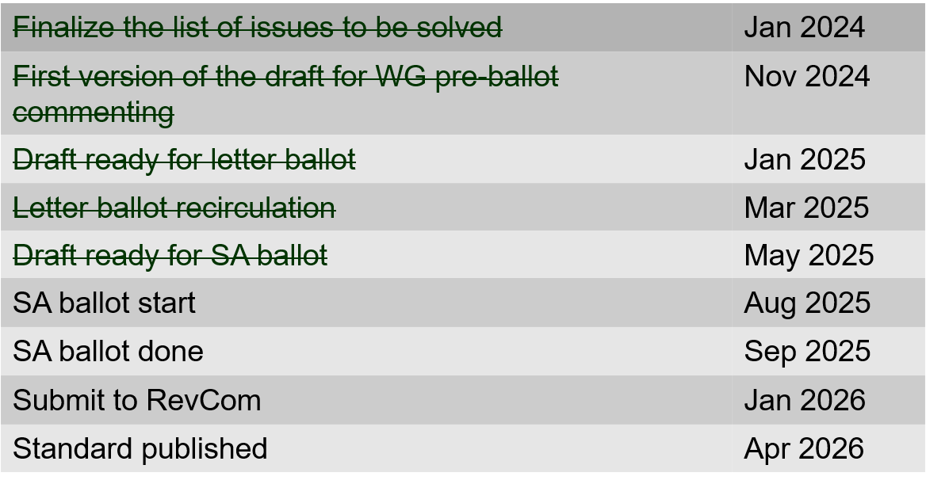
802.15.4ac Enhanced Privacy Timeline

Slide 122
802.15.4ad Next Generation SUN PHYs
Developing enhancements to the 802.15.4 SUN PHYs (FSK, OFDM)
State: pre-draft development
Meeting goals:
  Approval of minutes
  Presentations (see next page)
Closing report: https://mentor.ieee.org/802.15/dcn/25/15-25-0219-00-04ad-tg4ad-agenda-opening-and-closing-report-may-2025.pptx

Slide 123
802.15.4ad Timeline
2024
November: Approve Technical Guidance Document
Call for proposals issued
2025
January: Hear initial proposals
March: Hear updated proposals
March to May – 2 conference calls
  Simulation results of remaining proposals not yet provided
  Prepare table of proposals for analysing against technical guidance document
May: Hear final proposals
May to July – 2 conference calls
  Simulation results and proposal categorisation.
July: Heard final proposals. Categorized and summarized proposals
July – September: Merging proposals
September: Finish merging and start drafting the standard

Slide 124
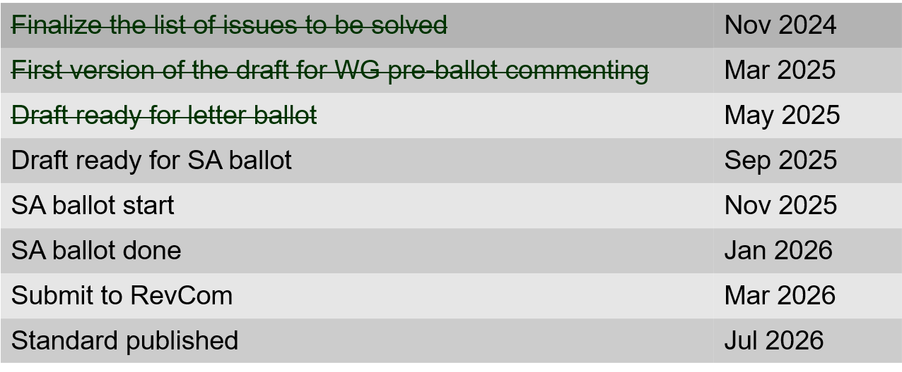
802.15.4ae (ASCON)
ASCON light weight encryption extension for 802.15.4
Meeting achievements
Resolve letter ballot comments
Prepare draft ready for letter ballot recirculation
Start letter ballot recirculation after the session
Closing report: https://mentor.ieee.org/802.15/dcn/25/15-25-0318-01-04ae-july-opening-and-closing.pptx

Slide 125
802.15.6ma
Completed WG balloting (recirc with no new comments)
Ready for SA ballot
Completed 4 WG Ballots and completed with 100 % approval rate (D06)
  The TG has resolved 113 comments received on drafts P802.15.6ma/D03
  The TG has resolved 265 comments received on drafts P802.15.6ma/D04
  The TG has resolved 127 comments received on drafts P802.15.6ma/D05
  The TG did not receive any comments for P802.15.6ma/D06
Closing report: https://mentor.ieee.org/802.15/dcn/25/15-25-0389-02-006a-tg15-6ma-closing-report-for-july-2025.pptx

Slide 126
TG 6ma Timeline(expected)
Final SB recirculation, if required. Submission to RevCom
Jan 2026
Tech Req Doc July 2022
Presentation of proposals
May 2023
Comment Resolutionfor LB210
Nov. 2024
Comment Resolutionfor LB212
March 2025
Comment Resolutionfor LB217
May
2025
Comment Resolution for LB217
July
2025
SA Ballot
Sept
2025
WG PreBallot submission for Draft2.5 August 2024
Revcom Approve
March 2026
SA recirculation if required
Oct 2025
^{Draft V1,18 Com}
May. 2024
Recirculation (LB212)
Jan. 2025
RevcomSubmission
Feb. 2026
TRD,CMD
Call Proposals Sept 2022
Std. Draf V1.9 Proposals
Nov. 2023
Comment Resolution fo Draft v2.3 on WG for PreBallot July 2024
1st Letter Ballot(LB210)
Sept. 2024
2nd Recirculation (LB217)
April 2025
3rd Recirculation (LB)
June 2025
Unconditional approval for Standard Association Ballot (SA)
July 2025
Request EC approval for SA Ballot
Nov. 2026
Comment Resolution for SA Ballot
Oct. 2025

Slide 127
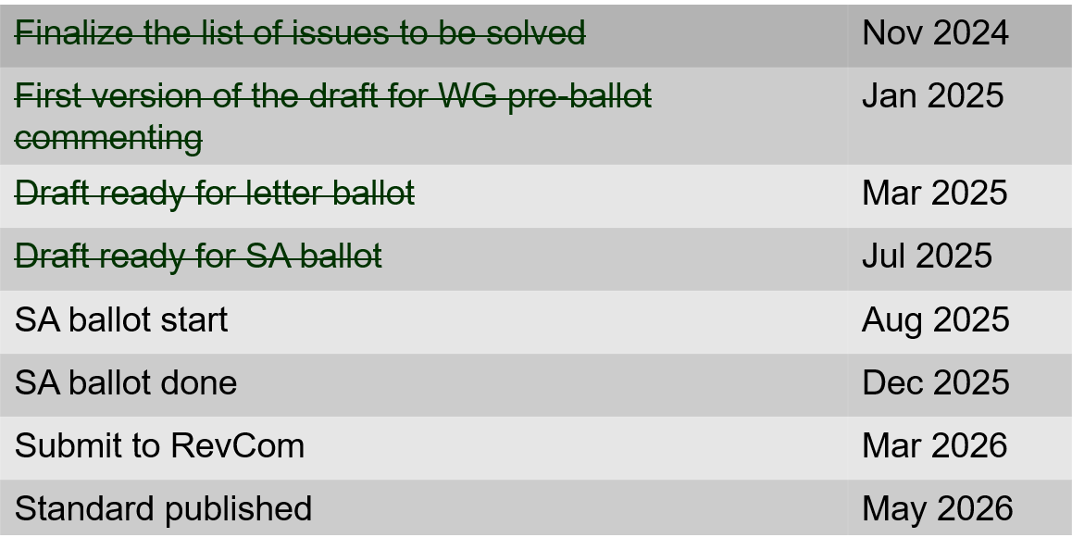
802.15.9a KMP Transport
Extensions to key management: extending to support EDHOC
State: Completed initial WG ballot
Session objectives
  Resolve comments
  Initiate recirculation ballot
  Conditional approval to start SA ballot
Opening and closing report: https://mentor.ieee.org/802.15/dcn/25/15-25-0319-02-009a-july-opening-and-closing.pptx

Slide 128
IG Access
Agenda, closing report and minutes: https://mentor.ieee.org/802.15/dcn/25/15-25-0346-01-acss-ig-access-july-2025-agenda-and-presentation.pptx
Presentations: “CCA Modes and Adaptive ED Threshold in suspendable CSMA-CA” Doc: 15-25-0353-02
Discussion

Slide 129
TG16me Revision of 802.16-2017
Revision to 802.16
  Includes rollup of 16t
Roll-up preparation underway
Heard technical contributions
Closing report: https://mentor.ieee.org/802.15/dcn/25/15-25-0397-00-16me-tg16me-july-2025-closing-report.pptx

Slide 130
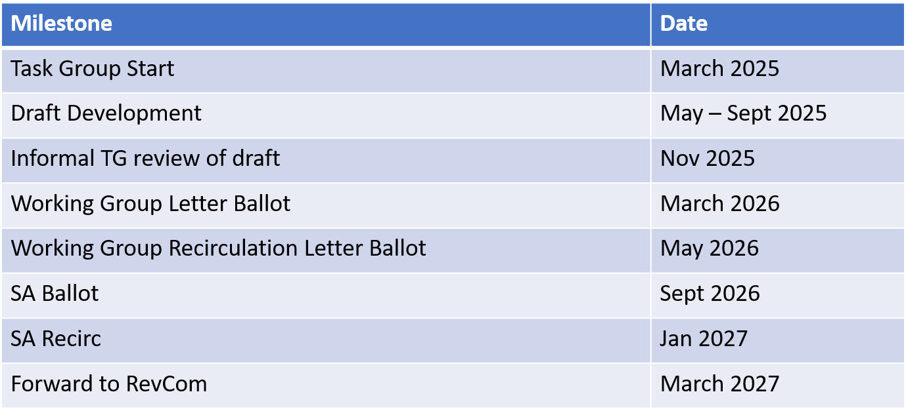
TG16me Revision Project Timeline

Slide 131
Interest Group Next Generation Optical Wireless Communication (NG-OWC)
IG NG-OWC Closing Report: https://mentor.ieee.org/802.15/dcn/25/15-25-0399-00-07ma-ieee-802-15-ig-ng-owc-closing-report-july-2025.pptx
Session objectives:
Hear contributions related to the future of next generation OWC(OCC, FSO) technology
Prepared extended Call for Applications on NG OWC
For September Session:
Invite contributors from companies
IEEE 802.15 IG NG OWC (OCC or FSO) Extended Call For Applications https://mentor.ieee.org/802.15/dcn/25/15-25-0162-02-07ma-ieee-802-15-ig-ng-owc-call-for-applications.doc

Slide 132
802.18 Liaison Report – July 2025
Date: 28 July 2025
Author:
Name | Company | Address | Phone | Email
Edward Au | Huawei Technologies |  |  | edward.ks.au@gmail.com

Slide 133
RR-TAG at a glance
Membership as of 17 May 2025
  65 voters (including 10 on LMSC)
  10 nearly voters
  14 aspirants
Officers
  Chair: Edward Au (Huawei Technologies)
  Co-Vice Chair: Gaurav Patwardhan (Hewlett Packard Enterprise)
  Co-Vice Chair: Al Petrick (Jones-Petrick Associates)
  Secretary: Chenhe Ji (Huawei Technologies)
  IEEE SA Program Manager: Jodi Haasz (IEEE SA)

Slide 134
Progress since the 2025 May interim
Reviewed the latest ongoing consultations
Approved the following IEEE 802 LMSC submissions:
  South Africa ICASA: Draft radio frequency plan 2025 (NRFP)
  South Africa ICASA: Draft regulations on dynamic spectrum access and opportunistic spectrum management in the innovation spectrum 3800-4200 MHz and 5925-6425 MHz
  India TRAI: Consultation Paper on Assignment of the Microwave Spectrum in 6 GHz (lower), 7 GHz, 13 GHz, 15 GHz, 18 GHz, 21 GHz Bands, E-Band, and V-Band
  Colombia ANE: Proposal for flexibility of the 900 MHz band
Discussed the latest topics related to spectrum and regulation in Europe, North America, and Asia Pacific.

Slide 135
Objectives this week (1)
Invited presentations (member enrichment activities)
  Speaker: Mr. Sietse van der Gaast, Co-chair of Body of European Regulators for Electronic Communications (BEREC) Wireless Network Evolution working group
  Title: Introduction to BEREC
  Document: 18-25/0065
  Speaker: Dr. Pelin Salem, Cisco Systems
  Title: FCC KDB basics
  Document: 18-25/0064

Slide 136
Objectives this week (2)
Discuss the latest topics related to spectrum and regulation in Europe, North America, and Asia Pacific, including
  ETSI BRAN 2025 July update
  Ongoing work of ECC PT1 with regards to whether or not a guard band is needed at the bottom end of the upper 6 GHz band to protect Wi-Fi (and other unlicensed technologies) at the top end of the lower 6 GHz band from IMT signal levels.

Slide 137
802.24 Vertical Applications TAG
July 2025
Liaison Report
July 2025 Plenary Session
Madrid, Spain

Slide 138
802.24 Overview
802.24 Vertical Applications TAG
802.24.1 Smart Grid TG
802.24.2 IoT TG
Officers
  TAG Chair: Tim Godfrey
  Secretary & TAG Vice Chair: Ben Rolfe
Task Groups
  802.24.1 Smart Grid TG Tim Godfrey
  802.24.2 IoT TG <open>
21 Voting Members
Meeting Plan: Two slots:
  Tuesday PM2 (17:00 Madrid)
  Wednesday PM2 (17:00 Madrid)
Accredited Hybrid Meeting with Remote Participation
M802.24-25-0016r3
C802.24-25-0018r0
Minutes 24-25-0020-00-0000
Tim Godfrey, EPRI

Slide 139
Agenda
Call session to order / “Guidelines for IEEE SA meetings”
Review of Agenda / Approval of Agenda / Approve Minutes
Liaison Updates / Regulatory
Discussion: new work
IoT white paper Development and Contributions
AFV Infrastructure communications white paper: Review contributions and white paper draft
Development of update to Smart Grid White paper.
AoB
Tim Godfrey, EPRI

Slide 140
Potential new activity
Indoor agriculture
  Explore gaps and needs for new standards that could be assigned to a WG
    Indoor Agriculture use cases
    Sensors, power management, etc
    Need for integration or coordination of standards.
    Need for a more efficient means of controlling DC power – ala POE.
  Will be a topic on the November agenda
Automotive Vertical
  Brief discussion from May 2025 meeting indicated possible interest in continuing 802.11 Auto TIG. Topic is welcomed if there is interest.
Tim Godfrey, EPRI

Slide 141
White Paper Development
IoT White paper – Reviewed and Action Items Assigned
  Draft from July 2025 meeting 802.24-25-0014r2
Alternative Fuels Vehicles and Charging Infrastructure
  802.24-25-0017r2 latest revision: reviewed by the TAG
  Further additions in next revision for Sept meeting
Smart Grid White Paper Update – Review and actions
  Output document from July – 802.24-25-0013r1
Tim Godfrey, EPRI

