Slide 1
Carrier Frequency Planning for BF in 11bn
Date: 2025-03
Authors:

Slide 2
Introduction and outline
11bn has 3 beamforming modes, SU, MU and CoBF
Carrier frequency sync between APs in CoBF is important, due to (equivalent) simultaneous transmission
Sounding and feedback functionality is perceived as a major overhead. Seamlessly re-using sounding results among different BF modes is a great way to minimize overall system overhead.
This re-use strategy also require additional considerations on carrier frequency sync among APs
This contribution is also trying to provide and harmonize ideas for the AP carrier frequency sync.

Slide 3
Carrier Frequency at different times
Sounding
fc(t_{s})
Data
fc(t_{d1})
Data
fc(t_{d2})
$$Precoding$$
$$P(k,ts)$$
$$H(k,td1)P(k,ts)$$
$$H(k,td2)P(k,ts)$$
It is beneficial (but not necessarily mandatory) for fc(t_{s}), to be close to fc(t_{d1}) and/or fc(t_{d2}). If H(k) has very mild variations w.r.t. k, then this kind of frequency difference doesn’t matter much.
There is no requirement, there is no need to have a requirement, for this kind of freq difference, fc(t_{s})-fc(t_{d}). APs can handle without standards’ involvement.

Slide 4
Carrier Frequency Diff for CoBF Joint Sounding
1st TX and 1st Correction
f_{c1}(t_{s})
f_{c1}(t_{d1})
f_{c1}(t_{d2})
NDPA
NDP
Trigger
Data
Data
AP₁
Est/Mod
f_{c2}(t_{d2})
f_{c2}(t_{s})
f_{c2}(t_{d1})
AP₂
NDP
Data
Trigger
Data
Est/Mod
Est/Mod
It is mandatory or more critical for f_{c1}(t) to be close to f_{c2}(t) in order to make ICI small enough in STA receivers.
11bn PHY meeting has been discussing the requirement for this freq difference, f_{c1}(t) - f_{c2}(t).
There is a wide consensus that either AP can modify its fc to be close to another AP’s fc, especially during data communication period (with trigger being the reference).
During joint sounding, NDPA is used for reference frequency which may have an intentional offset to the nominal carrier frequency, up to the AP to decide.

Slide 5
Carrier Frequency Diff for CoBF Joint Sounding
f_{c1}(t_{s1})
f_{c1}(t_{s2})
f_{c1}(t_{d2})
NDPA
NDP
NDP
Data
AP₁
Est/Mod
Est/Mod
f_{c2}(t_{d2})
f_{c2}(t_{s1})
f_{c2}(t_{s2})
AP₂
NDP
NDPA
NDP
Trigger
Data
Est/Mod
Key point #1: freq diff between 2 APs is more critical than freq diff of different times
We trust APs would do its best to mitigate impact of frequency difference, from a global point of view.
Key point #2:
First TX and correction is the most important correction, since initial difference is up to ±40PPM
APs can choose any strategy for subsequent correction.
f_{c2}(t_{s2}) could be intentionally quite different from f_{c1}(t_{s1}). It is up to an AP to choose.

Slide 6
Carrier Frequency Diff for CoBF Seq Sounding
xBSS Sounding
NDPA
NDP
NDPA
NDP
AP₁
Est/Mod
Est/Mod
inBSS Sounding
xBSS Sounding
AP₂
NDP
NDPA
NDP
NDPA
Est/Mod
Est/Mod
xBSS Sounding
inBSS Sounding
There is no true joint transmission during a Seq Sounding
APs know that it is beneficial to have small freq diff among different APs or different times
Key point:
First TX and correction is the most important correction, since initial difference is up to ±40PPM
APs can choose any strategy for subsequent carrier freq diff fine-tuning
Explicit indication for the 1st TX transmission (joint or seq sounding)
If freq diff (estimated) is meeting requirement already, it is still up to the AP to do 1st correction or not
Notes:
nominal carrier freq + delta

Slide 7
Impact of Sounding Result Re-use
With Samsung’s new proposal [?], sounding results from any mode (of SU/MU/CoBF) can be re-used in all other modes
It is up to an AP to wisely perform the frequency planning.
For Example.
If certain inBSS sounding results are available, CoBF sounding can choose to skip these inBSS sounding.
On the contrary, CoBF sounding can also choose to skip some crossBSS sounding
There is a big bag of sounding results from SU, MU, and CoBF. It is up to an AP to use them wisely and efficiently.

Slide 8
An Exemplary Suggestion
Each sounding result can have a frequency tag, and a time tag
Time tag: for channel aging and freq drift. Well understood already. [Session ID]
Frequency tag: for sounding result reuse and/or choosing future carrier freq.
Example (reusing in CoBF)
AP1 already have some valid inBSS sounding results at (fnc1+Δ1)
AP1 wants to do joint CoBF sounding now and also want to reuse existing sounding results
It make sense for AP1 (as the sync reference or first transmitter) to choose a carrier frequency close to (fnc1+Δ1) for this incoming joint CoBF sounding.
Similarly: reusing CoBF souding results in MU would need MU TX at the carrier frequency during sounding.
Note: nominal carrier frequency already has possible freq drift included.

Slide 9
Other Q&As
Q1: Many people expressed concerns that no fixed sync reference during a whole sequence may lead to unacceptable ping-pong issues.
A1: Simulation shows there are no extra complication on top of regular/expected “random” walk behavior (also similarly from freq drift).
Q2: An AP could be in multiple CoBF groups. This could make freq sync complex and create issues.
A2: AP could handle each group independent or otherwise. This is an AP internal implementation issue and doesn’t need standards’ involvement.

Slide 10
Check and Enforcement on Carrier Frequency
We trust that each AP will do its best to achieve reasonable performance, from a global point of view.
But bad players may still be unavoidable.
We support the idea to have a requirement on freq diff for simultaneous TX (already had similar requirement on STA for UL-MU), and an easy verification mechanism.
(Equivalent) Simultaneous TX
Joint data TX (CoBF data transmission simultaneously) -- mandatory
Joint sounding (simultaneous NDP TX) -- mandatory
Sequential (non-joint) sounding for CoBF (NDPs are TXed at different time) – exceptions are allowed [see Julia’s reasoning]

Slide 11
For Further Discussion
The First Transmission has to be defined without ambiguity.
Mechanism/protocol for negotiating the First Transmission.
Exact requirement (in Hz) for frequency difference during (equivalent) simultaneous transmission.
A mechanism to check if an AP is meeting this frequency difference requirement.

Slide 12
SP Ideas for Discussion
Exact requirement (in Hz) for frequency difference during (equivalent) simultaneous transmission and conditions.
NDPA is a reasonable choice;
(Don’t want add extra burden to other packets (such as invite) which doesn't care about freq error as long as it is within 20ppm)
Explicit Signaling for the First Transmission (and hence First correction)
A mechanism to check if an AP is meeting the frequency difference requirement when (equivalently) TXing simultaneously.

Slide 13
Reference
11-25-0283-01-00bn-inter-ap-carrier-synchronization-for-coordinated-beamforming-cobf ; [Bilal of Samsung]
11-25-0083-01-00bn-cfo-correction-and-related-simplifications-for-cobf; [Sameer of QCOM]
11-25-0836-01-00bn-follow-up-on-cfo-correction-for-cobf; [Sameer of QCOM]
11-25-0103-00-00bn-simplified-carrier-synchronization-for-cobf-transmissions; [Julia of MTK]
11-25-0872-00-00bn-on-cobf-APs-carrier-synchronization-overhearing-csi-report-in-cobf-sounding; [Julia of MTK]

Slide 14
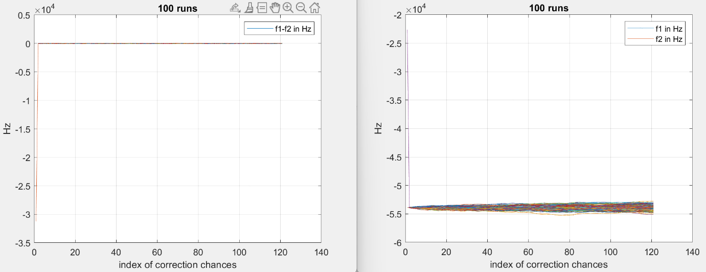
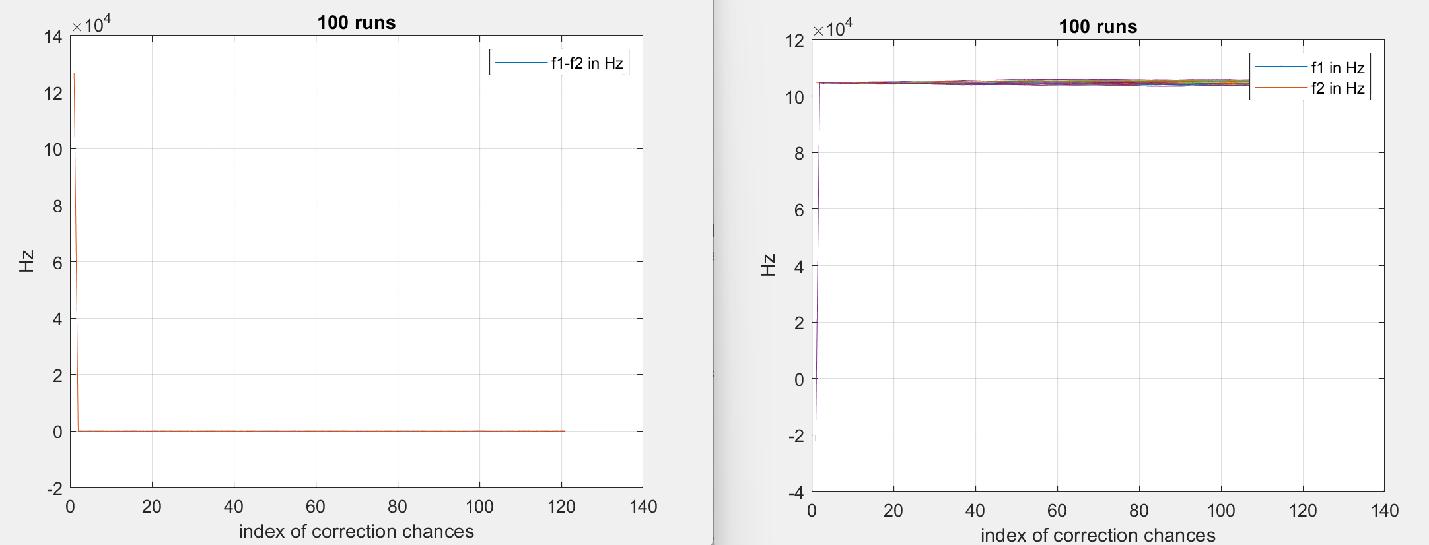
Simulation Results
Fc = 5.25GHz; xtal accuracy +/- 20ppm
Drift +/- 50Hz. Correction error +/-50Hz.
All uniformly distributed.
Correction in alternating order order
Correction in random order
Freq difference is very small
Actual frequencies do show small “random walk” behavior (<< f_{SCS})

