Slide 1
Maximal Reuse of Sounding Results in 11bn
Date: 2025-04
Authors:
Name | Affiliation | Address | Phone | Email
Aiguo Yan | Samsung | 3655 N First St, San Jose, CA 95134 |  | aiguo.yan@samsung.com
Zigui Yang
Srini Kandala

Slide 2
Introduction
11bn now has 3 BF modes
    SU
    MU
    CoBF
Sounding/feedback has been perceived as a major overhead which we would like to reduce as much as possible.
IEEE802.11 community has invested effort on investigation of using AIML methods to reduce BF feedback overhead.
Re-use is another way to reduce overall overhead.
We propose enhancements to further enable re-use.

Slide 3
Problem: BF modes and Sounding/Feedback
SU-MIMO: (H=U*S*V^{H})
    Essentially, V and SNRs are feedbacked. S is not.
MU-MIMO:
    Essentially, both V and S are feedbacked.
CoBF:
    A kind of MU-MIMO, in a broad sense.
    Essentially, both V and S are feedbacked.
Comments
UEQM (needs V only) is excluded for MU/CoBF.
So, info of S is critical for MU/CoBF (e.g., EQMCS)
SU sounding results can’t be re-used in MUMIMO/CoBF

Slide 4
Info on MU-MIMO and CoBF
CoBF:
11bn: “UHR Co-BF sounding uses EHT MU full bandwidth feedback” is already motioned
It is a valid case that AP₁ or AP₂ only has to sound ONE inBSS STA.
MU-MIMO
11be: “An EHT beamformer that initiates an EHT TB sounding sequence shall transmit an EHT NDP Announcement frame with TWO or MORE STA Info fields and the RA field set to the broadcast address”
We of course can fill the 2nd STA Info field with Dummy info.
Is filling “Dummy info” an efficient way?
Feedback using OFDMA will also waste UL BW.
Notes:
Thanks Wookbong Lee for discussion

Slide 5
Proposals for Discussion
Extend MU sounding/feedback to SU cases
    Option 1.1: all MU sounding/feedback options
    Option 1.2: only the option with the highest accuracy (since almost no one is using other options)
Minimum # of STAs in MU sounding/feedback
    Option 2.1: No changes at all (keep as 2, and use dummy for 2nd STA INFO).
    Option 2.2: Change from 2 to 1.

Slide 6
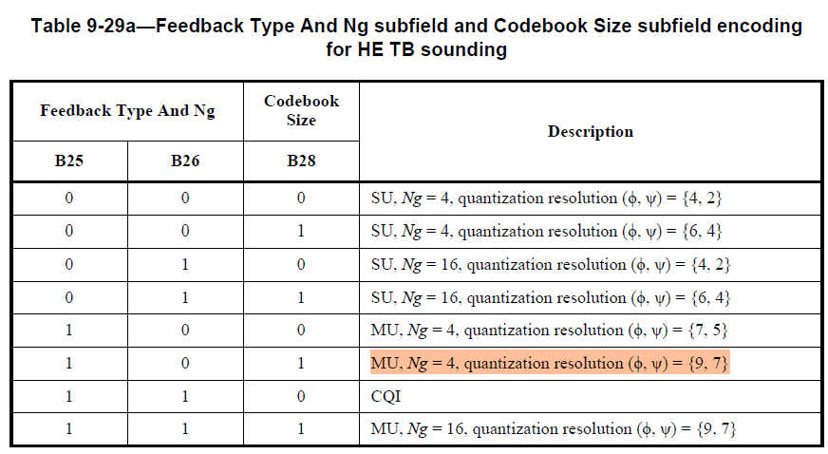
Existing MUMIMO Feedback (11be)
The highlighted option has the highest accuracy

Slide 7
Other Side Benefits
Before 11bn, EQMCS is used in SU-MIMO, without feedbacking info of S. It is recognized this is not optimal
11bn introduced UEQM specifically to deal with this deficiency. EQMCS is still allowed.
Rate adaptation
  With EQMCS, mature technologies in market for years.
  With UEQM, new and hence to be battle tested.
More freedoms for APs in SU mode
  Freedom for the AP to use EQMCS traditionally, more optimally.
  Freedom for the AP to use UEQM, new in11bn.

Slide 8
Summary
Extend the MU sounding/feedback mechanism to SU so that SU sounding results can be easily (and more suitably) used in MU and CoBF
Make MU sounding/feedback mechanism for cases of one STA more efficient [than the existing method with dummy filling].
SU-MIMO case with MU-type Sounding and Feedback mechanism enable more freedom for APs (in SU mode)

Slide 9
SP Ideas for Discussion
Extend the UHR MU sounding/feedback mechanism to SU.
    Option1: With the option of Ng=4 and accuracy [7 9] bits.
    Option2: With all Ng and Accuracy options
Minimum # of STAs in a UHR MU sounding is 1

Slide 10
References
[1] 24/1433: enhancing-bf-feedback-mechanism-in-11bn (Aiguo of Samsung)

