Slide 1
ETSI BRAN, July 2025 update
Date: 2025-07-03
Authors:

Slide 2
New Work Item—TR 104 893
ETSI TC BRAN approved a new Work Item (WI) for the creation of a Technical Report (TR)
To be published as TR 104 893
WI expects the TR to be completed by the end of this year
See BRAN(25)130007r5
TR 104 893 will address “Wireless Access System including Radio Local Area Networks (WAS/RLAN) coexistence challenges with emerging solid-state weather radars”

Slide 3
TR 104 893—Scope
“This work item proposes the development of a Technical Report (TR) to investigate coexistence between Wireless Access Systems including Radio Local Area Network (WAS/RLAN) systems and the next generation of weather radar systems operating in particular in the frequency band 5600 MHz to 5650 MHz using solid-state power amplifiers (SSPAs) in their transmitters. Dynamic Frequency Selection (DFS) is currently the primary regulatory mechanism for coexistence in this band (as specified in EN 301 893).
The TR will assess the DFS performance considering the SSPA-based radar signals. Key topics of the TR will include:
Information about the improvement of SSPA-based radar on the meteorological activities
Characterization of SSPA radar emissions, including pulse shapes, repetition rates, and power levels.
Evaluation of DFS effectiveness with SSPA-based radars, considering the reduced peak power compared to currently deployed meteorological radars and typical pulse patterns.
Assessment of DFS parameters to provide effective SSPA-based radar protection.
Consider the impact of temporarily inactive radars (on/off cycles) on DFS behavior
May include a targeted measurement campaign to validate assumptions regarding pulse detectability of SSPA-based Radars signals by DFS behavior of RLAN.
May also assess the effectiveness of alternative mitigation techniques that provide a level of protection at least equivalent to DFS.
The findings of this TR will inform potential future revisions of EN 301 893.”

Slide 4
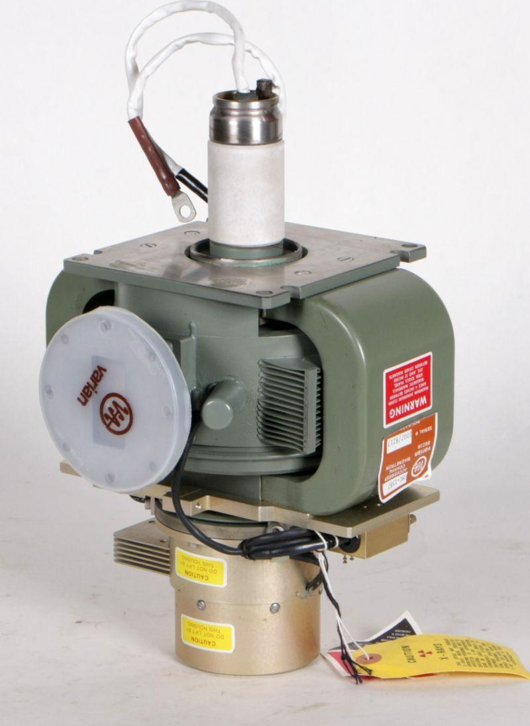
Example: weather radars
[1]
[3]
Existing radars mostly use klystrons or magnetrons (e. g. [2]) as amplifiers
Up to 500 kW output power (e. g., 250 kW [1])
Radars transitioning to solid-state based power amplifiers (SSPA)
Higher efficiency but peak output power reduced by at least 15 dB
To emit same amount of energy, SSPA radars to transmit pulses with longer duration
Today, coexistence between WLAN and radar relies on WLAN equipment detecting known radar pulse sequences exceeding a threshold of −62 dBm
[2]

Slide 5
EN 303 687—Version 1.1.7
ETSI TC BRAN continued discussions related to
Requirements for Narrowband Frequency Hopping (NB FH) equipment
Client-to-Client operation
Despite good discussions, TC BRAN did not progress the draft with respect to both topics
Current regulation limits Low Power Indoor (LPI) Access Points (APs) to using internal antennas
In dense deployments, however, small cells might be needed
To confine cell sizes, antennas with high gains are needed
Therefore, vendors need to offer APs with directional and omnidirectional antennas

Slide 6
EN 303 687—New discussion items
TC BRAN reviewed a contribution that proposes to permit LPI APs to use Self-Identifying Antennas
SIA could inform an AP of the antenna gain provided
To comply with Equivalent Isotropically Radiated Power (EIRP) limits, AP to reduce output power by the indicated antenna gain
Products may incorporate multiple radios that operate in the same frequency band
E. g., Wi-Fi, Bluetooth …
Therefore, EN 303 687 needs to differentiate between a product and its components
Relationship of terms “equipment,” “device” etc. need to be improved
TC BRAN reviewed a terminology related overview

Slide 7
Informal meeting with ECC WG FM
Working Group (WG) Frequency Management (FM) of the Electronic Communications Committee (ECC) conducted its meeting #110 at ETSI’s facilities
During the same week, TC BRAN also conducted its meeting #130 at ETSI
ECC WG FM and ETSI TC BRAN used this opportunity to conduct an informal joint meeting
TC BRAN presented the scope of its current work
ECC WG FM and TC BRAN had excellent discussions and exchanges of thoughts
It is intended to repeat such a joint meeting

Slide 8
Next meetings
BRAN #131 at ETSI’s facilities
2025-09-23T14:00+02:00 until 2025-09-25T18:00+02:00
BRAN #132 at ETSI’s facilities
2025-11-03T14:00+01:00 until 2025-11-07T14:00+01:00
BRAN #133 at ETSI’s facilities
2026-01-26T14:00+01:00 until 2026-01-30T14:00+01:00
BRAN #134 at ETSI’s facilities
2026-03-30T14:00+02:00 until 2026-04-02T14:00+02:00

Slide 9
References
LEONARDO Germany GmbH, “METEOR 1700C,” [Online]. Available: https://www.leonardogermany.com/en/products/meteor-1700c
Ostron, “Impulsmagnetron Varian VMC-1587,” [Online]. Available: https://www.ostron.de/Radar-GHz/Bauelemente-bis-SHF/Impulsmagnetron-Varian-VMC-1587.html
ETSI, “EN 301 893—5 GHz WAS/RLAN; Harmonised Standard for access to radio spectrum,” version 2.2.1, Nov. 2024. [Online]. Available: https://www.etsi.org/deliver/etsi_en/301800_301899/301893/02.02.01_60/en_301893v020201p.pdf

