Slide 1
Openwifi and sub-20 MHz Co-OFDMA
Date: 2025-07-16
Authors:

Slide 2
Abstract
In this work, we provide background information on openwifi and how it supports sub-20 MHz Co-OFDMA using IEEE 802.11ax frames and STAs
Synchronization, information sharing, and trigger are performed via a fiber backhaul
We show measurement results both in terms of synchronization of the APs and received power at the STAs

Slide 3
Background on openwifi
Openwifi [1] is an IEEE 802.11a/g/n compatible full-stack open-source Wi-Fi chip design on FPGA developed within Ghent University – imec
Mature features are open-source, more advanced/recent features such as 802.11ax, sensing, resilient comm., are behind a subscription model. A list is found in [2].
Project made possible by funding from:
Born in 2017 in ORCA project (EU’s Horizon2020 under agreement number 732174)
Flemish FWO SBO S006224N SMART-STRIP
Methusalem SHAPE: Next Generation Wireless Networks under grant 20-MET-004
6G MUSICAL, EU Horizon Grant Agreement No. 101139176
6G-SHINE, EU Horizon Grant Agreement No. 101095738
HORIZON-ERC-POC DCAP (Distributed Coordinated Access Point) with number 101158037
NLnet Foundation grants: 802.11n feature of openwifi, openwifi: 802.11a/g/n maturity, and Extensive openwifi support for OpenWRT

Slide 4
Background on openwifi
Platform for Wi-Fi innovation used by both us and other universities/companies. Some of the works/topics include: (full list found in [3])
Features and functionality
Cross-Technology Interference Detection and Mitigation by OFDMA
Experimental Study on Joint Transmission
MAPC Co-SR Scheduling with Multi-Armed Bandits (presented in [4])
…
CSI sensing and security
Wi-Fi Radar for Vital (hearth rate and breath rate) Signal Sensing and Device Tracking
…
Wireless Time-Sensitive Networking (WTSN)
Research on coexistence with cellular 5G/6G

Slide 5
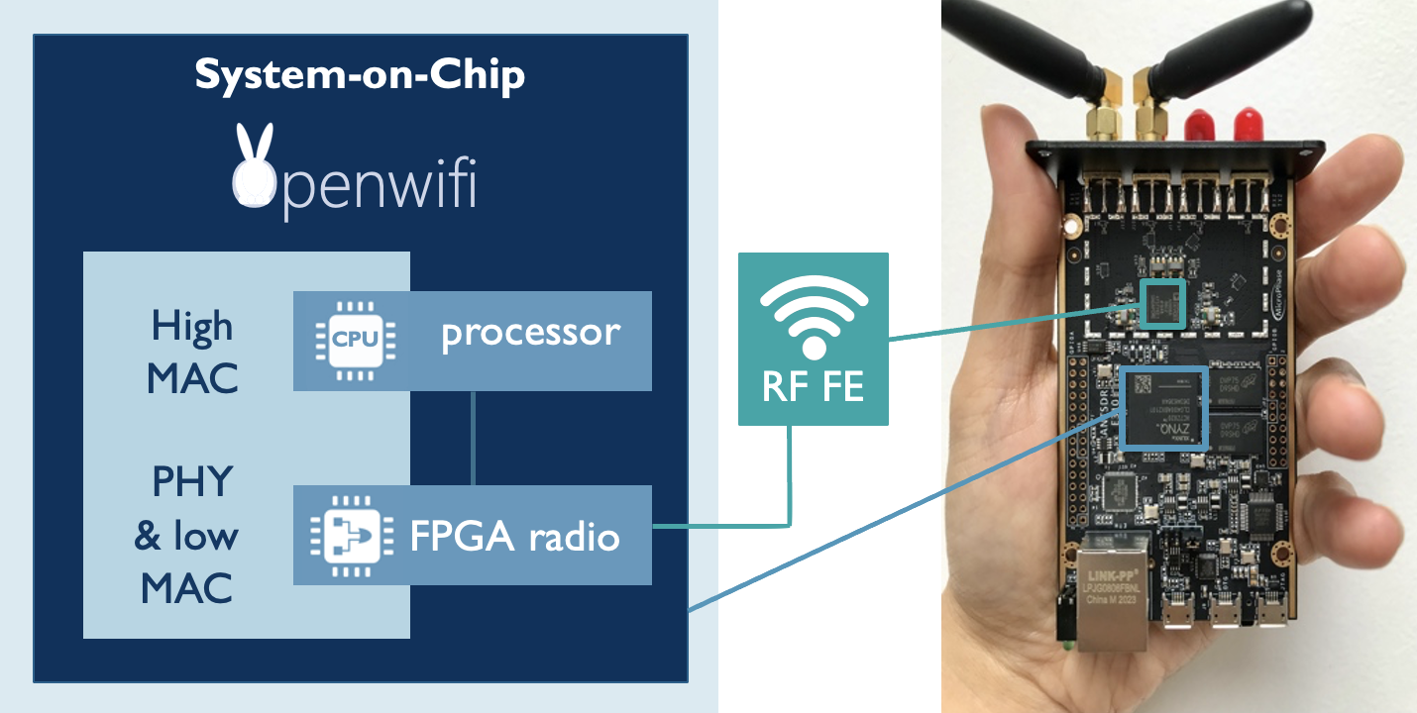
Background on openwifi
Today, support for 11 boards
Zynq 7000 series with AD9361
Zynq UltraScale with AD9361
20 MHz bandwidth, SISO, MCS 0-7
Soon, support for Zynq UltraScale+ RFSoC
Allows for bandwidths <= 320 MHz
Our largest FPGAs support IEEE 802.11ax
Co-OFDMA demo using Xilinx ZCU102 board + FMCOMMS3

Slide 6
Motivation for sub-20 MHz Co-OFDMA
Technical:
Multi-Access Point Coordination (MAPC) aims to reduce contention between Access Points (APs)
Coordinated Orthogonal Frequency Division Multiple Access (Co-OFDMA) improves reliability by allowing APs to concurrently serve their stations (STAs) in the overlapping coverage area
APs allocate power budget only to their own Resource Unit (RU), resulting in roughly 3 dB power boost (in case of two STAs, each 106-tone RU)
Sub-20 MHz attractive for lower-rate, low-latency, high-reliability users
Works such as [5] show effectiveness of Co-OFDMA with RU bandwidths of just 2 MHz

Slide 7
Motivation for sub-20 MHz Co-OFDMA
Within our research group:
Past knowledge and expertise on 802.11n, 802.11ax, OFDMA
Not in Specification Framework Document (SFD) of Task Group bn (TGbn) [6]
(nor in IEEE 802.11bn D0.3)
Wired/fiber synchronization and signalling outside the scope of standardization

Slide 8
Previous work on sub-20 MHz Co-OFDMA
Issues raised by previous work in UHR SG [7]
Large scheduling overhead for such fine-grained Co-OFDMA
Preamble spans full 20 MHz bandwidth
All credits for the subsequent technical work, results, and figures, go to my colleague, Thijs Havinga. In [8] is the paper on his work.

Slide 9
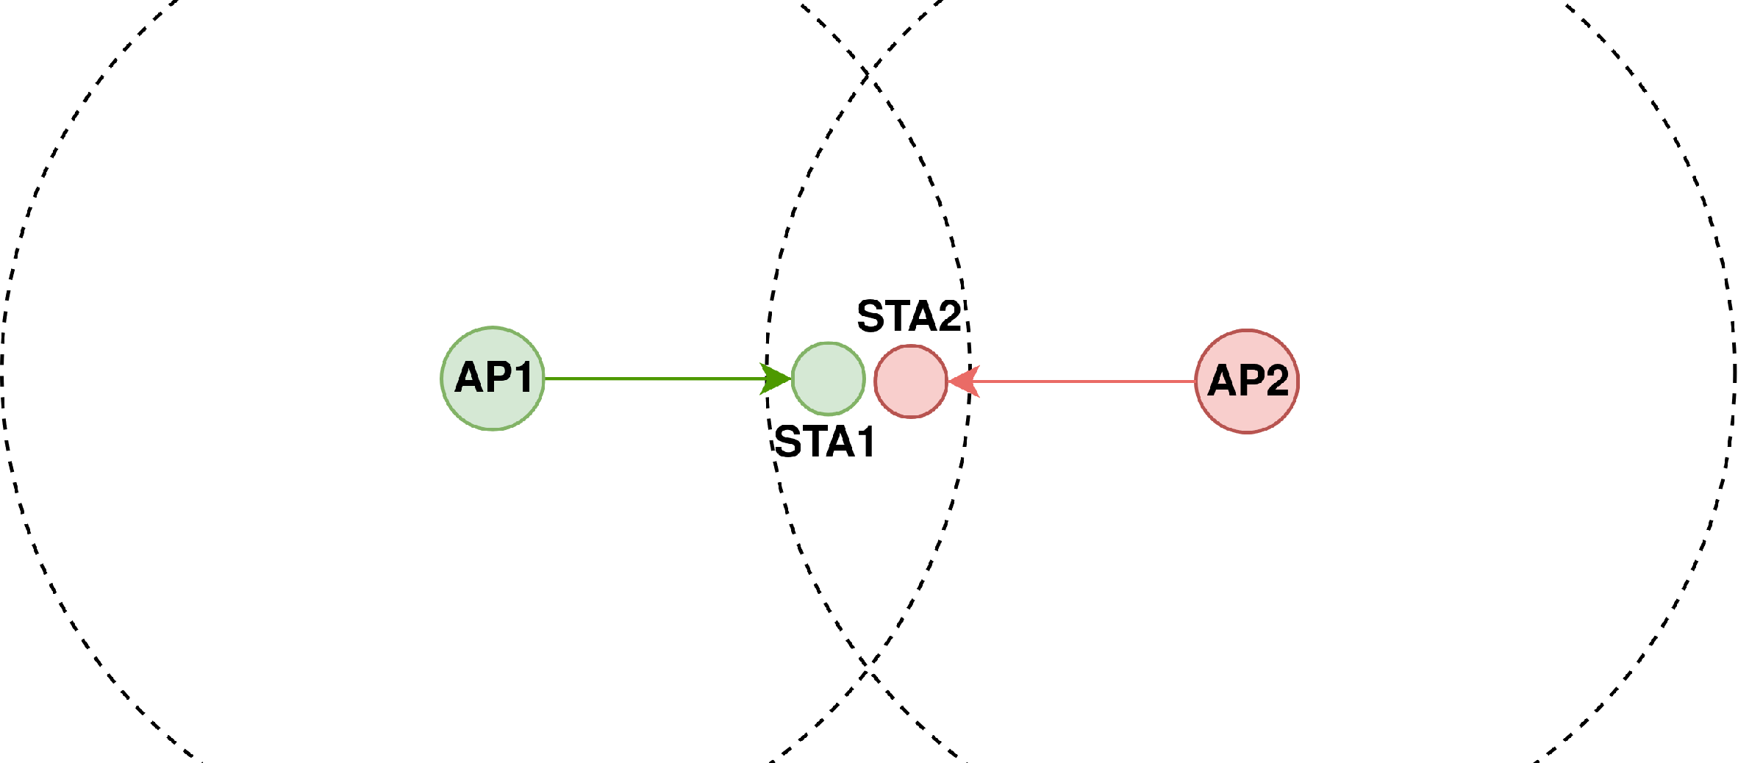
Considered sub-20 MHz Co-OFDMA setup
Considered setup
Two ZCU102 openwifi APs and two Commercial Off-The-Shelf (COTS) STAs that are IEEE 802.11ax compatible
STAs located in overlapping coverage area
Fiber backhaul
Allows for carrier frequency and time synchronization
No need for APs to hear each other
No overhead of over-the-air frame exchange

Slide 10
Requirements
Similar synchronization requirements to uplink OFDMA
< 350 Hz Carrier Frequency Offset (CFO) between APs
+-400 ns time offset between each AP starting transmission
Sharing of information
All information contained in (R)L-SIG, HE-SIG-A, and HE-SIG-B fields
Both APs should use same BSS color (or temporarily disable it)
STAs their Association Identifiers (AIDs) should be unique

Slide 11
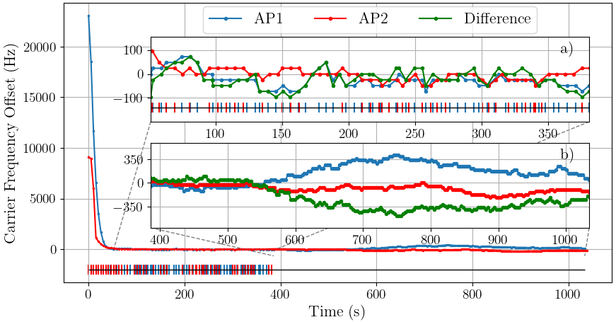
Synchronization and timing results
Subfigure a: CFO tuning is enabled
Subfigure b: CFO tuning is disabled
On average, 27.34 Hz residual CFO between APs (R&S CMW270 wireless connectivity tester)
Without tuning, CFO between APs seen here > 350 Hz after roughly 250 s
Maximum deviation in start of transmission between APs is +-48 ns
One-way trigger latency of 1.92 microseconds with perspective on improvement

Slide 12
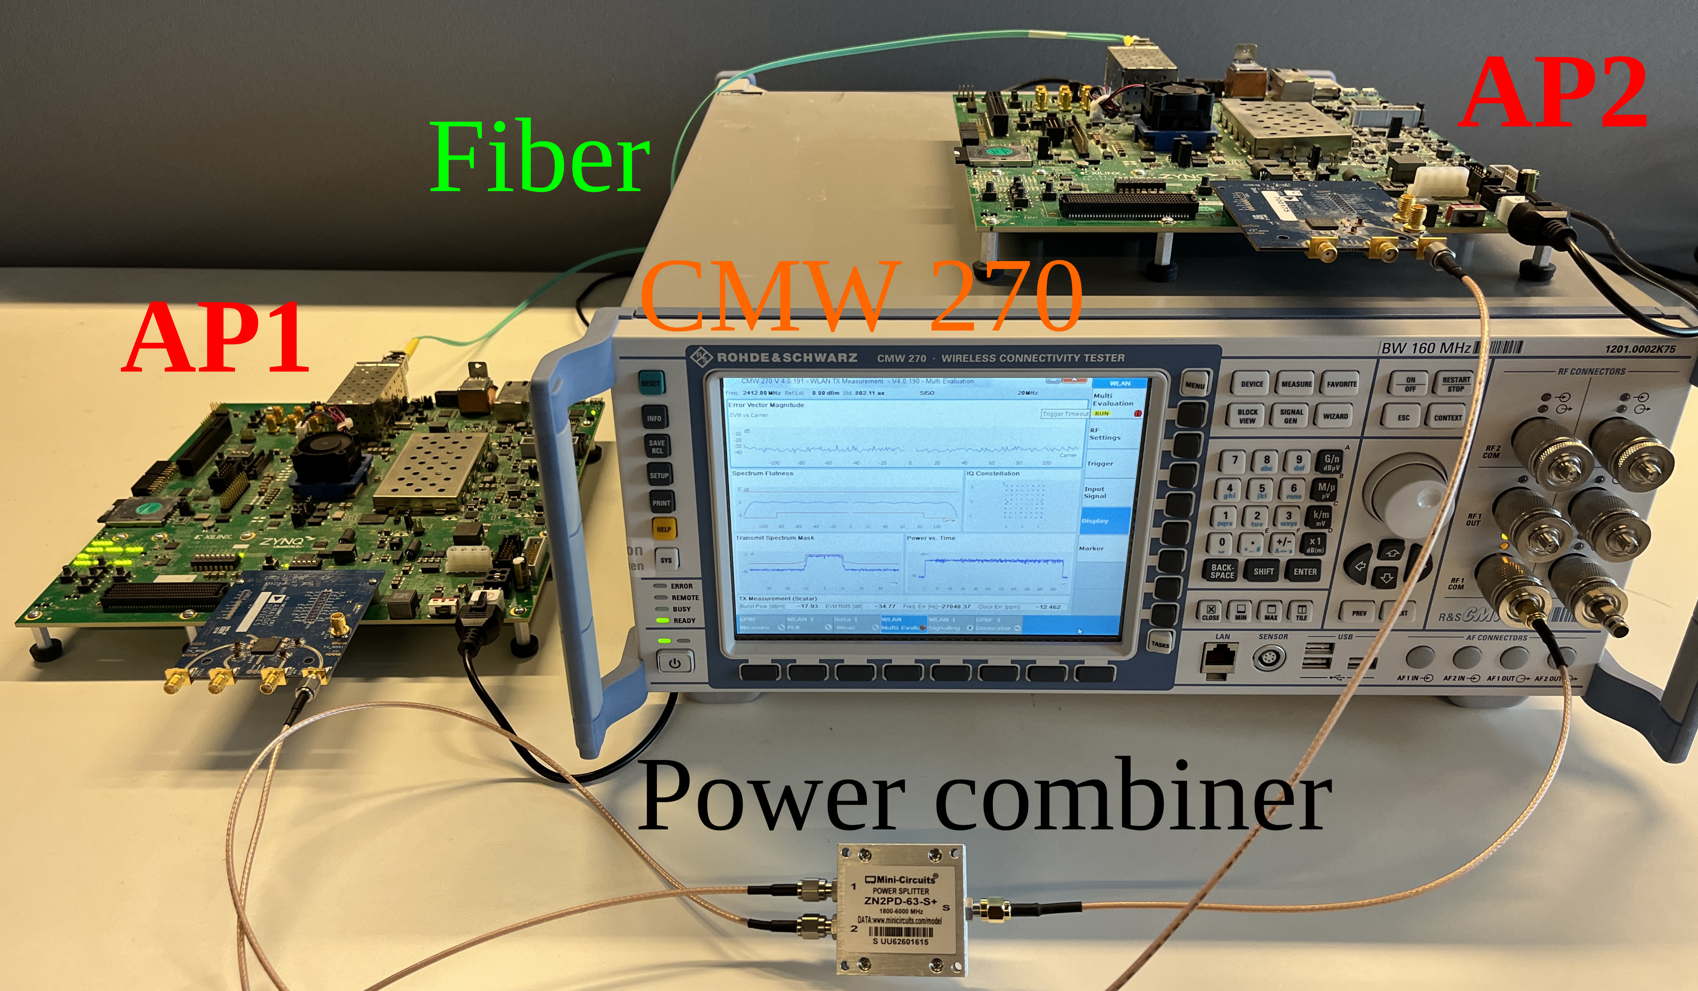
Received power results
Setup: both APs connected via power combiner to R&S CMW270 wireless connectivity tester
Each STA sees an EVM improvement of 1.4 dB
In the measurement, transmitter noise dominated over receiver noise
3 dB increase in burst power

Slide 13
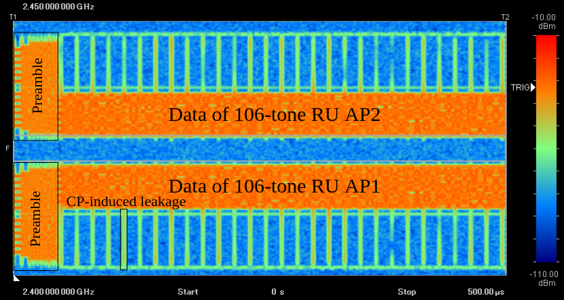
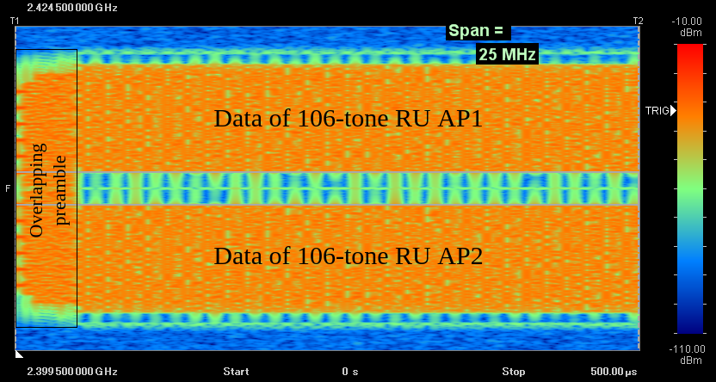
Spectrogram results
Co-OFDMA on channel 1 and 6
Illustrates synchronized transmission
Co-OFDMA, both APs same channel

Slide 14
Conclusion
Openwifi is a versatile platform for Wi-Fi innovation
Despite not in the SFD of TGbn, Co-OFDMA is a feasible MAPC scheme that is attractive for low-rate, low-latency, high-reliability applications
Sub-20 MHz Co-OFDMA is demonstrated using IEEE 802.11ax frames to COTS STAs by concurrent transmission of two coordinated openwifi APs supported by a fiber backhaul
Fiber solution exceeds synchronization requirements; leaving space for more cost-effective transport technologies (UTP Ethernet)

Slide 15
Future work
Identify STAs who may benefit from Co-OFDMA
Research into effective scheduling algorithms for Co-OFDMA
Extend this openwifi synchronization and data sharing over fiber link towards Coordinated-Beamforming (Co-BF) and Joint Transmission (JT)
Support for sounding

Slide 16
Questions or comments?

Slide 17
References
[1] https://github.com/open-sdr/openwifi
[2] https://openwifi.tech
[3] https://github.com/open-sdr/openwifi/blob/master/doc/publications.md
[4] “MAPC C-SR Scheduling with Multi-Armed Bandits Revisited”, IEEE 802.11-25/0710r1
[5] G. Lacalle, I. Val, Ó. Seijo, M. Mendicute, D. Cavalcanti and J. Perez - Ramirez, "Multi-AP Coordination PHY/MAC Management for Industrial Wi-Fi," 2022 IEEE 27th International Conference on Emerging Technologies and Factory Automation (ETFA)
[6] “Specification Framework for TGbn”, IEEE 802.11-24/0209r16
[7] “Discussion on C-OFDMA operation”, IEEE 802.11-25/0768r0
[8] T. Havinga, X. Jiao, W. Liu, B. Chen, R. Gaeremynck and I. Moerman, “Fine-Grained Coordinated OFDMA With Fiber Backhaul Enabled by openwifi and White Rabbit” arXiv:2507.10210 [cs.AR], Jul. 2025. [Online]. Available: https://arxiv.org/abs/2507.10210

