Slide 1
Co-SR/Co-BF Frame Sequence for eMLSR STA
Date: 2025-07-xx
Authors:

Slide 2
Introduction
MAC protocols for Co-SR/Co-BF have been discussed extensively [1] [2].
When an STA receiving data via Co-SR/Co-BF is an EMLSR STA, the AP must exchange ICF/ICR before initiating Co-SR/Co-BF transmission.
This contribution focuses on detailing the protocol sequence of Co-SR/Co-BF for EMLSR STA.

Slide 3
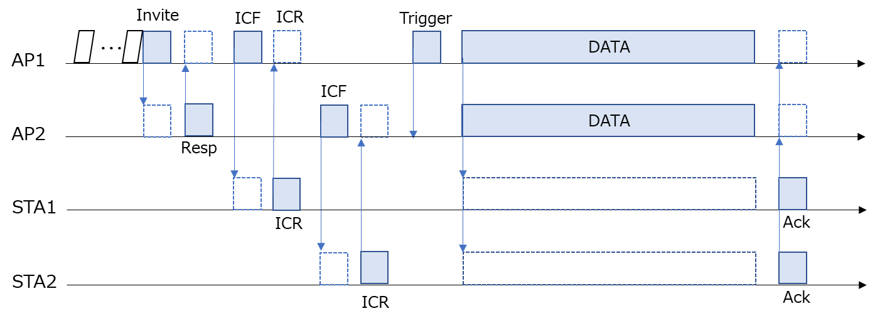
Recap: Co-SR/Co-BF Frame Sequence
Baseline of Co-SR/Co-BF Frame Sequence [3]
  A coordinating AP and a coordinated AP exchange Invite frame and Response frame.
  The coordinating AP starts exchanging ICF/ICR frames with the receiver STA (if necessary).
  The coordinated AP starts exchanging ICF/ICR frames with the receiver STA (if necessary).
  The coordinating AP sends Trigger frame, then starts Co-SR/Co-BF data transmission.

Slide 4
Discussion on the Frame Sequence
While the frame sequence described in the previous page is natural and effective for EMLSR STA, it presents several points need consideration.
  Coordinated AP transmission initiation issue
    In the described frame sequence, the coordinated AP initiates ICF transmission.
    However, the coordinated AP transmits the ICF after a predefined interval (such as SIFS) following the ICR sent by a non-TXOP holder STA, there is a risk of transmission timing misalignment.
  Error case issue when ICF/ICR frame exchange fails
    Even if STA2 does not send ICR for some reason and the coordinated AP is unable to transmit data to STA2, the coordinating AP will start coordinated transmission.
In this contribution, we propose enhancement of the frame sequence mechanism to address these issues.

Slide 5
Proposal.1 : TXOP Sharing for ICF/ICR
We propose to allow the coordinating AP to share time resource with the coordinated AP specifically for ICF/ICR exchange by utilizing a Coordinated TDMA mechanism.
  The coordinating AP to share time resource with the coordinated AP by sending MU-RTS TXS Trigger frame.
  The time allocated for this exchange will be precisely the duration required for ICF/ICR.
  A CTS frame from the coordinated AP responding to the MU-RTS TXS Trigger frame is unnecessary, because the ICF could potentially serve as a substitute.
  Regarding the duration required for ICF/ICR exchange, we consider two options:
    Option 1: Fixed Duration. Set a predefined fixed duration. It is simple but, if the amount of information in ICF/ICR is small, this could lead to wasted idle time.
    Option 2: Dynamic Allocation. The coordinated AP shares the required time information within a Response frame. While this increases the amount of information exchanged, it offers greater efficiency.
    We favor Option 2.

Slide 6
Proposal.2a : MAPC TXOP return frame
We propose that the coordinating AP requests the coordinated AP to send a MAPC TXOP return frame when it successfully receives an ICR from the STA.
  The coordinating AP will share time with the coordinated AP for the ICF/ICR exchange plus an additional α duration for a MAPC TXOP return frame.
  Here's how the procedure would work:
    Successful ICR Reception: If the coordinated AP successfully receives the ICR from the STA, it will send the MAPC TXOP Return frame after a SIFS. Following this, the coordinating AP will send a trigger frame and initiate Co-SR/Co-BF transmission.
    Failed ICR Reception: If the coordinated AP fails to receive the ICR from the STA, it will not send the MAPC TXOP return frame. In this case, the coordinating AP will wait for the shared time without receiving the return frame, and then initiate data transmission independently, without sending a trigger frame.

Slide 7
Proposal.2b : ICR Frame Overhearing
We propose that the coordinating AP be allowed to overhear the transmission to confirm whether the ICR is being correctly sent by the STA.
  This approach allows the coordinating AP to easily confirm that the ICR is transmitted from STA2, facilitating efficient time sharing for the ICF/ICR exchange with the coordinated AP.
  Here's how the process would work:
    ICR Detection: If an ICR from STA2 is detected, the coordinating AP will transmit a Trigger frame as scheduled and initiate Co-SR/Co-BF transmission.
    No ICR Detection: If no ICR from STA2 is detected, the coordinating AP will not send a Trigger frame and will instead initiate data transmission independently.
  For this mechanism to be effective, the coordinating AP must confirm in advance its capability to receive signal from STA2. This can be achieved through various methods, such as RSSI measurements for Co-SR, or sounding for Co-BF.

Slide 8
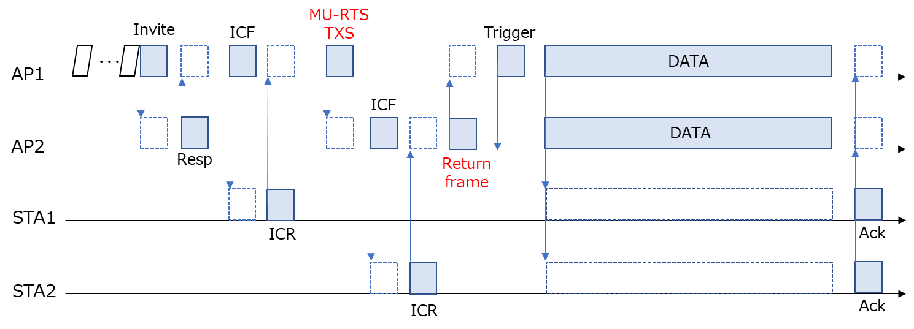
Proposed Frame Sequence (Option.1)
The sequence combining Proposal 1 and Proposal 2a is as follows.
  If the coordinated AP cannot successfully receive ICR from the STA, it does not send the MAPC TXOP return frame. The coordinating AP waits for the shared time resource without receiving the return frame, then initiates data transmission independently without sending the trigger frame.

Slide 9
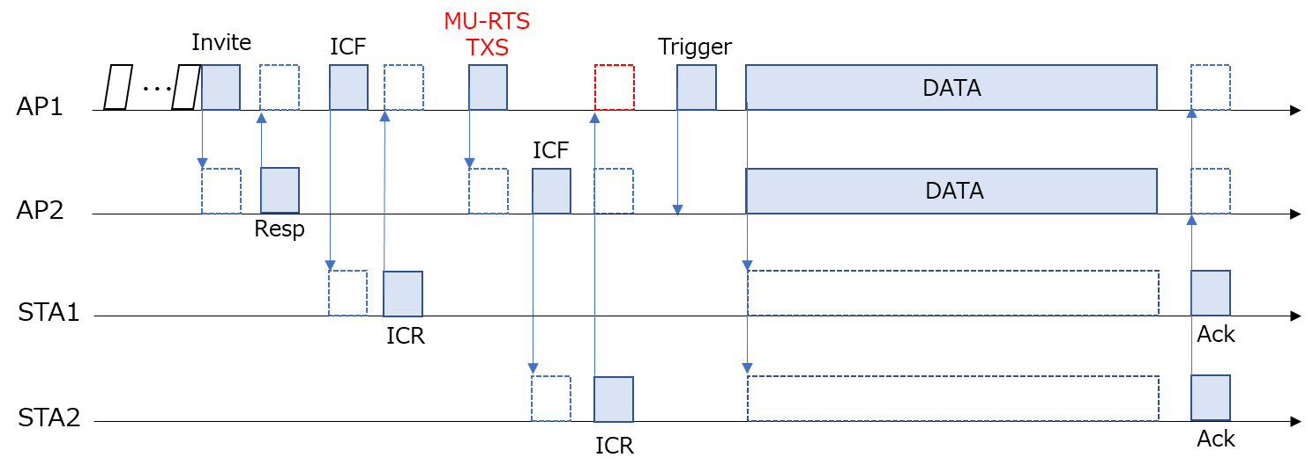
Proposed Frame Sequence (Option.2)
The sequence combining Proposal 1 and Proposal 2b is as follows.
  If no ICR from STA2 is detected, the coordinating AP does not send Trigger frame and starts data transmission independently.
  Compared to the previous option, the number of frame exchange is reduced, but reliability is compromised.

Slide 10
Summary
In this contribution, we proposed the detailed protocol sequence for Co-SR/Co-BF specifically designed for EMLSR STA.
  We propose to allow the coordinating AP to share time resource with the coordinated AP specifically for ICF/ICR exchange by utilizing a Coordinated TDMA mechanism.
  To ensure successful ICF/ICR exchange, we propose two methods:
    The coordinating AP requests the coordinated AP to send a MAPC TXOP return frame when it successfully receives an ICR from the STA.
    The coordinating AP be allowed to overhear the transmission to confirm whether the ICR is being correctly sent by the STA.

Slide 11
References
[1] 2025/0766r0, “PDT MAC and CR Coordinated Spatial Reuse Protocol,” Jason Yuchen Guo (Huawei)
[2] 2025/0768r0, “PDT MAC and CR Coordinated Beamforming Protocol,” Jason Yuchen Guo (Huawei)
[3] 2025/0879r0, “CoBF Signaling Details,” Sherief Helwa (Qualcomm)
[4] 2024/2124r2, “Frame-Sequence-for-CSR-and-CBF,” Jason Yuchen Guo (Huawei)
[5] 2025/0574r5, “CoBF Sequence Optimization,” Avner Epstein (Maxlinear)

Slide 12
SP #1
Do you agree to add the following in SFD?
The Co-BF/SR coordinating AP may use the Coordinated TDMA mechanism to transmit MU-RTS TXS Trigger frame and share time with the coordinated AP only for ICF/ICR exchange.

Slide 13
SP #2
Do you agree to add the following in SFD?
When the coordinating AP does not receive MAPC TXOP return frame from the coordinated AP within the time allocated only for the exchange of ICF/ICR, it may terminate the Co-SR/Co-BF procedure by not sending the Trigger frame to initiate the coordinated transmission.

Slide 14
SP #3
Do you agree to add the following in SFD?
The coordinating AP may try to detect ICR frame from OBSS STA.
When the coordinating AP cannot detect the ICR frame, it may terminate the Co-SR/Co-BF procedure by not sending the Trigger frame to initiate the coordinated transmission.

