Slide 1
Sequential Ack Procedure of Co-SR
Date: 2025-06-08
Authors:
Name | Affiliations | Address | Phone | Email
Yurong Qian | ZTE |  |  | qian.yurong@zte.com.cn
Jay Yang
Yan Li
Zisheng Wang
Yun Li
Qisheng Huang
Bo Cao
Chun Huang
Bo Sun | Sanechips
Shuang Fan

Slide 2
Introduction
Several contributions have investigated the Ack procedures in Coordinated Spatial Reuse (Co-SR), which can be categorized into two types:
Concurrent Ack [1]-[3],
Sequential Ack [1]-[4].
In this contribution, we present our insights into sequential Ack procedure of Co-SR.

Slide 3
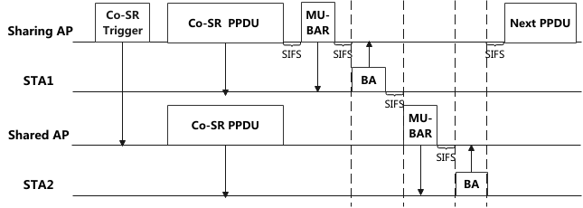
Recap of Sequential Ack Procedure
The Ack procedures for the sharing AP and the shared AP are executed sequentially to ensure orderly reception and minimize interference.
Each AP explicitly indicates the duration of its MU-BAR/BA exchange to its peer AP, thereby enabling both APs to determine the appropriate timing for initiating their subsequent transmissions — such as the next PPDU by the sharing AP or Ack frame solicitation by the shared AP.

Slide 4
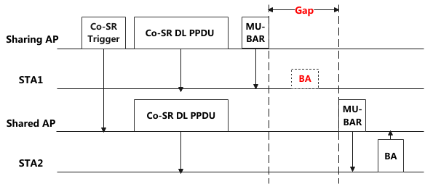
Problem of Sequential Ack Procedure of Co-SR
However, the sequential Ack procedure has limited robustness in transmission failure scenarios.
When a STA fails to receive the preceding PPDU from its associated AP, it does not transmit the BA frame, resulting in a gap corresponding to the predefined BA duration.
This increases collision probability within the medium, as third-party STAs with improperly set NAV may contend for channel access during this gap.

Slide 5
Robust sequential Ack procedure (1)
To enhance the robustness of the sequential Ack procedure, each AP should transmit an Ack indication to its peer AP immediately following the BA exchange.
Consequently, the receiving AP can start its subsequent frame transmission.
Mode 1: The MU-BAR/BA transmission is initiated first by the sharing AP, followed sequentially by the shared AP.
Upon completing its MU-BAR/BA exchange, the sharing AP transmits a trigger indication to the shared AP, initiating the shared AP's MU-BAR/BA transmission.
Following completion of its MU-BAR/BA exchange, the shared AP transmits an explicit Ack indication to the sharing AP, thereby signaling the end of the Co-SR transmission.

Slide 6
Robust sequential Ack procedure (2)
Mode 1: The MU-BAR/BA transmission is initiated first by the sharing AP, followed sequentially by the shared AP.
The Co-BA Trigger frame and Co-BA Confirm frame convey the Ack reception indications for the sharing AP and shared AP, respectively.
The specific frame formats remain TBD.

Slide 7
Robust sequential Ack procedure (3)
Mode 2 (Preferred): The shared AP initiates the MU-BAR/BA transmission immediately following the Co-SR PPDU, earlier than the sharing AP..
Compared to Mode 1, Mode 2 reduces signaling overhead through elimination of the Co-BA Trigger frame while maintaining the sharing AP's TXOP control.
The specific frame formats remain TBD.

Slide 8
Robust sequential Ack procedure (4)
The sequential Ack mode must be determined prior to Co-SR PPDU transmission.
Option 1: APs may negotiate the sequential Ack mode during the MAPC negotiation phase; both APs then follow this mode for all subsequent Co-SR transmissions.
Option 2: The sharing AP explicitly notifies the shared AP of the selected sequential Ack mode through the Co-SR Trigger frame or ICF frame immediately preceding each transmission phase.

Slide 9
Summary
This contribution proposes a robust sequential Ack procedure for Co-SR, which introduces an inter-AP indication signaling the completion of the MU-BAR/BA exchange.
Based on the sequence of the BA exchange, two operational modes are introduced.
Mode 1: Sharing AP initiates BA exchange first
Mode 2: Shared AP initiates BA exchange first, which has lower signaling overhead.
The negotiation mechanism for these modes is established.
Pre-coordination during MAPC phase, or
Dynamic per-transmission notification via Co-SR Trigger/ICF frames

Slide 10
THANK YOU

Slide 11
Reference
[1] 20/0590r5, “Coordinated Spatial Reuse: Focus on Downlink”
[2] 24/2060r0, “CSR/COBF Protocol Design”
[3] 25/0690r0, “Thoughts on Ack Policy in MAP Co-transmission”
[4] 25/0189r2, “Elicitation of Response Transmissions in Coordinated Spatial Reuse”

