Slide 1
Sequential Ack Procedure of Co-SR
Date: 2025-06-08
Authors:
Name | Affiliations | Address | Phone | Email
Yurong Qian | ZTE |  |  | qian.yurong@zte.com.cn
Jay Yang
Yan Li
Zisheng Wang
Yun Li
Qisheng Huang
Bo Cao
Chun Huang
Bo Sun | Sanechips
Shuang Fan

Slide 2
Introduction
Several contributions have investigated the Ack procedures in Coordinated Spatial Reuse (Co-SR), which can be categorized into two types:
Concurrent Ack [1]-[3],
Sequential Ack [1]-[4].
In this contribution, we present our insights into sequential Ack procedure of Co-SR.

Slide 3
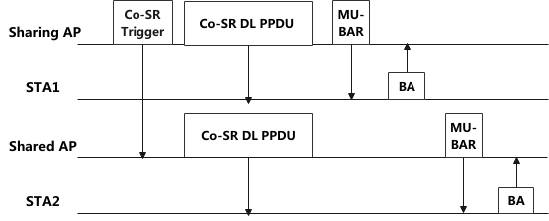
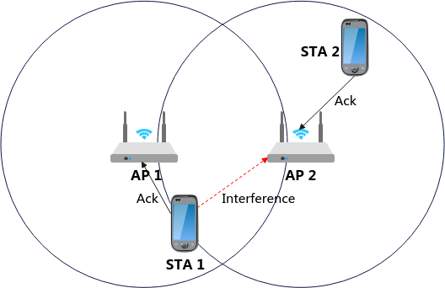
Recap of Sequential Ack Procedure
The Ack procedures for the sharing AP and the shared AP are executed sequentially to ensure orderly reception and minimize interference.
While Co-SR enables concurrent multi-AP transmissions through transmit power control, STA’s transmit power during Ack frame transmission remains uncontrolled.
It can be applied to scenarios where concurrent Ack frames are at high risk of interference.

Slide 4
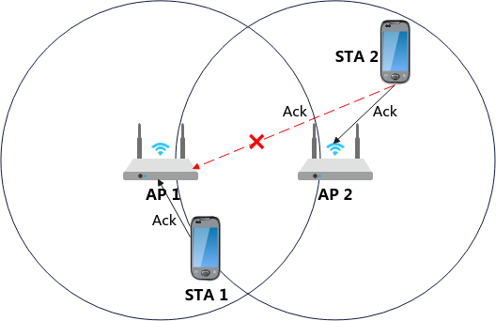
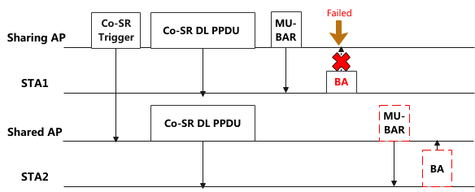
Problem of Sequential Ack Procedure of Co-SR
An AP may fail to overhear the Ack frame transmitted by a STA associated with another AP, due to interference or physical location constraints.
This issue arises particularly when a STA fails to transmit an Ack frame.
Without successful overhearing of frame exchanges at other APs, the AP cannot determine appropriate timing for initiating subsequent transmissions—such as new transmissions by the sharing AP or Ack frame solicitation by the shared AP.

Slide 5
Robust sequential Ack procedure (1)
After receiving Ack frame during a Co-SR transmission, participating AP shall transmit an acknowledgment reception indication to the other participating AP.
Then, the receiving AP can start its subsequent frame transmission.
The frame for carring the reception indication of Ack frame is TBD.
Mode 1: Ack frame transmission is first initiated by the sharing AP, followed by the shared AP.
After receiving the Ack frame from its associated STA, the sharing AP transmits an indication to the shared AP, triggering it to initiate Ack frame transmission.
Following successful reception of the Ack frame from its associated STA, the shared AP transmits an indication to the sharing AP.

Slide 6
Robust sequential Ack procedure (2)
Mode 1: Ack frame transmission is first initiated by the sharing AP, followed by the shared AP.
The Co-BA Trigger frame and Co-BA Confirm frame carry the Ack reception indication of sharing AP and shared AP, respectively, and the specific frame formats are TBD.

Slide 7
Robust sequential Ack procedure (3)
Mode 2 (Preferred): The shared AP initiates the Ack frame transmission immediately following the Co-SR PPDU, earlier than the sharing AP.
Compared to Mode 1, Mode 2 reduces signaling overhead by eliminating the Co-BA Trigger frame, while ensuring the sharing AP's control over the TXOP.

Slide 8
Robust sequential Ack procedure (4)
The sequential Ack mode must be determined before transmitting the Co-SR PPDU.
Option 1: APs may negotiate the sequential Ack mode during the MAPC negotiation phase; both APs then follow this mode in subsequent Co-SR transmissions.
Option 2: The sharing AP notifies the shared AP of the selected sequential Ack mode via the Co-SR Trigger frame or ICF frame preceding each Co-SR transmission phase.

Slide 9
Summary
This contribution proposes a robust sequential Ack procedure for Co-SR to address overhearing limitations.
Mode 1: The sharing AP performs the Ack frame exchange immediately following the Co-SR data frame transmission and, upon completion, it triggers the shared AP to initiate its own Ack frame exchange. After receivng Ack frame, the shared AP subsequently notifies the sharing AP.
Mode 2: The shared AP initiates Ack frame exchange immediately after Co-SR data frame transmission and subsequently notifies the sharing AP upon completion.

Slide 10
THANK YOU

Slide 11
Reference
[1] 20/0590r5, “Coordinated Spatial Reuse: Focus on Downlink”
[2] 24/2060r0, “CSR/COBF Protocol Design”
[3] 25/0690r0, “Thoughts on Ack Policy in MAP Co-transmission”
[4] 25/0189r2, “Elicitation of Response Transmissions in Coordinated Spatial Reuse”

