Slide 1
Sequential Ack Procedure of Co-SR
Date: 2025-06-08
Authors:
Name | Affiliations | Address | Phone | Email
Yurong Qian | ZTE |  |  | qian.yurong@zte.com.cn
Jay Yang
Yan Li
Zisheng Wang
Yun Li
Qisheng Huang
Bo Cao
Chun Huang
Bo Sun | Sanechips
Shuang Fan

Slide 2
Introduce
Several contributions have investigated the Ack procedures in Coordinated Spatial Reuse (Co-SR), which can be categorized into two types:
Concurrent Ack [1]-[3],
Sequential Ack [1]-[4].
In this contribution, we present our insights into sequential ack procedure of Co-SR.

Slide 3
Recap of Concurrent Ack Procedure
The Ack frames for coordinated APs can be transmitted simultaneously over the same bandwidth as the Co-SR PPDU [2].
Ack frames are typically transmitted using low MCS levels, they exhibit a higher tolerance to interference.
The Ack frames for coordinated APs can be transmitted simultaneously over different sub-channels [1].
To avoid interference among ACK frames, non-overlapping frequency resources may be allocated to different STAs for their Ack frames.

Slide 4
Recap of Sequential Ack Procedure
The Ack frames for the sharing AP and the shared AP are transmitted in a sequential manner to ensure orderly reception and minimize interference.
It can be applied to scenarios where Ack frames are at high risk of interference.
The sharing AP may indicate that the Ack policy for the shared AP is "Delayed Ack".

Slide 5
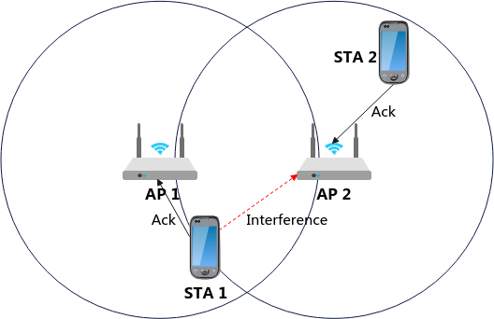
Problem of Sequential Ack Procedure of Co-SR
The participating APs may lack awareness of the timing at which each other completes transmission confirmation.
APs may be unable to receive Ack frames transmitted by STA associated with the other AP, like the AP1 can’t receive the Ack frame transmitted by STA2.
As the TXOP holder, the sharing AP may transmit another frames following the Co-SR transmission, the absence of knowledge regarding the shared AP's Ack reception status impedes it to determine the start time for these subsequent transmissions.
The shared AP also requires knowledge of the sharing AP's Ack reception status to initiate its own transmission confirmation procedure.
In particular, when any AP fails to receive the Ack frame and transmits a BAR frame to solicit retransmission of the Ack.

Slide 6
Robust sequential Ack procedure (1)
After completing transmission confirmation, AP can transmit an indication to the cooperating AP.
Then, the cooperating AP can start its subsequent frame transmission, for instance, a new transmission (either non-Co-SR or Co-SR) or the solicitation of an Ack frame.
The frame for carring the reception indication of Ack frame is TBD.
Mode 1: Ack frame transmission is first initiated by the sharing AP, followed by the shared AP.
After receive the Ack frame from its associated STA, the sharing AP send an indication to the shared AP, triggerring it to initiate the Ack frame transmission.
Following reception of the Acknowledgement (Ack) frame from its associated STA, the shared AP transmits an indication to the sharing AP.

Slide 7
Rubost sequential Ack procedure (2)
Mode 1: Ack frame transmission is first initiated by the sharing AP, followed by the shared AP.
The Co-BA Trigger frame and Co-BA Confirm frame carry the Ack reception indiaction of sharing AP and shared AP, respectively, and the specific frame formats are TBD.

Slide 8
Robust sequential Ack procedure (3)
Mode 2: The shared AP initiates the Ack frame transmission prior to the sharing AP.
Compared to Mode 1, it reduces signaling overhead by omitting the Co-BA Trigger frame, while accelerating transmission confirmation for the shared AP.

Slide 9
Summary
The contribution proposes a robust sequential Ack procedure of Co-SR.
Mode 1: The sharing AP performs the Ack frame exchange immediately following the Co-SR data frame transmission and, upon completion, triggers the shared AP to initiate its own Ack frame exchange. After receivng its Ack frame, the shared AP subsequently notifies the sharing AP.
Mode 2: The shared AP initiates the Ack frame exchange immediately after the Co-SR data frame transmission and subsequently notifies the sharing AP upon successful completion.

Slide 10
THANK YOU

Slide 11
Reference
[1] 20/0590r5, “Coordinated Spatial Reuse: Focus on Downlink”
[2] 24/2060r0, “CSR/COBF Protocol Design”
[3] 25/0690r0, “Thoughts on Ack Policy in MAP Co-transmission”
[4] 25/0189r2, “Elicitation of Response Transmissions in Coordinated Spatial Reuse”

