Slide 1
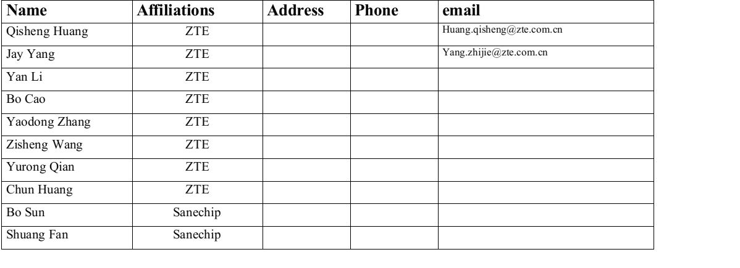
Overlapping Bandwidth Sounding for Coordinated Beamforming-follow up

Slide 2
Recap of 802.11bn Draft 0.1

Slide 3
Observation on Bandwidth Mismatch
Practical Bandwidth Mismatches:
In real-world deployments, it is rare for APs and STAs to have exactly matching bandwidths. Cases where BW_STA1≠BW_STA2 exist, making the current protocol inefficient for broader application.
Lack of Protocol Design for Such Cases:
The current protocol does not define a negotiation mechanism to form a beamforming group when bandwidth mismatches exist among APs and STAs.
Seek for Improving UHR Sounding efficiency
The feedback data volume for both STAs in Co-BF is large. However, since Co-BF only occurs in the overlapping frequency bands, leveraging this fact can help reduce feedback overhead.

Slide 4
Motivation
Main idea:
Pre-Sounding Frame Exchange for Bandwidth: Before starting the Sounding measurement , invite/response frame exchange process is utilized to identify the bandwidth where next Co-BF occurs.

Slide 5
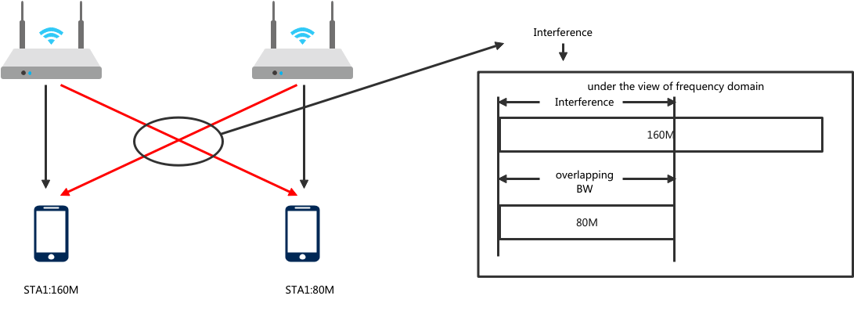
Overlapping Bandwidth and Interference Mitiagation
Co-BF happens on overlapping bandwidth.
where Co-BF deals with cross-bss interference through beam nulling .

Slide 6
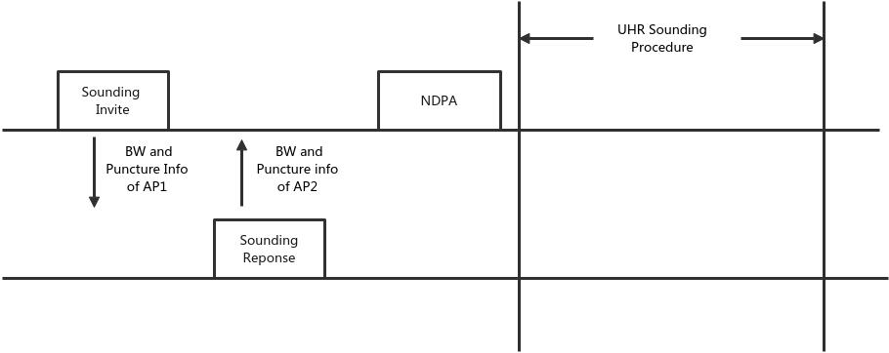
Indication of BW in Sounding Invite/Response
Exchanging BW and Punctured Channel Infomation in invite and response frame:
Same defination with the fields in UHR NDPA.
The final BW will be announced by NDPA

Slide 7
Summary
Considering the Practical Bandwidth Mismatches in deployment.
Therefore try to handle it with a unified scheme.
Before starting the Sounding measurement in Co-BF, an additional frame exchange process is introduced to identify the bandwidth.
In the following Co-BF process, Co-BF is applied only to the bandwidth segments where Co-BF is performed, improving efficiency and reducing computational overhead.
Similar design with what invite/respone indicates in Co-SR and Co-BF transmission.

Slide 8
SP-1
Do you agree to include overlapping bandwidth sounding in 11bn?
The relevant indications and frame exachanges are TBD..

Slide 9
SP-2
Do you agree to include bandwidth negotiation in UHR sounding procedure?
The bandwidth could be negotiated through exchange of invite/response frames before the transmission of UHR NDPA.
The sounding bandwidth announced by UHR NDPA might be less than the operating bandwidth of the UHR beamformee.

Slide 10
THANK YOU ☺

Slide 11
Reference
[1]802.11bn PAR

