Slide 1
Overlapping Bandwidth Sounding for Coordinated Beamforming-follow up

Slide 2
Recap of 802.11bn Draft 0.1

Slide 3
Observation on Bandwidth Mismatch
Practical Bandwidth Mismatches:
In real-world deployments, it is rare for APs and STAs to have exactly matching bandwidths. Cases where BW_STA1≠BW_STA2 exist, making the current protocol inefficient for broader application.
Lack of Protocol Design for Such Cases:
The current protocol does not define a negotiation mechanism to form a beamforming group when bandwidth mismatches exist among APs and STAs.
Seek for Improving UHR Sounding efficiency
The feedback data volume for both STAs in Co-BF is large. However, since Co-BF only occurs in the overlapping frequency bands, leveraging this fact can help reduce feedback overhead.

Slide 4
Motivation
Main idea:
Pre-Sounding Frame Exchange for Bandwidth: Before starting the Sounding measurement , invite/response frame exchange process is utilized to identify the bandwidth where next Co-BF occurs.

Slide 5
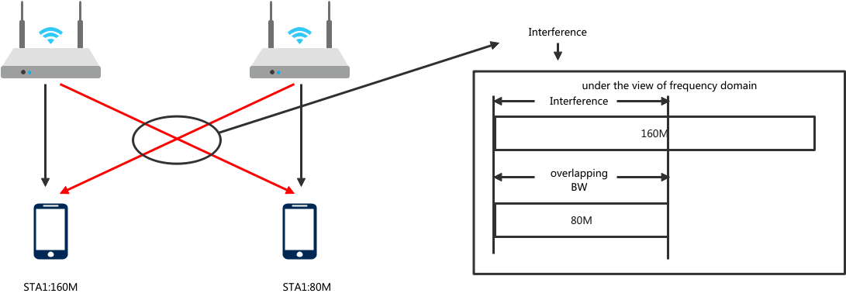
Overlapping Bandwidth and Interference Mitiagation
Co-BF happens on overlapping bandwidth.
where Co-BF deals with cross-bss interference through beam nulling .

Slide 6
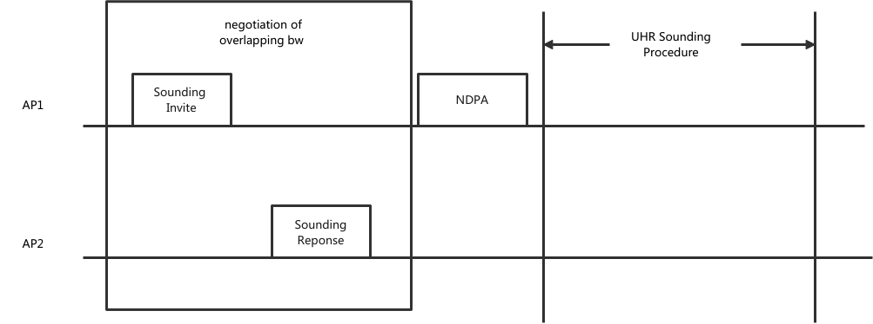
Bandwidth Negotiation for UHR Sounding
Bandwidth Exchange and Sounding within a TXOP:
Within a single TXOP during each sounding process, the initiating AP and responding AP exchange information about the bandwidth at the begining. Then, the sounding is triggered using NDPA according to the negotiation results.

Slide 7
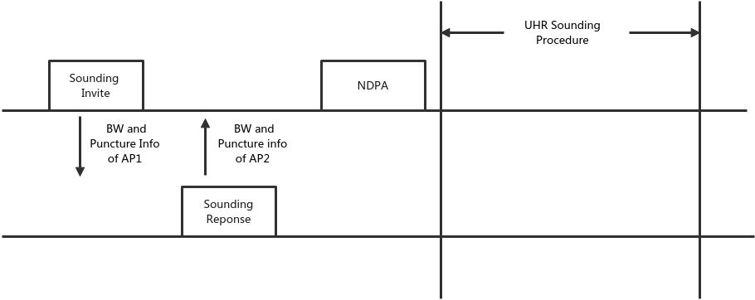
Indication of BW in Sounding Invite/Response
Adding BW and Punctured Channel Infomation in invite and response:
Same defination with the fields in UHR NDPA.
The final overlapping BW will be announced by NDPA

Slide 8
Summary
Considering the Practical Bandwidth Mismatches in deployment.
Therefore try to handle it with a unified scheme.
Before starting the Sounding measurement in Co-BF, an additional frame exchange process is introduced to identify the bandwidth.
In the following Co-BF process, Co-BF is applied only to the bandwidth segments where Co-BF is performed, improving efficiency and reducing computational overhead.
Similar design with what invite/respone indicates in Co-SR and Co-BF transmission.

Slide 9
SP-1
Do you agree to include overlapping bandwidth sounding in 11bn?
The relevant indications and frame exachanges are TBD..

Slide 10
SP-2
Do you agree to include bandwidth negotiation in UHR sounding procedure?
The bandwidth could be negotiated through exchange of invite/response frames before the transmission of UHR NDPA.
The sounding bandwidth announced by UHR NDPA might be less than the operating bandwidth of the UHR beamformee.

Slide 11
THANK YOU ☺

Slide 12
Reference
[1]802.11bn PAR

