Slide 1
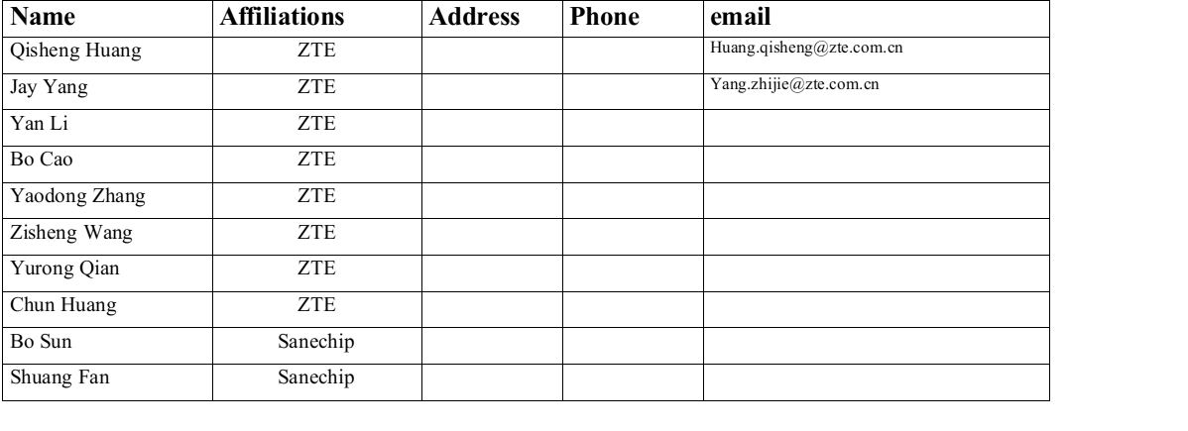
Overlapping Bandwidth Sounding for Coordinated Beamforming-follow up

Slide 2
Recap of 802.11bn Draft 0.1

Slide 3
Observation on Bandwidth Mismatch
Practical Bandwidth Mismatches:
In real-world deployments, it is rare for APs and STAs to have exactly matching bandwidths. Cases where BW_AP1≠BW_AP2 or BW_STA1≠BW_STA2 are more common, making the current protocol inefficient for broader application.
Lack of Protocol Design for Such Cases:
The current protocol does not define a negotiation mechanism to form a beamforming group when bandwidth mismatches exist among APs and STAs.
Seek for Reducing Feedback Overhead in UHR Sounding
The feedback data volume for both STAs in Co-BF is large. However, since interference only occurs in the overlapping frequency bands, leveraging this fact can help reduce feedback overhead.

Slide 4
Consideration
Main Purpose: Find a way to realize Co-BF with minimum feedback overhead
Beamforming is at subcarrier level
Beamforming is performed at the granularity of subcarriers
The primary objective of coordinated beamforming is to mitigate interference between APs during simultaneous downlink transmissions.
Interference Identification for Effective Beamforming
To ensure the minimum required effectiveness of coordinated beamforming for interference suppression, it is sufficient to identify only the subcarriers where interference occurs.
Reduced Feedback Overhead in Sounding Stage
This approach significantly reduces the feedback overhead during the sounding phase by focusing only on the interfering subcarriers instead of the entire bandwidth.

Slide 5
Motivation
Main idea:
Pre-Sounding Frame Exchange for Overlapping(Partial) Bandwidth: Before starting the Sounding measurement in Co-BF, invite/response frame exchange process is utilized to identify the bandwidth where interference occurs.
Might Co-BF Only on Overlapping Interfering Bandwidth: In the following Co-BF process, Co-BF is applied only to the overlapping bandwidth segments where interference is detected, improving efficiency and reducing computational overhead.

Slide 6
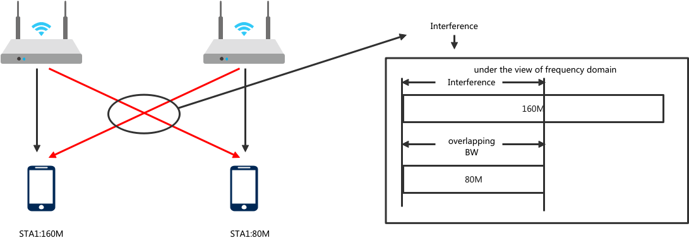
Overlapping Bandwidth and Interference Mitiagation
Interference of Co-Tx mainly happens on overlapping bandwidth.
where Co-BF deals with it through based band beam nulling .

Slide 7
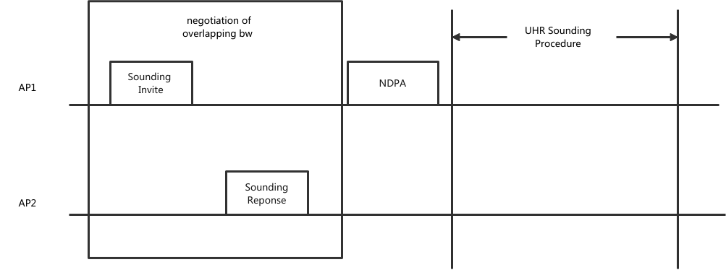
Overlapping Bandwidth Sounding
Bandwidth Exchange and Sounding within a TXOP:
Within a single TXOP during each sounding process, the initiating AP and responding AP exchange information about the overlapping bandwidth at the begining. Then, the sounding for the overlapping bandwidth is triggered using NDPA according to the negotiation results.

Slide 8
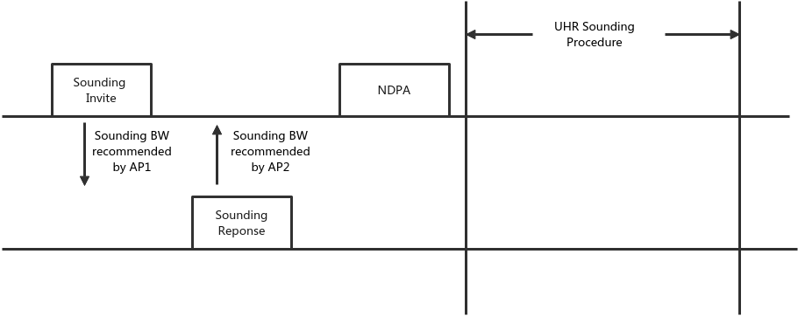
Indication of BW in Sounding Invite/Response
Adding BW and Punctured Channel Info in invite and response:
Same defination with the fields in UHR NDPA.
The final overlapping BW will be announced by NDPA

Slide 9
Summary
Considering the Practical Bandwidth Mismatches in deployment .
Therefore try to find a way to realize Co-BF with minimum feedback overhead
Before starting the Sounding measurement in Co-BF, an additional frame exchange process is introduced to identify the bandwidth where interference occurs.
In the following Co-BF process, Co-BF is applied only to the overlapping bandwidth segments where interference is detected, improving efficiency and reducing computational overhead.

Slide 10
SP-1
Do you agree to include overlapping bandwidth sounding in 11bn?
The relevant indications and frame exachanges are TBD..

Slide 11
SP-2
Do you agree to include overlapping bandwidth sounding in 11bn?
The overlapping bandwidth could be negotiated through exchange of invite/response frames before the transmission of UHR NDPA.
The sounding bandwidth announced by UHR NDPA might be less than the operating bandwidth of the UHR beamformee.

Slide 12
THANK YOU ☺

Slide 13
Reference
[1]802.11bn PAR

