Slide 1
CoSR and CoBF follow up

Slide 2
Background
Known from the following passed motion, the AP decides which associated STA to participate the CoBF and CoSR operation.
  M#327,M#328,M#311
    Co-BF Invite frame includes the Per-User Info in Sharing BSS
    Co-BF Response frame includes the Per-User Info in Shared BSS
    Co-BF Sync frame includes the Per-User Info in Both BSS
How AP to select the candidate associated STAs?
    Based on the associated STA’s QoS information, like SCS, QoS characteristic
    Randomly select some associated STAs

Slide 3
Proposal
Due to the asymmetric view issue, the channel condition between STA and its association AP may be quite different.
  The AP may not detect the hidden node near to its associated STA.
  Some STAs may be hard to decode the PPDU with a low SNR due to either the constraint TX power of the received PPDU controlled by sharing AP in Co-SR or the interference from hidden node.
We propose to define a procedure to allow STA to recommend itself to enroll in the CoSR, CoBF scheme or not via some signaling exchange, to make the implementation make flexible.
  The STA is unaware of the CoBF and CoSR operation between its associated AP and neighbor AP until UHR sounding or CoSR transmission happened.
  Before that, AP should provide the MAPC negotiation information to its associated STAs.

Slide 4
The proposed procedure with recommendation functionality in CoSR,CoBF
1) MAPC discovery & MAPC negotiation
2) AP provides the negotiated CoSR, CoBF along with the peer AP’s information to its associated STAs via a TBD signaling.
3) Optional Measurement to obtain RSSI information between STA and OBSS AP
  Reuse some exist protocol, like RTS/CTS, probe request/response etc.
4) Recommend itself to enroll in CoSR and/or CoBF procedure or not based on its associated AP’s negotiated MAPC information
  Reuse the exist protocol with some extension, like Beacon report.
5) The AP may schedule the self recommended STA in CoSR and/or CoBF procedure.
6) The AP synchronize to the associated STA if the CoSR,CoBF agreement is updated.
  E.g. new agreement set up or agreement tore down.

Slide 5
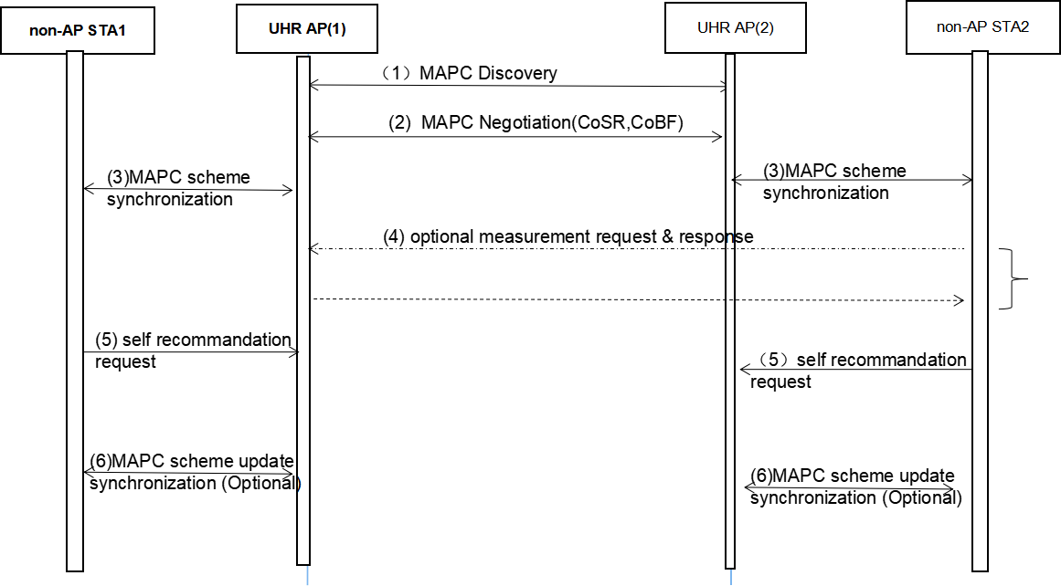
The following figure depicts an example that the STA recommends itself to enroll in the CoSR, CoBF procedure

Slide 6
Summary
To make the implementation more flexible and certainly level agreement in CoBF and CoSR, we propose to define a STA self recommendation procedure with following additional signaling exchange.
  The AP shall provide CoBF, CoSR negotiation information(including the agreement set-up, update, etc.) to the STA.
  The STA optionally sperform some measurement with the target OBSS AP
  The STA self recommend to enroll in a certain CoBF, CoSR procedure or not.

Slide 7
THANK YOU ☺

Slide 8
Reference
802.11bn draft0.2
24/209r15 TGbn Specification Framework for TGbn

Slide 9
SP1
Do you agree to define a preparation phase for CoBF and CoSR including the following signaling exchange:
  The AP shall provide CoBF, CoSR negotiation information(including the agreement set-up, update, etc.) to the STA.
  The STA optionally perform some measurement with the target OBSS AP
  The STA self recommend to enroll in a certain CoBF, CoSR procedure or not.

