Slide 1
Channel Recommendation for P2P Communcations
Date: 2025-09-10
Authors:
Name | Affiliations | Address | Phone | Email
Chun Huang | ZTE |  |  | huang.chun2@zte.com.cn
Jay Yang
Bo Cao
Yurong Qian
Zisheng Wang
Yun Li
Yan Li
Qisheng Huang

Slide 2
Introduction
In 802.11bn, there are several potential technologies for enhancing Peer-to-Peer (P2P) communications[1][2].
  TXOP sharing for multiple P2P non-AP STAs
  Coordinated channel recommendation (Co-CR)
In this contribution, we present our insights on channel recommendation for P2P communications.

Slide 3
Recap: EHT channel usage
Enhanced coexistence with infrastructure BSS
  The AP provides Channel Usage information to non-AP STAs to assist their operation in a non-infrastructure network or off-channel TDLS link and help them better coexist with the infrastructure BSS.
  The Channel Usage information provided by the AP to the non-AP STA is to advise the STA on how to coexist with the infrastructure network.
Channel Usage Information
  An AP may also include one or more Channel Usage elements in Beacon frames and (Re)Association Response frames. Such elements may provide partial channel usage information and/or may not be individualized for the recipient’s traffic.
  STA can exchange Channel Usage Request and Channel Usage Response frames with an AP of the channel-usage-aiding BSS set or or receiving an unsolicited Channel Usage Response frame from the AP.
  The AP may send an unsolicited group addressed or individually addressed Channel Usage Response frame to the STAs that have requested channel usage information if the corresponding channel usage information needs to be updated.

Slide 4
Motivation
When assisting with P2P management, the AP lacks necessary group information.
The AP should provide enough incentives for the P2P STAs to use those designated channel resources for their P2P transmission.
  If the AP directs all P2P communications to the same channel, interference will occur between the P2P transmissions.
  If STA1 and STA2 belong to the same P2P communication group (TDLS or WiFi Direct), an invalid recommendation would occur if the AP recommends them to operate on different channels.
If an AP decides to share a portion of its obtained TXOP with a P2P group, it tends to assign P2P STAs that intend to communicate with each other to the same group—that is, those P2P STAs that have already established group communication.
  If an AP shares the same TXOP duration with STAs from different P2P groups, competition between these STAs are more likely to be triggered.

Slide 5
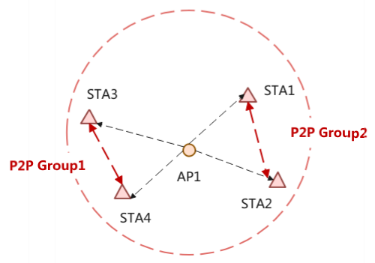
The problem statement for legency Channel Recommendation
Duplicate or Conflicting Channel Recommendations
Suppose STA1 and STA2 associated with the AP belong to the same P2P (Peer-to-Peer) group, P2P Group 1, but the AP is unaware of this.
In this case, the AP may perform duplicate channel recommendation operations for STA1 and STA2, or recommend conflicting channels for them.
Suppose that STA3, which is associated with the AP, belongs to P2P Group 2. If the AP recommends the same off-channel or same time window for both Group 2 and Group 1, communication within Group 2 and Group 1 may suffer from significant interference.

Slide 6
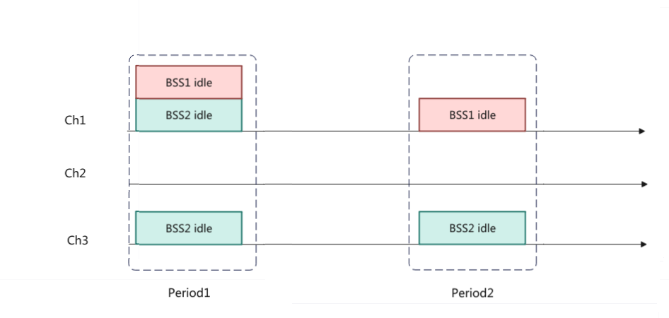
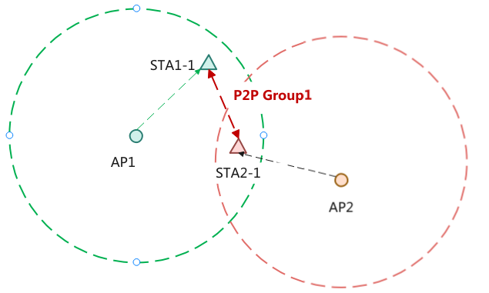
The problem statement for Co-CR
Conflicting recommendations
  If P2P Group1 contains STAs associated with both AP1 and AP2, and the two APs independently provide channel recommendations without awareness of shared group membership, they may assign inconsistent channels and time windows to the STAs.

Slide 7
The Proposal of Channel Recommendation
AP should be aware of some P2P communication details of P2P Non-AP STAs
Non-AP STA notifies AP of its P2P communications details, including P2P Group ID (Group Address), TID, Queue Size, etc.
The Group ID (e.g., the P2P Group ID of WiFi Direct) is used to identify the P2P Group.
TID is used to represent the traffic priority of P2P communications.
Queue Size for P2P communications.
Channel Recommendation Considerations by the AP
  Consistency of Recommendations for Same-Group STAs
    the AP shall recommend the same channel and time window for STAs within the same P2P group to maintain consistency.
  Identification and Differentiated Recommendations for Different Group Devices
    If STAs from different P2P groups request channel recommendations, the AP may differentiate its recommendations.

Slide 8
The Proposal of Co-CR
When AP1 and AP2 coordinate channel recommendations, the information to be exchanged includes
The P2P Group ID associated with the AP.
Through the exchange of Group IDs, an AP can identify whether a P2P group includes STAs associated with multiple APs.
If STA associated with both AP1 and AP2 are included within P2P Group 2, and assuming that, under the same conditions, there are channels and time windows where both BSS1 and BSS2 are idle, as well as channels where only BSS2 is idle, AP should prioritize recommending the channel where both BSS1 and BSS2 are idle to P2P Group2.

Slide 9
Summary
A non-AP STA shall notify its associated AP of the details regarding its P2P communications.
The AP shall recommend the same channel for STAs within the same P2P group.

Slide 10
Straw Poll
Do you agree to introduce an optional mechanism for a P2P STA to report its P2P Group Information (e.g., the P2P Group ID of WiFi Direct) to the AP, to assist in TXOP sharing and channel recommendation?

Slide 11
THANK YOU ☺

Slide 12
Reference
[1] 25/764r1 Peer-to-Perr (P2P) PDT
[2] 802.11 Draft0.2
[3] 24/393r3 Enhancements for Off-Channel Peer-to-peer (P2P) Communications

