Slide 1
Channel Recommendation for P2P Communcations
Date: 2025-06-04
Authors:
Name | Affiliations | Address | Phone | Email
Chun Huang | ZTE |  |  | huang.chun2@zte.com.cn
Jay Yang
Bo Cao
Yurong Qian
Zisheng Wang
Qisheng Huang

Slide 2
Introduction
In 802.11bn, there are several potential technologies for enhancing Peer-to-Peer (P2P) communications.
  TXOP sharing for multiple P2P non-AP STAs
  Coordinated channel recommendation (Co-CR)
In this contribution, we present our insights on channel recommendation for P2P communications.

Slide 3
Recap: EHT channel usage
Enhanced coexistence with other BSSs
  The AP provides Channel Usage information to non-AP STAs to assist their operation in a non-infrastructure network or off-channel TDLS link and help them better coexist with the infrastructure BSS.
  The Channel Usage information provided by the AP to the non-AP STA is to advise the STA on how to coexist with the infrastructure network.
Channel switch request and Capability notification
  A STA can send a Channel Usage Request frame to its associated AP to request a channel switch.
  A STA can inform its associated AP of its channel usage capability via Channel Usage Request/Response exchange.

Slide 4
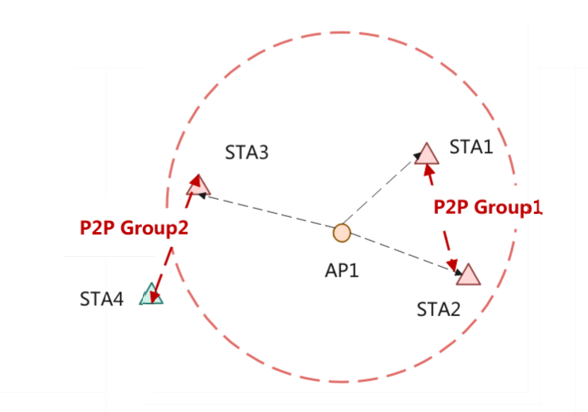
The problem statement for Channel Recommendation
Duplicate or Conflicting Channel Recommendations
Suppose STA1 and STA2 associated with the AP belong to the same P2P (Peer-to-Peer) group, P2P Group 1, but the AP is unaware of this.
In this case, the AP may perform duplicate channel recommendation operations for STA1 and STA2, or recommend conflicting channels for them.
Suppose that STA3, which is associated with the AP, belongs to P2P Group 2. If the AP recommends the same off-channel for both Group 2 and Group 1, communication within Group 2 and Group 1 may suffer from significant interference.

Slide 5
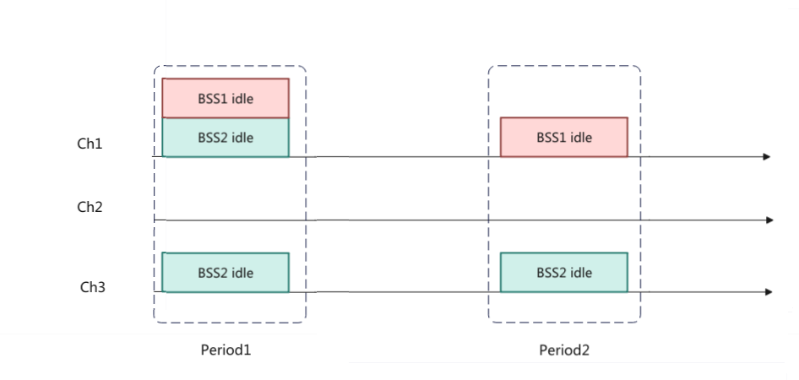
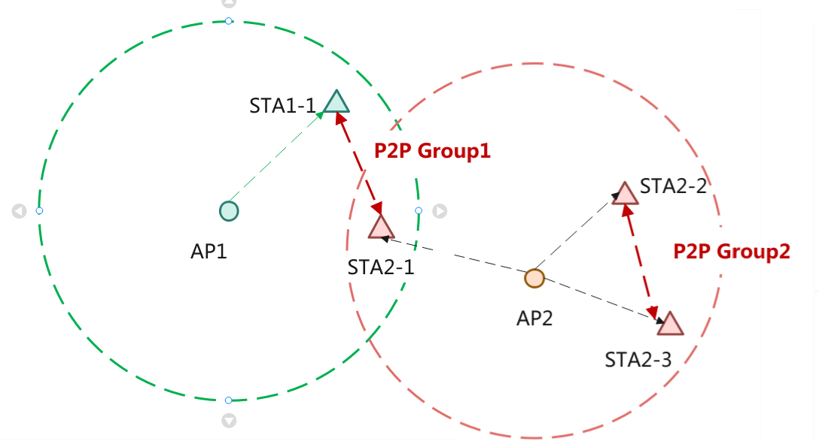
The problem statement for Co-CR
Conflicting recommendations
  If P2P Group1 contains STAs associated with both AP1 and AP2, and the two APs independently provide channel recommendations without awareness of shared group membership, they may assign inconsistent channels and time windows to the STAs.
AP2 shall handle two scenarios when recommending channels:
  Scenario 1: P2P Group1 requires a channel where both AP1 and AP2 are simultaneously free.
  Scenario 2: P2P Group2, associated only with AP2, can use a channel (ch3) where only AP2 is free.

Slide 6
The Proposal of Channel Recommendation
AP should be aware of some P2P communication details of P2P Non-AP STAs
Non-AP STA notifies AP of its P2P communications details, including P2P Group ID (Group Address), TID, Queue Size, etc.
The Group ID is used to uniquely identify the P2P Group.
  For Wi-Fi Direct networks, when a P2P Group is established, the Group ID is created and generated by the Group Owner.
  For TDLS communication, the Group ID can be specified by the TDLS initiator when establishing the TDLS link.
  The Group ID is generated by the P2P communication itself. In addition, the Group ID should be reported to the AP by the STA.
TID is used to represent the traffic priority of P2P communications.
Queue Size for P2P communications.
Channel Recommendation Considerations by the AP
  Consistency of Recommendations for Same-Group STAs
    the AP shall recommend the same channel and time window for STAs within the same P2P group to maintain consistency.
  Identification and Differentiated Recommendations for Different Group Devices
    If STAs from different P2P groups request channel recommendations, the AP should differentiate its recommendations.

Slide 7
The Proposal of Co-CR
When AP1 and AP2 coordinate channel recommendations, the information to be exchanged includes
The P2P Group ID associated with the AP.
Through the exchange of Group IDs, an AP can identify whether a P2P group includes STAs associated with multiple APs.
If STA associated with both AP1 and AP2 are included within P2P Group 2, and assuming that, under the same conditions, there are channels and time windows where both BSS1 and BSS2 are idle, as well as channels where only BSS2 is idle, AP should prioritize recommending the channel where both BSS1 and BSS2 are idle to P2P Group2.

Slide 8
Summary
Non-AP STA notifies AP of its P2P communications details.
Therefore,
The AP should recommend the same channel and time window for STAs within the same P2P group, while differentiating recommendations for STAs from different P2P groups.

Slide 9
THANK YOU ☺

Slide 10
Reference
[1] 25/764r1 Peer-to-Perr (P2P) PDT
[2] 802.11 Draft0.2

