Slide 1
P-EDCA in NPCA Operation
Date: 2025-09-16
Authors:

Slide 2
Abstract
This contribution proposes a method to link the P-EDCA conditions to the NPCA primary channel (PCH) when the NPCA switching conditions are met during the P-EDCA is enabled on the BSS PCH to continue the ongoing P-EDCA operation on the NPCA PCH.

Slide 3
Introduction (1/2)
In TGbn [1], Prioritized-EDCA (P-EDCA) is under discussion to reduce tail latency of low-latency (LL) traffics.
  When QSRC[AC_VO] exceeds a certain threshold (e.g., more than or equal to 2), the STA (or EDCAF[AC_VO]) can perform P-EDCA to prioritize LL traffic transmission.
Also, in TGbn [2], Non-Primary Channel Access (NPCA) is under discussion to improve spectrum utilization efficiency.
Although it still requires discussion at the TGbn level whether P-EDCA is allowed on NPCA PCH, the linkage of P-EDCA with NPCA can enable more flexible and prompt support for LL traffic of P-EDCA STA.
  Similar concept was proposed in several contributions [3].
Furthermore, the support of P-EDCA on the NPCA PCH may be determined by the LL traffic requirements and the AP’s own policy.
  Nevertheless, this issue also needs to be further discussed among the TGbn members.

Slide 4
Introduction (2/2)
If P-EDCA is allowed on the NPCA PCH, switching to the NPCA PCH may reset the P-EDCA enabling conditions, even if those conditions are already satisfied on the BSS PCH.
This contribution proposes a method to link the P-EDCA conditions to the NPCA PCH when the NPCA switching conditions are met during the P-EDCA operation to continue the P-EDCA operation on the NPCA PCH.

Slide 5
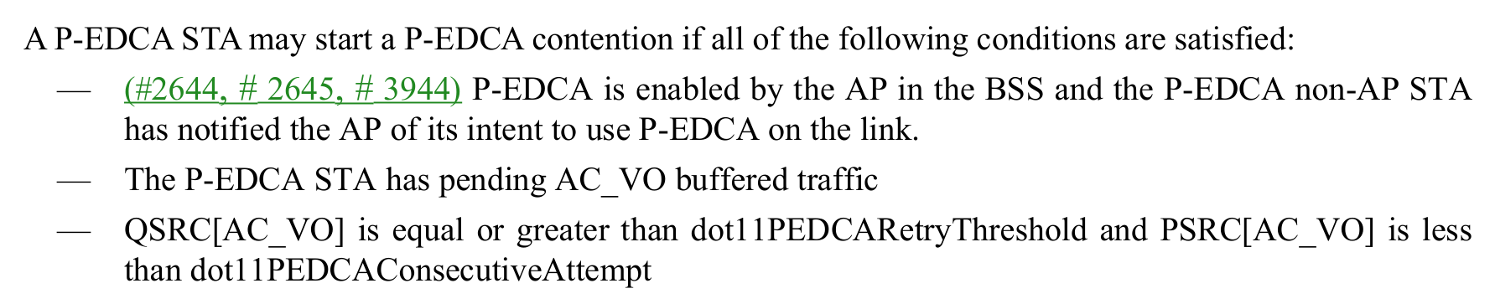
Problem Statement (1/2)
Under the current NPCA operation, the QSRC[AC] values used on the BSS PCH are saved, while new QSRC_NPCA[AC] values are employed.
Because P-EDCA evaluates QSRC[AC_VO] as part of its enabling conditions, this mechanism may inherently prevent P-EDCA from being activated on the NPCA PCH.
To address the issue, a P-EDCA STA operating on the NPCA PCH may need to use QSRC_NPCA[AC_VO] instead of QSRC[AC_VO] as part of the enabling conditions for P-EDCA.
37.6 Prioritized EDCA

Slide 6
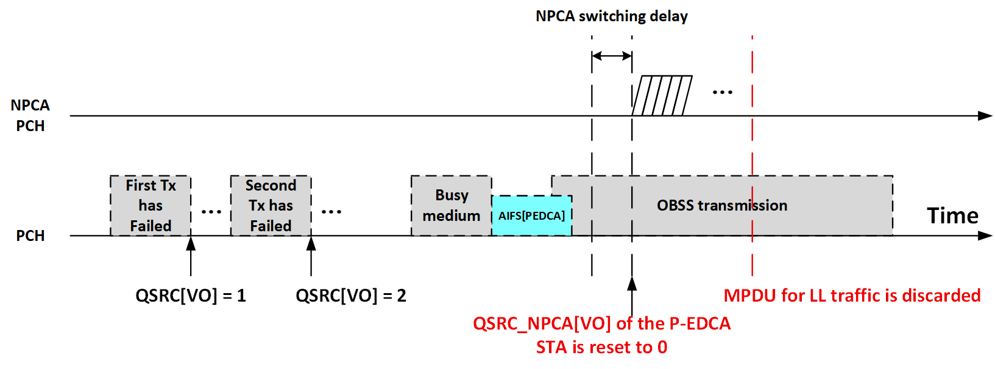
Problem Statement (2/2)
On the BSS PCH, there may be a P-EDCA STA whose QSRC[AC_VO] becomes more than or equal to 2 after consecutive AC_VO traffic transmission failures.
During its channel access attempt on the BSS PCH, the P-EDCA STA may receive an OBSS transmission that satisfies the NPCA switching condition.
In such a case, the P-EDCA STA may switch to the NPCA PCH, and QSRC_NPCA[AC_VO] is reset to other value.
  E.g., 0 or 1 that is lesser than 2.
In other words, if P-EDCA is allowed on NPCA PCH, when a P-EDCA STA performs NPCA, the parameters that satisfy the P-EDCA condition are reset, making it impossible to continue P-EDCA operation on the NPCA PCH.
  This can happen even when the P-EDCA STA use QSRC_NPCA[AC_VO] instead of QSRC[AC_VO] as part of the enabling conditions for P-EDCA on the NPCA PCH.

Slide 7
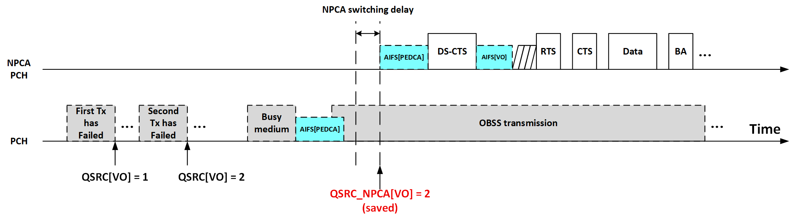
Possible Approach
To address the issue, when a P-EDCA STA that meets the P-EDCA condition switches to the NPCA PCH, QSRC_NPCA[AC_VO] is not reset and uses the value of the QSRC[AC_VO].
As a result, the P-EDCA condition can be carried over to the NPCA PCH, allowing LL traffic to be quickly transmitted using P-EDCA on the NPCA PCH.

Slide 8
Conclusion
In this contribution, two problems are investigated that arise when the P-EDCA is linked to the NPCA PCH.
  1. P-EDCA does not evaluate QSRC_NPCA[AC_VO] that is used be half of the QSRC[AC_VO] for its enabling condition.
  2. Even P-EDCA evaluates the QSRC_NPCA[AC_VO], the QSRC_NPCA[AC_VO] may be reset to other values such as 0 or 1 (lesser than 2).
To address the problems two possible solutions were proposed.
  1. P-EDCA evaluate QSRC_NPCA[AC_VO] as its enabling condition when P-EDCA STA is on the NPCA PCH.
  2. Even the P-EDCA STA switches to the NPCA PCH, the QSRC_NPCA[AC_VO] is not reset and uses the value of the QSRC[AC_VO].
By applying the proposed methods, even when the P-EDCA STA switches to the NPCA PCH, LL traffic can be transmitted by performing P-EDCA on the NPCA PCH.

Slide 9
References
[1] Draft P802.11bn_D1.0, 37.6 Prioritized EDCA
[2] Draft P802.11bn_D1.0, 37.18 Non-primary channel access (NPCA)
[3] 11-25-1501-00-00bn-on-the-interoperability-between-npca-and-p-edca

Slide 10
Straw Poll
SP: Do you agree to modify the 11bn SFD text as follows?
  An NPCA STA shall initiate a TXOP on the NPCA Primary channel following the rules defined in 10.23.2.2 (EDCA backoff procedure) and 10.23.2.4 (Obtaining an EDCA TXOP) with the following exception:
    Every time the STA switches to the NPCA Primary channel, it shall initialize CW_NPCA[AC] to TBD value and pick a new backoff counter (BO_NPCA) randomly between 0 and CW_NPCA[AC]. QSRC_NPCA[AC] shall be set to 0.
    If the NPCA STA is a P-EDCA STA, QSRC_NPCA[VO] shall be set to QSRC[VO].
Y / N / A

