Slide 1
Discussion on P-EDCA internal collision
Date: 2025-09-16
Authors:

Slide 2
Abstract
11bn adopted Prioritized EDCA (P-EDCA) to prioritize low-latency traffic.
In the current P-EDCA operation of 11bn D1.0, DS-CTS frame is used for deferring non P-EDCA STA’s transmission
Generally, DS-CTS frame can be transmitted at DSAIFS slot boundary
DSAIFS[AC_VO] = aSIFSTime + (AIFSN + DSr) × aSlotTime
However, there are no considerations on internal collision resolution procedure when DS-CTS and another EDCAFs’ channel access are collided.
In this submission, the internal collision issue in P-EDCA will be discussed.

Slide 3
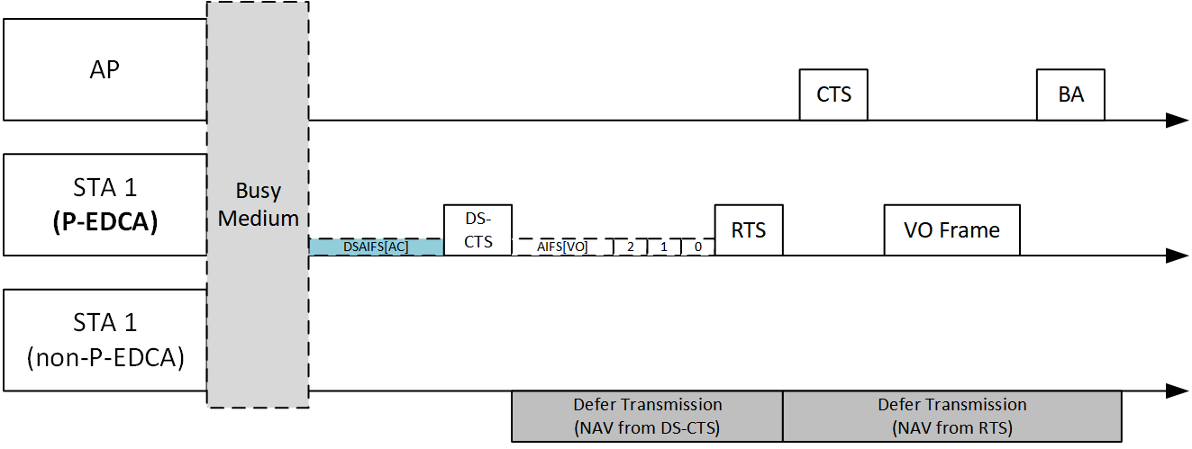
Recap: P-EDCA operation
In P-EDCA operation, a STA which enabled P-EDCA can transmit DS-CTS frame to start P-EDCA contention
DS-CTS can be transmitted at a slot boundary based on DSAIFSN (e.g., DSAIFS[AC_VO] = aSIFSTime + (AIFSN + DSr) × aSlotTime))
After DS-CTS transmission, P-EDCA contention is followed. After P-EDCA contention, the STA can transmit low latency frame.

Slide 4
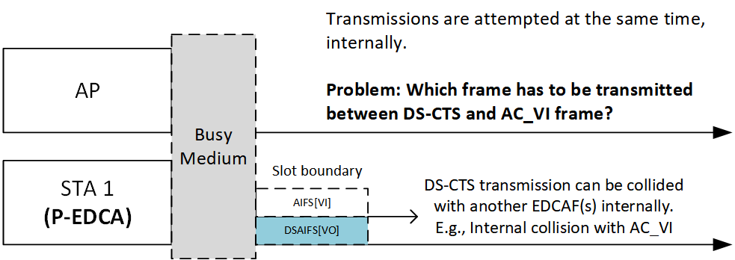
Internal collision of the P-EDCA operation
P-EDCA DS-CTS transmission operation and EDCAF(s) operate independently at the same time.
In the current 11bn draft, DS-CTS is not transmitted by EDCA operation. In other words, any EDCAF does not transmit DS-CTS.
Therefore, in case DSAIFS[AC_VO] and AIFS[AC] (+ backoff slots) (e.g., AC_VI) are same, an internal collision occurs.
Because of the same value of slot boundaries, DS-CTS transmission and the EDCAF’s frame transmission are attempted at the same time
In such case, internal collision resolution procedure shall be performed.

Slide 5
Internal collision of the P-EDCA operation (Cont’d)
However, there is no definition that if EDCAF is used for DS-CTS transmission or not and which access category DS-CTS falls into. Therefore, internal collision resolution cannot be performed
10.23.2.4 Obtaining an EDCA TXOP (IEEE 802.11-2024)
At each of the above-described specific slot boundaries, each EDCAF shall report an internal collision (which results in invocation of the backoff procedure as specified in 10.23.2.2 (EDCA backoff procedure) (see item d)) if
— There is a frame available for transmission at that EDCAF, and
— The backoff counter for that EDCAF has a value of 0, and
— Initiation of a frame exchange sequence is allowed to commence at this time for an EDCAF of higher UP.
In the baseline text, there is internal collision resolution procedures for EDCAFs.
However, internal collision collision resolution procedure between DS-CTS and EDCAF(s) is not defined.

Slide 6
A fundamental problem: DCF vs EDCA
Like the DS-CTS transmission operation, we can also check another frame transmission operation which potentially collides with EDCA: The beacon frame transmission
A Beacon frame can be transmitted at the TxPIFS slot boundary of an AP
If the AP’s AIFSN setting makes AIFS equal to PIFS or the AP uses PIFS recovery, internal collisions similar to the DS-CTS case may occur.
The Beacon frame transmission is performed based on the channel access as defined in clause 10 (MAC sublayer functional description), so we should check the subclause.
Commonly, post-HE STAs (including UHR STAs) use the followings:
DCF: the fundamental MAC service for the post-HE STAs; STAs can directly access to the DCF service
HCF contention-based channel access (EDCA): the service using the services of DCF
TUA: the service using the services of DCF
We can observe that beacon frame transmission is a direct DCF service, specifically transmitting beacon frames at the TxPIFS boundary without backoff.
Similarly, DS-CTS transmission is another direct DCF service, transmitting DS-CTS at the DSAIFSN slot boundary .
EDCA, while different in its QoS based contention operation, is still another DCF service.

Slide 7
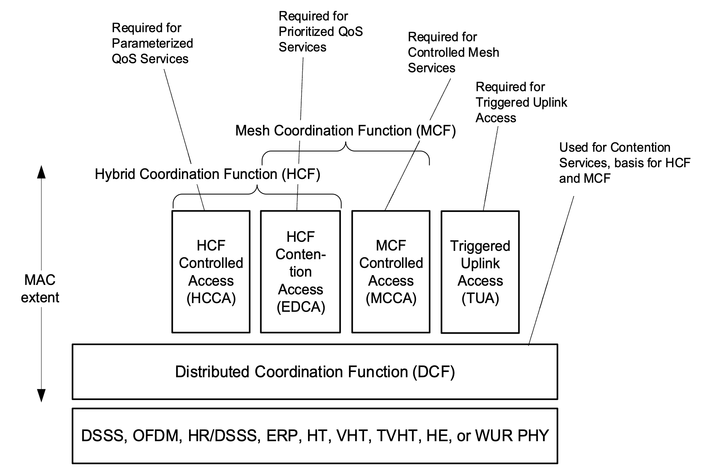
A fundamental problem: DCF vs EDCA (Cont’d)

Slide 8
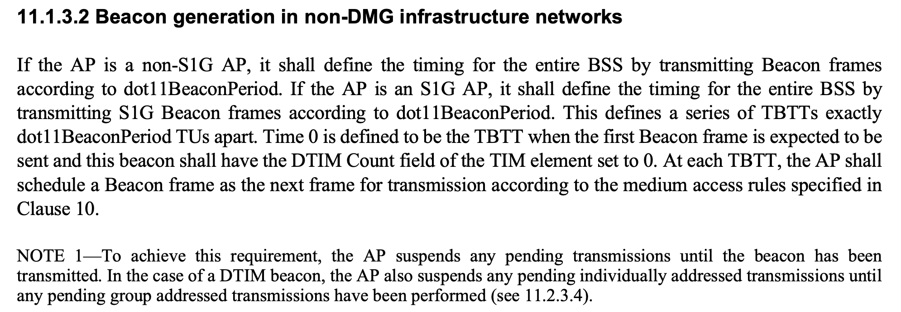
A fundamental problem: DCF vs EDCA (Cont’d)
In Beacon frame transmission scenario, an internal collision between the EDCAF’s frame transmission and the Beacon frame transmission will not occur.
Referring 11.1.3.2, an AP suspends any pending transmission at TBTTs.
Interpretation of “suspend”
If it refers to suspending EDCAFs themselves: the EDCAFs will stop its operation
If it refers to suspending Tx queues: the EDCAFs will perform operation as defined in 10.23.2.3
These actions are implementation-specific (“do nothing” or “choose not to transmit”), but still no internal collision occurs.

Slide 9
A fundamental problem: DCF vs EDCA (Cont’d)
Unlike Beacon transmission, internal collision problem between DS-CTS and EDCAF transmissions still exists, Because the EDCAFs are not suspended when the P-EDCA STA transmits DS-CTS.
Let’s assume that the P-EDCA STA chooses to transmit DS-CTS over a frame with EDCAF in the internal collision.
Selection between two frame transmissions can be determined with implementation specific methods of the STA.
If the STA has to select between a frame with EDCAF[VO] and DS-CTS, selecting a frame (AC_VO) frame over DS-CTS is preferred since it requires less overhead.
The baseline DCF does not provide an internal collision resolution procedure between multiple DCF services.
Therefore, an action which the EDCAF shall perform after the DS-CTS frame transmission, is not defined. The internal collision resolution procedure of EDCA is only defined for collision of EDCAFs, not defined for collision of DCF services including non-EDCA protocol.
Therefore, a clear procedure for the EDCAF in case of DS-CTS transmission is necessary, as it is the role of the standard.

Slide 10
Clarification for the internal collision resolution
When the start of a DS-CTS transmission coincides with an EDCAF slot boundary (e.g., DSAIFS[AC_VO] = AIFS[AC] + backoff slots, such as AC_VI), the STA should transmit the DS-CTS frame (selected over any EDCAF frame).
This shall not be regarded as an internal collision because a DS-CTS frame is not transmitted by any EDCAF and carries no UP; EDCAFs shall not invoke the internal-collision resolution procedure.
EDCAFs keep their contention parameters unchanged (e.g., QSRC[AC]).

Slide 11
Conclusion
This submission explained the internal collision issue on P-EDCA operation.
In the current 11bn draft, there is no procedure for internal collision resolution between DS-CTS transmission and EDCAF(s).
Because a DS-CTS is not transmitted by any EDCAF and carries no UP, such simultaneity shall not be treated by EDCAFs as an internal collision.
If DSAIFS[AC_VO] and AIFS[AC] + backoff slots coincide, the STA should transmit the DS-CTS frame; EDCAFs shall not invoke internal-collision resolution and shall keep their contention parameters unchanged (e.g., QSRC[AC]).

Slide 12
Straw Poll
SP #1
Do you agree to the following text?:
37.6 Prioritized EDCA
In a P-EDCA STA, if the start of a DS-CTS transmission and the start of an EDCAF frame transmission occur at the same time (e.g., when DSAIFS[AC_VO] coincides with AIFS[AC] plus the remaining backoff slot(s) of an EDCAF), the STA should transmit the DS-CTS frame. This shall not be regarded by any EDCAF of the STA as an internal collision; EDCAFs shall not invoke the internal-collision resolution procedure, and the EDCAFs’ channel-access parameters (e.g., QSRC[AC]) shall remain unchanged.

