Slide 1
Thoughts on Control Frame Transmission Failure in Co-TDMA Date: 2025-05-26
Authors:
Name | Affiliations | Address | Phone | email
Shu Yang | Ruijie Networks Co., Ltd. |  |  | yangshu1@ruijie.com.cn
Hang Yang |  |  |  | yanghang1@ruijie.com.cn
Fangchang Guo

Slide 2
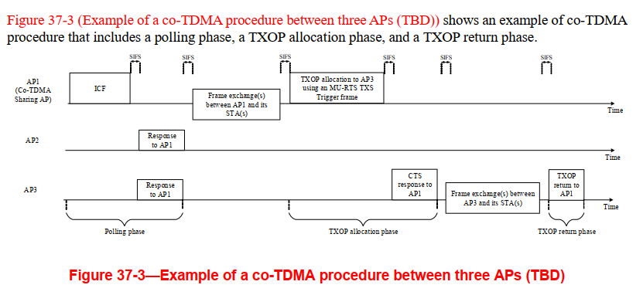
Introduction
TGbn defines a Coordinated TDMA (Co-TDMA) procedure for an AP to share its time resources of an obtained TXOP with a set of APs
In this contribution, we discuss the procedure after the transmission failure of ICF and MU-RTS TXS frame in Co-TDMA

Slide 3
ICF Transmission Failure
Case1：ICR timeout
ICR timeout will happen if polled AP has no intention to the TXOP sharing. It is unfair for sharing AP to lose the obtained TXOP.
Sharing AP may use the remain time of obtained TXOP by starting in-BSS frame exchange(s) which needs CS mechanism indicating medium idle at the TxPIFS slot boundary after ICR timeout
Timeout interval which equals to aSIFSTime + aSlotTime + aRxPHYStartDelay will begin when MAC receives the PHY-TXEND.confirm primitive
Timeout interval
Remain time of TXOP
AP1
(sharing AP)
ICF
Frame exchange in BSS1
no signal received
AP2
(polled AP)
polled AP has no intention

Slide 4
ICF Transmission Failure
Case2：RX invalid response
The receipt of any frame other than ICR frame shall be interpreted as a failure of the initiated TXOP
Then sharing AP shall invoke its backoff procedure at the PHY-RXEND.indication primitive
RX invalid frame
AP1
(sharing AP)
ICF
Backoff procedure
Other STA
Any other frame

Slide 5
MU-RTS TXS Transmission Failure
Similar to a TXOP failure in non-initial PPDU, sharing AP may choose one option shown below
utilize the remain time of TXOP by performing a PIFS recovery
invoke its backoff procedure
Compare to normal TXOP procedure, the difference is NAV duration of MU-RTS TXS dose not protect the remain time of TXOP
TX fail
AP1
(sharing AP)
MU-RTS TXS
Frame exchange in BSS1
AP2
(coordinated AP)
no signal received or invalid frame

Slide 6
Summary
In this presentation, we discussed on ICF and MU-RTS TXS frame transmission failure issues and the possible behavior base on different failure conditions
utilize the remain time of TXOP
invoke backoff procedure

Slide 7
SP1
Do you agree that, Co-TDMA procedure shall provide a mechanism for ICF transmission failure ？
In case of response frame timeout, sharing AP may utilize the remain time of TXOP
In other cases, sharing AP invokes backoff procedure

Slide 8
SP2
Do you agree that, Co-TDMA procedure shall provide a mechanism for MU-RTS TXS transmission failure？
Sharing AP can perform either a PIFS recovery or invoke backoff procedure

