Slide 1
Adaptive power boosting design for dRU
Date: 2025-05-29
Authors:
Name | Affiliations | Address | Phone | email
Sawaira R. Ali | VESTEL
Shaima Abidrabbu
Salim Yahya
H. M. Madani
Basak Ozbakish

Slide 2
Introduction (1)
Efficient utilization of 6GHz spectrum and achieving reliable communication in 6GHz band is one of the key objectives for 11bn UHR system
In 6GHZ two main power modes have been introduced: ​
Standard Power (SP) ​
Indoor and outdoor applications​
For SP APs it is required to operate with AFC, to mitigate 6Ghz Wi-Fi from interfering with incumbent services.​
Low Power Indoor (LPI) ​
For indoor applications​
Does not require AFC​
For LPI mode, the PSD limitations are very tough​
Example: For non-AP STA in LPI mode, the PSD limitation is -1dBm/MHz . This will significantly limit UL coverage range.
dRU can significantly boost transmission power and enhance overall 6GHz spectrum efficiency.

Slide 3
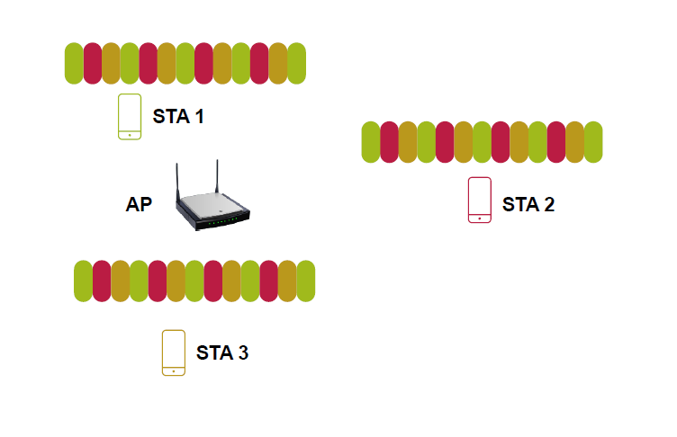
Introduction (2)
dRU is particularly useful in UL-OFDMA
  All STAs transmit at boosted transmit power
  When there are enough STAs to transmit on all available dRUs, spectral efficiency is also maintained.
The main goal is to distribute the tones to have the maximum power boost.
Example: For 20MHz, in case of dRU-26, 9 dRU’s can be supported.
For such a case, the goal of tone distribution is to boost power by distributing the subcarrier belonging to i-th dRU-26 as far as possible to have minimum no of subcarriers in 1MHz

Slide 4
Introduction (3)
dRU has been considered from different perspectives such as:
dRU Spreading BW and RU Sizes [1], [2] , [3] , [4] , [5] ​
Operation modes for dRU [6], [7]​
Tone planning and pilot design for dRU [8], [9], [10], [11], [12], [13], [14], [15], [16], [17], [18], [19], [20], [21], [22] ​
In literature, dRU is primarily considered with the aim of overcoming PSD limitation by decreasing the number of tones per MHz per station. By doing so, the power boost will be maximized.
However, we aim to exploit the dRU from various perspectives, examining multiple factors that can affect the overall performance and efficiency.

Slide 5
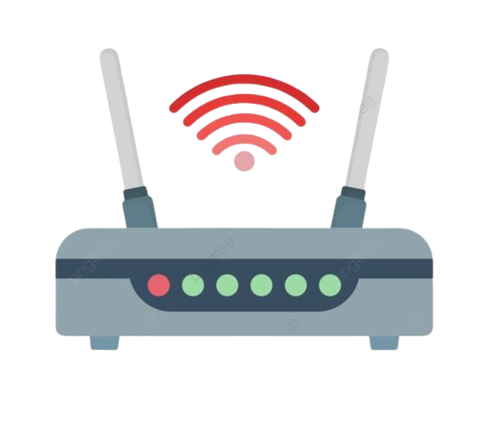
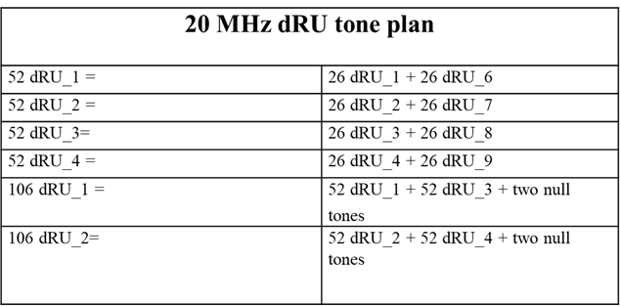

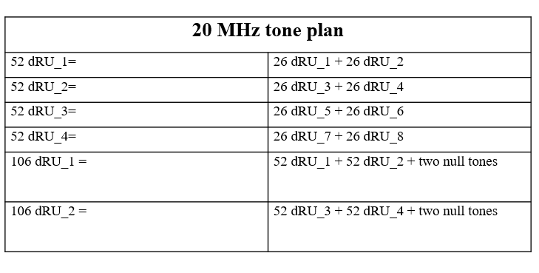


dRU in literature
Consider a three-user case in which the users are at different distances from the AP.
However, based on the dRU design considered in literature, User 1 (26 dRU_1+ 26 dRU_6) and User 2 (26 dRU_1+ 26 dRU_2) will get enough power, however, for the user-3 , if it is served by (26 dRU_1+ 26 dRU_6) , the power will be surplus for it and if we serve it by (26 dRU_1+ 26 dRU_2) , it will be insufficient for it.
Considering that, we want to exploit the Dru from adaptivity viewpoint.
User 2
User 3
User 1

Slide 6
Proposed Approach
As evident from the previous slide, two extremes have been discussed in literature for dRU designing either the maximum power boost or the least power boost extremes.
However, we want to design dRU considering other parameters as well such as range, QoS requirements of users and other TBD parameters to make sure that each users gets the enough/required power boost based on its requirements.
In this case, the power boost will neither be surplus nor insufficient.

Slide 7
Proposed Approach: Considering range
Consider a three-user case in which the users are at different distances from the AP.
Taking into account the proposed framework, all the three users will get the dRU based on their range from the AP
In this way each user will get a sufficient power boost neither surplus nor insufficient.
We propose adaptive dRU design based on the parameters such as range, QoS requirements and other TBD parameters.
User-2
User-3
User-1

Slide 8
Summary
In this contribution, we review the literature of the dRUs and highlights our thoughts about the missing aspects of designing the dRUs.
Particularly, we propose adaptive power boosting for dRU by considering range , QoS requirements of users and other TBD parameters.

Slide 9
REFERENCES
[1]:“Distribution bandwidth of DRU”, IEEE 802.11-23/2200r0
[2]:“Follow Up on High Level Thoughts on DRU Design”, IEEE 802.11-24/0500r0
[3]:“Further Thoughts on Dru”, IEEE 802.11-24/0014r0
[4]:“Distribution Bandwidth within 80 MHz for DRU”, IEEE 802.11-24/0766r1
[5]:“Discussion on Distribution Bandwidth of DRU”, IEEE 802.11-24/0801r1
[6]:“Hybrid PPDU and Distribution Bandwidth for DRU” , IEEE 802.11-24/0400r0
[7]:“High-Level Perspectives on Distributed Tone RU for 11bn”, IEEE 802.11-23/2020r0
[8]:“20 MHz Tone Plan and Pilot Design for DRU”, IEEE 802.11-24/0402r0
[9]:“DRU Tone Plan for 11bn”, IEEE 802.11-24/468r0
[10]:“Pilot Design Considerations for dRU”, IEEE 802.11-24/0501r0
[11]:“dRU Signaling for UHR”, IEEE 802.11-24/1117r0

Slide 10
[12]:“CFO Impact and Pilot Design for dRU Follow up”, IEEE 802.11-23/1447r0
[13]:“Principle and Methodology for dRU Tone Plan Design”, IEEE 802.11-23/2021r0
[14]:“A dRU Design Approach for 20 MHz”, IEEE 802.11-24/0078r1
[15]:“20 MHz Tone Plan and Pilot Design for DRU”, IEEE 802.11-24/0402r1
[16]:“DRU Tone Plan for 11bn”, IEEE 802.11-24/468r1
[17]:“Pilot Design Considerations for dRU”, IEEE 802.11-24/0501r2
[18]:“Thoughts on DRU Pilot”, IEEE 802.11-23/0728r2
[19]:“20 MHz Tone Plan and Pilot Design for DRU Follow Up”, IEEE 802.11-24/0767r0
[20]:“On the Pilot Tone Allocations in DRU”, IEEE 802.11-24/0769r0
[21]:“Discussions on DRU pilot design principles”, IEEE 802.11-24/0800r2
[22]:“Tone distribution in DRUs”, IEEE 802.11-24/0814r0

Slide 11
Straw Poll
Do you agree to add the following statement to the standards?
“Adaptive power boosting for dRU, considering factors such as range, QoS requirements, and other TBD parameters to improve 6GHz efficiency”
  Yes
  No
  Abstain or More Discussion needed

