Slide 1
Deep Learning-Based Angle-Difference Feedback with Vector Quantization for MIMO WLAN Systems
Date: 2025-05-29
Authors:

Slide 2
Introduction
During the AIML TIC, we have explored various AIML use-cases and their feasibility for WLAN networks, which include [1]
CSI feedback compression
Distributed channel access
Roaming enhancement
Multi-AP coordination
In the topic of CSI feedback compression, studies have shown that deep learning (DL) technique can significantly reduce the CSI feedback overhead and improve system throughput
In [2], the angle parameters of downlink CSI were separately compressed using hyperparameterized pre-processing and two distinct fully connected networks (FCNs)
In [3], convolutional neural network (CNN)-based model with a channel attention module was used to compress a right singular matrix in SVD, rather than the angle parameters

Slide 3
Introduction
However, none of the existing research has leveraged the temporal correlation of CSIs in DL-based CSI feedback specifically for MIMO WLAN systems
Moreover, jointly training the quantization module with the encoder and decoder leads to more effective learning of the latent representations in DL-based CSI feedback models
The potential benefits of the joint training of the quantization module and the utilization of temporal correlation in CSIs remain unexplored

Slide 4
Main Contributions
In this contribution, we propose a novel DL-based angle-difference feedback framework for MIMO WLAN systems that effectively leverages the temporal correlation of angle parameters
This framework incorporates joint training of the VQ module with encoder and decoder networks, enabling efficient finite-bit representation of the latent vector
This framework selectively feed back the difference between the current and previous angle parameters when the difference is sufficiently small
To address the challenge of error propagation inherent in the angle-difference feedback, we design a novel VQ structure tailored to compensate for residual errors from the previous feedback
To ensure the minimally required feedback performance depending on the situation, we propose a criterion at the STA side that allows switching to the standard method based on the quantization error of the encoder output (two-track approach)

Slide 5
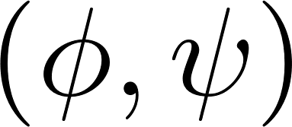
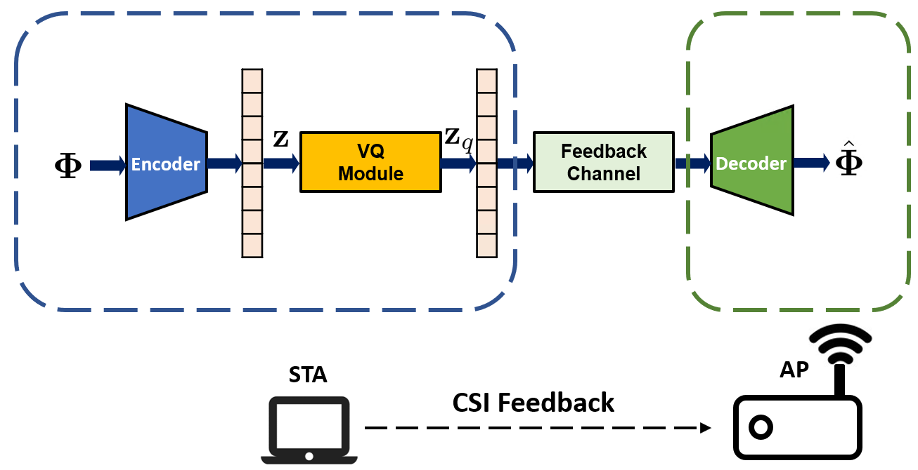
System Model: DL-based CSI Feedback
Use as an CSI input where angle parameters
are concatenated for each subcarrier
STA employs an encoder network as
The latent vector z is considered as the STA’s feedback that needs to be transmitted to the AP
To feed the latent vector back to the AP over a finite-rate link, STA quantizes the latent vector z into $z_{q}$
Upon the feedback of the STA, AP employs a decoder network as
, where denotes the reconstructed CSI

Slide 6
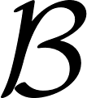
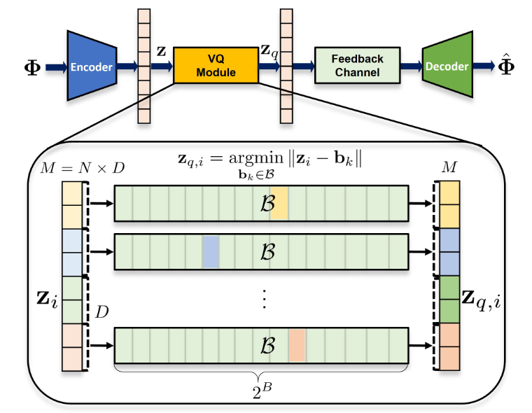
Trainable VQ module structure
To avoid a significant computational complexity required for VQ,
we adopt the product VQ structure in [4]
Divide $M$-dimensional latent vector z into N number of D-dimensional sub-vectors $z_{i}$
Use a trainable VQ codebook using $B$ bits, where the sub-vector is quantized as

Slide 7
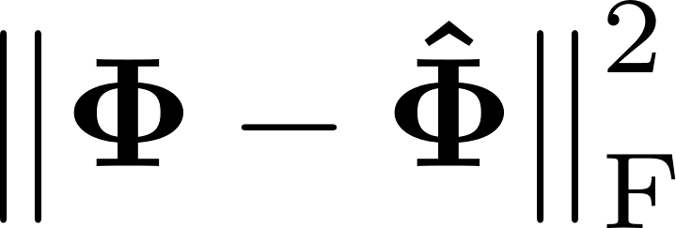
Trainable VQ module structure
Encoder, codebook, and decoder are jointly trained using a loss structure as
: minimize the difference btw. the input and reconstruction
: minimize the quantization error [5]
(*sg(): stop-gradient operator)

Slide 8
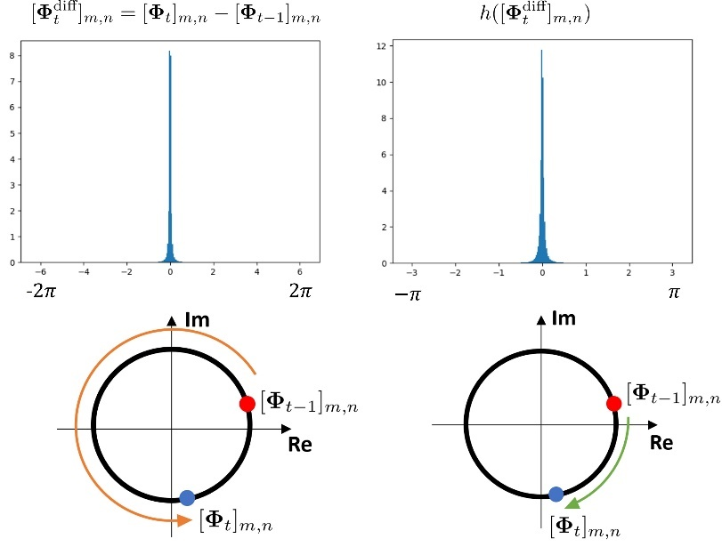
Proposed Angle-Difference Feedback
Sequential CSI inputs are temporally correlated
Their difference would be sparse, which is easier form to compress than the original input
Use angle difference as an input of another encoder, with an appropriate preprocessing, which considers the shortest path in calculating difference

Slide 9
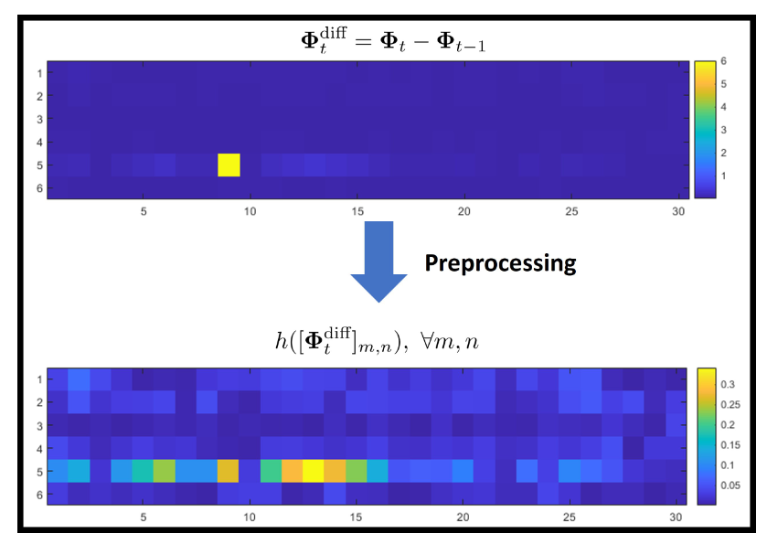
Proposed Angle-Difference Feedback
By applying the preprocessing to the AD, the physical sparseness considering the circularity of the angle parameter can be observed
Use AD feedback selectively only if the AD is considered to be sparse enough
*False sparse

Slide 10
Proposed Angle-Difference Feedback
Quantize the residual vector of the previous feedback and latent vector of the current feedback jointly
Compensate the quantization error of the previous feedback
Reconstructed AD by a decoder is added to the previous reconstruction

Slide 11
Proposed Angle-Difference Feedback
Alternative encoder/codebook/decoder are jointly trained using a loss structure as
Reconstruction loss is designed considering the circularity of the angle parameter

Slide 12
Two Track Approach
The aforementioned DL-based approach achieves high average performance
However, performance variability across samples can lead to suboptimal results for some CSI realizations
At the STA side, we introduce a quantization error-based criterion to assess the encoder output quality
When error exceeds a threshold, the system switches to the standard method, ensuring minimum required performance
Key advantages:
Leverages the strength of DL-based feedback when it's effective
Guarantees reliability by falling back to standard feedback in difficult cases
Improves fairness in feedback performance across diverse CSI conditions

Slide 13
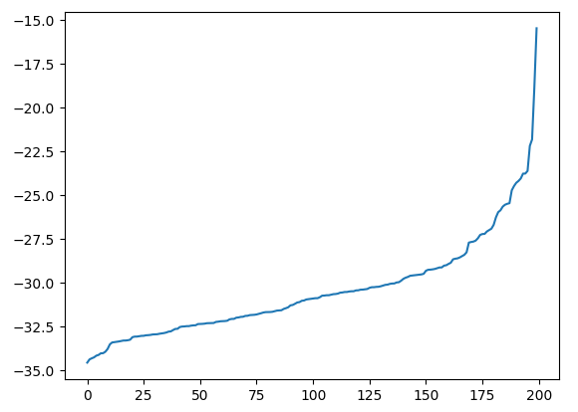
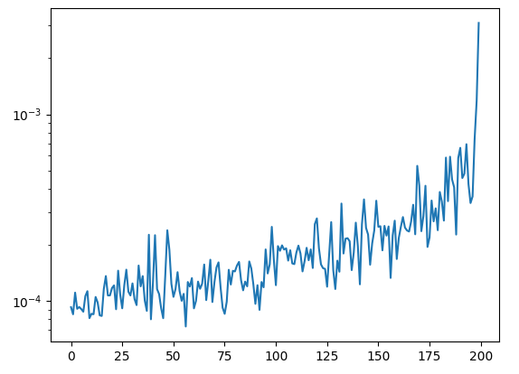
Two Track Approach
The feedback quality can be accessed by the quantization error
NMSE
Quantization Error
threshold!

Slide 14
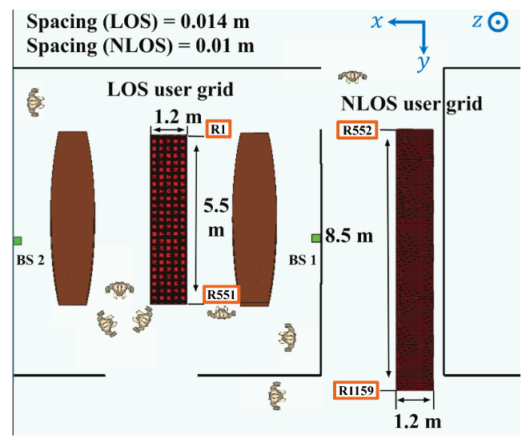
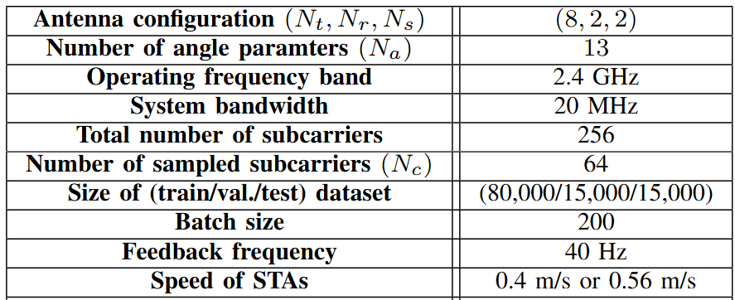
Simulation Settings
DeepMIMO I3 Scenario [6]
Encoder / Decoder network structure
Notes:
Adam optimizer 10^-4 lr

Slide 15
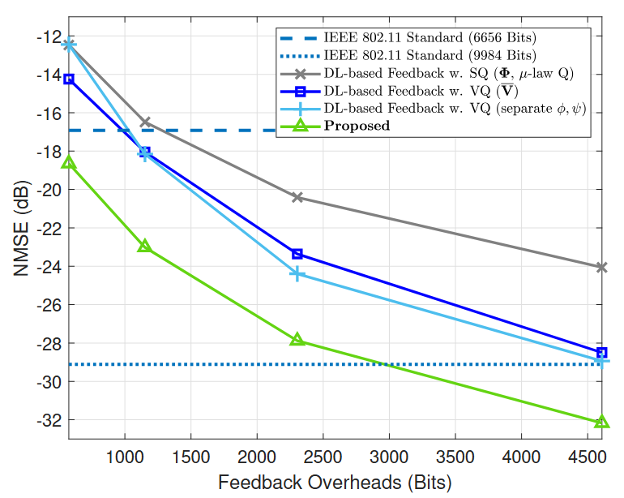
Simulation Results
NMSE performance
IEEE 802.11 Standard
${(b}_{φ},b_{ψ})=\left(5,3\right)$ or $\left(7,5\right)$
→ 6656 bits or 9984 bits
DL-based Comparison Schemes
(w.o. temporal correlations)
Input form:
Quantization method: SQ & VQ
Proposed (only DL-based; one track)
*$NMSE=𝔼\{{\left\|\overline{V}−\hat{V}\right\|}_{\text{F}}^{2}/{\left\|\overline{V}\right\|}_{\text{F}}^{2}\}$

Slide 16
Simulation Results
NMSE performance
Proposed (only DL-based one track)
Proposed (two track approach)
Proposed Frameworks | Avg. Feedback Overheads | NMSE (dB)
one track | 4608 bits | -32.131 dB
two track | 5963 bits | -34.625 dB
*$NMSE=𝔼\{{\left\|\overline{V}−\hat{V}\right\|}_{\text{F}}^{2}/{\left\|\overline{V}\right\|}_{\text{F}}^{2}\}$

Slide 17
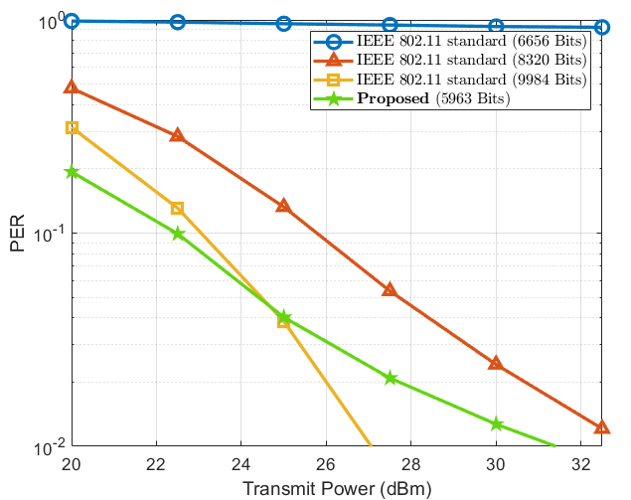
Simulation Results
PER performance (4000 bits per packet, 16-QAM, ¾ LDPC)
IEEE 802.11 Standard
${(b}_{φ},b_{ψ})=\left(5,3\right)$ or $\left(6,4\right)$ or $\left(7,5\right)$
→ 6656 bits or 8320 bits or 9984 bits
Proposed (two track)

Slide 18
Summary
In this contribution, we propose a novel DL-based angle-difference feedback framework for MIMO WLAN systems
We incorporates joint training of the VQ module with encoder and decoder networks, enabling efficient quantization of the latent vector
To address the challenge of error propagation inherent in the angle-difference feedback, we design a novel VQ structure tailored to compensate for residual errors from the previous feedback
To ensure the minimally required feedback performance depending on the situation, we propose a criterion at the STA side that allows switching to the standard method based on the VQ error of the encoder output (two-track approach)

Slide 19
Reference
[1] IEEE P802.11, “IEEE 802.11 AIML TIG Technical Report Draft,” IEEE AIML TIG/0987r23, Nov. 2023.
[2] P. K. Sangdeh, H. Pirayesh, A. Mobiny, H. Zeng, “LB-SciFi: Online Learning-Based Channel Feedback for MU-MIMO in Wireless LANs,” in Proc. IEEE Int. Conf. Netw. Protocols (ICNP), Oct. 2020, pp. 1-11.
[3] F. Qi, J. Guo, Y. Cui, X. Li, C.-K. Wen, and S. Jin, “Deep learning-based CSI feedback in Wi-Fi systems,” in Proc. IEEE Int. Symp. Comput. Eng.Intell. Commun. (ISCEIC), Nov. 2024, pp. 1–6.
[4] M. Sabin and R. Gray, “Product code vector quantizers for waveform and voice coding,” IEEE Trans. Acoust., Speech, Signal Process., vol. 32, no.3, pp. 474–488, Jun. 1984.
[5] A. van den Oord, O. Vinyals, and K. Kavukcuoglu, “Neural discrete representation learning,” Adv. Neural Inf. Process. Syst., Dec. 2017, pp.6306–6315.
[6] A. Alkhateeb, “DeepMIMO: A generic deep learning dataset for millimeter wave and massive MIMO applications,” 2019, arXiv:1902.06435.

Slide 20
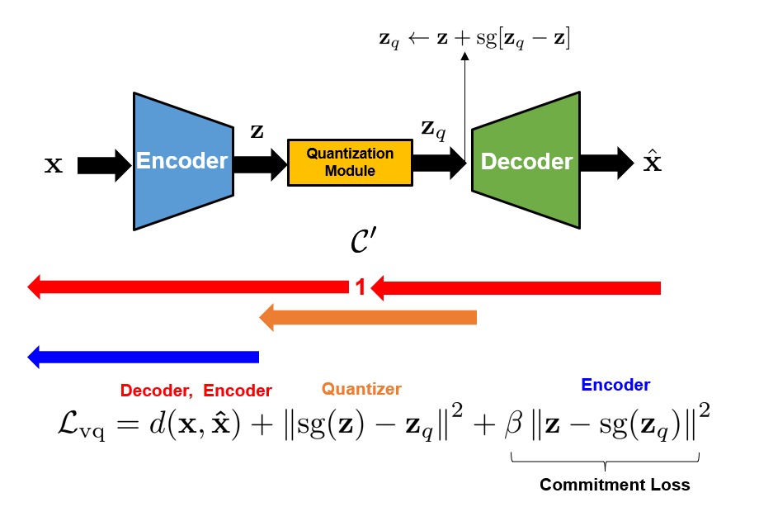
Appendix 1: Loss Structure

Slide 21
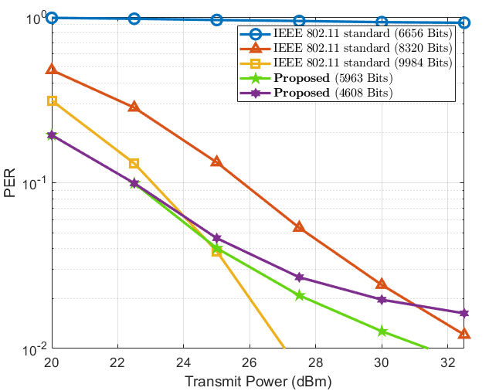
Appendix

