Slide 1
Over-the-Air Notification of SMD BSS Transition Execution Response
Date: 2025-05-15
Authors:

Slide 2
Abstract
This contribution proposes enhancements to the SMD BSS transition execution via target AP MLD in section 37.9.7 of the TGbn draft.
In the current Execution via Target AP MLD flow, the current AP MLD is not explicitly notified when a non-AP MLD completes its transition.
As a result, per-link context, scheduling assignments, QoS state, and buffer resources may remain active.
This contribution proposes two alternative solutions to enable explicit over-the-air notification to the current AP MLD via group-addressed Link Reconfiguration Response frames, enabling faster state transitions and improved coordination.
Both solutions maintain alignment with the current TGbn draft and do not introduce new frame types or state transitions.

Slide 3
Introduction
TGbn introduces support for SMD BSS transition as part of its Ultra High Reliability (UHR) feature set. SMD BSS transition allows a non-AP MLD to move across AP MLDs in the same Seamless Mobility Domain (SMD) without reassociation, minimizing connectivity disruption.
Defined procedure:
Discovery: Learn candidate AP MLDs in same SMD
Preparation (optional): Context transfer, link setup
Execution: Trigger actual transition, context transfer
DL Buffer Transmission & Target Link Setup
This contribution targets a limitation in the Execution step via the target AP MLD, where real-time transition state is not explicitly signaled to the current AP MLD.

Slide 4
Problem statement
In Execution via Target AP MLD, the target AP MLD:
Receives Link Reconfiguration Request (Execution) from the non-AP MLD
Performs DS mapping update to redirect data
Transmits a Link Reconfiguration Response to the non-AP MLD
The current AP MLD is not explicitly notified of the SMD transition execution — it only can learn of the execution from backhaul-based DS mapping updates.
This leads to the following issues:
Context retention: AIDs, QoS policies, TSPECs, and link-specific state are not cleared in a deterministic manner.
Resource waste: Uplink/downlink scheduling, buffer queues, and channel assignments may remain active unnecessarily.
No consistent transition point for releasing per-link state.
Goal: Provide an over-the-air mechanism to explicitly remove all content and configuration relating to the non-AP MLD at the current AP MLD when SMD BSS transition is completed.

Slide 5
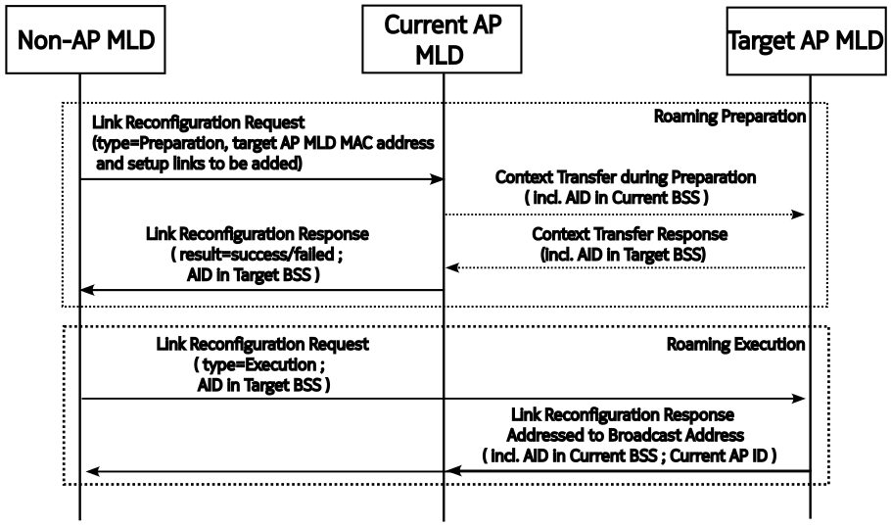
Receiver address set to Broadcast in Link Reconfiguration Response in execution (Option 1)
The target AP MLD sends the Link Reconfiguration Response frame using the broadcast MAC address.
The frame includes in its body:
The AID of the non-AP MLD (in the current AP MLD)
The AP ID of the current AP MLD
Pros:
Simple to implement using standard broadcast behavior
Useful for minimal or rapid roaming deployments
Works without the Preparation step
No multicast setup required
Cons:
Requires frame body parsing logic
May reach unintended APs without filtering
Slightly larger frame payload due to identifiers

Slide 6
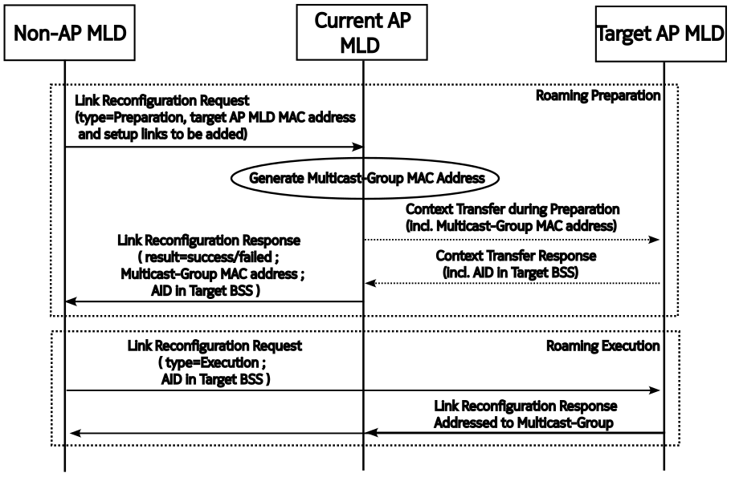
Receiver address set to Multicast in Link Reconfiguration Response in execution (Option 2)
During Roaming Preparation, the current AP MLD assigns a multicast group MAC address.
This address is shared with the non-AP MLD and target AP MLD.
The target AP MLD sends the Link Reconfiguration Response using this multicast address.
Both non-AP MLD and current AP MLD receive the frame.
Pros:
Clean, MAC-level solution — no payload parsing needed
Supports precise, synchronized context cleanup
Enables prompt termination of DL buffers, AID, and scheduling
Aligned with Preparation-based roaming logic
Cons:
Requires multicast coordination during preparation
Less applicable when Preparation step is skipped
Slight increase in control complexity

Slide 7
Conclusions
This contribution addresses a concrete technical gap in the draft: lack of explicit teardown signaling to the current AP MLD.
Enables immediate removal of context, scheduler state, and DL buffers
Improves UHR behavior by eliminating race conditions during roaming
Both options are implementable, optional, and align with the roaming flow
We recommend adoption of one or both solutions for inclusion in the draft.

Slide 8
Straw Polls
SP1: Do you support
(Option 1) Using a broadcast MAC address with identifiers of the non-AP MLD and current AP MLD in the frame body of the Link Reconfiguration Response from target AP MLD to allow both non-AP MLD and AP MLD to process the response?

Slide 9
Straw Polls
SP2: Do you support
(Option 2) Using a multicast group MAC address in the Link Reconfiguration Response frame from target AP MLD to notify both the non-AP MLD and the current AP MLD about the roaming execution response?

Slide 10
References
[1] PDT MAC Seamless Roaming Part 1, IEEE 802.11-25/0566r10.
[2] PDT-CR MAC Seamless Roaming Part 2, IEEE 802.11-25/0736r8.
[3] PDT MAC Seamless Roaming Part 3, IEEE 802.11-25/0732r1.
[2] TGbn Motion List - Part 1, v26.
[3] TGbn Motion List - Part 2, v14.
[4] IEEE P802.11bn™/D0.2.

