Slide 1
802.15 Liaison Report – May 2025
Date: 2025-05-15
Authors:

Slide 2
Abstract
Overview of current activities in WG15.

Slide 3
Working Group 15 November Agenda
Agenda:
https://mentor.ieee.org/802.15/dcn/25/15-25-0167-03-0000-may-2025-802-15-agenda.xlsx
WG opening report:
https://mentor.ieee.org/802.15/dcn/25/15-25-0168-03-0000-may-2025-802-15-opening-report.pptx

Slide 4
Subgroup Closing Reports
Title | URL
TG15.6ma Closing Report for May 2025 | https://mentor.ieee.org/802.15/dcn/25/15-25-0265-00-006a-tg15-6ma-closing-report-for-may-2025.pptx
SCM Agenda, Opening and Closing Report May 2025 | https://mentor.ieee.org/802.15/dcn/25/15-25-0235-01-0mag-scm-agenda-opening-and-closing-report-may-2025.pptx
TG4ab May Closing Report | https://mentor.ieee.org/802.15/dcn/25/15-25-0272-00-04ab-tg4ab-may-2025-closing-report.pptx
TG4ac May Opening and Closing Report | https://mentor.ieee.org/802.15/dcn/25/15-25-0215-01-04ac-may-opening-and-closing.pptx
TG4ad Agenda, Opening and Closing Report May 2025 | https://mentor.ieee.org/802.15/dcn/25/15-25-0219-01-04ad-tg4ad-agenda-opening-and-closing-report-may-2025.pptx
TG4ae (ASCON) May Opening and Closing | https://mentor.ieee.org/802.15/dcn/25/15-25-0216-01-04ae-may-opening-and-closing.pptx
IG Access agenda opening and closing report and Minutes | https://mentor.ieee.org/802.15/dcn/25/15-25-0238-01-acss-ig-access-may-2025-meeting-slides.pptx
TG9A May Opening and Closing report | https://mentor.ieee.org/802.15/dcn/25/15-25-0217-01-009a-may-opening-and-closing.pptx
TG16me Revision to 802.16-2017 | https://mentor.ieee.org/802.15/dcn/25/15-25-0271-00-16me-tg16me-may-2025-closing-report.pptx

Slide 5
802.15 Overview
Wireless Specialty Networks Active standards:
802.15.3 - no active projects but a bunch of really cool stuff
802.15.4 - many current projects (see next slide)
802.15.6a Body Area Networks: WG ballot recirculations
802.15.7a Higher Rate, Longer Range Optical, in publication
802.15.9a KMP Transport, extensions to key management: Working group ballot
802.16t Extension to 802.16 for specific bands: approved (DONE!)
802.16.me Revision of 802.16-2017 – first TG meeting
Interest Group Access: Several technical concepts to be developed into potential new projects
SC THz: discussing future THz communications with Terabit/second data rates – did not meet this session

Slide 6
802.15.4 Projects
802.15.4ab Next Generation UWB: First WG recirculation
802.15.4ac Enhanced Privacy: Initial WG ballot
802.15.4ad Next Generation SUN PHYs: Pre-draft, technical contributions and proposals
802.15.4ae ASCON light weight encryption extension for 802.15.4: draft in progress

Slide 7
802.15.4ab Next generation UWB: Amendment to IEEE Std 802.15.4-2024 (rev E)
Recirculation comment resolution in progress
Closing report: https://mentor.ieee.org/802.15/dcn/25/15-25-0272-00-04ab-tg4ab-may-2025-closing-report.pptx
 | Current Schedule
First recirculation | March 2025
Recirculation comment resolution | March-July 2025
Second recirculation | Aug 2025
Recirculation comment resolution | Aug-Spet 2025
First SA-Ballot | After Sept 2025…
SA-Ballot comment resolution | After that

Slide 8
802.15.4ac Enhanced Privacy
This amendment specifies modifications to the IEEE Std 802.15.4 medium access control (MAC) specification to specify mechanisms that address and improve user privacy. These mechanisms include randomized addresses, and exchanges that support session continuity. This amendment maintains backward compatibility with the base standard.
State: WG Recirculation comment resolution
Opening and closing report: https://mentor.ieee.org/802.15/dcn/25/15-25-0215-01-04ac-may-opening-and-closing.pptx

Slide 9
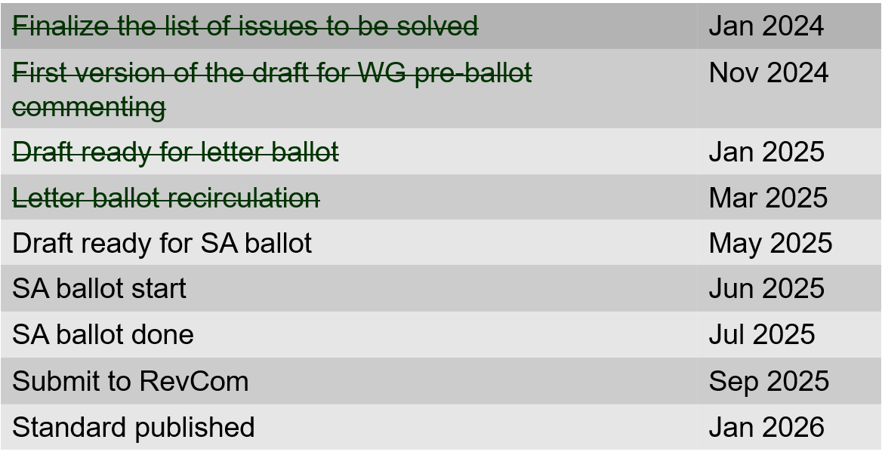
802.15.4ac Enhanced Privacy Timeline

Slide 10
802.15.4ad Next Generation SUN PHYs
Developing enhancements to the 802.15.4 SUN PHYs (FSK, OFDM)
State: pre-draft development
Meeting goals:
Considering technical contributions
15 contributions heard
Objectives completed
Closing report: https://mentor.ieee.org/802.15/dcn/25/15-25-0219-00-04ad-tg4ad-agenda-opening-and-closing-report-may-2025.pptx

Slide 11
802.15.4ad Timeline
2024
November: Approve Technical Guidance Document
Call for proposals issued
2025
January: Hear initial proposals
March: Hear updated proposals
March to May – 2 conference calls
Simulation results of remaining proposals not yet provided
Prepare table of proposals for analysing against technical guidance document
May: Hear final proposals
May to July – 2 conference calls
Simulation results and proposal categorisation.
July and beyond: Merging and start drafting the standard

Slide 12
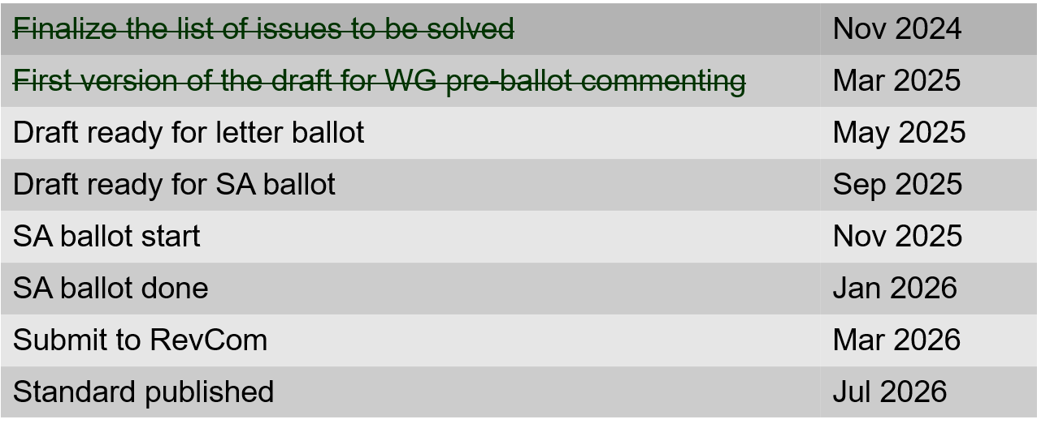
802.15.4ae (ASCON) ASCON light weight encryption extension for 802.15.4
Meeting achievements
Reviewed pre-letter ballot comments
Created draft ready for letter ballot
Start letter ballot after this meeting
Closing report: https://mentor.ieee.org/802.15/dcn/25/15-25-0216-01-04ae-may-opening-and-closing.pptx

Slide 13
802.15.6ma
Draft in WG ballot
Completed 2nd recirculation 10-May
Resolved comments
Preparing for 3rd recirculation
Preparing for initial SA ballot (post July)
Closing report: https://mentor.ieee.org/802.15/dcn/25/15-25-0265-00-006a-tg15-6ma-closing-report-for-may-2025.pptx

Slide 14
TG 6ma Timeline(expected)
Final SB recirculation, if required. Submission to RevCom
Jan 2026
Tech Req Doc July 2022
Presentation of proposals
May 2023
Comment Resolutionfor LB210
Nov. 2024
Comment Resolutionfor LB212
March 2025
Comment Resolutionfor LB217
May
2025
Comment Resolution for LB217
July
2025
SA Ballot
Sept
2025
WG PreBallot submission for Draft2.5 August 2024
Revcom Approve
March 2026
SA recirculation if required
Oct 2025
^{Draft V1,18 Com}
May. 2024
Recirculation (LB212)
Jan. 2025
RevcomSubmission
Feb. 2026
TRD,CMD
Call Proposals Sept 2022
Std. Draf V1.9 Proposals
Nov. 2023
Comment Resolution fo Draft v2.3 on WG for PreBallot July 2024
1st Letter Ballot(LB210)
Sept. 2024
2nd Recirculation (LB217)
April 2025
3rd Recirculation (LB)
June 2025
Unconditional approval for Standard Association Ballot (SA)
July 2025
Request EC approval for SA Ballot
Nov. 2026
Comment Resolution for SA Ballot
Oct. 2025
Notes: SASB/RevCom scheduled for 2024 a guess

Slide 15
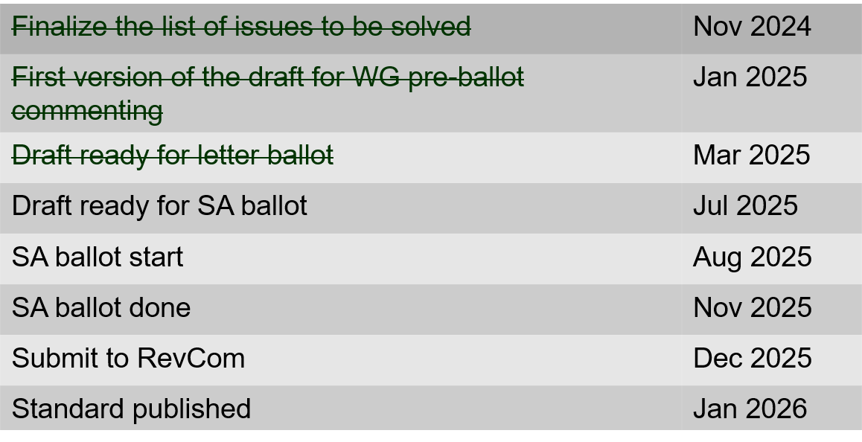
802.15.9a KMP Transport
Extensions to key management: extending to support EDHOC
State: Completed initial WG ballot
Session objectives
Resolve comments
Initiate recirculation ballot
Opening and closing report: https://mentor.ieee.org/802.15/dcn/25/15-25-0217-01-009a-may-opening-and-closing.pptx

Slide 16
IG Access
CCA modes for suspendable CSMA-CA
https://mentor.ieee.org/802.15/dcn/25/15-25-0243-01-acss-cca-modes-for-suspendable-csma-ca.pptx
Contribution on 802.15.4 Spectrum Resource Measurement features
https://mentor.ieee.org/802.15/dcn/25/15-25-0245-01-acss-overview-of-srm-function.pptx

Slide 17
Licensed Narrowband Amendment TG16t
Approved, in publication

Slide 18
TG16me Revision of 802.16-2017
Revision PAR approved
First meeting as TG
Beginning revision work
Heard technical contributions
Closing report: https://mentor.ieee.org/802.15/dcn/25/15-25-0271-00-16me-tg16me-may-2025-closing-report.pptx

Slide 19
TG16me Revision Project Timeline
Milestone | Date
Task Group Start | March 2025
Draft Development | May – Sept 2025
Informal TG review of draft | Nov 2025
Working Group Letter Ballot | March 2026
Working Group Recirculation Letter Ballot | May 2026
SA Ballot | Sept 2026
SA Recirc | Jan 2027
Forward to RevCom | March 2027

