Slide 1
Enhancement of Link Reconfiguration Request/Response
Date: 2025-05-09
Authors:
Name | Affiliation | Address | Phone | Email
Yunpeng Yang | TP-Link |  |  | yangyunpeng@tp-link.com.hk
Yingjie Yan |  |  |  | yanyingjie@tp-link.com.hk
Junbin Chen |  |  |  | chenjunbin@tp-link.com.hk
Yaoshen Cui |  |  |  | cuiyaoshen@tp-link.com.hk
Qingwei Fu |  |  |  | fuqingwei@tp-link.com.hk
Renfang Zhou |  |  |  | zhourenfang@tp-link.com.hk
Shuyu Shi |  |  |  | shishuyu@tp-link.com.hk
Yu Zhu |  |  |  | zhuyu@tp-link.com.hk
Yunpeng Yang (TP-Link)

Slide 2
Introduction
TGbn has agreed to use Link Reconfiguration Request/Response frames as the frames used in roaming preparation and roaming execution [1].
Under existing frame format, when current AP MLD receives a Link Reconfiguration Request frame, it will reconfigure link(s) between current AP MLD and non-AP MLD.
There requires some indications in Link Reconfiguration Request/Response frames to inform that non-AP MLD wants to reconfigure link(s) with current AP MLD or target AP MLD.
In this presentation, we provide the modification of these frames to support seamless roaming functions.

Slide 3
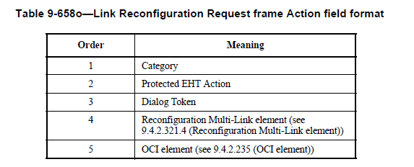
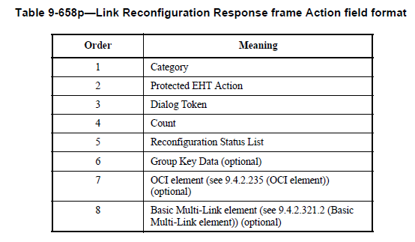
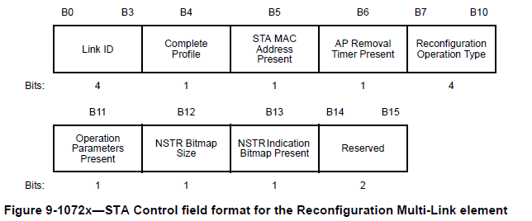
Recap: Link Reconfiguration Request/Response Frames
Link Reconfiguration Request / Response frames are Protected EHT action frames with action code=“11” / “12”.
In request frame, there is a Multi-Link element with Type=“2 (Reconfiguration)”, named Reconfiguration Multi-Link element.
The Presence Bitmap, Common Info and Link Info in Reconfiguration Multi-Link element contain the non-AP MLD’s information used in link reconfiguration.
Link Info
Common Info

Slide 4
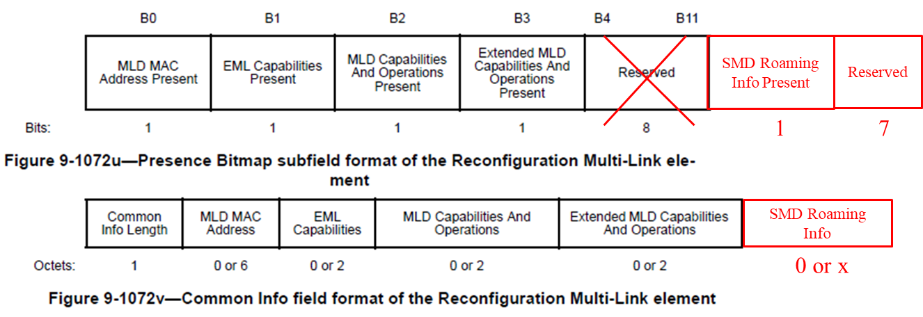
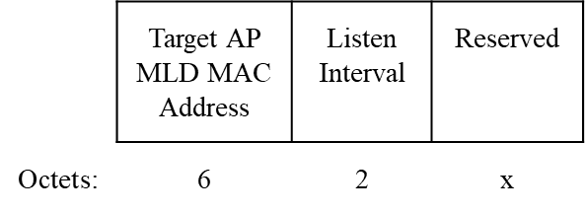
Improvements of Reconfiguration Multi-Link Element
In Link Info field, there may be one or more Per-STA Profile subelement(s), each is used for the configuration of a link specified by Link ID.
Note that link ID is a value that uniquely identifies an AP affiliated with the AP MLD. In roaming scenario, it’s necessary for non-AP MLD to indicate that the Link ID is used for target AP MLD instead of current AP MLD.
We propose to add the related information in Presence Bitmap and in corresponding Common Info field.
If the SMD Roaming Info Present=1, the link reconfiguration request intends to configure link(s) with AP MLD identified by the Target AP MLD MAC Address.
Otherwise, the link reconfiguration request intends to configure link(s) with current AP MLD.

Slide 5
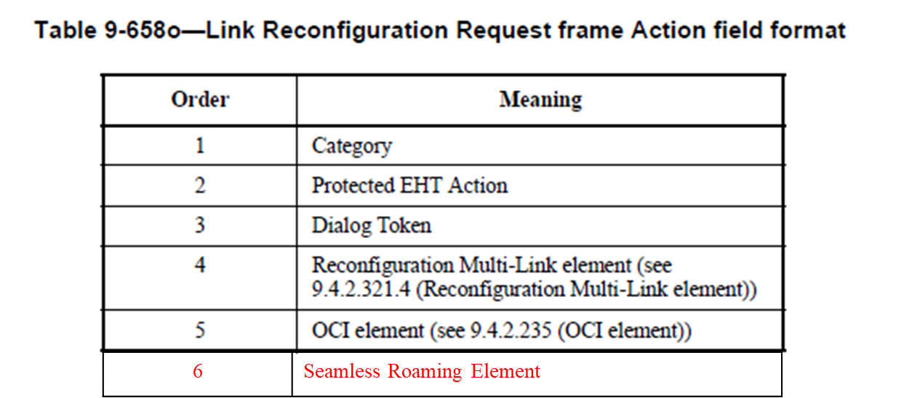
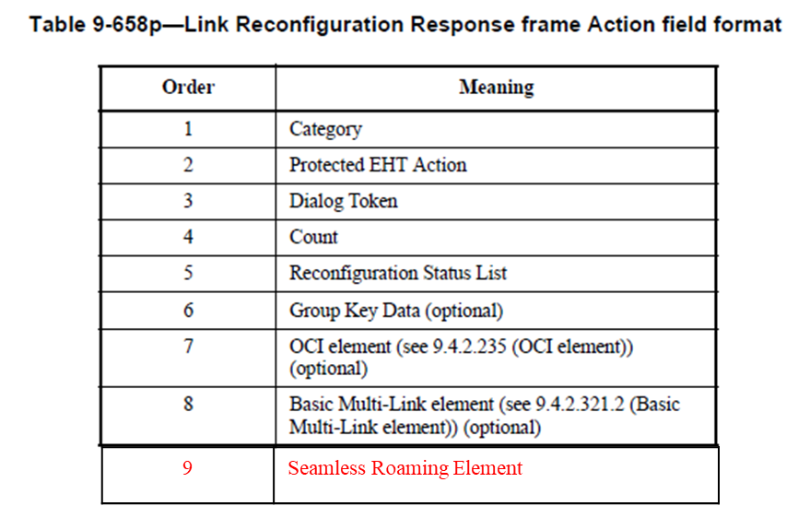
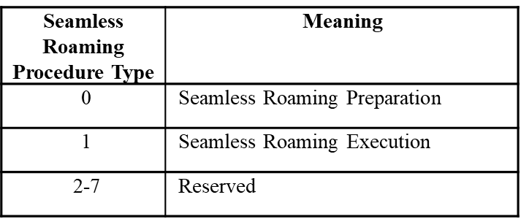
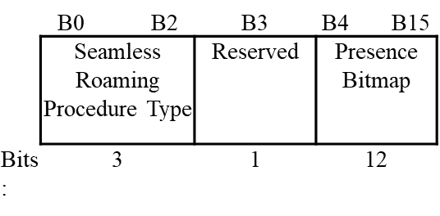
Add New Seamless Roaming Element (1/3)
We propose to add new designed Seamless Roaming element in Link Reconfiguration Request/Response frames.
This element has different types in Req frame and in Resp frame. The type is indicated in Seamless Roaming Control field, which decides the content in Seamless Roaming Operations field.
Seamless Roaming element format
Seamless Roaming Control field format
Seamless Roaming Control field format

Slide 6
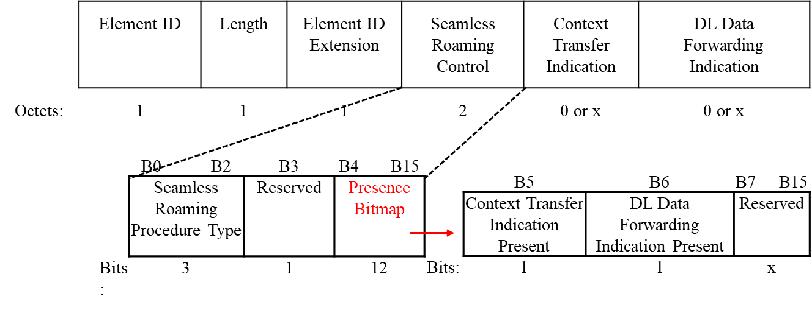
Add New Seamless Roaming Element (2/3)
Seamless Roaming element format in Req frame
Context transfer Indication indicates the context that non-AP MLD wants to transfer from current AP MLD to target AP MLD.
DL Data Forwarding Indication indicates the data forwarding rules from current AP MLD to target AP MLD.
These two field may present in preparation req frame and/or execution req frame.
Seamless Roaming element format in Resp frame
AID and Context Transfer Status may present in preparation resp and/or execution resp.
Seamless Roaming Timeout presents in preparation resp.
DLDrainTime presents in execution resp.

Slide 7
Add New Seamless Roaming Element (3/3)
The Context Transfer Indication field is used for non-AP MLD to indicate which contexts need to be transferred from current AP MLD to target AP MLD.
Contexts transfer can be indicated via different types, such as BA type, TWT Type, MSCS/SCS type etc.
In each type, there may be subtype to indicate details about which contexts are needed.
If data forwarding is supported by SMD, the DL Data Forwarding Indication field indicates the DL data forwarding policy required by non-AP MLD.
For example, DL Data forwarding can be per TID.
The Context Transfer Status field provides the context transfer results, so that non-AP MLD can determine which contexts need to be renegotiated.
The BA context result shall be displayed for each TID.
Recommended parameters (e.g. TWT) may be carried in Context Transfer Status field if the context is refused by target AP MLD.

Slide 8
Summary
In this submission, we have discussed the enhancement of Link Reconfiguration Request/Response frames for seamless roaming.
We propose to enhance the Reconfiguration Multi-Link element to add the the Target AP MLD MAC address information.
The information shall be carried in Common Info field to indicate that the parameters (e.g. Link ID) of Link Info are used for target AP MLD.
We propose to add a new Seamless Roaming element in request/response frames to carry the seamless roaming functionality.
The functions includes context transfer indication, data forwarding indication, timeout value, DLDraintime value and so on.

Slide 9
Reference
[1] 11-24/0209 Specification Framework for TGbn

Slide 10
SP1
Do you support to add the Target AP MLD MAC address information in the Presence Bitmap and Common Info of the Reconfiguration Multi-Link element?

Slide 11
SP2
Do you support to add a new Seamless Roaming element in Link Reconfiguration Request/Response frames to carry the functions of seamless roaming?

