Slide 1
The timing of initiating DL data forwarding
Date: 2025-04-30
Authors:
Name | Affiliation | Address | Phone | Email
Yunpeng Yang | TP-Link |  |  | yangyunpeng@tp-link.com.hk
Yingjie Yan |  |  |  | yanyingjie@tp-link.com.hk
Yaoshen Cui |  |  |  | cuiyaoshen@tp-link.com.hk
Junbin Chen |  |  |  | chenjunbin@tp-link.com.hk
Qingwei Fu |  |  |  | fuqingwei@tp-link.com.hk
Renfang Zhou |  |  |  | zhourenfang@tp-link.com.hk
Shuyu Shi |  |  |  | shishuyu@tp-link.com.hk
Yu Zhu |  |  |  | zhuyu@tp-link.com.hk
Yunpeng Yang(TP-Link)

Slide 2
Abstract
TGbn has agreed DL data forwarding between AP MLDs within same SMD during seamless roaming[1], but when and how to forward DL data is still TBD.
[Motion#27] As part of the seamless roaming procedure, during roaming,
after the request/response exchange that initiates notification of the DS mapping change from the current AP MLD to the target AP MLD,
The current AP MLD may deliver buffered DL data frames for a TBD period of time.
The non-AP MLD may retrieve buffered DL data frames from the current AP MLD
The non-AP MLD may send UL data to target AP MLD.
It is assumed that the target AP MLD is able to deliver data frames to non-AP MLD after the DS mapping change
The current AP MLD may forward DL data to the target AP MLD.
When and how to initiate the forwarding of DL data is TBD
Some submissions[2-3] agree that data forwarding can be initiated after roaming request, i.e., during/after roaming execution stage.
In this presentation, we propose that data forwarding can also be initiated once successful preparation to minimize the DL delay after roaming caused by unavailable DLDrainTime.

Slide 3
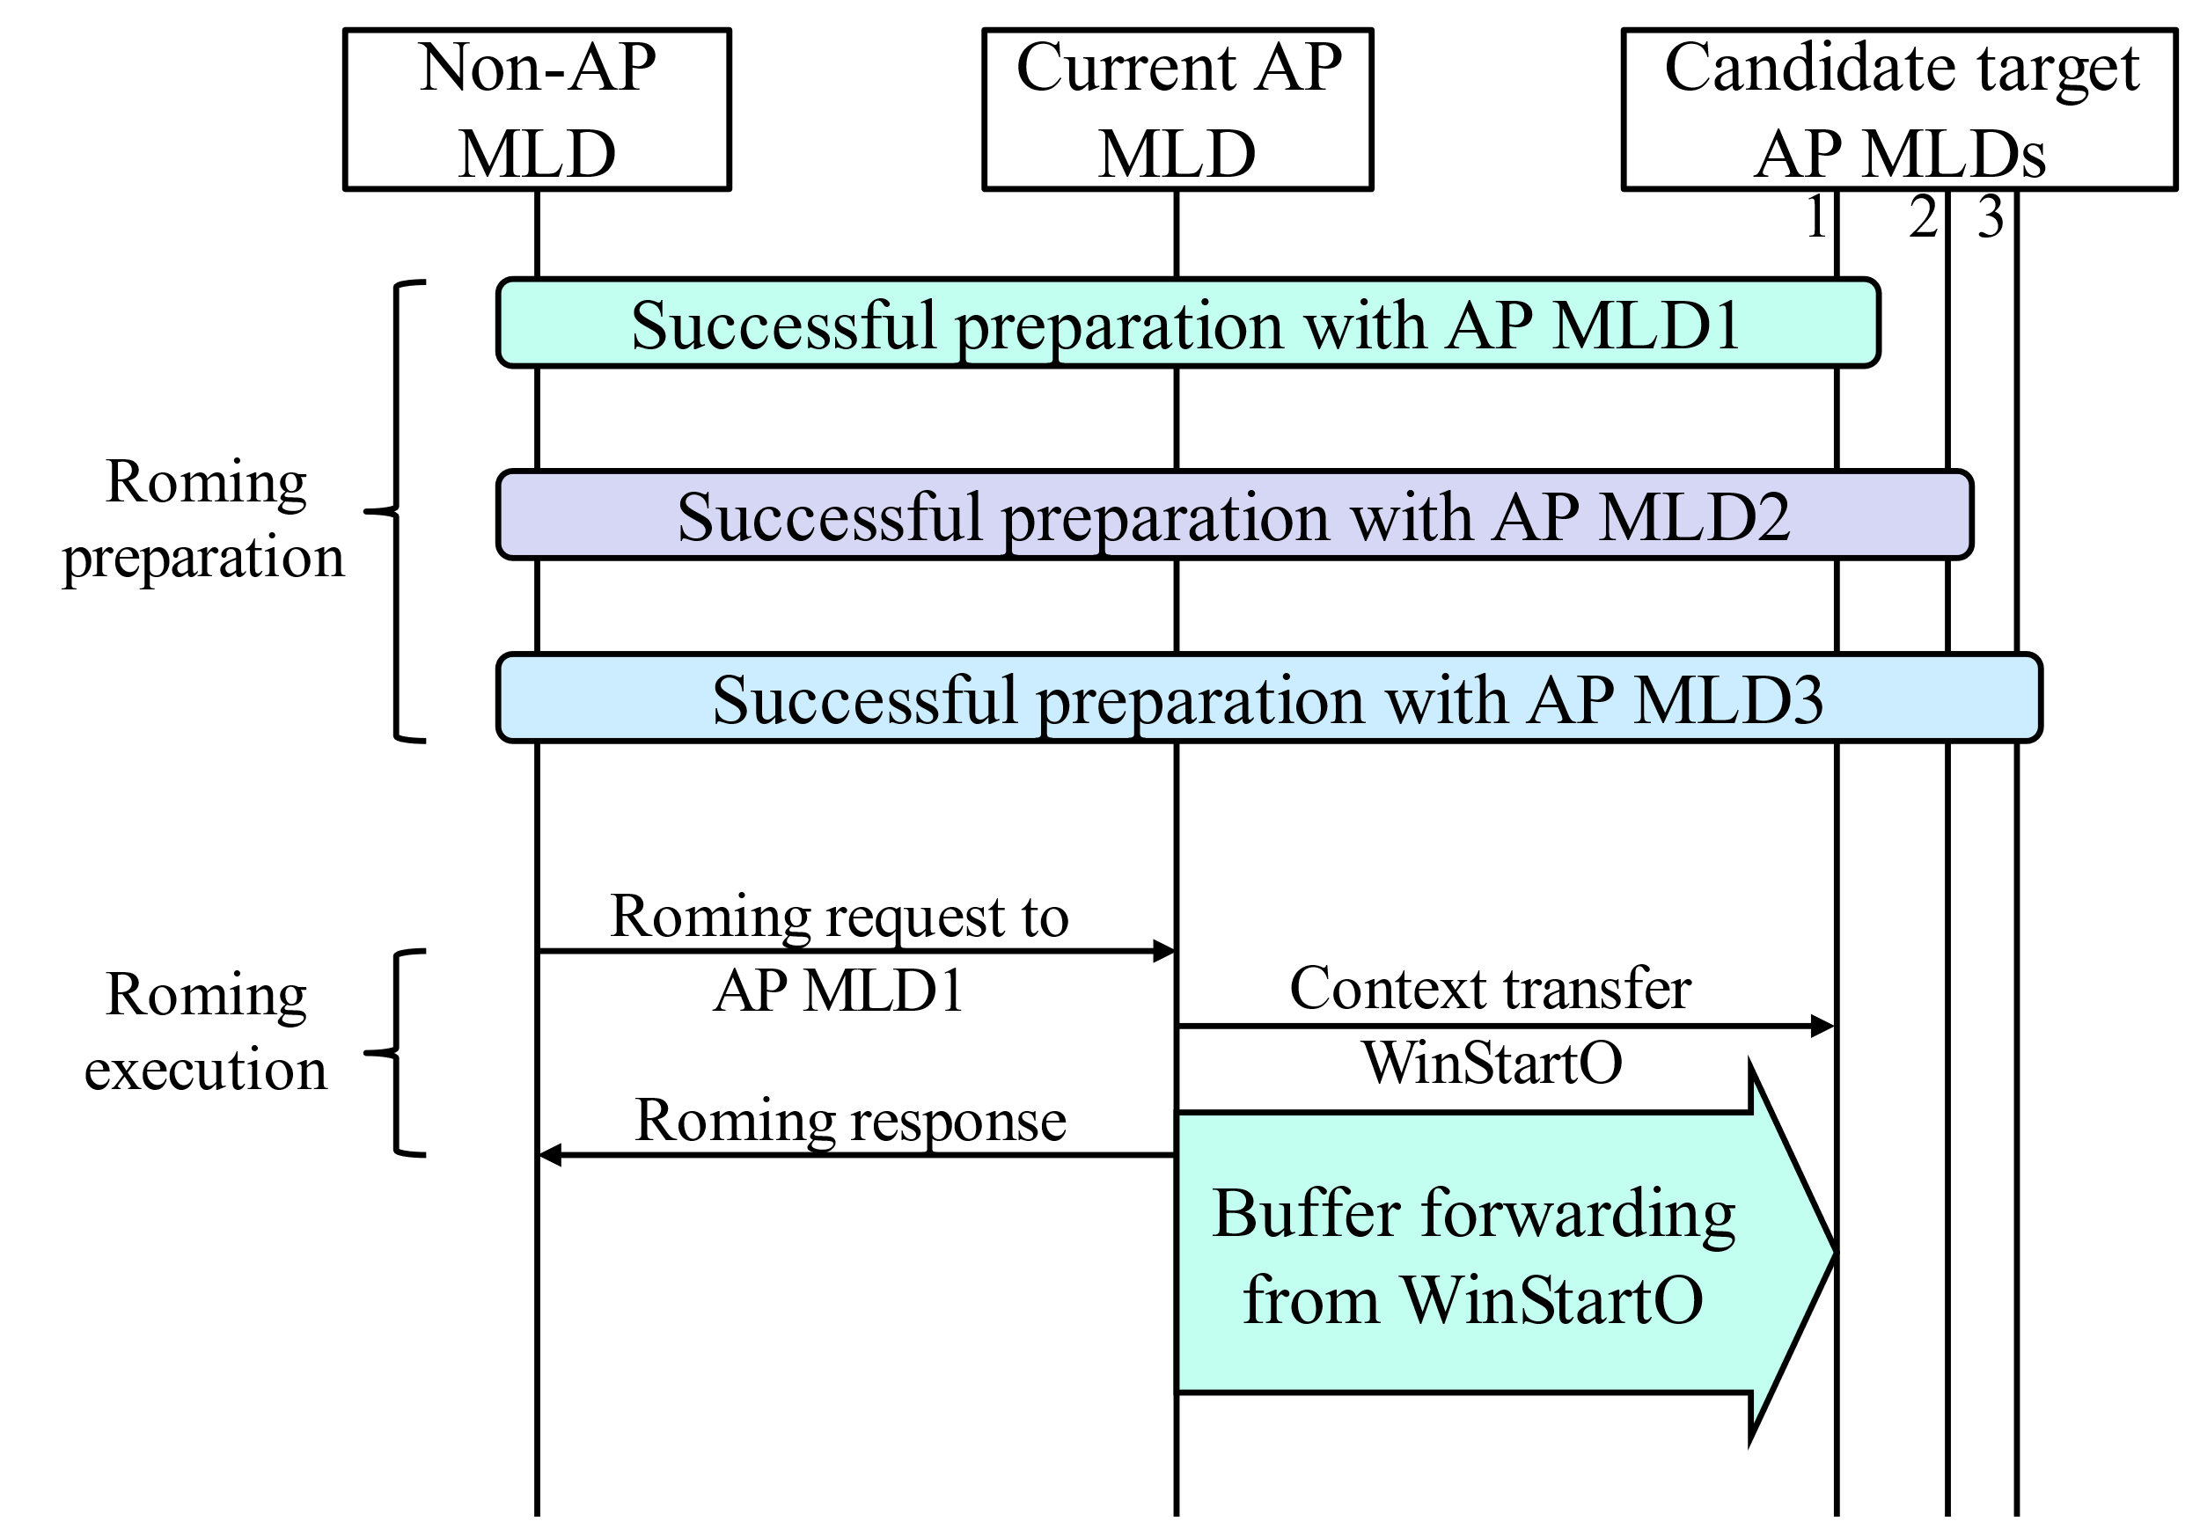
Common Case: Data Forwarding After Roaming Request
During roaming preparation, non-AP MLD may make preparations with multiple candidate target AP MLDs.
During roaming execution, non-AP chooses one target AP MLD.
Current AP MLD transfers WinStartO to target AP MLD.
Current AP MLD initiates data forwarding from WinStartO to target AP MLD.
Problem: After roaming response, if current AP MLD suffers from poor link (no DLDrainTime), non-AP MLD has to wait for a while to receive DL data from target AP MLD, which may lead to latency.
Waiting for data forwarding from current AP MLD to target AP MLD
DL delay due to data forwarding
Link is too poor to retrieve buffered data
DL data

Slide 4
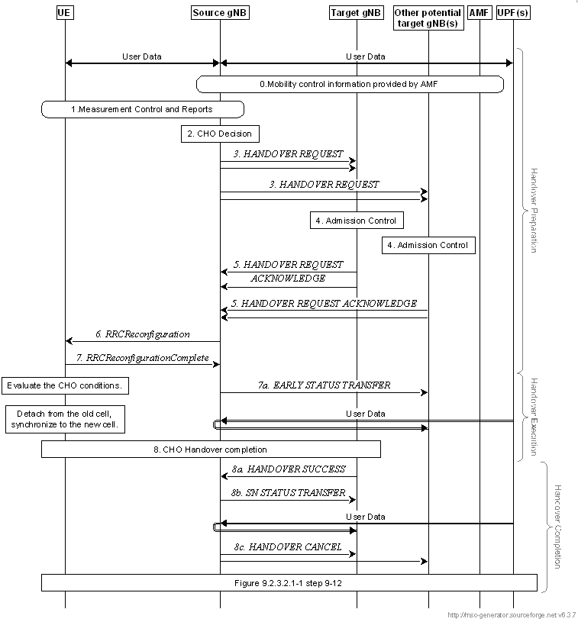
Recap: Data Forwarding in 3GPP Handover
gNB1
gNB2
There are two modes of data forwarding specified in 3GPP Handover [4], i.e., early data forwarding and late data forwarding.
Early Data Forwarding: data forwarding that is initiated before the UE executes the handover.
Late Data Forwarding: data forwarding that is initiated after the source NG-RAN node knows that the UE has successfully accessed a target NG-RAN node.
If early data forwarding is applied, source gNB may initiate data forwarding upon reception of HANDOVER REQUEST ACKNOWLEDGE.
Data may be forwarded to multiple candidate target gNBs before handover execution.
Once handover is completed, target gNB can transmit DL data to UE immediately.
If late data forwarding is applied, source gNB may initiate data forwarding upon reception of HANDOVER SUCCESS.
Data will be forwarded to one target gBN after successful handover execution.
Target gNB shall wait for data forwarding before it can transmit DL data to UE.
Similar ways can be introduced in seamless roaming to minimize the DL delay after roaming response.
Initiate early data forwarding to gNB1
Initiate early data forwarding to gNB2
Initiate late data forwarding to gNB1

Slide 5
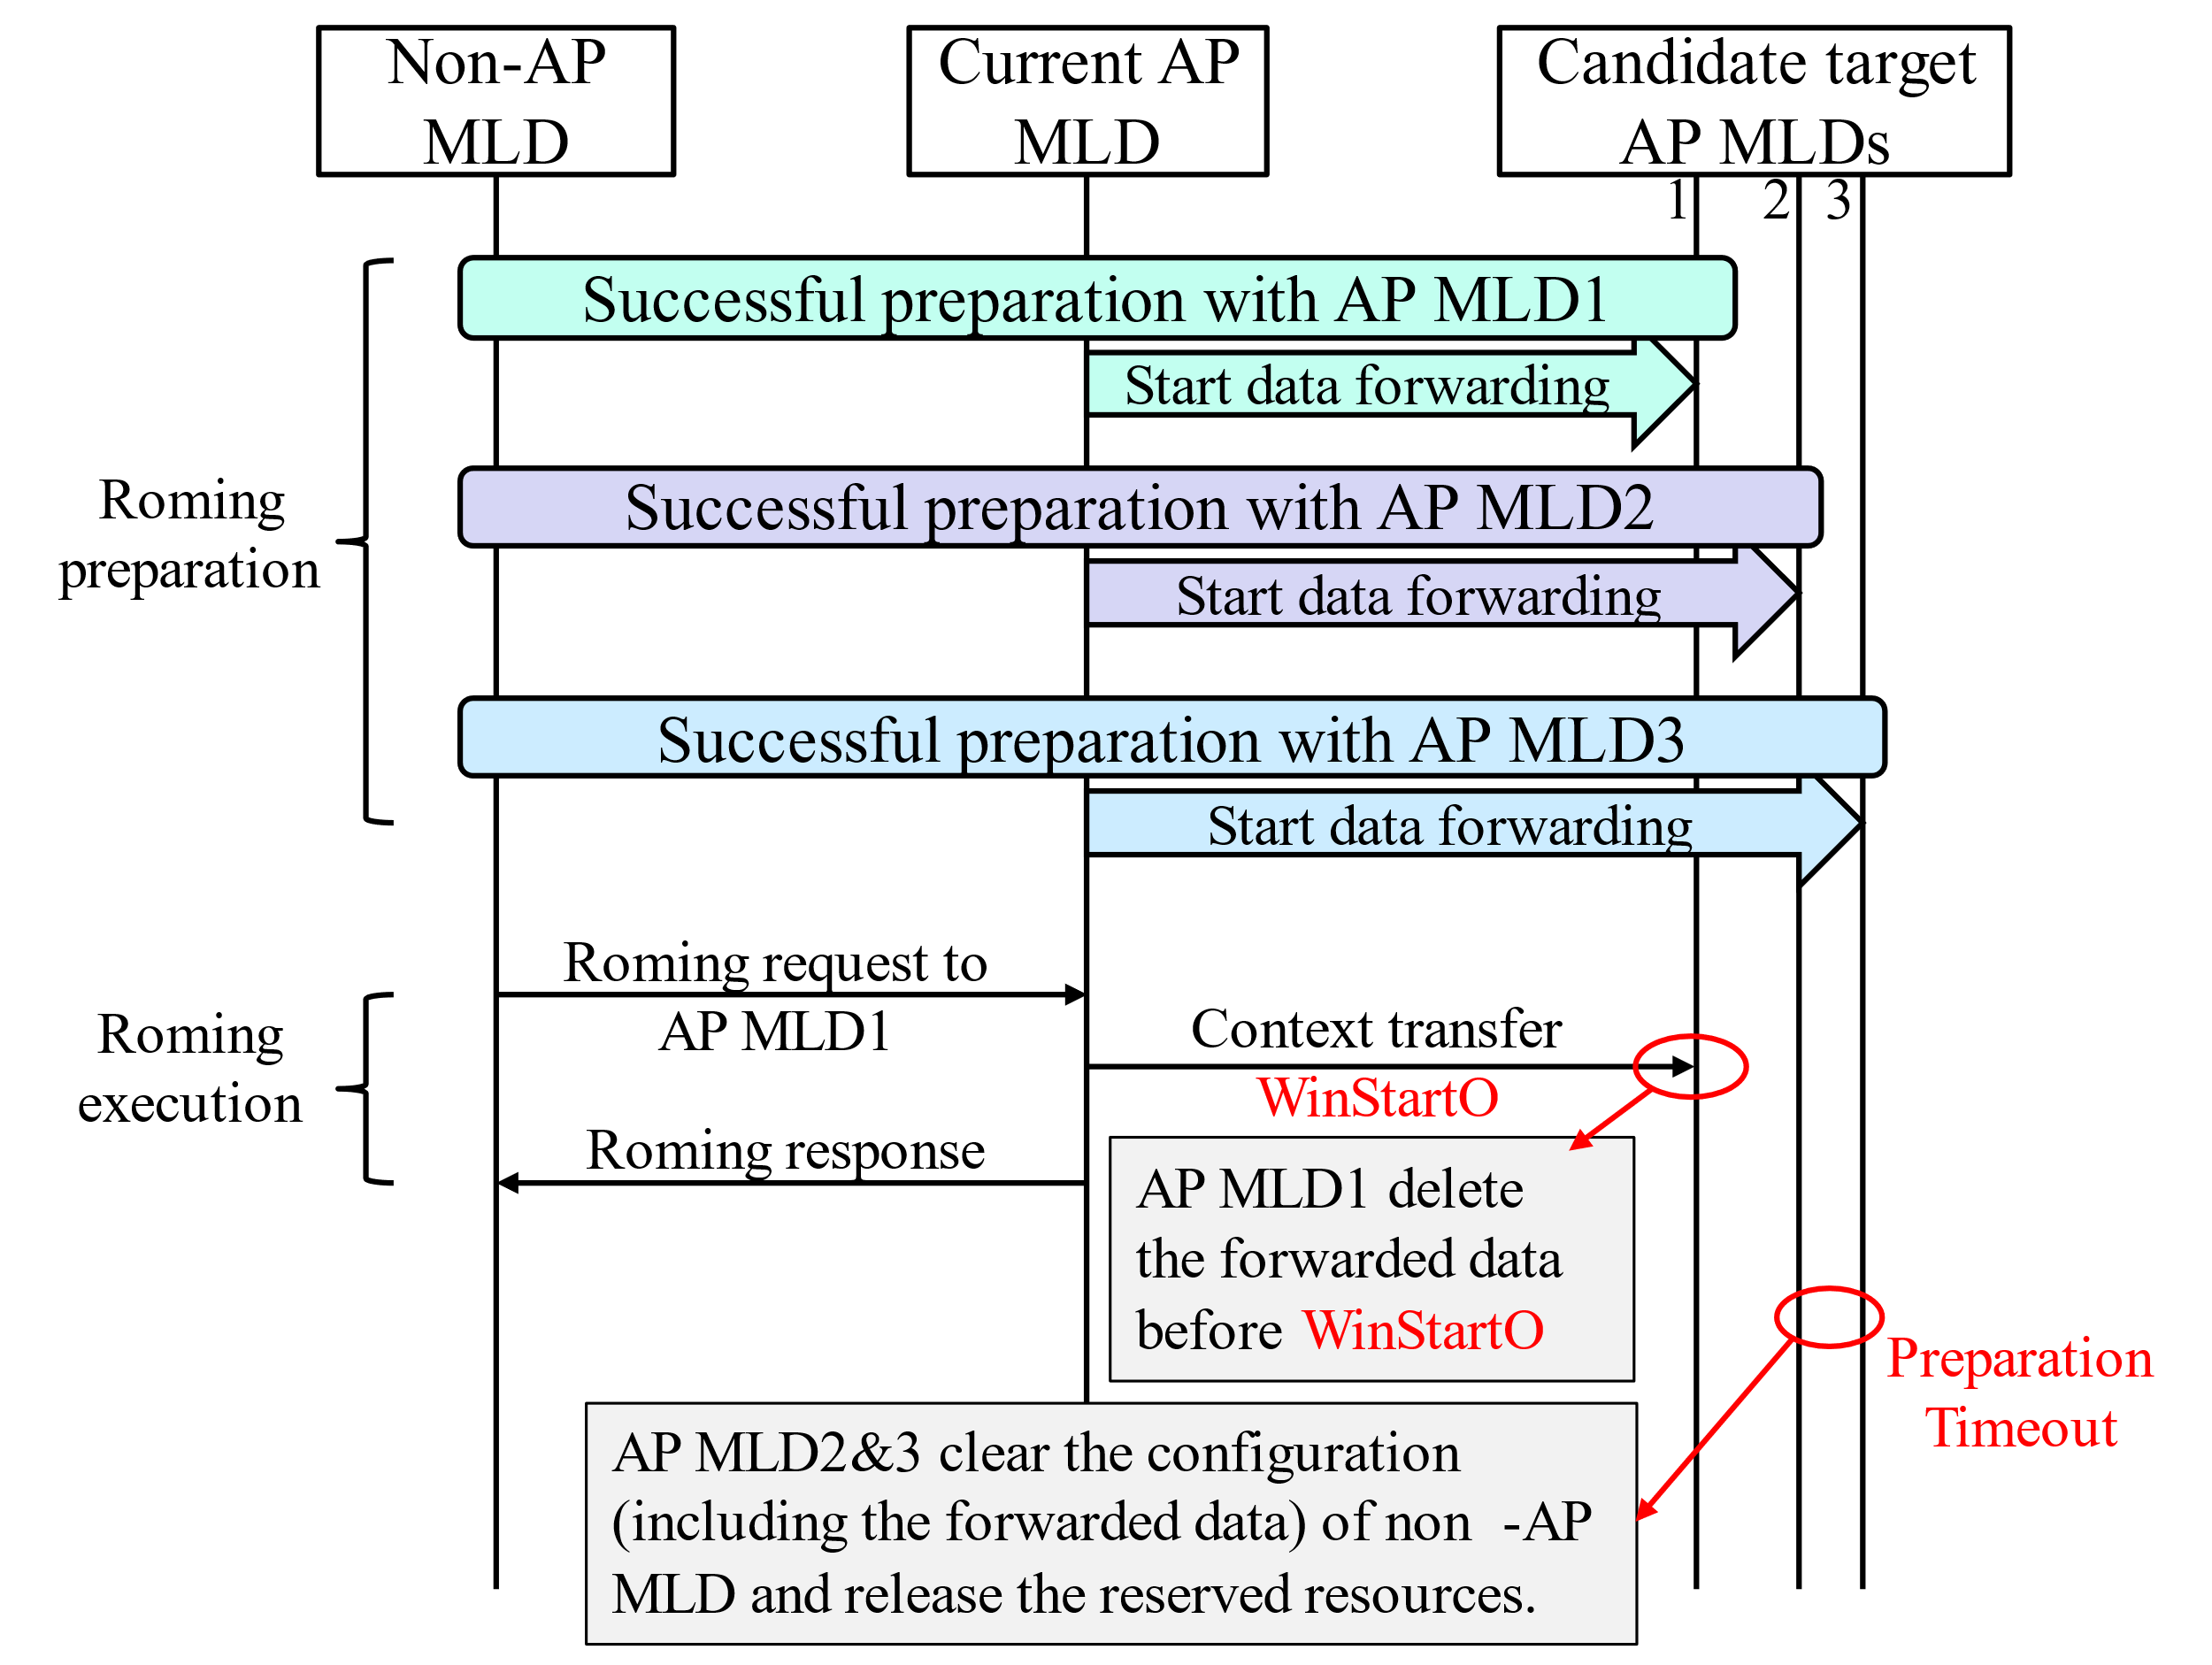
Propose: Data Forwarding After Successful Preparation
During roaming preparation, non-AP MLD may make preparations with multiple (two or three) candidate target AP MLDs.
Current AP MLD initiates data forwarding to an AP MLD after successful preparation.
The forwarded data will be buffered in candidate target AP MLD.
Once data forwarding initiated, all data in buffer and from DS before DS mapping update will be forwarded to target AP MLD.
Data forwarding may last until DS mapping update.
To avoid occupying too much resources for data forwarding, the number of prepared AP MLDs and the buffer size of target AP MLD to store the forwarded data should be limited.

Slide 6
Propose: Data Forwarding After Successful Preparation
During roaming execution, non-AP chooses a target AP MLD.
Current AP MLD transfers WinStartO to target AP MLD.
Target AP MLD discards the forwarded data before WinStartO, and transmits data to non-AP MLD from WinStartO after roaming response.
Other prepared candidate target AP MLDs will clear the configuration (including the forwarded data) about non-AP MLD after timeout or TBD indicate signal.
The timeout value is indicated in roaming preparation.
TBD indicate signal may be send by non-AP MLD or current AP MLD
Advantage and disadvantage:
Target AP MLD can transmit forwarded data to non-AP MLD after roaming response, which reduces the latency of roaming.
However, it occupies more resources than common case.

Slide 7
Summary
We propose that data forwarding may be initiated once successful preparation.
Current AP MLD may forward buffered data to multiple (two or three) candidate target AP MLDs simultaneously. Candidate target AP MLDs shall buffer the forwarded data before they can transmit to non-AP MLD.
Context transfer in roaming execution can indicated the WinStartO, and target AP MLD discard the data before WinStartO.
Low latency. There is pending data at target AP MLD so that it can transmit data immediately after roaming response, which reduces DL delay especially when unavailable DLDrainTime.
Occupy more resources. Multiple candidate target AP MLDs need reserve resources for non-AP MLD.

Slide 8
Reference
[1] 11-24/0209 Specification Framework for TGbn
[2] 11-24/1517 Seamless Roaming Data Transfer
[3] 11-24/1528 Details on data forwarding for seamless roaming
[4] 3GPP TS 38.300 V18.0.0

Slide 9
SP1
Do you support that data forwarding can be initiated once successful preparation is made?
The numbers of prepared candidate AP MLDs is TBD
The buffer size of target AP MLD to store the forwarded data is TBD.

