Slide 1
PAPR reduction considerations
Date: 2025-05-14
Authors:

Slide 2
Abstract
May 2025
This contribution aims to kickstart technical discussion on
peak-to-average power ratio (PAPR) reduction
for direct-current orthogonal frequency division multiplexing (DC-OFDM) signals

Slide 3
Outline
May 2025
Motivation
Possible Solutions
Discrete Fourier Transform (DFT) Spreading and Related Technologies
DFT-s-OFDM/SC-FDMA in 3GPP
DFT-s-OFDM/SC-FDMA in 802.11 + 2 slides
2x Straw polls
Conclusion

Slide 4
Motivation
May 2025
High PAPR has a greater impact on the performance of light communications (LC) than radio frequency (RF) communications:
Non-negative signal requirement
High PAPR requires higher DC bias ➔ higher power consumption and lower eye safety
Light source nonlinearities
Temperature dependence, etc., ➔ increased costs to overcome high PAPR
For RF comms, primary issue is power amplifier (PA) nonlinearities

Slide 5
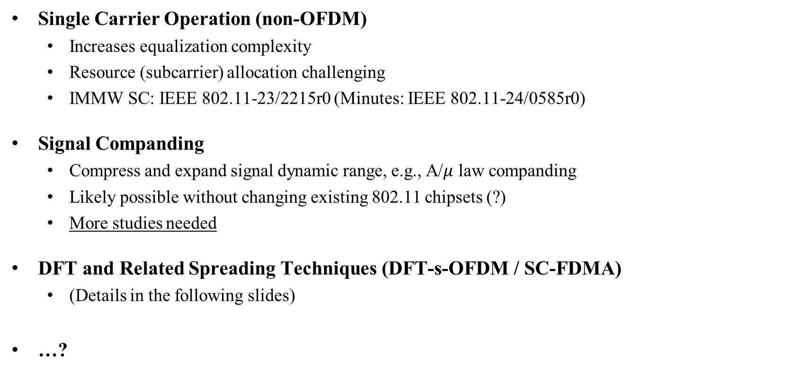
Possible Solutions
May 2025
Single Carrier Operation (non-OFDM)
Increases equalization complexity
Resource (subcarrier) allocation challenging
IMMW SC: IEEE 802.11-23/2215r0 (Minutes: IEEE 802.11-24/0585r0)
Signal Companding
Compress and expand signal dynamic range, e.g., A/$μ$ law companding
Likely possible without changing existing 802.11 chipsets (?)
More studies needed
DFT and Related Spreading Techniques (DFT-s-OFDM / SC-FDMA)
(Details in the following slides)
…?

Slide 6
DFT and Related Spreading Techniques
May 2025
Several proposals in 3GPP, 802.11, and academic literature (in the following)
Retains the benefits of OFDM while achieving a lower PAPR – also termed SC-FDMA
Several alternatives to M-DFT have been proposed: Sine and cosine transform based
May lead to more advantageous output distributions than DFT spreading
Forward Error Correction
Interleaving + Mapping
M-DFT
N-IDFT

Slide 7
DFT-s-OFDM/SC-FDMA in 3GPP
May 2025
Long Term Evolution (LTE) Release 8: Mandatory for Uplink
Low PAPR
Further details available in 3GPP RAN1 meeting documents, e.g., RAN1#41—44.
5th Generation (5G) New Radio (NR) Release 15: Optional for Uplink
Mainly for Internet of Things (IoT) devices and low-power handsets
Driven by advancements in PAs

Slide 8
DFT-s-OFDM/SC-FDMA in 802.11
May 2025
Part of the LC tutorial by Nikola, Volker, Yeong, and John in July 2017
Doc: IEEE 802.11-17/0962r3
Unsuccessfully brought up in 802.11 TGs (RF comms) four times
May 2011, 802.11ah: IEEE 802.11-11/0753r0
Not followed up: IEEE 802.11-11/0845r0
Mar 2012, 802.11ah: IEEE 802.11-12/0349r1
Moderate success: IEEE 802.11-12/0468r0
Unsuccessful: IEEE 802.11-12/1452r0 (number incorrect in DOC)
Jan 2017, 802.11ay: IEEE 802.11-17/0048r0
Successful with many abstains: IEEE 802.11-17/0177r0
Mar 2017, 802.11ay: IEEE 802.11-17/0428r0
Unsuccessful: IEEE 802.11-17/0508r0
Discussed in IMMW SC Minutes (IEEE 802.11-24/0585r0) regarding IEEE 802.11-23/2215r0

Slide 9
IEEE 802.11-12/0468r0 (39.2)
May 2025
Analog filtering of signals before presenting simulation results
Impact of gain (?) – Perhaps not relevant for LC
DFT-s-OFDM complexity
Uplink or downlink?
Only on data or also other frames? SIG field robustness

Slide 10
IEEE 802.11-12/1452r0 (29.2)
May 2025
Revised channel estimation technique + simulation
Signalling/pilot frames: Long training field (LTF) / short training field (STF) redefinition?
Quantifying of PAPR reduction compared to OFDM
Characterize SIG field PAPR with DFT spreading
Travelling pilots
…

Slide 11
Conclusion
May 2025
High PAPR has a greater impact on LC than RF comms
Several detailed aspects must be addressed
In TGbr, we are well in time to address relevant aspects of PAPR reduction in detail and make a proposal

Slide 12
Straw Poll 1: Broad Proposal for Inclusion into SFD
May 2025
“ELC PHY TX¹ may support techniques for PAPR reduction of the LC intermediate frequency (IF) signal”
Y / N / A: (5 / 4 / 7)
¹ IEEE Std 802.11bb-2003 Amendment 6: Light Communications, Figure 33-1

Slide 13
Straw Poll 2: Broad Proposal for Inclusion into SFD
May 2025
“RF ELC Converter² may support techniques for PAPR reduction of the LC intermediate frequency (IF) signal”
Y / N / A: (1 / 4 / 10)
² IEEE Std 802.11bb-2003 Amendment 6: Light Communications, Figure 33-2

Slide 14
Thank You
May 2025

