Slide 1
PAPR reduction considerations
Date: 2025-05-13
Authors:

Slide 2
Abstract
May 2025
This contribution aims to kickstart technical discussion on
peak-to-average power ratio (PAPR) reduction
for direct-current orthogonal frequency division multiplexing (DC-OFDM) signals

Slide 3
Outline
May 2025
Motivation
Possible Solutions
Discrete Fourier Transform (DFT) Spreading and Related Technologies
  DFT-s-OFDM/SC-FDMA in 3GPP
  DFT-s-OFDM/SC-FDMA in 802.11 + 2 slides
2x Straw polls
Conclusion

Slide 4
Motivation
May 2025
High PAPR has a greater impact on the performance of light communications (LC) than radio frequency (RF) communications:
Non-negative signal requirement
  High PAPR requires higher DC bias ➔ higher power consumption and lower eye safety
Light source nonlinearities
  Temperature dependence, etc., ➔ increased costs to overcome high PAPR
  For RF comms, primary issue is power amplifier (PA) nonlinearities

Slide 5
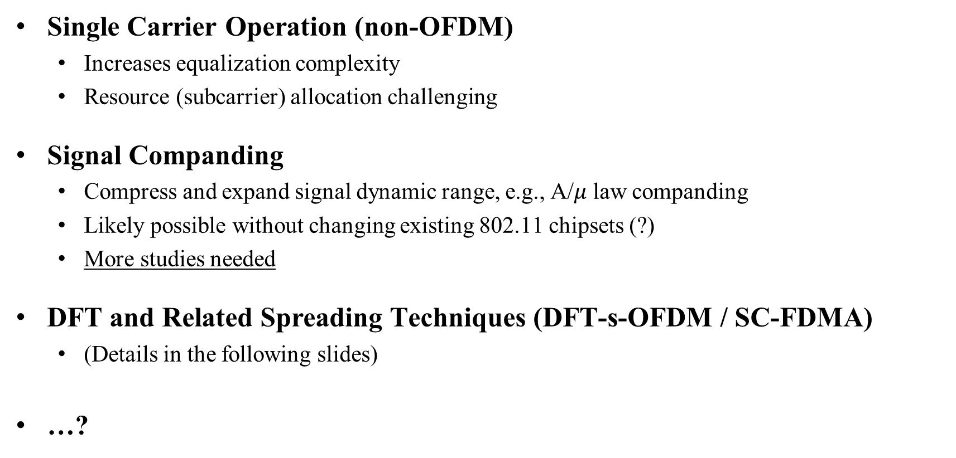
Possible Solutions
May 2025
Single Carrier Operation (non-OFDM)
  Increases equalization complexity
  Resource (subcarrier) allocation challenging
Signal Companding
  Compress and expand signal dynamic range, e.g., A/$μ$ law companding
  Likely possible without changing existing 802.11 chipsets (?)
  More studies needed
DFT and Related Spreading Techniques (DFT-s-OFDM / SC-FDMA)
  (Details in the following slides)
…?

Slide 6
DFT and Related Spreading Techniques
May 2025
  Several proposals in 3GPP, 802.11, and academic literature (in the following)
  Retains the benefits of OFDM while achieving a lower PAPR – also termed SC-FDMA
  Several alternatives to M-DFT have been proposed: Sine and cosine transform based
    May lead to more advantageous output distributions than DFT spreading
Forward Error Correction
Interleaving + Mapping
M-DFT
N-IDFT

Slide 7
DFT-s-OFDM/SC-FDMA in 3GPP
May 2025
Long Term Evolution (LTE) Release 8: Mandatory for Uplink
  Low PAPR
  Further details available in 3GPP RAN1 meeting documents, e.g., RAN1#41—44.
5th Generation (5G) New Radio (NR) Release 15: Optional for Uplink
  Mainly for Internet of Things (IoT) devices and low-power handsets
  Driven by advancements in PAs

Slide 8
DFT-s-OFDM/SC-FDMA in 802.11
May 2025
Part of the LC tutorial by Nikola, Volker, Yeong, and John in July 2017
  Doc: IEEE 802.11-17/0962r3
Unsuccessfully brought up in 802.11 TGs (RF comms) four times
  May 2011, 802.11ah: IEEE 802.11-11/0753r0
    Not followed up: IEEE 802.11-11/0845r0
  Mar 2012, 802.11ah: IEEE 802.11-12/0349r1
    Moderate success: IEEE 802.11-12/0468r0
    Unsuccessful: IEEE 802.11-12/1452r0 (number incorrect in DOC)
  Jan 2017, 802.11ay: IEEE 802.11-17/0048r0
    Successful with many abstains: IEEE 802.11-17/0177r0
  Mar 2017, 802.11ay: IEEE 802.11-17/0428r0
    Unsuccessful: IEEE 802.11-17/0508r0

Slide 9
IEEE 802.11-12/0468r0 (39.2)
May 2025
  Analog filtering of signals before presenting simulation results
  Impact of gain (?) – Perhaps not relevant for LC
  DFT-s-OFDM complexity
  Uplink or downlink?
  Only on data or also other frames? SIG field robustness

Slide 10
IEEE 802.11-12/1452r0 (29.2)
May 2025
  Revised channel estimation technique + simulation
  Signalling/pilot frames: Long training field (LTF) / short training field (STF) redefinition?
  Quantifying of PAPR reduction compared to OFDM
  Characterize SIG field PAPR with DFT spreading
  Travelling pilots
  …

Slide 11
Conclusion
May 2025
High PAPR has a greater impact on LC than RF comms
Several detailed aspects must be addressed
In TGbr, we are well in time to address relevant aspects of PAPR reduction in detail and make a proposal

Slide 12
Straw Poll 1: Broad Proposal for Inclusion into SFD
May 2025
“LC PHY TX¹ shall support optional techniques for PAPR reduction of the LC intermediate frequency (IF) signal”
Y / N / A:
¹ IEEE Std 802.11bb-2003 Amendment 6: Light Communications, Figure 33-1

Slide 13
Straw Poll 2: Broad Proposal for Inclusion into SFD
May 2025
“RF LC Converter² shall support optional techniques for PAPR reduction of the LC intermediate frequency (IF) signal”
Y / N / A:
² IEEE Std 802.11bb-2003 Amendment 6: Light Communications, Figure 33-2

Slide 14
Thank You
May 2025

