Slide 1
MLO-Based IMMW Channel Access
Date: 2025-05-11
Authors:
Name | Affiliations | Address | Phone | Email
Yurong Qian | ZTE |  |  | qian.yurong@zte.com.cn
Zisheng Wang
Qisheng Huang
Bo Cao
Yaodong Zhang
Yihua Xu | China Mobile (Hangzhou) Information Technology Co., Ltd
Chaofan Ji

Slide 2
Introduce
The scope of 802.11bq proposes to expand multi-link operation defined for sub-7.25 GHz bands to support non-standalone operation in the 42 GHz to 71 GHz unlicensed bands [1].
Several contributions have proposed offloading certain management and control frames of the mmWave link to a sub-7.25 GHz link based on MLO [2]–[5].
In this contribution, we present our insights into sector-level channel access mechanism for the mmWave link based on MLO.

Slide 3
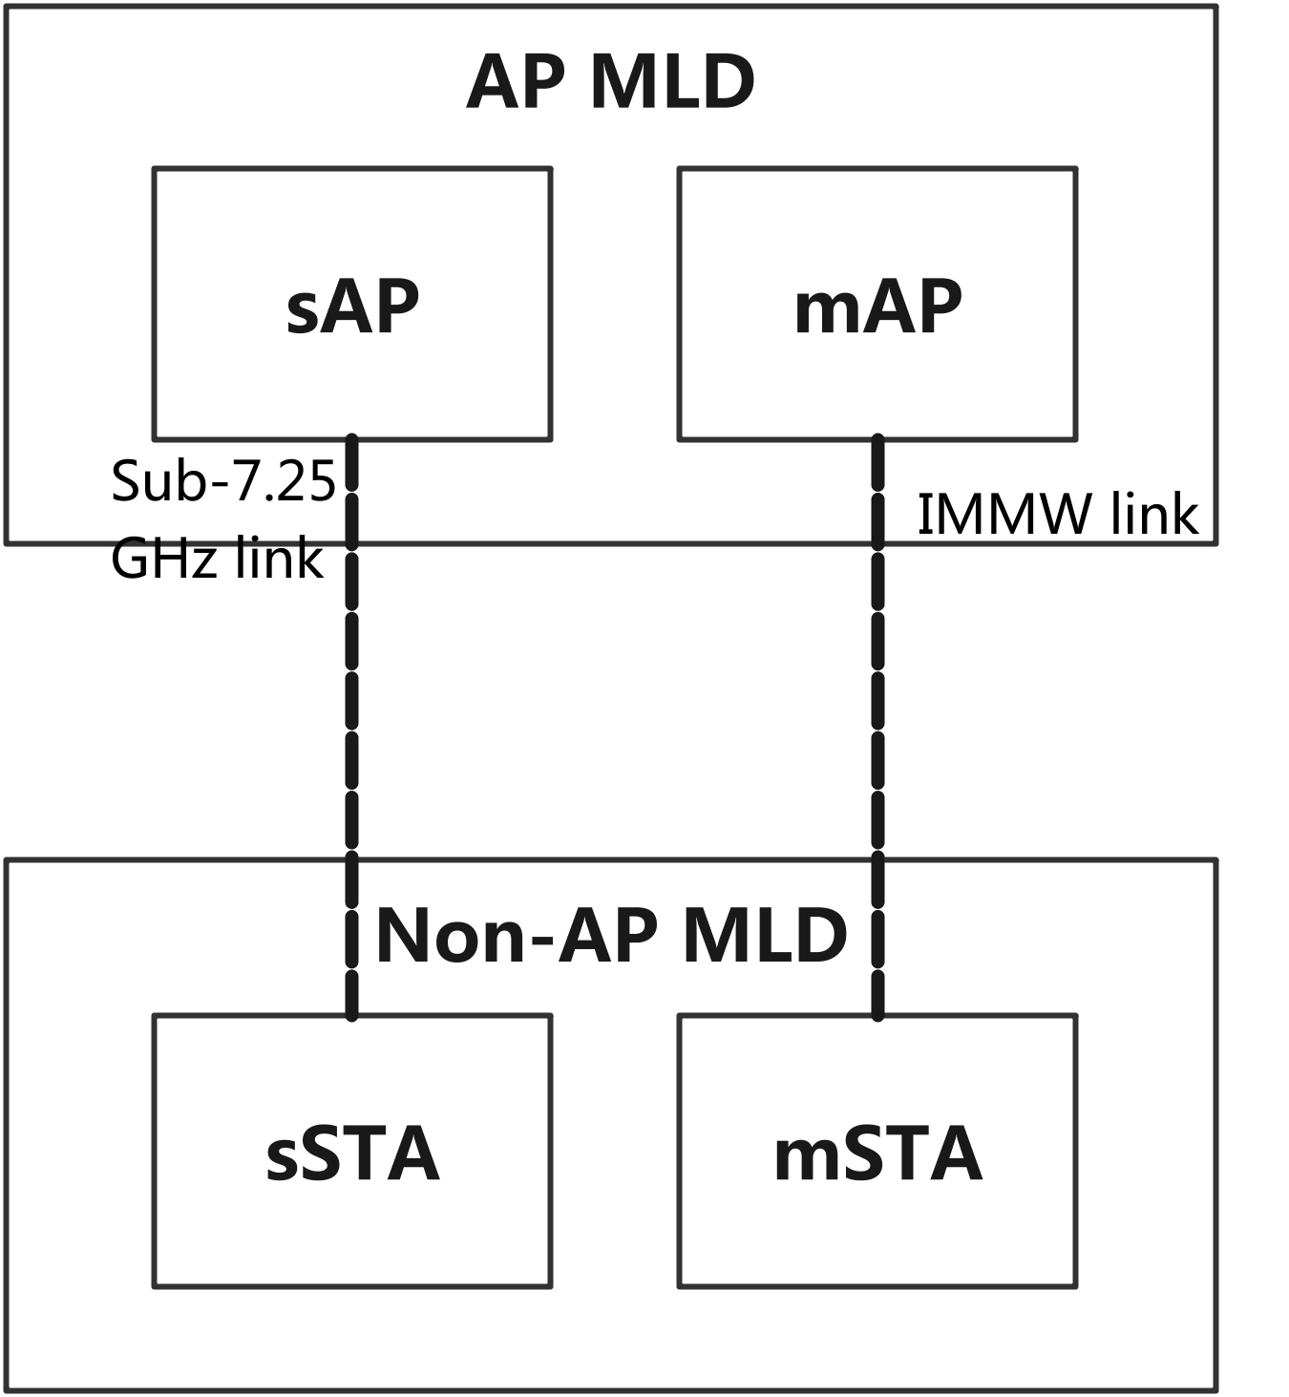
Illustration of MLO-based IMMW operation
For the AP and STA operating in the mmWave band, there should be corresponding AP and STA operating in the sub-7.25 GHz band, which respectively affiliated with the same MLDs as the mmWave AP and STA.
The AP and STA operating over the mmWave band are referred to as mAP and mSTA, respectively, whereas the AP and STA operating over the sub-7.25 GHz band are referred to as sAP and sSTA.
The sAP and sSTA are capable of exchanging certain management and control frames on behalf of the mAP and mSTA affiliated with the same MLDs as the sAP and sSTA.

Slide 4
Problem of mmWave Channel Access
Directional transmissions in mmWave channels create carrier sensing blind zones, which greatly increase the chance of hidden node problems.
When the sAP is serving a specific sector, it may lose medium synchronization with other sectors.
When switching to another sector, the sAP may be unable to determine the appropriate timing for channel access without the medium busy/idle status.
Full-sector channel protection can solve the above issue, it significantly reduce medium access efficiency.
Channel access is not restricted to a specific sector.
Once the AP successfully obtains a TXOP, all third-party devices that may cause potential interference to any of the AP’s sectors should defer their transmissions accordingly.
The AP may transmit on only one sector, while transmission opportunities in other sectors—where the medium is idle—are left unused, resulting in wasted channel resources.

Slide 5
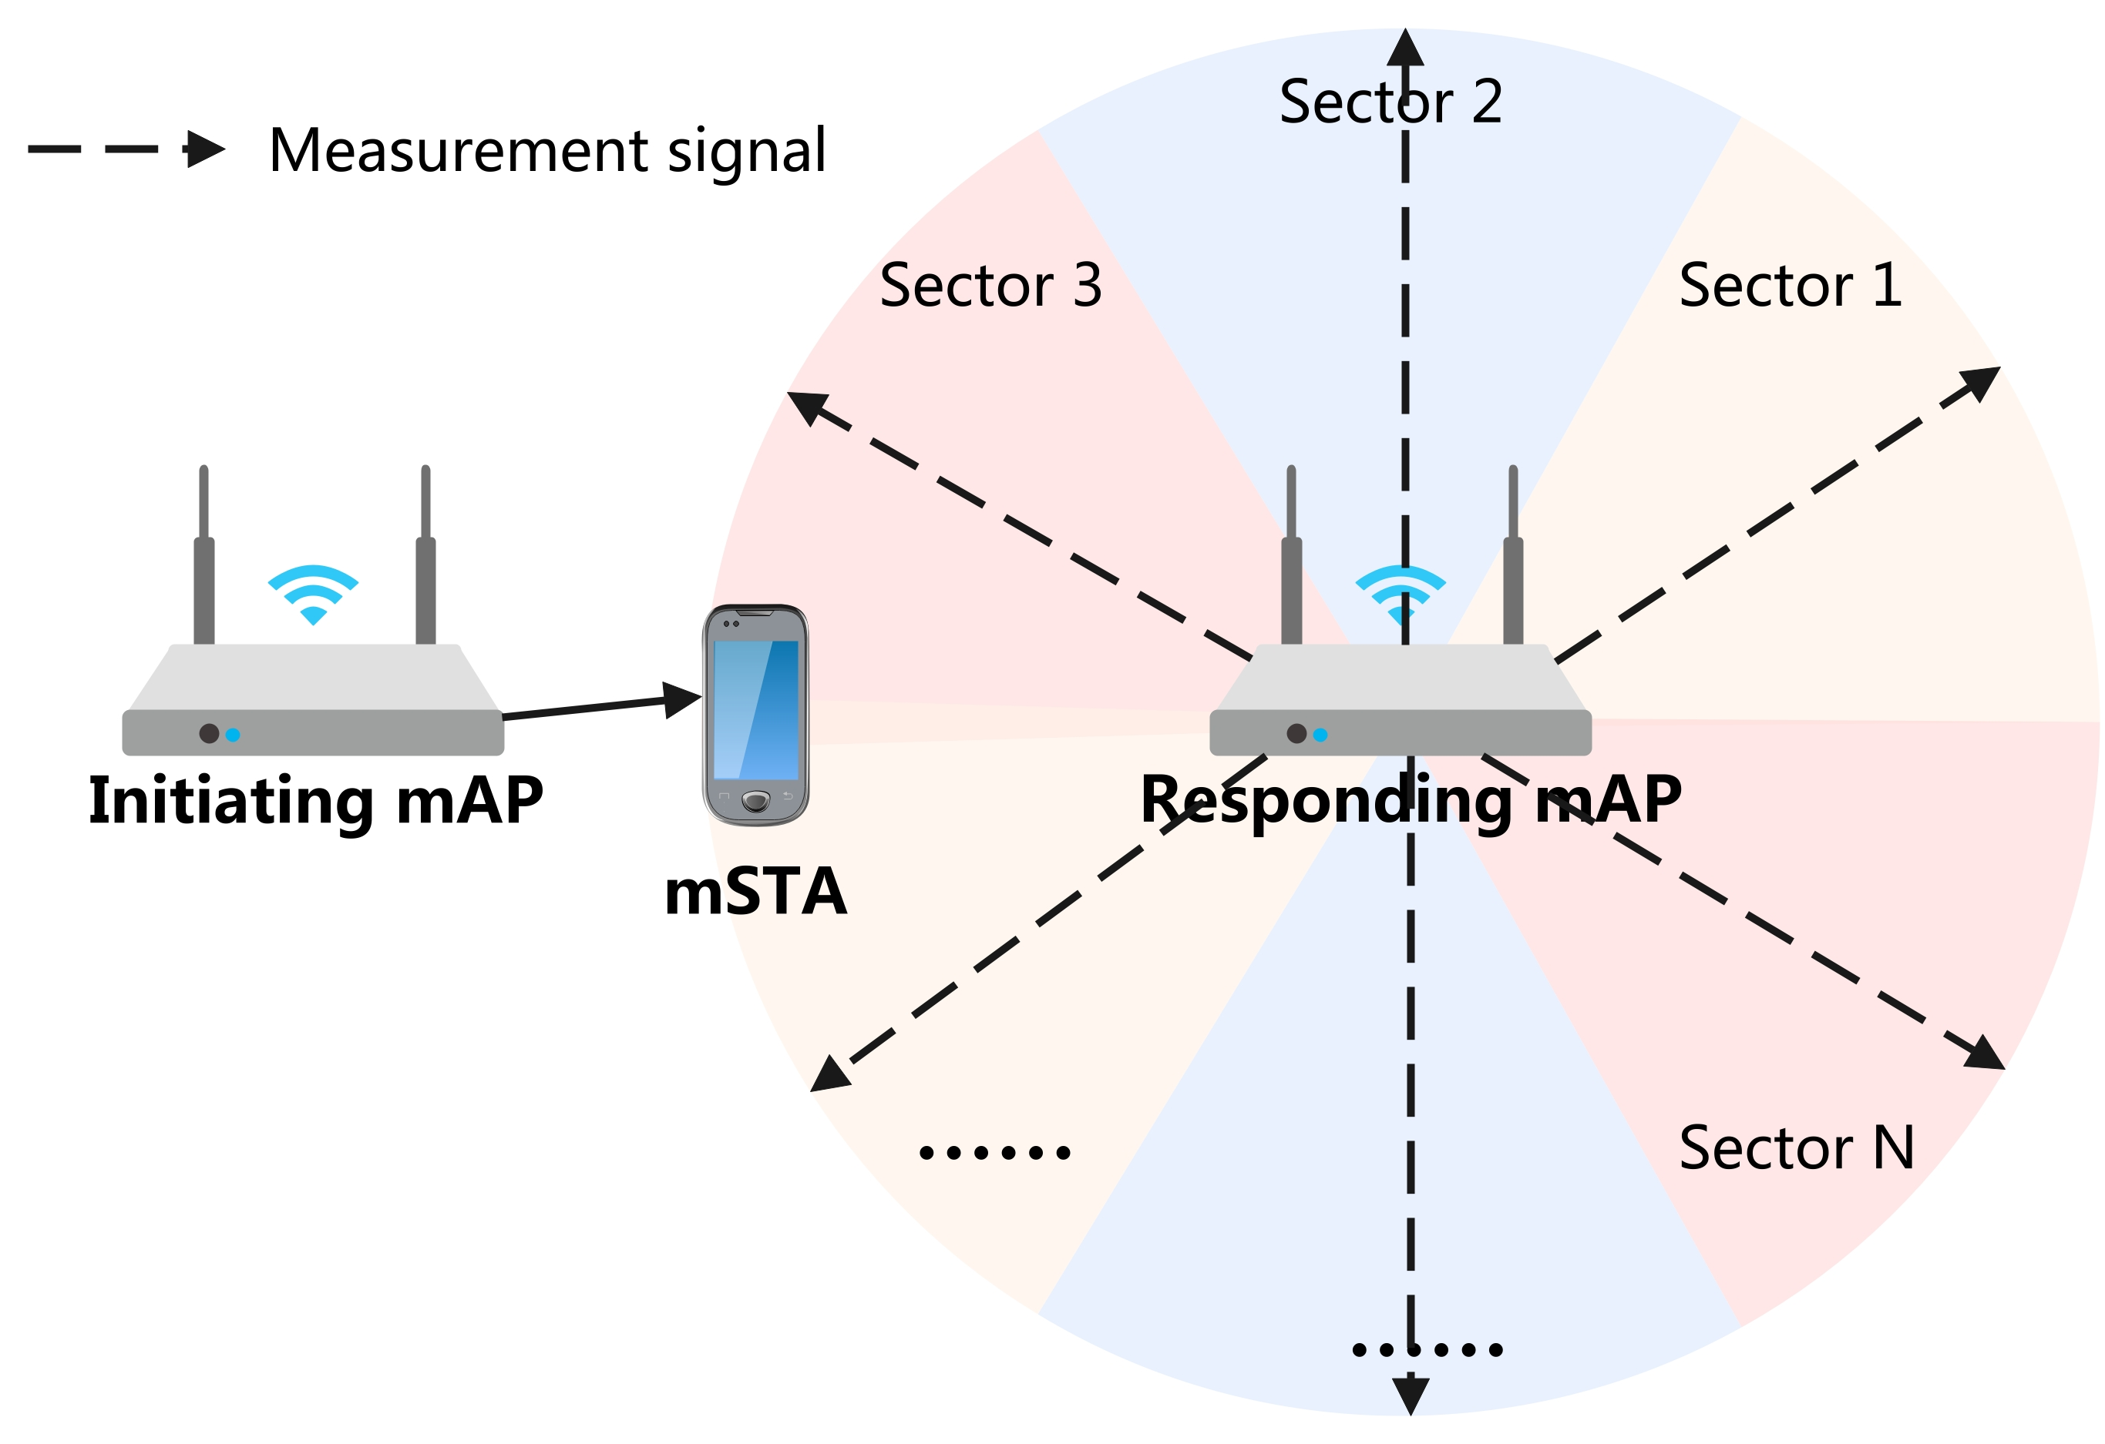
Cross-BSS Interference Sector Measurement
To evaluate the interference from neighboring mAPs to the mSTAs associated with the initiating mAP, sector-level interference measurements are required over the mmWave channel.
The sAP affiliated with the same AP MLD as the initiating mAP, can send a Request frame to the OBSS sAP, requesting the OBSS mAP affiliated with the same AP MLD as the OBSS sAP to send measurement signals across different sectors.
The mSTA then measures the RSSI of this signals from the OBSS mAP and reports the measurement results to the initiating mAP via the sSTA and the sAP.
Based on the reported results, the initiating mAP can identify the interference sectors of the OBSS mAP to its associated mSTA.

Slide 6
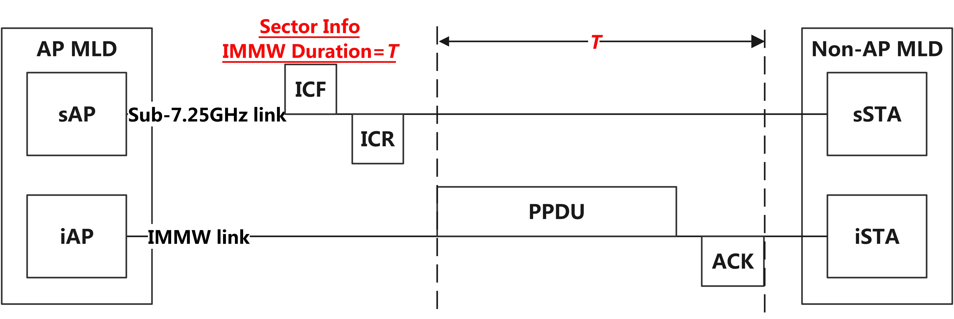
MLO-based sector-level IMMW channel access (1)
An sAP affiliated with an AP MLD can initiate a TXOP for a sector of the mmWave link on behalf of the mAP affiliated with the same AP MLD.
To initiate a TXOP of the mAP, the sAP transmits an ICF, and the sSTA responds with an ICR.
The ICF and ICR need to include essential information, such as the sector in which the TXOP is to be initiated and the intended TXOP duration of the mAP.

Slide 7
MLO-based sector-level IMMW channel access (2)
A third-party device can avoid initiating a TXOP in sectors that may cause interference to the sector of an AP during an already active TXOP.
Accordingly, interference sector information should also be carried in the ICF and ICR frames
If a TXOP has been successfully established by AP 1 in Sector X, AP 2 shall defer channel access attempts in Sector Y throughout the duration of that TXOP, given that transmissions in Sector Y are expected to interfere with Sector X, while the channel access in Sector Z is available.
The interference sector from third-party devices can be reported to the AP by the STA.

Slide 8
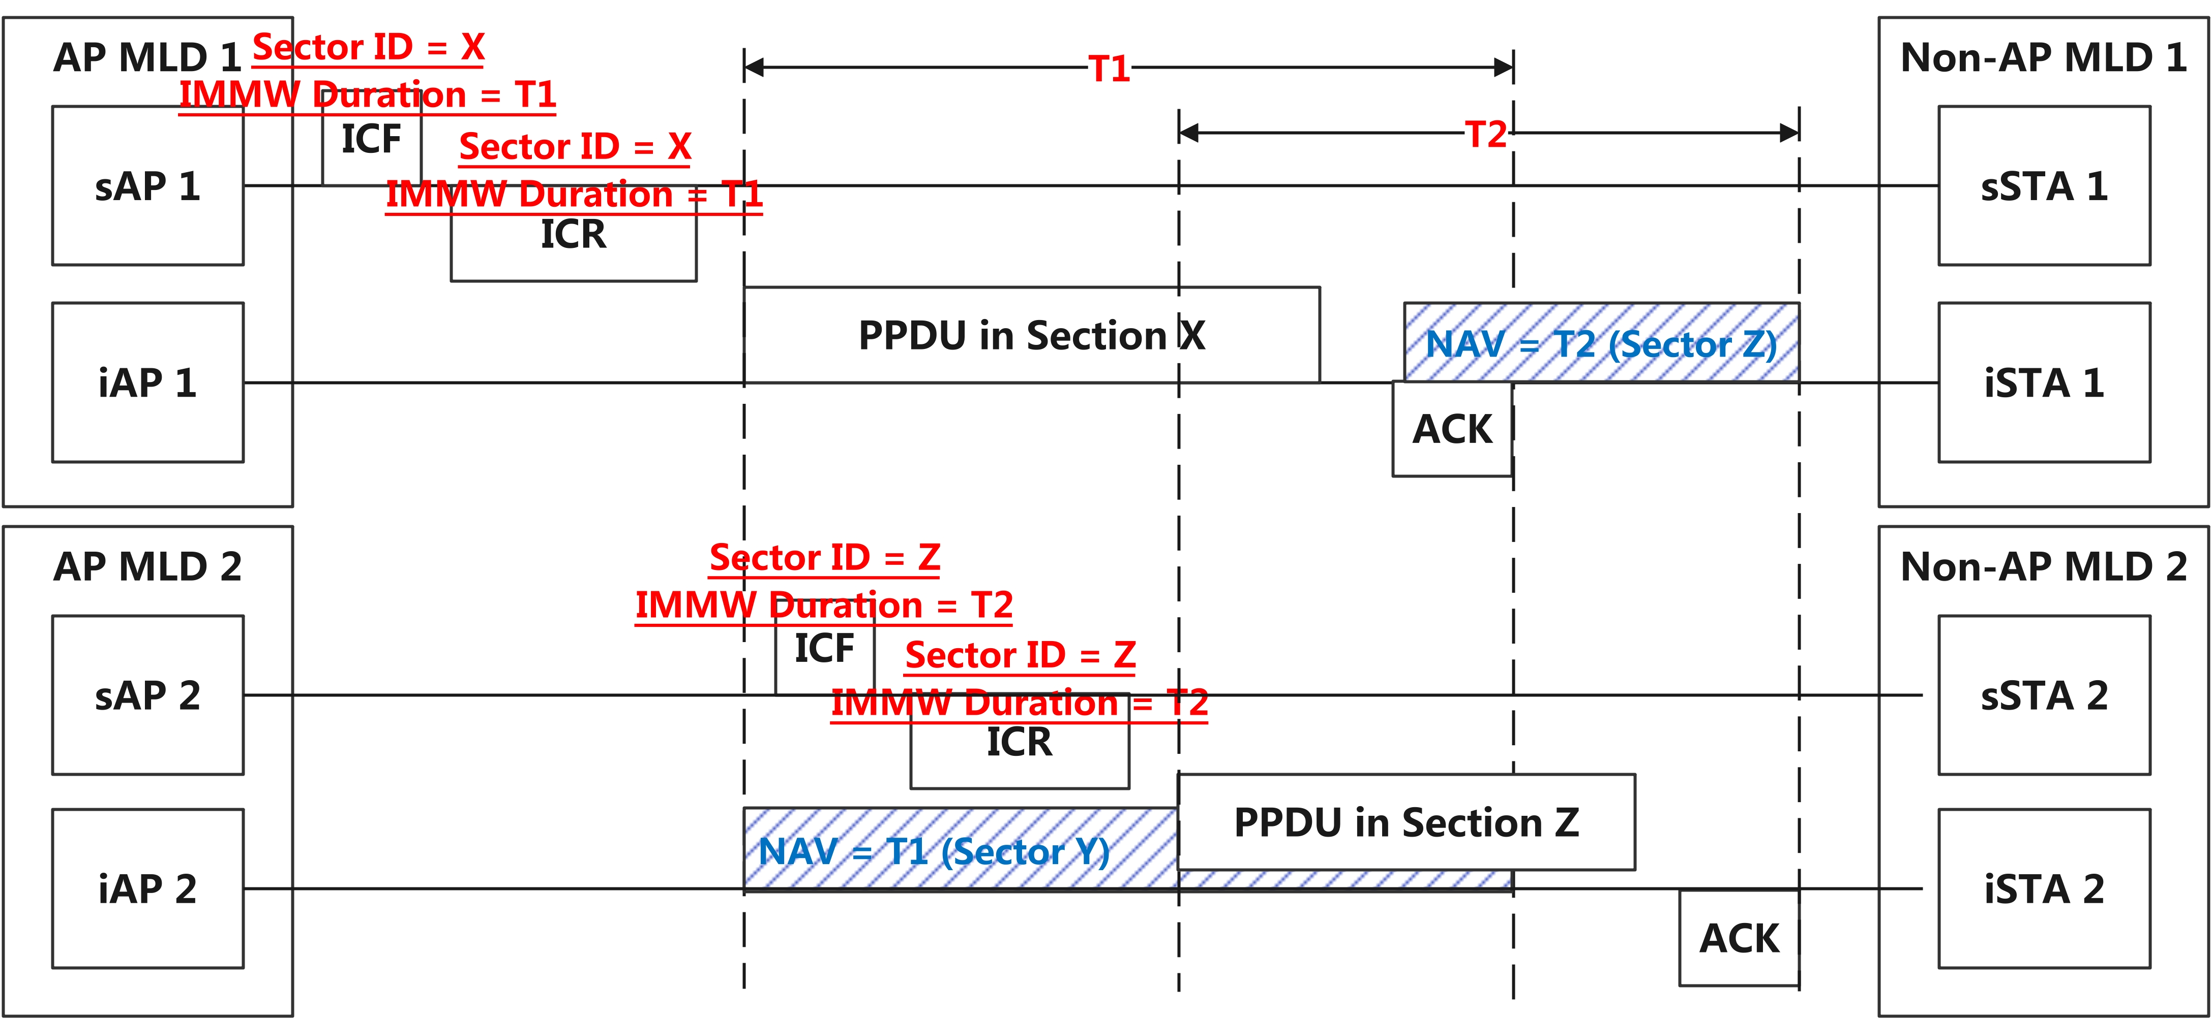
MLO-based sector-level IMMW channel access (3)
The NAV protection is applied on a per-sector basis.
Each AP needs to maintain NAVs for multiple sectors.

Slide 9
Summary
The contribution proposes an MLO-based mmWave link channel access mechanism that leverages the sub-7.25 GHz link to assist in NAV protection for the mmWave link.
The sAP affiliated with an AP MLD can send a ICF to initial a TXOP for a specific sector of the mmWave link on behalf of the mAP affiliated with the same AP MLD.
The ICF and response frame may include the sector in which the TXOP is to be initiated, the intended TXOP duration of the mAP and the interfering sector information.
Each AP needs to maintain NAVs for multiple sectors.

Slide 10
THANK YOU

Slide 11
Reference
[1] 24/0116r7, “802.11 IMMW Proposed PAR”
[2] 24/0096r0, “mmWave RTS/CTS”
[3] 25/0294r0, “A Service Period Based Integrated mmWave Link Operation Scheme”
[4] 25/0433r2, “Channel Access for IMMW”
[5] 25/0632r1, “Anchor Link for ML Operation with mmWave Link”

