Slide 1
EBCS Certificate ID
Date: 2025-05-11
Authors:

Slide 2
Abstract
This presentation is a proposal to introduce EBCS certificate ID to reduce frame length.

Slide 3
Certificate in EBCS
EBCS DL uses a certificate for HCFA and PKFA.
The certificate is included in every EBCS Info frame that will be transmitted periodically.
As the size of certificate is large (approx. 1kB), it makes EBCS Info frame large.
  Large frame occupies more airtime.
  Large frame increases chance of receiving failure.
EBCS UL also uses a certificate for PKFA.
The EBCS UL frame has the same issue.

Slide 4
Proposed Solution
Pre-install certificates to receivers (non-AP STA for DL / AP for UL) by trusted way (out of scope).
Transmitter (AP for DL / non-AP STA for UL) transmits a certificate ID instead of a certificate itself.
TX
Certificate ID
RX
Cert
Cert
Cert
Cert
Use pre-installed certificate
According to the received Certificate ID

Slide 5
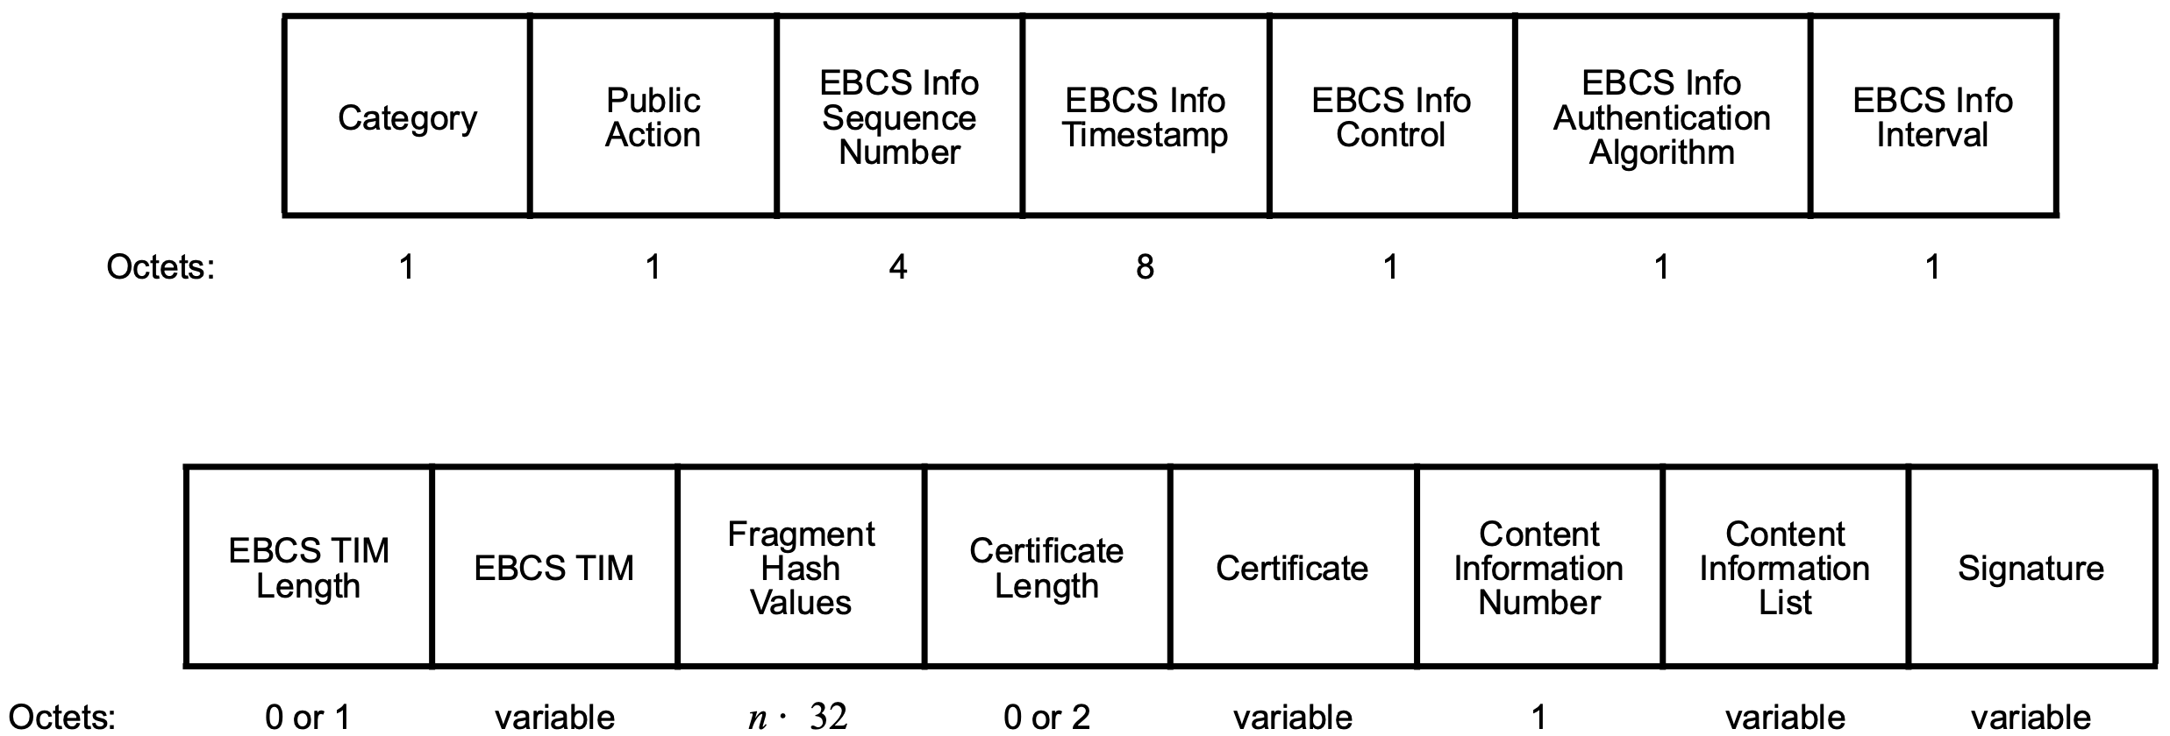
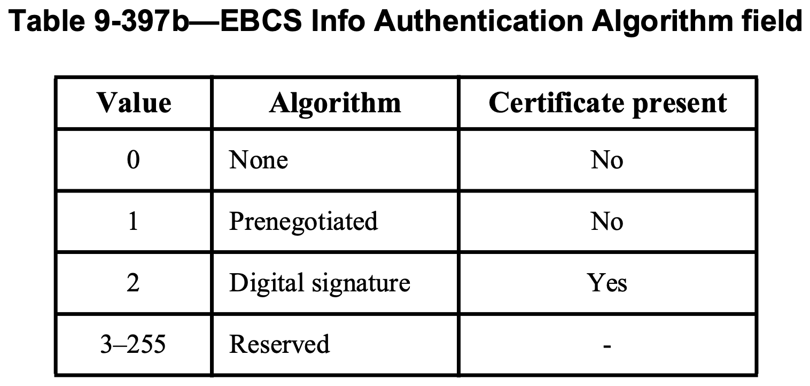
Changes of EBCS Info frame
Add “Certificate ID” algorithm type
to the Algorithm subfield
Actual “Certificate ID” value is contained in the Certificate field

Slide 6
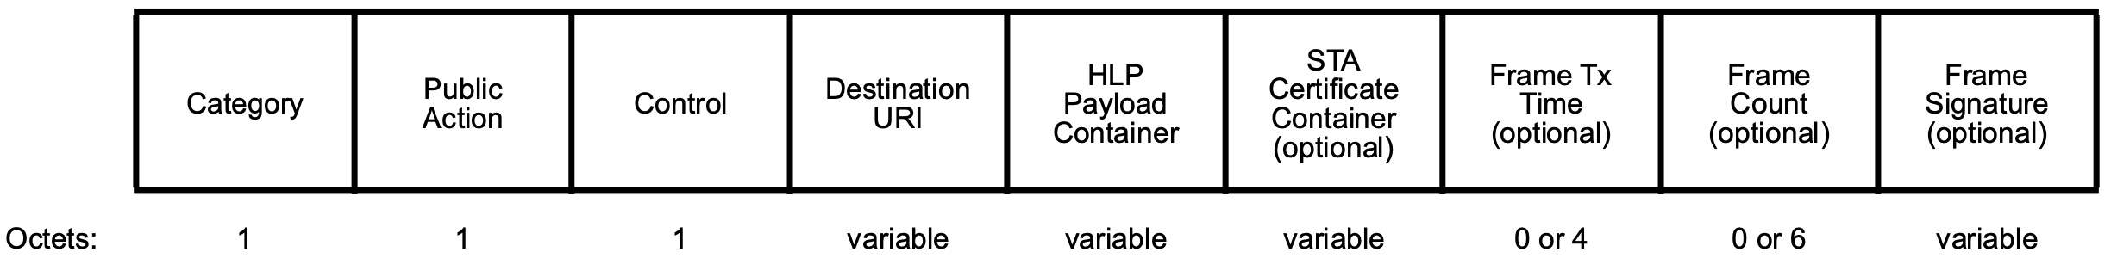
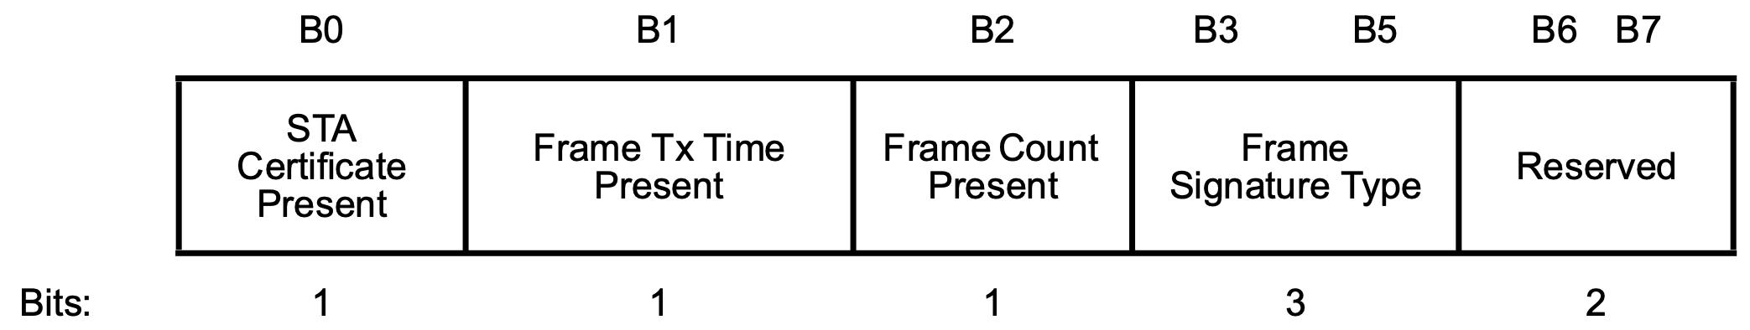
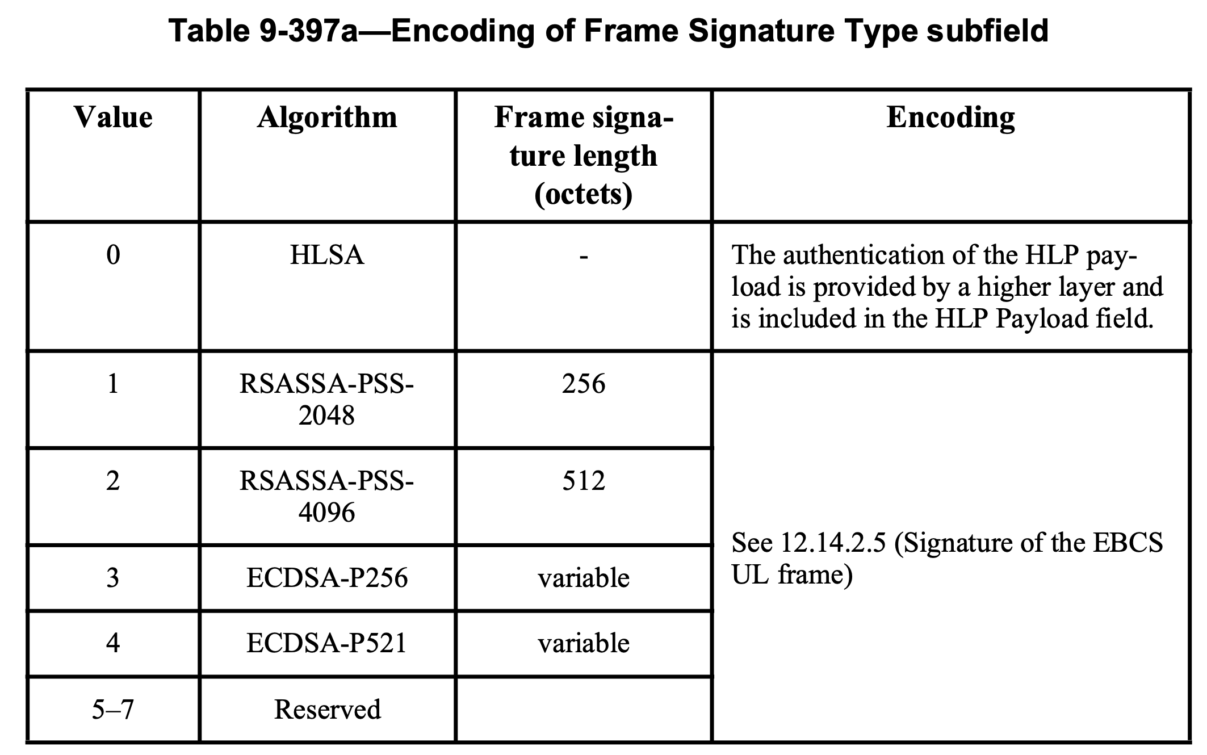
Changes of EBCS UL frame
Add “Certificate ID” to Frame Signature Type subfield
Actual “Certificate ID” value is contained in the STA Certificate Container field

Slide 7
Certificate ID
Certificate has an expiration date in general, and it may be invalidated before the expiration date.
  The certificate cannot be identified by the MAC Address.
Certificate ID Options
  Hash value of the certificate
  MAC Address + Sequential number
  Other…
Discuss in the future.

Slide 8
Straw poll
Do you prefer to add the Certificate ID to EBCS?
Yes:
No:
Abstain:

