Slide 1
CCA Issue in NPCA Operation
Date: 2025-09-12
Authors:

Slide 2
Introduction
In TGbn [1], NPCA operation is introduced to enhance reliability under dense OBSS environments.
In NPCA operation, a NPCA STA may switch from the BSS Primary Channel (PCH) to a designated NPCA Primary Channel (NPCA PCH) when specific conditions are met.
  E.g., reception of OBSS PPDU(s), NPCA minimum duration threshold, and availability of the NPCA PCH.
Within the NPCA STA, PHY layer issues PHY-CCA.indication primitive to inform MAC layer of whether the BSS PCH is idle or busy.
After the NPCA STA decides to transition to NPCA PCH upon reception of OBSS PPDU(s), CCA status of the PHY of the NPCA STA can be hold until the expected duration of the PPDU.
  This ‘Busy’ status may be hold even on the NPCA PCH.
In this contribution, the issue is raised, and a possible approach is proposed.

Slide 3
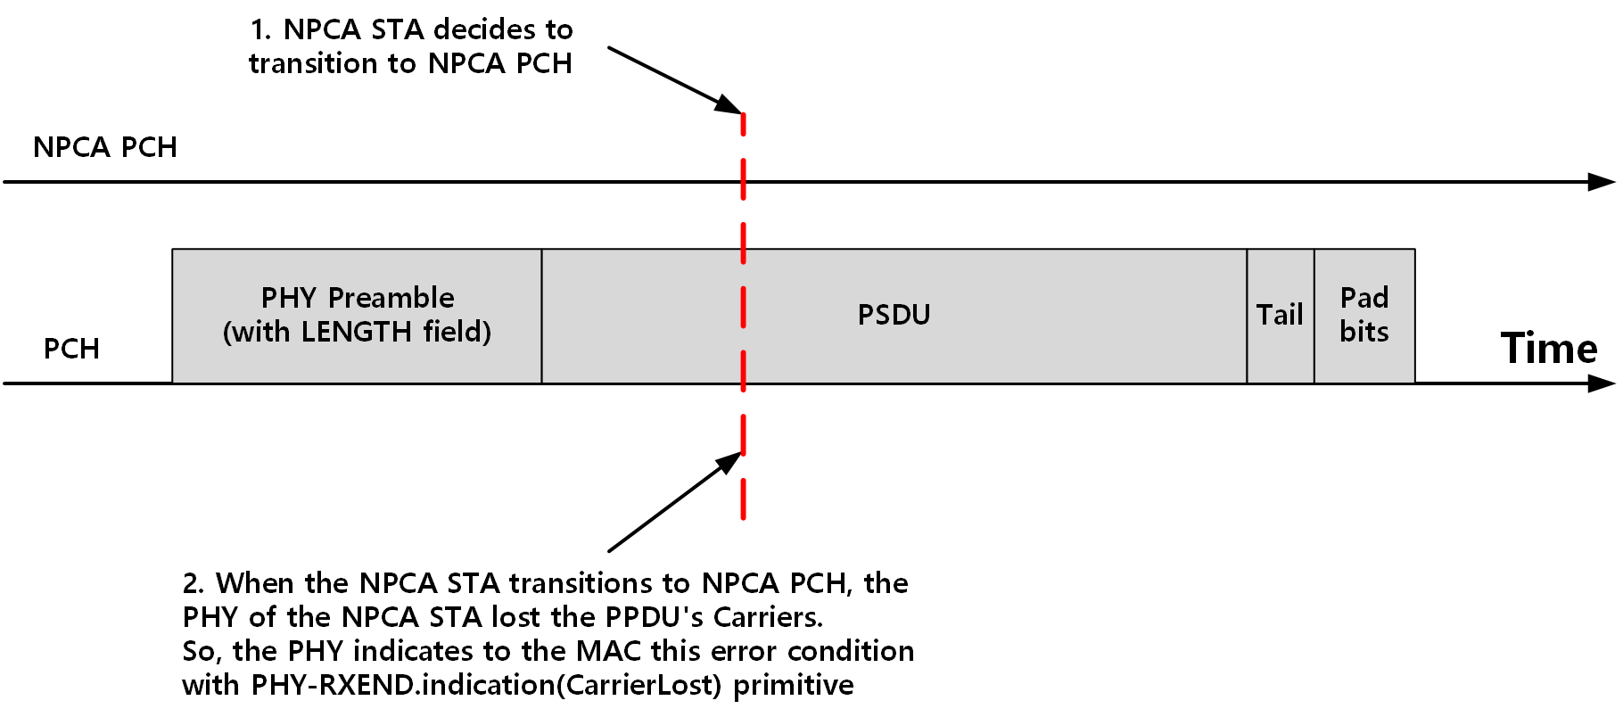
Problem Statement
Upon inter-BSS PPDU reception on the BSS PCH, an NPCA STA may decide to transition to the NPCA PCH.
When the NPCA STA transition to the NPCA PCH, it may fail to detect the signal of the inter-BSS PPDU that was being received on the BSS PCH.
As a result, the PHY may encounter a carrier lost error condition.

Slide 4
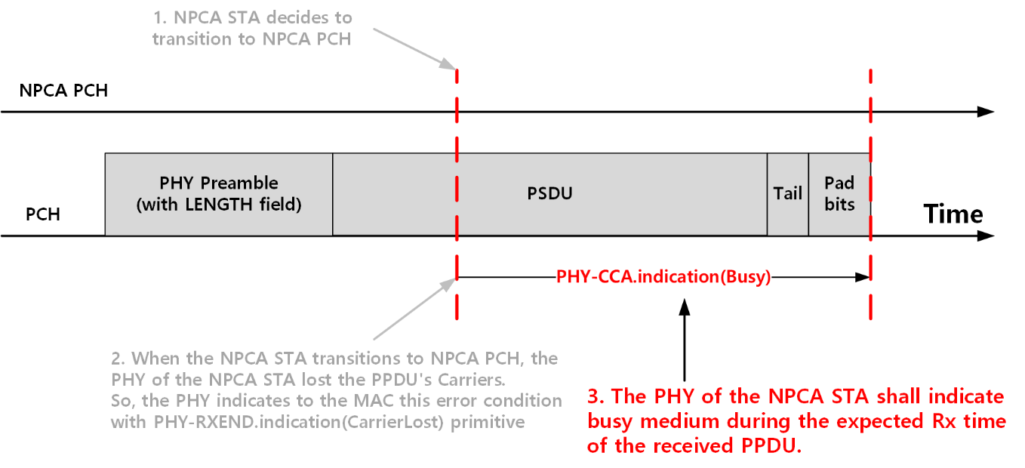
Problem Statement
Even after the NPCA STA switches to the NPCA PCH, the PHY may still maintain the CCA status as busy until the end of the expected PPDU reception duration, as indicated by the PPDU's LENGTH field[2].
This error condition can be raised not only on OFDM PHY but also other PHY’s
  E.g., HT, VHT, …
17. Orthogonal frequency division multiplexing (OFDM) PHY specification
17.3.12 Receive PHY
In the event that a change in the RSSI causes the status of the CCA to return to the IDLE state before the complete reception of the PSDU, as indicated by the PHY LENGTH field, the error condition shall be reported to the MAC using a PHY-RXEND.indication(CarrierLost) primitive and the PHY receiver shall return to the RX IDLE state. The CCA of the OFDM PHY shall indicate a busy medium for the intended duration of the transmitted PPDU.

Slide 5
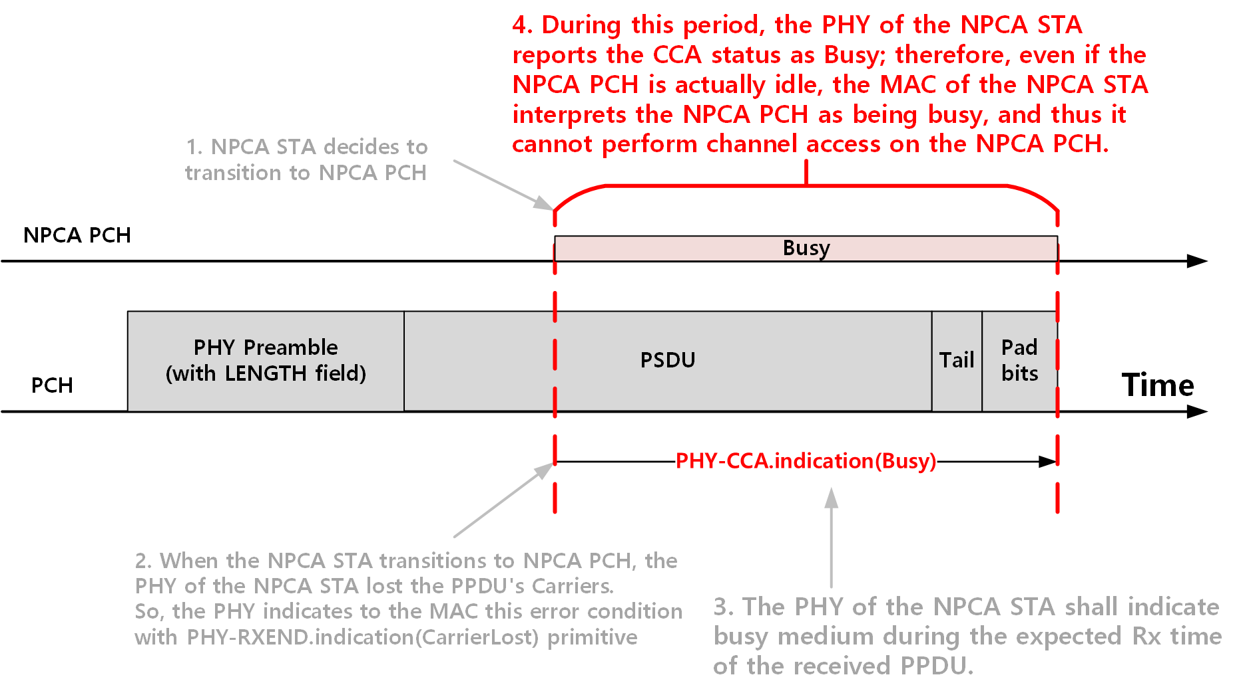
Problem Statement
As a result, the channel access and frame transmission on the NPCA PCH may be incorrectly blocked by the Busy status of the CCA, despite the NPCA PCH is idle actualy.

Slide 6
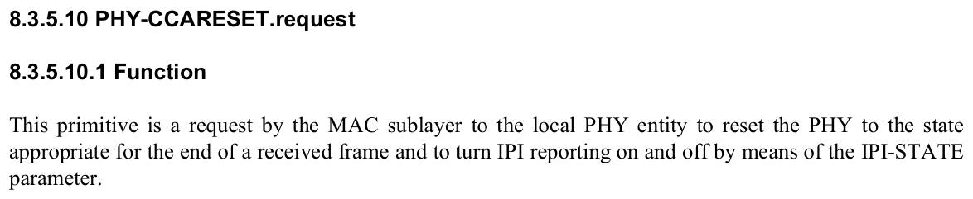
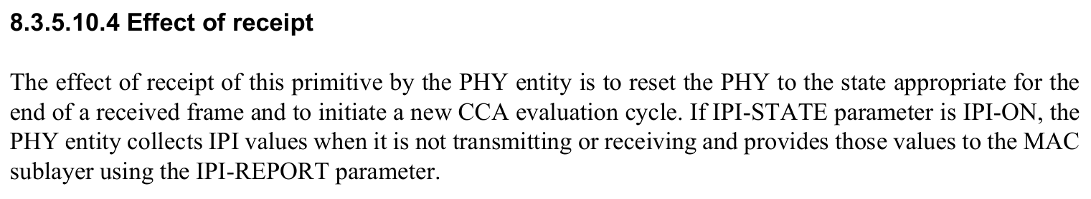
Possible Approach
To address the CCA issue, the MAC issues a PHY-CCARESET.request primitive to the PHY after it decides to transition to the NPCA PCH during reception of the OBSS PPDU.
When the PHY receives the primitive, the PHY is reset, and it initiate a new CCA evaluation cycle.

Slide 7
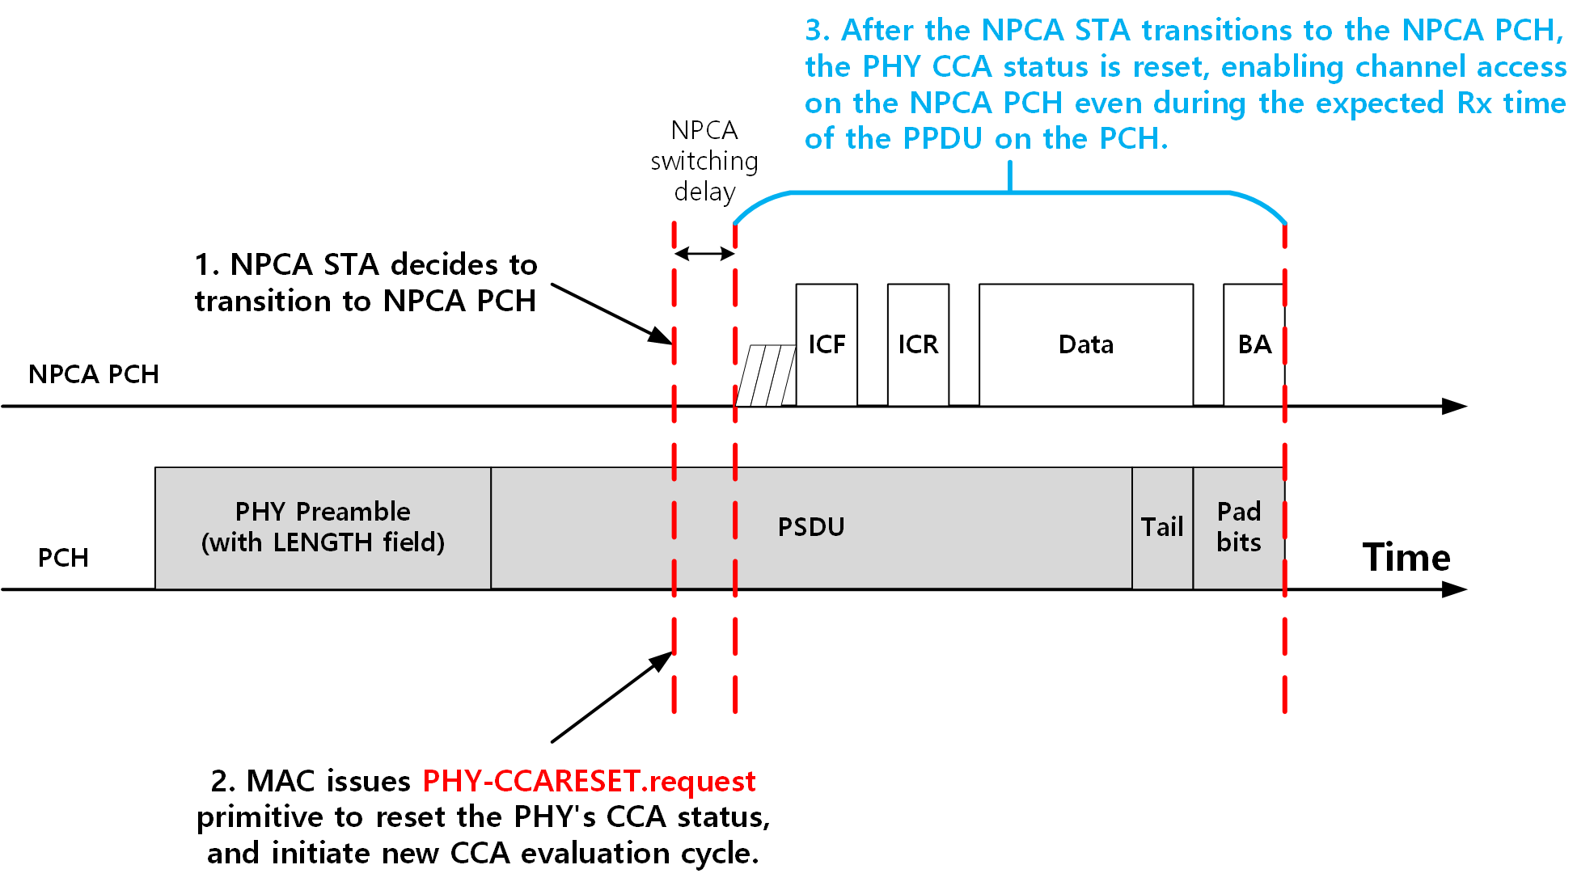
Possible Approach
By using the PHY-CCARESET.request primitive the CCA status can be reset, and the NPCA STA can start channel access on the NPCA PCH.
This approach utilizes the existing primitives without modification.

Slide 8
Conclusion
In current NPCA operation, when an NPCA STA receives a PPDU, PHY of the NPCA STA forced to indicate the medium as busy until the Length of the received PPDU on its BSS PCH, even after transition to its NPCA PCH.
  This might block channel access of the NPCA STA on the NPCA PCH despite the NPCA PCH is idle.
To address the issue, a possible approach was proposed.
  MAC issues a PHY-CCARESET.request primitive to the PHY to reset CCA state of the PHY.
  So, the PHY can initiate new CCA evaluation cycle on the NPCA PCH.
This approach leverages existing PHY-CCARESET.request primitive.

Slide 9
References
[1] Draft P802.11bn_D1.0, 37.18 Non-primary channel access (NPCA)
[2] IEEE 802.11-2024, 17.3.12 Receive PHY

Slide 10
Straw Poll
SP: Do you agree to include the following text into the 11bn SFD?
  When an NPCA STA decides to transition to NPCA primary channel, the MAC of the NPCA STA shall issue PHY-CCARESET.request primitive to the PHY to clear the previous CCA state and initiate new CCA evaluation cycle on the NPCA primary channel.
Y / N / A

