Slide 1
CCA Issue in NPCA Operation
Date: 2025-05-10
Authors:

Slide 2
Introduction
In TGbn[1], NPCA operation is introduced to enhance reliability under dense OBSS environments.
In NPCA operation, a STA may switch from the Primary Channel (PCH) to a designated NPCA Primary Channel (NPCA PCH) when specific conditions are met.
  Such as OBSS traffic presence, NPCA duration thresholds, and NPCA PCH availability.
Within the STA, the PHY indicates whether the Primary Channel (PCH) is idle or busy using the PHY-CCA.indication primitive, which is delivered to the MAC layer.
After the STA decided to transition to NPCA PCH upon reception of an inter-BSS PPDU, CCA status of the PHY of the STA can be hold until the expected duration of the PPDU.
In this contribution, the issue is examined and an approach addressing it is proposed.

Slide 3
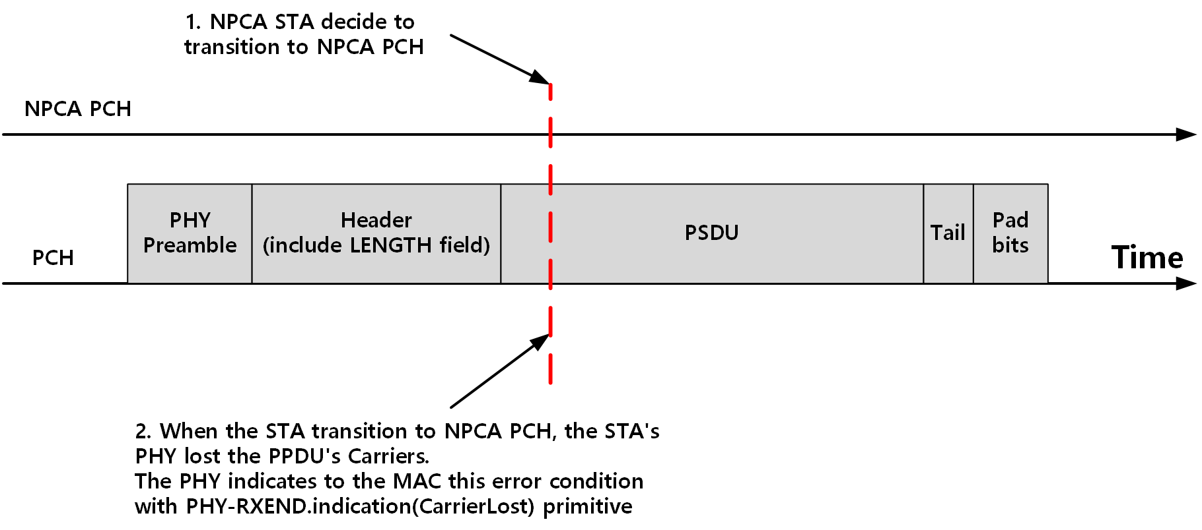
Problem Statement
During ongoing inter-BSS PPDU reception on the PCH, NPCA STA may decide to transition to NPCA PCH.
When the STA transition to NPCA PCH, since the STA's PHY is no longer operating on the PCH, it may fail to detect the signal of the PPDU that was being received. As a result, the PHY may encounter a carrier lost error condition.

Slide 4
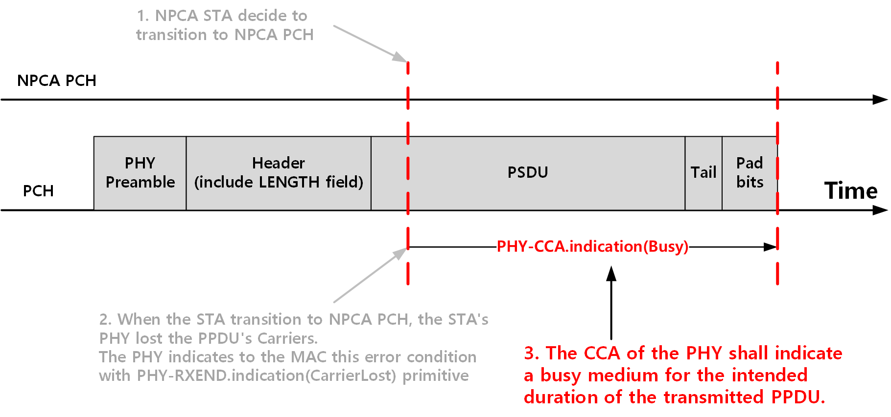
Problem Statement
Even after the STA switches to NPCA PCH, PHY in the STA may still maintain the CCA status as busy until the end of the expected PPDU reception duration, as indicated by the PPDU's LENGTH field[2].
  In the event that a change in the RSSI causes the status of the CCA to return to the IDLE state before the complete reception of the PSDU, as indicated by the PHY LENGTH field, the error condition shall be reported to the MAC using a PHY-RXEND.indication(CarrierLost) primitive and the PHY receiver shall return to the RX IDLE state. The CCA of the OFDM PHY shall indicate a busy medium for the intended duration of the transmitted PPDU.

Slide 5
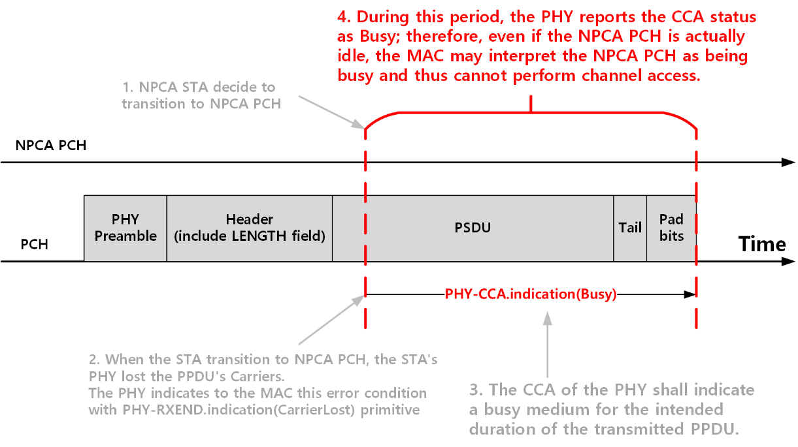
Problem Statement
As a result, the channel access and frame transmission on the NPCA PCH may be incorrectly blocked, despite the NPCA PCH being idle.

Slide 6
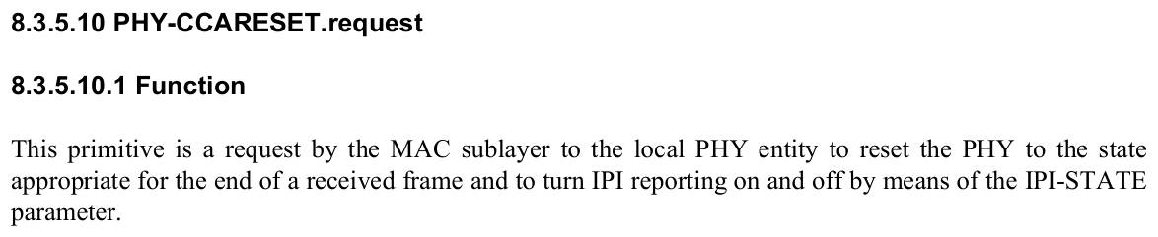
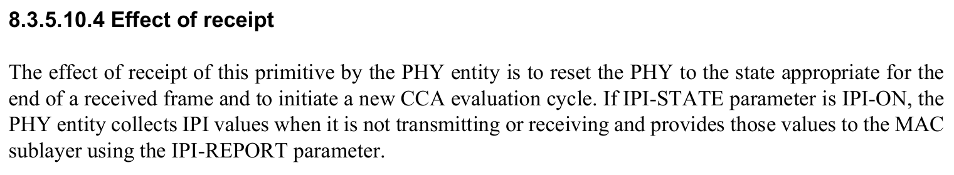
Possible Approach
To address the issue, the MAC issues a PHY-CCARESET.request primitive to the PHY after it decides to perform transition to NPCA PCH during reception of the inter-BSS PPDU.
When PHY receives the primitive, the PHY is reset, and it initiate a new CCA evaluation cycle.

Slide 7
Possible Approach
When the STA transitions to NPCA PCH, it should also notify the PHY that the context for CCA evaluation has changed.
This is achieved using the existing PHY-CCARESET.request primitive, which instructs the PHY to reset or clear its current CCA state and treat the new operating channel (NPCA PCH) independently.
This approach utilizes the existing primitives without modification.

Slide 8
Conclusion
In NPCA operation, the PHY may continue to indicate a busy medium based on the PCH, even after transition to the NPCA PCH, due to ongoing inter-BSS PPDU reception on the PCH.
To address the issue, an approach that the MAC issues a PHY-CCARESET.request to the PHY to clear the CCA state on the PCH and enable accurate CCA assessment on the NPCA PCH was proposed.
This approach leverages existing standard primitives.
  Therefore, it can be considered as a primary candidate for the issue.

Slide 9
References
[1] Draft P802.11bn_D0.2, 37.11 Non-primary channel access (NPCA)
[2] IEEE 802.11-2024, 17.3.12 Receive PHY

Slide 10
Straw Poll
SP: Do you agree to include the following text into the 11bn SFD?
  When an NPCA STA decides to transition to NPCA primary channel, the MAC of the NPCA STA shall issue PHY-CCARESET.request primitive to the PHY in order to clear the previous CCA state and initiate CCA evaluation on the NPCA primary channel.
Y / N / A

