Slide 1
Further Considerations on NPCA Switching Conditions
Date: 2025-06-06
Authors:

Slide 2
Introduction
During the NPCA procedure [1], the conditions for switching from BSS primary channel to NPCA primary channel have been mainly defined for two cases:
  Condition-1: Switching for the duration of the PPDU or for the duration of the TXOP based on receiving a PPDU (e.g., HE+ PPDU)
  Condition-2: Switching for the duration of the TXOP based on receiving PPDUs as part of control frame exchange (e.g., (MU-)RTS-CTS exchange)
While these two cases cover most of the switching scenarios, further considerations are needed for more efficient switching.
In this contribution, we point out to two switching scenarios, where the use of NPCA primary channel by the NPCA STAs can be made more efficient with minimal modifications to the existing NPCA switching conditions in the IEEE P802.11bn draft.

Slide 3
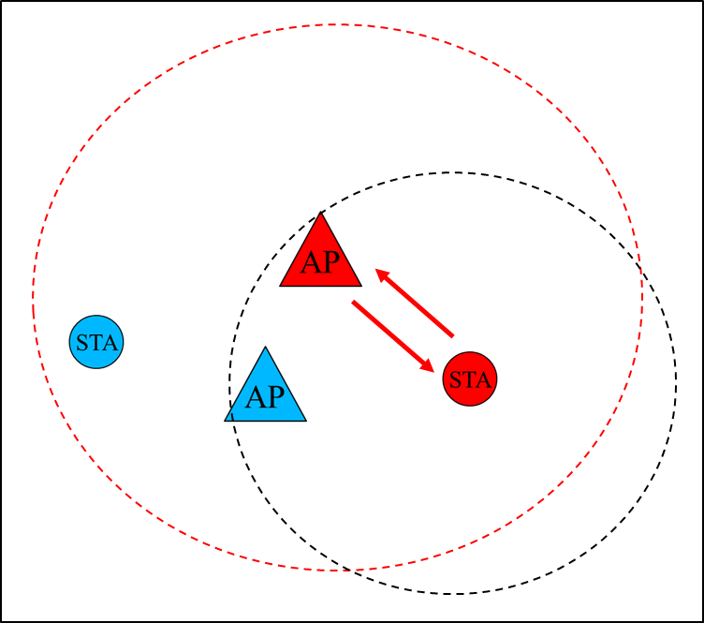
Switching During DL Transmission
Scenario-1:
According to the current switching conditions in IEEE P802.11bn D0.3:
  Condition-1
  AP transmits a PPDU → AP and STA switch
  STA transmits a PPDU → AP switches (STA cannot receive the PPDU)
  Condition-2
  AP and STA exchange control frames (e.g., (MU-)RTS-CTS) → AP switches
  STA switches only after receiving a DL PPDU (i.e., back to Condition-1)
AP can hear both AP and STA
STA can only hear AP

Slide 4
Problem for Switching During UL Transmission
Scenario-1
T1
T3
T2
AP = AP1
STA = STA1
NPCA PCH
AP1
TF
PCH
BA
AP = AP2
STA = STA2
NPCA PCH
STA1
PCH
PPDU
AP1 transmits a TF to STA1.
On receiving the TF, both AP2 and STA2 set their NAVs on the PCH, but cannot switch to the NPCA PCH.
STA1 transmits to AP1 TB PPDU in response to TF.
On receiving the TB PPDU, AP2 switches to the NPCA PCH at time T3, however, STA2 cannot switch to the NPCA PCH due to not receiving the TB PPDU.
AP2 transmits an ICF to STA2 but does not receive a response. AP2 cannot transmit its buffered data to STA2.
NPCA PCH
ICF
AP2
PCH
NAV
NPCA PCH
STA2
PCH
NAV
STA2 needs to stay on the PCH until T2
→ STA losses opportunities on the NPCA PCH

Slide 5
Proposal for Switching During UL Transmission
Scenario-1
T1
T2
AP = AP1
STA = STA1
NPCA PCH
AP1
TF
PCH
BA
AP = AP2
STA = STA2
NPCA PCH
STA1
PCH
PPDU
Different from Condition-2 (i.e., control frame exchange), if a STA receives an inter-BSS PPDU containing a control frame that solicits a TB PPDU on the PCH, then the STA may switch to the NPCA PCH.
  The STA (e.g., STA2) does not need to receive the TB PPDU from the OBSS STA (e.g., STA1) for switching to the NPCA PCH.
  STA2 may communicate with AP2 on the NPCA PCH while AP1 is receiving a TB PPDU from STA1 on the PCH.
  Note: Current switching conditions may not allow STA2 to switch to the NPCA PCH under the Scenario-1 depicted above.
NPCA PCH
PPDU
ICF
AP2
PCH
NAV
NPCA PCH
ICR
BA
STA2
PCH
NAV
STA2 may switch to the NPCA PCH and may communicate with AP2

Slide 6
Switching During Co-TDMA Operation
Scenario-2: NPCA AP/STAs switching based on Conditions 1 and 2 during Co-TDMA operation
A polled AP (e.g., AP3) and its associated STAs (e.g., STA3) may switch back and forth between the PCH and the NPCA PCH as illustrated below during the allocated TXOP duration of Co-TDMA coordinated AP (e.g., AP2).
Accordingly, AP3 and STA3 may have to switch frequently and also may not be able to fully utilize the TXOP allocation duration allocated by AP1 to AP2.
Duration: Short
Alloc. Dur.: Long
Duration < Threshold
→ AP3 and STA3 cannot switch
(Co-TDMA sharing AP)
AP1
ICF
MRTT to AP2
TXOP allocation for AP2
PCH
Frame exchanges within BSS1
Duration-1
Duration-2
AP2
PCH
ICR
CTS to AP1
RTS
PPDU
TF
BA
STA1
STA1
STA2
STA2
BA
PPDU
CTS
STA1
STA2
STA1
NPCA PCH
ICF
PPDU
ICF
PPDU
AP3
PCH
ICR
BSS3
NPCA PCH
ICR
BA
ICR
BA
STA3
PCH

Slide 7
Proposal for Switching During Co-TDMA Operation
AP3 reads the allocation duration for AP2 from the user info field of the MU-RTS TXS trigger (MRTT) frame and determines to switch on receiving a response to MRTT frame. After the first control frame exchange, AP3 and STA3 switch to the NPCA PCH.
  AP3 switches for the TXOP allocation duration obtained from the user info field of the MRTT frame.
  STA3 may switch for the value indicated in the Duration field of RTS-CTS frames.
AP3 informs STA3 via the ICF regarding the TXOP allocation duration. AP3 performs frame exchanges until the end of TXOP allocation for AP2.
Duration: Short
Alloc. Dur.: Long
(Co-TDMA sharing AP)
AP1
ICF
MRTT to AP2
TXOP allocation for AP2
PCH
Frame exchanges within BSS1
Duration-1
Duration-2
AP2
PCH
ICR
CTS to AP1
RTS
PPDU
TF
BA
STA1
STA1
STA2
STA2
BA
PPDU
CTS
STA1
STA2
STA1
NPCA PCH
ICF
PPDU
AP3
PCH
ICR
BSS3
NPCA PCH
ICR
BA
STA3
PCH

Slide 8
Conclusion
In this contribution, we pointed out to two switching scenarios, where the use of NPCA primary channel by the NPCA STAs can be made more efficient with minimal modifications to the existing NPCA switching conditions in the IEEE P802.11bn draft.
As one switching condition, if the received inter-BSS PPDU contains a control frame that solicits a TB PPDU, an AP/STA may switch to the NPCA PCH after receiving the PPDU without waiting for the TB PPDU.
As another switching condition, an AP/STA may switch to the NPCA PCH for the TXOP allocation duration after receiving an MRTT frame – CTS exchange during a Co-TDMA operation.

Slide 9
References
[1] IEEE P802.11bn™/D0.3

