Slide 1
Feedback Signalling for Efficient Co-RTWT Operation
Date: 2025-05-09
Authors:

Slide 2
Abstract
Coordinated restricted target wake time (Co-RTWT) have been discussed in multiple UHR and TGbn contributions [1-11].
In this presentation, we will discuss feedback signaling to improve efficiency in Co-RTWT operation.

Slide 3
Recap (1/2) [1]
Coordinated restricted target wake time (Co-RTWT) is considered as part of the multi-AP (MAP) generalized framework.
Co-RTWT discovery and negotiations are carried out using the generalized MAP framework.
R-TWT specific procedures include intra- BSS r-TWT announcement, intra-BSS r-TWT negotiation, and intra-BSS r-TWT maintenance.
Finally, modification/termination of Co-RTWT agreement is carried out using the generalized MAP framework.

Slide 4
Recap (2/2)
Current PDT text [10] indicates that Co-RTWT enabled STAs associated to a Co-RTWT coordinated AP must terminate their TXOP before the beginning of an announced Co-RTWT schedule.
To mitigate over protection, [8][11] propose to allow the Co-RTWT coordinated AP and the associated STAs to decide if STAs need to extend protection to the Co-RTWT schedule (STA near OBSS vs far OBSS).
This contribution assumes Co-RTWT coordinated AP and associated STAs negotiate whether STA extend protection to the Co-RTWT schedule during the Co-RTWT MAP negotiation phase.

Slide 5
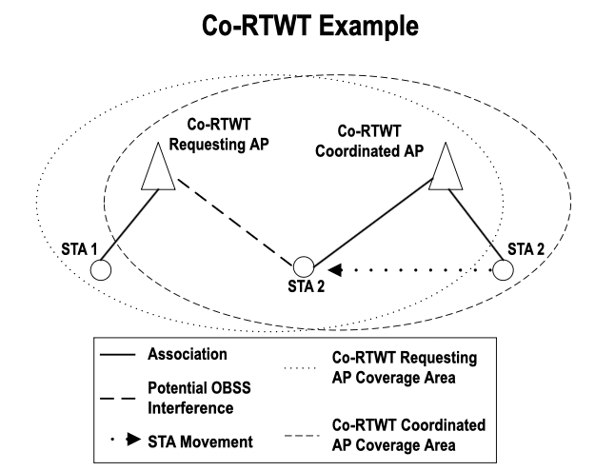
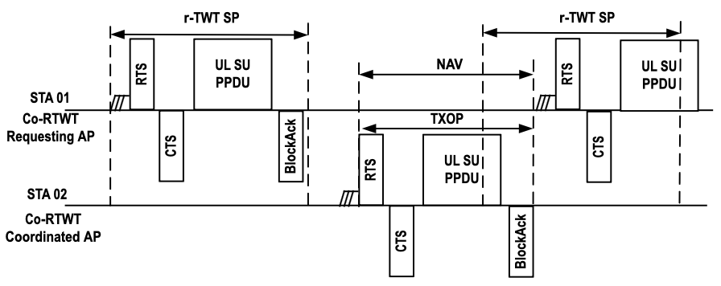
Efficient Co-RTWT operation in a dynamic network environment may be challenging (1/2)
Example of Co-RTWT operation with mobile STAs:
During Co-RTWT discovery/negotiation it is decided which APs and associated STAs will extend protection to the r-TWT schedule. This configuration is static and does not change over time.
R-TWT schedule misalignment between coordinating AP and coordinated AP may allow STAs to invertedly send data during the r-TWT SP.
Movement of STAs from non-OBSS to OBSS region may cause STAs to transmit during r-TWT SP.

Slide 6
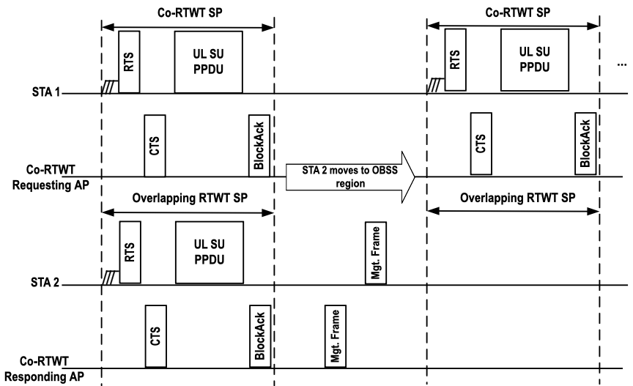
STA signalling for efficient Co-RTWT Operation
STAs associated to Co-RTWT coordinated AP signal if they are following the Co-RTWT schedule:
While STA 2 is in an OBSS interference free zone, it signal that it is not following the Co-RTWT schedule, i.e., it does not terminate its TXOP upon arrival of the Co-RTWT SP.
Once STA 2 moves to an OBSS interference region, it signal the Co-RTWT coordinated AP it is now following the Co-RTWT schedule.
This information is used by the AP to come up with another non-overlapping r-TWT schedule, or to drop the STA 2 as a member of the overlapping r-TWT schedule.
Information could be also used to trigger coordinated beamforming/TDMA to avoid rescheduling.
Re-schedule overlapping RTWT schedule

Slide 7
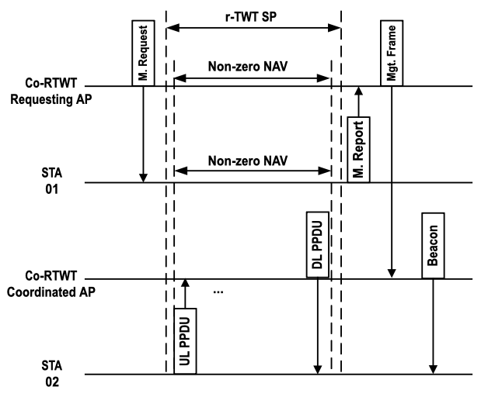
AP signalling for efficient Co-RTWT Operation
Requesting Co-RTWT AP sends frame to Co-RTWT coordinated APs to indicate Co-RTWT schedule ID + BSS ID information (e.g., BSS color or BSSID) of decoded packets disrupting normal Co-RTWT operation:
Requesting Co-RTWT AP monitors/receives/decode all agreed upon Co-RTWT schedules, e.g., monitors that communications during the Co-RTWT schedules occur as negotiated.
If OBSS communications occur during the Co-RTWT SP, AP decodes packets to extract BSS color.
Co-RTWT coordinating AP creates OBSS information containing all Co-RTWT schedules that have been interfered and the OBSS color, e.g., ({Co-RTWT_ID1, BSS_color1}, {Co-RTWT_ID2, BSS_color2},).
Requesting Co-RTWT AP sends the OBSS information to Co-RTWT coordinated APs.
Co-RTWT coordinated APs can use this information as follows:
Indicate STAs associated to affected Co-RTWT schedule to extend protection to the Co-RTWT schedule (e.g., check which STAs were transmitting during Co-RTWT schedule and notify them to extend protection).
Check if there is misalignment between Co-RTWT schedules in requesting and coordinated Co-RTWT AP, e.g., time drift.
Schedule quiet intervals for only the affected Co-RTWT schedules (efficient legacy STA operation).

Slide 8
Conclusion
Efficient Co-RTWT operation may be challenging in a dynamic network environment.
Intra-BSS Co-RTWT maintenance requires feedback signaling from participating APs and associated STAs.
We propose a feedback mechanism for a requesting Co-RTWT AP to indicate interference from Co-RTWT Coordinated APs and their associated STAs.
Additionally, we also propose a feedback mechanism for STAs associated with Co-RTWT coordinated APs to indicate if they are extending protection to the Co-RTWT schedule.
Our proposed approach assists Co-RTWT coordinated APs and their associated STAs to operate more efficiently by:
Supporting the detection of interfering STAs (associated with the Co-RTWT coordinated AP) during the Co-RTWT SPs.
Supporting the detection of Co-RTWT schedule misalignment between the requesting Co-RTWT AP and the coordinated Co-RTWT AP.
Allow for more efficient operation of legacy STAs in Co-RTWT operation.

Slide 9
References
[1] 11-24/626r2, Coordinated R-TWT – Follow up, (Rubayey Shafin, Panasonic)
[2] 11-23/250r0, AP Coordination with R-TWT, (Liwen Chu, NXP)
[3] 11-23/771r0, Coordinated R-TWT Protection in Multi-BSS, (SunHee Baek, LG Electronics)
[4] 11-24/1916r1, R-TWT Coordination in Multi-BSS, (SunHee Baek, LG Electronics)
[5] 11-24/0909r0, RTWT Announcement in Multi-BSS – Follow Up, (SunHee Baek, LG Electronics)
[6] 11-24/2146r0, Discussion on the Protection of Co-RTWT (Yingqiao, Spreadtrum)
[7] 11-25/11r1, Co-RTWT Follow up, (Xiangxin Gu, Spreadtrum)
[8] 11-24/1206r1, Considerations on Coordinated R-TWT (Yason Yuchen Guo, Huawei)
[9] 11-23/291r0, R-TWT Multi-AP Coordination, (Muhammad Kumail Haider, Meta)
[10] 11-25/600r13, PDT MAC Co-RTWT Signaling and Protocol Aspects, (Giovanni Chisci, Qualcomm)
[11] 11-24/160r0, R-TWT Coordination Negotiation in Multi-BSS, (SunHee Baek, LG Electronics)

