Slide 1
IMMW PHY Performance and Design Implications
Date: 2025-05-12
Authors:
Name | Affiliations | Address | Phone | E-mail
Thomas Handte | Sony Group Corporation |  |  | Thomas.Handte@sony.com
Kosuke Aio |  |  |  | Kosuke.Aio@sony.com
Yusuke Tanaka |  |  |  | Yusuke.YT.Tanaka@sony.com
Dana Ciochina
Daniel Verenzuela
Ryuichi Hirata
Qing Xia

Slide 2
Introduction
TGbq aims [1,2] to …
… combine mmWave and sub-7 GHz via MLO framework
… reuse sub-7GHz OFDM waveform for application in mmWave
Studies have been done which compare parameters of upclocked 11ac waveform with EDMG OFDM waveform e.g. [3,4]
An earlier submission [5] compared OFDM with single carrier (SC) waveform and provided some design considerations
The design considerations targeted unchanged PHY performance between IMMW OFDM and EDMG SC
This submission is a follow-up and provides …
… additional insights in PHY performance of a radio reusing upclocked sub-7 GHz OFDM waveform
… predicted PHY performance tables for sensitivity, bitrate, and exemplary link margin
… suggested PHY design considerations in terms of bandwidth and MCS for TGbq PHY

Slide 3
Sensitivity overview
PHY design of IMMW is yet under discussion
Consideration of existing waveforms to predict sensitivity
Table lists sensitivity of BPSK with code rate R ½
Note that sensitivity definition may be slightly different among PHY formats
Comparison of PHY formats reveals
Sensitivity at a bandwidth of 320 MHz is almost same
Spectral efficiency except VHT is almost same
=> Assume -73dBm and 0.85 in the following
PHY format | Bandwidth (BW) [MHz] | Sensitivity for BW [dBm] | Sensitivity for 320 MHz [dBm] | Spectral efficiency
EDMG SC | 1760 | -66 | -73 | 0.87
EDMG OFDM | 1760 | -66 | -73 | 0.83
EHT/UHR | 320 | -70 | -70 | 0.85
HE | 160 | -73 | -70 | 0.85
VHT | 160 | -73 | -70 | 0.73
-73
0.85

Slide 4
Predicted sensitivity
Sensitivity [dBm] for several MCS and BWs can be predicted based on
a reference value of -73dBm for BPSK R1/2 at 320 MHz
relative MCS sensitivity spacing of EHT
+/- 3dB for double/half bandwidth
Bandwidth [MHz] / MCS | 80 | 160 | 320 | 640 | 1280
BPSK R1/2 | -79 | -76 | -73 | -70 | -67
QPSK R1/2 | -76 | -73 | -70 | -67 | -64
QPSK R3/4 | -74 | -71 | -68 | -65 | -62
16Q R1/2 | -71 | -68 | -65 | -62 | -59
16Q R3/4 | -67 | -64 | -61 | -58 | -55
64Q R2/3 | -63 | -60 | -57 | -54 | -51
64Q R3/4 | -62 | -59 | -56 | -53 | -50
64Q R5/6 | -61 | -58 | -55 | -52 | -49
256Q R3/4 | -56 | -53 | -50 | -47 | -44

Slide 5
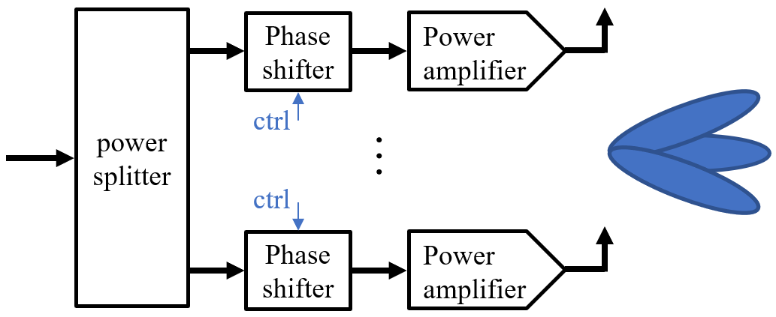
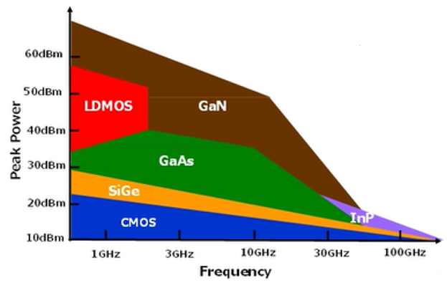
RF frontend at 60 GHz is different
A mmWave RF frontend is challenging to implement
Need for power splitters, switches, and phase shifting circuitries to implement analog beamforming
Those components have non-zero loss
RF power is scarce resource [6, 7]
A CMOS power amplifier (PA) for 60 GHz has typ. 10 to 15 dBm peak transmit power
PAs on other substrate may achieve higher peak transmit power
Various PAs reside in an RF frontend
It is difficult to do digital predistortion (DPD) for all [8]
Thus, consideration of PA characteristic is very important
For our analysis, we use the PA model of EDMG evaluation methodology [9]
PA backoff parameter is defined as $BO=−10\log_{10}\left({P_{avg}}/{P_{sat}}\right)$
of [7]
$P_{avg}$ average transmit power
$P_{sat}$ peak transmit power

Slide 6
Estimation of link margin and range
Link margin can be estimated under the following assumptions
Carrier frequency 60 GHz
Phased antenna array (PAA) gain at Tx and Rx each 8 dB
Power amplifier (PA) maximum transmit power 10 dBm
PA backoff
OFDM: 8dB (same for all MCS)
SC: 0.5 / 3 / 5dB (for BPSK, QPSK / 16QAM / 64QAM)
AWGN channel
Unlimited power spectral density for the considered bandwidths
Range can be estimated based on link margin
Friis’ pathloss
$PL=32.5+20\log_{10}{f[GHz]}+20\log_{10}{d[m]}$
Good model for 60 GHz LOS propagation [10,11]

Slide 7
Predicted link margin for IMMW waveform
Link margin [dB] at 1m distance
OFDM suffers high BO for low constellation sizes
320 MHz OFDM has same margin as 1760 MHz SC for BPSK/QPSK
Gap between OFDM and SC closes for higher QAM
64QAM may be applicable for very directive PAAs or high-power PA
256QAM may be rarely used
1280 MHz may be applicable for small constellations only
Predicted range can be found in Appendix
10m => -20dB
Bandw. [MHz] / MCS | 80 | 160 | 320 | 640 | 1280
BPSK R1/2 | 29 | 26 | 23 | 20 | 17
QPSK R1/2 | 26 | 23 | 20 | 17 | 14
QPSK R3/4 | 24 | 21 | 18 | 15 | 12
16Q R1/2 | 21 | 18 | 15 | 12 | 9
16Q R3/4 | 17 | 14 | 11 | 8 | 5
64Q R2/3 | 13 | 10 | 7 | 4 | 1
64Q R3/4 | 12 | 9 | 6 | 3 | 0
64Q R5/6 | 11 | 8 | 5 | 2 | -1
256Q R3/4 | 6 | 3 | 0 | -3 | -6
1760 (EDMG SC)
23
20
18
13
9
-
2
-
-

Slide 8
Predicted Rate
≈18%
Rate [Mbps] for several MCS and BWs can be predicted
Based on the spectral efficiency value of 0.85
Comparable PHY performance
BPSK and QPSK at 320 MHz have same PHY performance as EDMG SC at 1760 MHz
Rate is 18% compared to EDMG
16Q and 64Q at 640 MHz have same PHY performance as EDMG SC at 1760 MHz
Rate is 35% compared to EDMG
Bandw. [MHz] / MCS | 80 | 160 | 320 | 640 | 1280
BPSK R1/2 | 34 | 68 | 136 | 272 | 544
QPSK R1/2 | 68 | 136 | 272 | 544 | 1088
QPSK R3/4 | 102 | 204 | 408 | 816 | 1632
16Q R1/2 | 136 | 272 | 544 | 1088 | 2176
16Q R3/4 | 204 | 408 | 816 | 1632 | 3264
64Q R2/3 | 272 | 544 | 1088 | 2176 | 4352
64Q R3/4 | 306 | 612 | 1224 | 2448 | 4896
64Q R5/6 | 340 | 680 | 1360 | 2720 | 5440
256Q R3/4 | 408 | 816 | 1632 | 3264 | 6528
1760 (EDMG SC)
770
1540
2310
3080
4620
-
6930
-
-
≈35%

Slide 9
Conclusions
Constellation size
Constellations ≤ 64-QAM are sufficient
Bandwidth
≤ 640 MHz is sufficient
Use of 1280MHz questionable
Reasonable link margin for small constellation sizes
80 MHz may be needed for omni-reception (or even omni-transmission)
Achievable rates are generally smaller as in EDMG
Rates for a bandwidth of 640 MHz are about 35% of single channel EDMG SC
This brings rates quite close to those of EHT PHY which is beneficial for MLO
MLO of sub-7 and 60 GHz combines links of comparable rates
Rates for a bandwidth of 320 MHz are about 18% of single channel EDMG SC

Slide 10
Straw Poll
Do you agree that TGbq PHY design should consider the following boundary conditions?
Min. bandwidth greater or equal to 80 MHz
Max. bandwidth lower or equal to 640 MHz
Min. modulation constellation greater or equal to BPSK
Max. modulation constellation lower or equal to 64QAM

Slide 11
References
[1] 11-23/1819r1 “Integrated mmWave Design Considerations”
[2] 11-23/1905r0 “High Level Thoughts on IMMW”
[3] 11-22/1395r0 “ Thoughts on high frequency band”
[4] 11-22/1872r0 “Considerations on PHY designs for mmWave band”
[5] 11-24/0076r0 “Comparison of OFDM and EDMG SC Waveform”
[6] Power Amplifiers Performance Survey 2000-Present
[7] K. Kohama et al., IWPC Workshop, A GaN Technology to Meet Future Radio Requirements, October 2024
[8] Why Millimeter Wave Requires a Different Approach to DPD and How to Quantify Its Value | Analog Devices
[9] 11-15/0866r4 “11ay evaluation methodology”
[10] 11-09/0334r8 “Channel Models for 60 GHz WLAN Systems”
[11] 11-09/0553r1 “ Path Loss Model Development for TGad Channel Models”

Slide 12
Appendix

Slide 13
Predicted range for IMMW waveform
Range [m]
OFDM suffers high BO for low constellation sizes
320 MHz OFDM has same range as 1760 MHz SC for BPSK/QPSK
Gap between OFDM and SC closes for higher QAM
64QAM may be applicable for very directive PAAs or high-power PA
256QAM may be rarely used
1280 MHz may be applicable for small constellations only
Bandw. [MHz] / MCS | 80 | 160 | 320 | 640 | 1280
BPSK R1/2 | 28 | 20 | 14 | 10 | 7
QPSK R1/2 | 20 | 14 | 10 | 7 | 5
QPSK R3/4 | 16 | 11 | 8 | 6 | 4
16Q R1/2 | 11 | 8 | 6 | 4 | 3
16Q R3/4 | 7 | 5 | 4 | 3 | 2
64Q R2/3 | 4 | 3 | 2 | 2 | 1
64Q R3/4 | 4 | 3 | 2 | 1 | 1
64Q R5/6 | 4 | 3 | 2 | 1 | 1
256Q R3/4 | 2 | 1 | 1 | 1 | 0
1760 (EDMG SC)
14
10
8
4
3
-
1
-
-

Slide 14
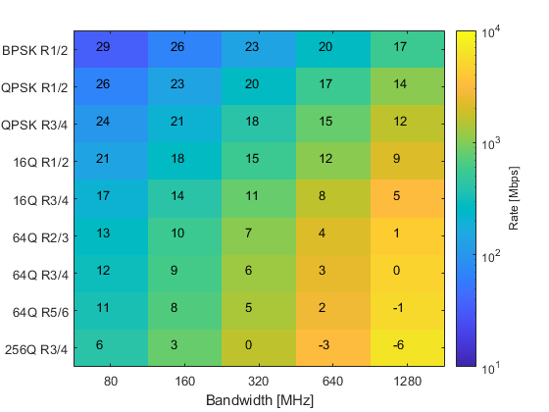
Link margin and Rate vs. Bandwidth and MCS
Graphical representation of predicted rate and predicted link margin
Table of slide 8 and side 9 combined in one graphic
Number is link margin [dB] at 1m
Color is rate [Mbps]

Slide 15
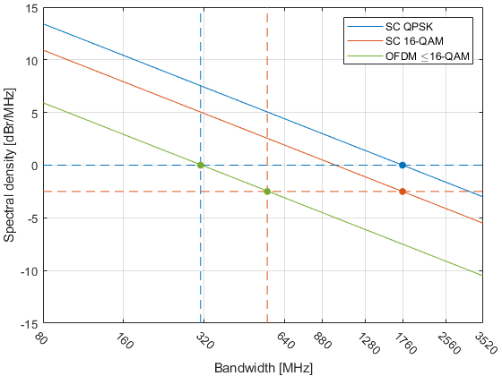
Recap of [5]
OFDM and SC waveform have different power amplifier (PA) backoff (BO) requirements
SC has an advantage of 7.5dB over OFDM for BPSK and QPSK
OFDM can compensate by lower bandwidth
Factor of ${10}^{−{7.5}/{10}}≈0.178$
Bit rate of OFDM is only 17.8% of the SC bit rate at same PHY performance
Same PHY performance means same link margin or achievable range
The analysis has certain limitations
E.g. impact of phase noise, unknown guard bands, guard interval, implementation specific parameters, etc.
0.178
7.5dB

