Slide 1
Discussion on Uplink Sync Field Design for Active Transmitters
May 2025
Date: 2025-05-12
Authors:
Name | Affiliations | Address | Phone | Email
Bin Qian | Huawei | Shenzhen, China |  | qianbin14@huawei.com
Lumin Liu |  | Singapore
Lei Huang |  | Singapore
Panpan Li |  | Singapore
Notes:
September 2012

Slide 2

Introduction
May 2025
Three types of STAs are defined in 802.11bp
  Backscatter non-AP AMP STA
  AMP Enabled non-AP STA
  Active Tx non-AP AMP STA (active transmitter): capable of receiving only AMP DL PPDUs and supporting active transmission of AMP UL PPDUs
The AMP Uplink (UL) PPDU for active transmitters includes AMP-Sync field, AMP-Data field and AMP-SIG field (TBD)
  The bandwidth is less than 20 MHz
This contribution aims to discuss the design of the UL AMP-Sync field for active transmitters and present preliminary simulation results

Slide 3
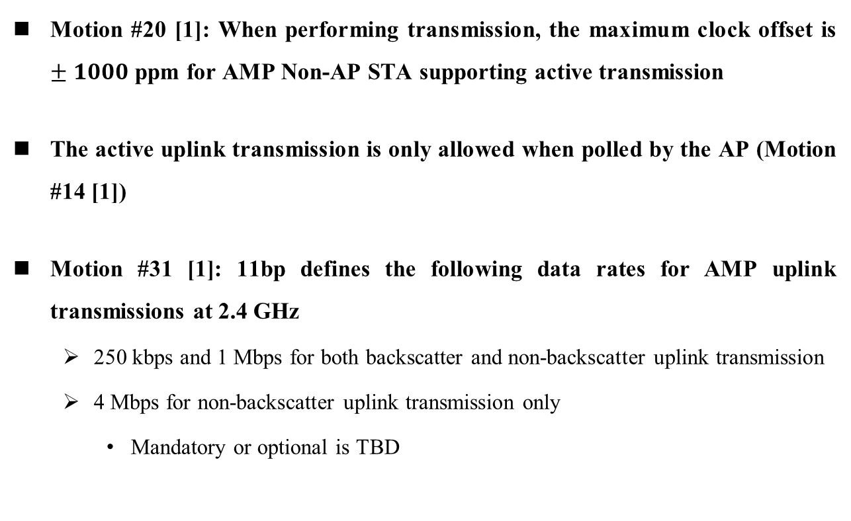
Recap: Related Consensus
May 2025
Motion #20 [1]: When performing transmission, the maximum clock offset is $±1000$ ppm for AMP Non-AP STA supporting active transmission
The active uplink transmission is only allowed when polled by the AP (Motion #14 [1])
Motion #31 [1]: 11bp defines the following data rates for AMP uplink transmissions at 2.4 GHz
  250 kbps and 1 Mbps for both backscatter and non-backscatter uplink transmission
  4 Mbps for non-backscatter uplink transmission only
    Mandatory or optional is TBD

Slide 4
UL Sync Field Design Criteria for Active Transmitters
May 2025
One sync sequence for different data rates [2]
  Chip duration of the sync field aligns with the data field to reduce STA complexity
Consecutive symbols limit: Maximum of three consecutive zeros to prevent misinterpretation of an idle channel
Auto-correlation property: Ensures reliable detection
Start with ON symbols
Balanced bit pattern: Equal number of ones and zeros
DL/UL indication [2-3]
  Good cross-correlation with DL sync field for non-backscatter STAs: The UL sync field should minimize interference to the non-backscatter STAs

Slide 5
Simulation Setting
May 2025
Parameters | Values | Comment
Transmit Bandwidth | < 20 MHz | Motion #11
On Symbol | RRC pulse with roll-off factor 0.1 | The STA cannot generate OFDM symbols. Other pulses could be used
UL Sync Sequence Length | 16, 24, 32 | (1) The Sync field must be more reliable than the data field for stable synchronization (2) Proper threshold should be set to reduce false alarm rate
Sync Chip Duration | 2us, 0.5us, 0.125us | Same as the payload
Payload size | 16 Octets
Channel model | AWGN | Channel Model B/D will be considered in the future
SNR Definition | Rx signal power vs. noise power over 20 MHz | There is an Rx filter at the AP
Sync Detection False Alarm Rate Definition Interval | 16 us | UL transmission is polled by DL
Receiver architecture | Non-coherent detector | Coherent detector will be considered in the future
Receiver sampling rate at AP | 20 MHz, 40 MHz (for 4 Mbps only) | At lease four samples per chip
Successful sync detection definition | The detected peak exceeds the threshold, and the offset between the detected peak position and the ideal peak position is no greater than 25% of the chip duration

Slide 6
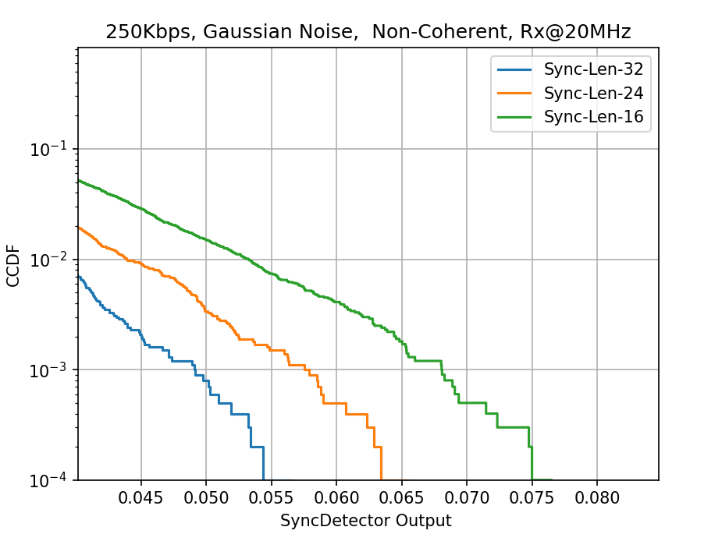
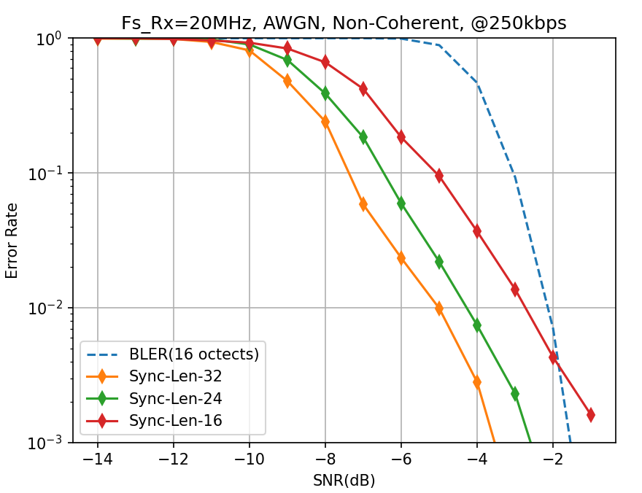
Detection Performance: 250 kbps
May 2025
Correlation peak statistics between sync and noise
Sync detection and data decoding performance
Sync length | 32 | 24 | 16
Threshold | 0.06 | 0.07 | 0.08

Slide 7
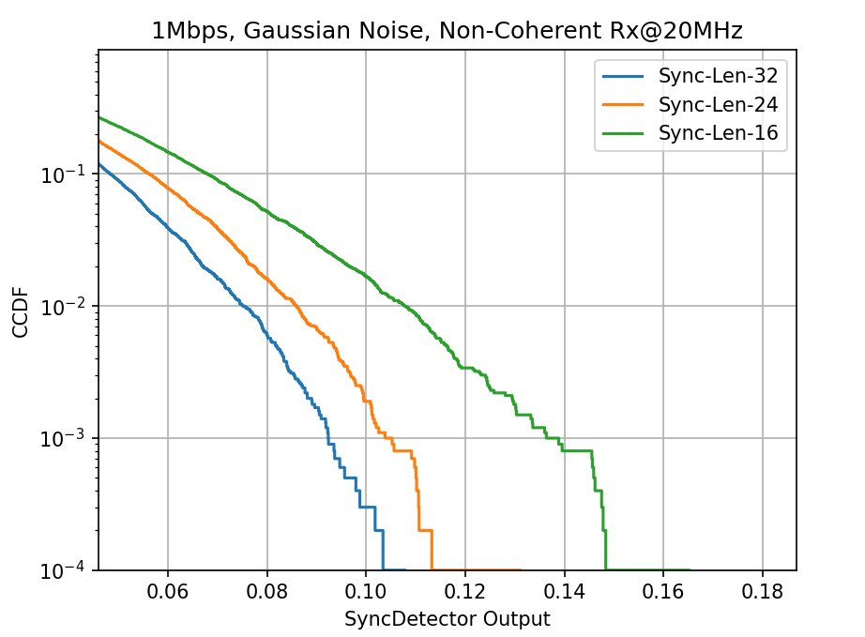
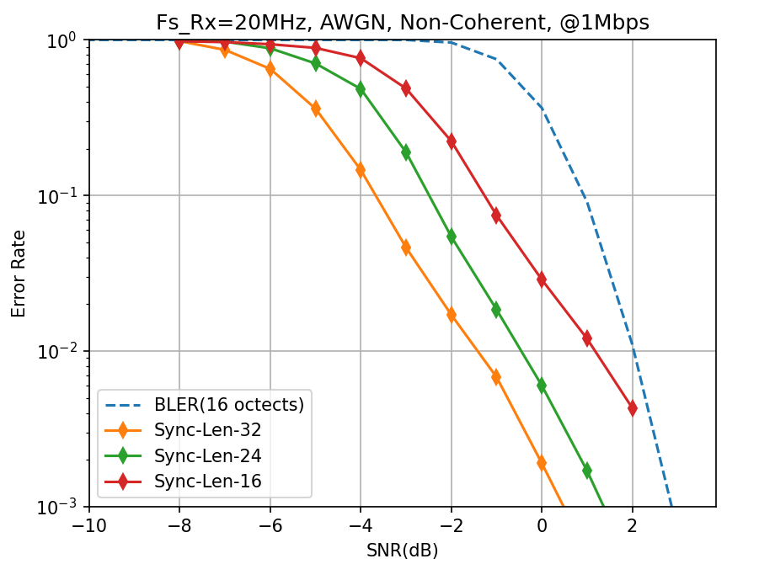
Detection Performance: 1 Mbps
May 2025
Correlation peak statistics between sync and noise
Sync detection and data decoding performance
Sync length | 32 | 24 | 16
Threshold | 0.12 | 0.14 | 0.18

Slide 8
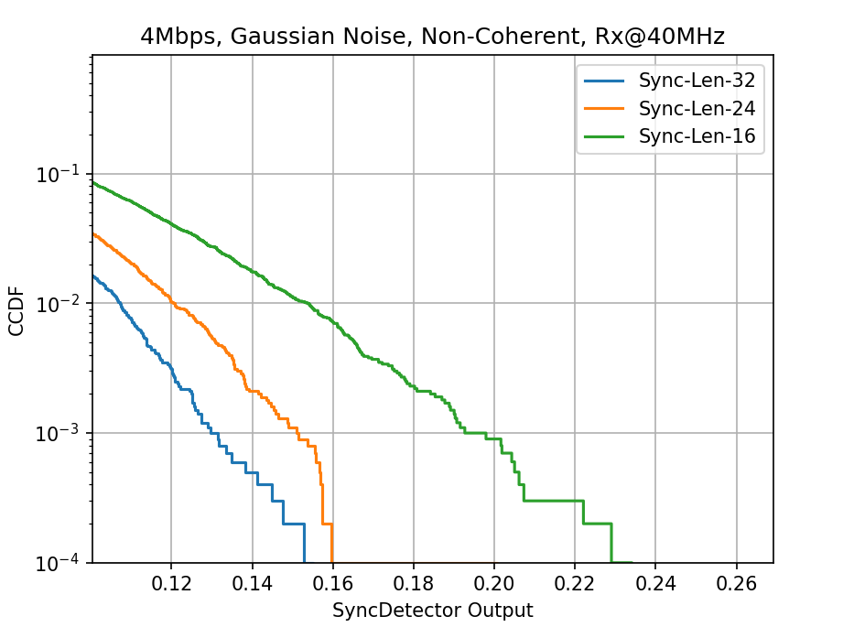
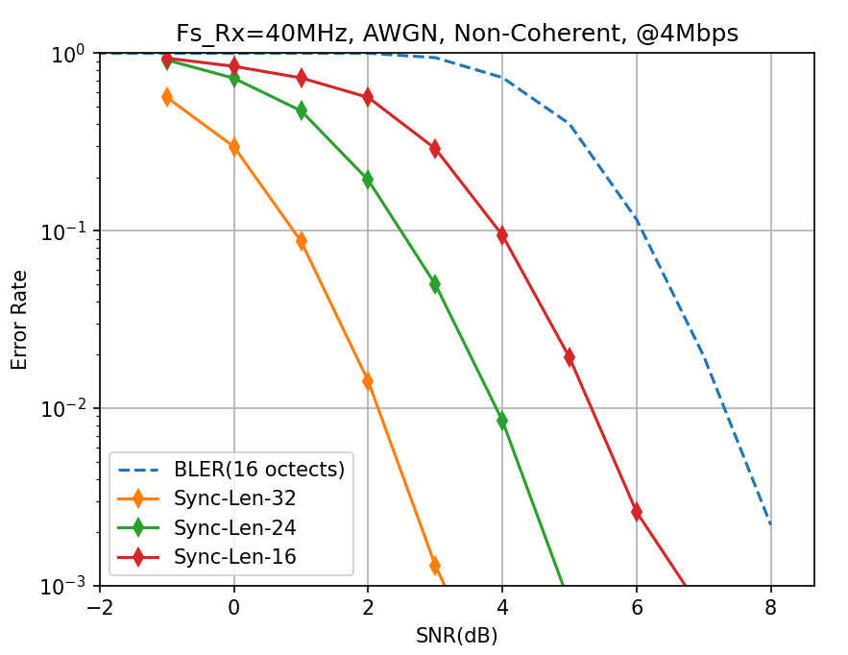
Detection Performance: 4 Mbps
May 2025
Correlation peak statistics between sync and noise
Sync detection and data decoding performance
Sync length | 32 | 24 | 16
Threshold | 0.16 | 0.18 | 0.24

Slide 9
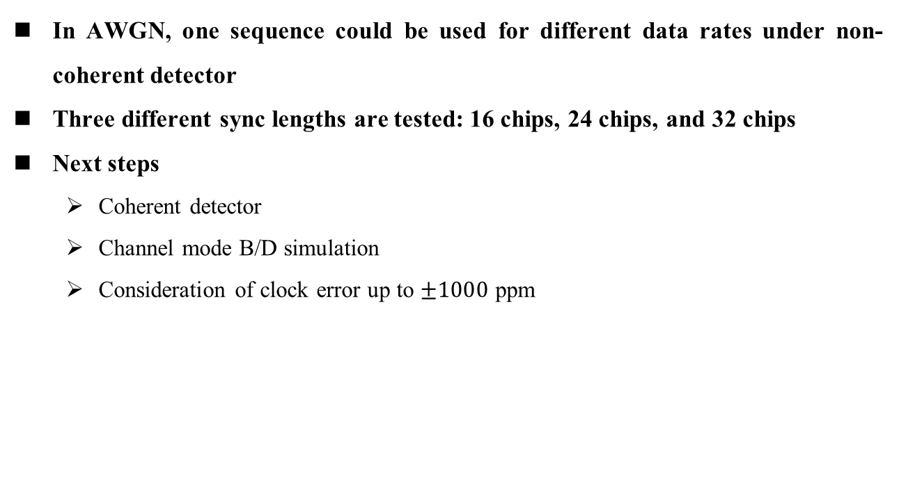
Summary
May 2025
In AWGN, one sequence could be used for different data rates under non-coherent detector
Three different sync lengths are tested: 16 chips, 24 chips, and 32 chips
Next steps
  Coherent detector
  Channel mode B/D simulation
  Consideration of clock error up to $±1000$ ppm

Slide 10
References
May 2025
[1] 11-24-1322-07-00bp-tgbp-motion-dock
[2] 11-25-0400-00-00bp-sync-field-design-considerations
[3] 11-25-0316-00-00bp-follow-up-on-amp-ppdu-design

