Slide 1
Thoughts on secure AMP operation
May 2025
Doc.: IEEE 802.11-25/0860r0
Date: 2025-05-02
Authors:
Name | Affiliation | Address | Phone | Email
Chuanfeng He | OPPO |  |  | hechuanfeng@oppo.com
Weijie Xu |  |  |  | xuweijie@oppo.com
Yinan Qi |  |  |  | v-qiyinan@oppo.com

Slide 2
Background
Doc.: IEEE 802.11-25/0860r0
The motions about secure communication were agreed.[1]
MM-3: 11bp defines a mechanism to support secure communications for 802.11bp clients.
MM-5:
IEEE 802.11bp will specify secure data communication methods that do not require maintaining security associations.
Note:
The methods are based on existing 802.11 security protocols.
The security for backscattering AMP devices are TBD.
The details are TBD.
Chuanfeng He (OPPO)

Slide 3
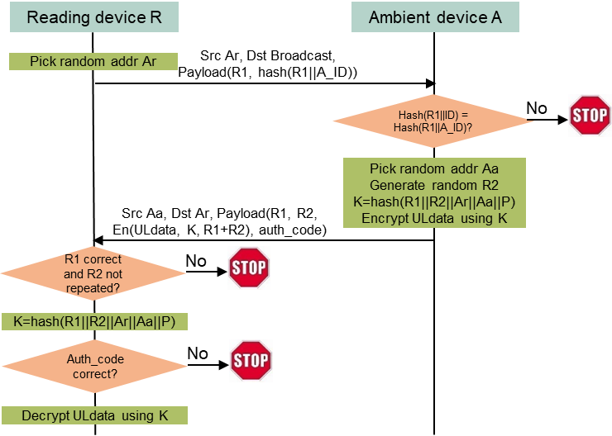
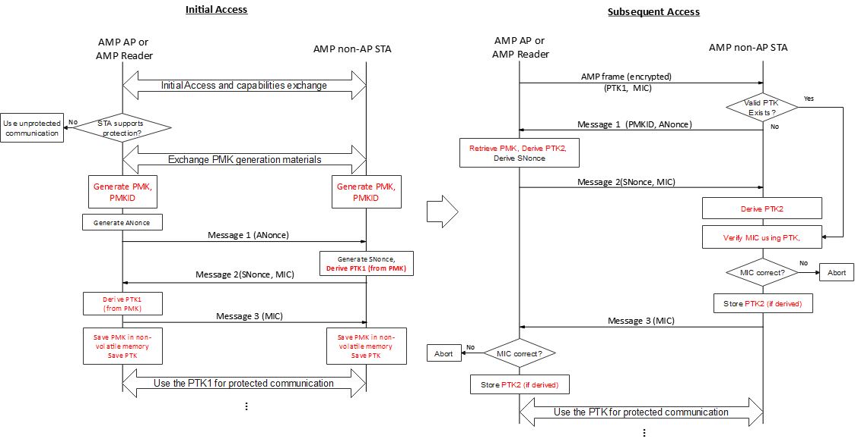
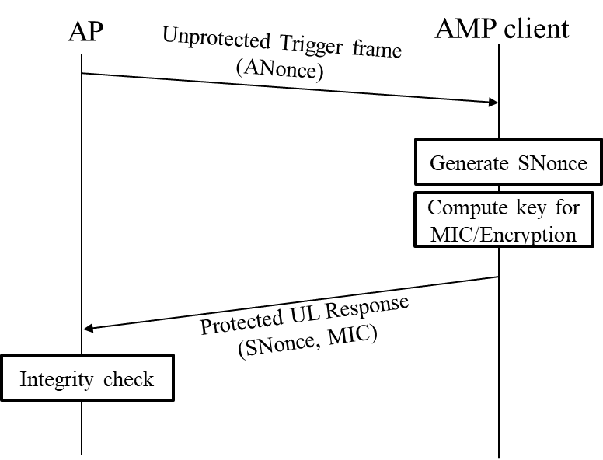
May 2025
Doc.: IEEE 802.11-25/0860r0
Recap: Lightweight secure AMP operation
In [4][5], it was proposed to have a initial secure setup procedure before protected communication.
In [4], Initial Info Exchange and AMP Operation Mode Information Exchange before Trigger @ UL transmission are proposed.
In [5], there are the PMK generation and the PTK generation for initial access, and PTK generation for subsequent access, before protected communication.
In [3][5], it was also proposed to have a integrated procedure for key generation and protected data transmission.
Slide 3
Chuanfeng He (OPPO)

Slide 4
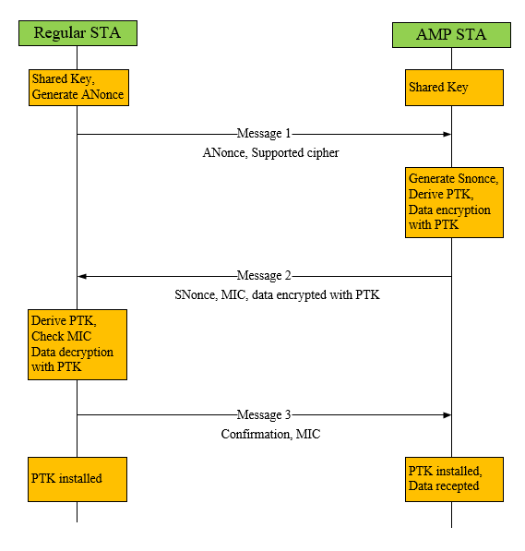
May 2025
Doc.: IEEE 802.11-25/0860r0
Recap: Lightweight secure AMP operation
In[2], we propose Integrated Security and data transaction for AMP to simply the secure data communication procedure for AMP STA. We combine the Key generation and protected data communication in the same procedure.
It helps to reduce frame exchange during secure transaction, to address energy constraints and low latency for logistics like use cases.
Slide 4
Chuanfeng He (OPPO)

Slide 5
May 2025
Doc.: IEEE 802.11-25/0860r0
Integrated secure AMP operation
Motivations
For logistics use case
Energy constraints do not allow many frame exchanges for secure setup before protected UL data transmission.
Low latency is required for quick UL data transmission for AMP STA identification.
One shot data communication does not require maintaining security associations.
We propose the integrated secure AMP operation, which is a integrated secure procedure for key generation and protected data transmission.
An AP transmits a AMP trigger frame containing an ANonce.
An AMP STA receiving the AMP trigger frame generates an SNonce.
The AMP STA generates a transient key using the ANonce, the SNonce, and a preestablished Pairwise Master Key (PMK) between the AP and the AMP STA.
The AMP STA transmits an uplink AMP frame that carries the SNonce, and MIC along with the encrypted UL data using the generated transient key.
If the MIC is verified, the AP uses the ANonce it transmitted in the previous AMP trigger frame, the SNonce, and the preestablished PMK to generate the transient key.
The AP receiving the uplink AMP frame decrypts the encrypted UL data using the generated transient key.
Slide 5
Chuanfeng He (OPPO)

Slide 6
May 2025
Doc.: IEEE 802.11-25/0860r0
Summary and Proposal
Integrated secure procedure for key generation and protected data transmission can address the energy constraints, low latency requirement, and one shot data communication for logistics like use cases.
Proposal:
11bp supports integrated secure procedure for key generation and protected data transmission.
An AP transmits a AMP trigger frame containing an ANonce.
An AMP STA receiving the AMP trigger frame generates an SNonce.
The AMP STA generates a transient key using the ANonce, the SNonce, and a preestablished Pairwise Master Key (PMK) between the AP and the AMP STA.
The AMP STA transmits an uplink AMP frame that carries the SNonce, and MIC along with the encrypted UL data using the generated transient key.
If the MIC is verified, the AP uses the ANonce it transmitted in the previous AMP trigger frame, the SNonce, and the preestablished PMK to generate the transient key.
The AP receiving the uplink AMP frame decrypts the encrypted UL data using the generated transient key.
Slide 6
Chuanfeng He (OPPO)

Slide 7
May 2025
Doc.: IEEE 802.11-25/0860r0
Straw Poll #1
Do you agree with the following text:
802.11bp defines a secure data communication method, which includes:
An AP transmits a AMP trigger frame containing an ANonce.
An AMP STA receiving the AMP trigger frame generates an SNonce.
The AMP STA generates a transient key using the ANonce, the SNonce, and a preestablished Pairwise Master Key (PMK) between the AP and the AMP STA.
The AMP STA transmits an uplink AMP frame that carries the SNonce, and MIC along with the encrypted UL data using the generated transient key.
If the MIC is verified, the AP uses the ANonce it transmitted in the previous AMP trigger frame, the SNonce, and the preestablished PMK to generate the transient key.
The AP receiving the uplink AMP frame decrypts the encrypted UL data using the generated transient key.
Yes
No
Abstain
Slide 7
Chuanfeng He (OPPO)

Slide 8
Reference
May 2025
Doc.: IEEE 802.11-25/0860r0
IEEE 802.11-24/1613r7, Specification framework for tgbp
IEEE 802.11-24/1203r0, Authentication and Security transaction for AMP, OPPO
IEEE 802.11-24/1998r1, Secure transaction methods with low computation complexity for AMP, Infineon
IEEE 802.11-24/2112r0, Secure E2E Operation for AMP, Qualcomm
IEEE 802.11-24/1548r2, Thoughts on security for AMP, Huawei

