Slide 1
AMP Ack frame
May 2025
Doc.: IEEE 802.11-25/0859r0
Date: 2025-05-02
Authors:
Name | Affiliation | Address | Phone | Email
Chuanfeng He | OPPO |  |  | hechuanfeng@oppo.com
Weijie Xu |  |  |  | xuweijie@oppo.com
Yinan Qi |  |  |  | v-qiyinan@oppo.com

Slide 2
Background
Doc.: IEEE 802.11-25/0859r0
The motion about the support pf AMP Ack was agreed.[1][2]
FM-2: 802.11bp defines an AMP Ack frame that an AMP AP transmits to acknowledge the received UL AMP frame(s).
It was not discussed how to acknowledge the received UL AMP frame with AMP ACK frame.
Chuanfeng He (OPPO)

Slide 3
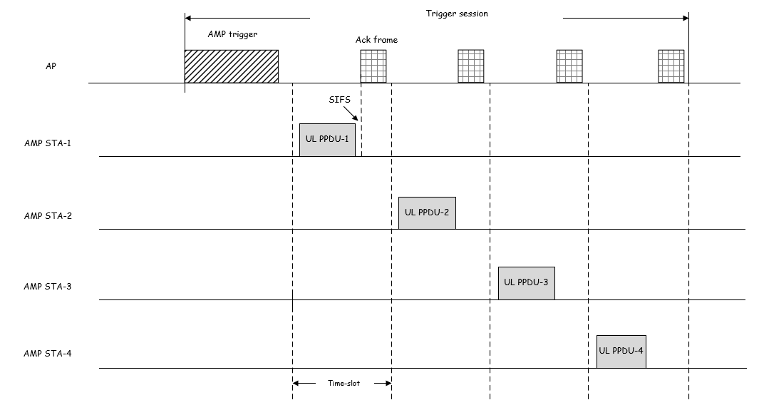
May 2025
Doc.: IEEE 802.11-25/0859r0
Scheme 1: Separate ACK frame for each UL PPDU
AMP AP transmits an ACK frame at the end of each time-slot, to acknowledge the received UL PPDU in this time-slot.
AMP STA can go to sleep immediately after ACK frame reception.
The overhead of ACK frame is large.
The long time-slot length to cover both UL PPDU and ACK PPDU.
It is challenge for AMP STA to switch from Tx to Rx within SIFS, in order to receive ACK frame in the same time-slot.
Slide 3
Chuanfeng He (OPPO)

Slide 4
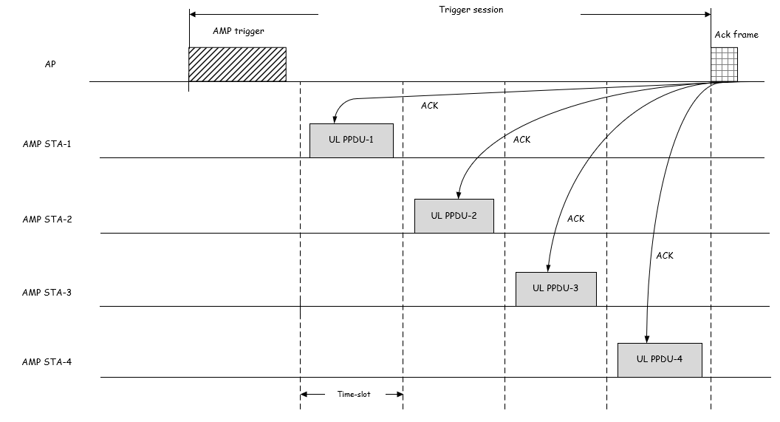
May 2025
Doc.: IEEE 802.11-25/0859r0
Scheme 2: Block ACK frame for all UL PPDUs
AMP AP transmits an block ACK frame after all time-slots indicated by the AMP trigger, to acknowledge the received UL PPDUs in the time-slots.
Block Ack for multiple MPDUs are supported in legacy 802.11 protocol.
AMP STA should keep awake until the end of trigger session.
The overhead of block ACK frame is smaller.
Slide 4
Chuanfeng He (OPPO)

Slide 5
May 2025
Doc.: IEEE 802.11-25/0859r0
Summary and Proposal
Separate ACK and block ACK can be considered to acknowledge the received UL PPDUs in the time-slots indicated by an AMP trigger.
The issues on the overhead and processing time requirement of AMP STA should be considered for separate ACK scheme.
Proposal:
AMP AP transmits an block ACK frame after all time-slots indicated by the AMP trigger, to acknowledge the received UL PPDUs in the time-slots.
Slide 5
Chuanfeng He (OPPO)

Slide 6
May 2025
Doc.: IEEE 802.11-25/0859r0
Straw Poll #1
Do you agree with the following text:
802.11bp defines an AMP Block Ack frame that an AMP AP transmits to acknowledge the received UL AMP frame(s) in one or more time-slots indicated by an AMP trigger.
Yes
No
Abstain
Slide 6
Chuanfeng He (OPPO)

Slide 7
Reference
May 2025
Doc.: IEEE 802.11-25/0859r0
IEEE 802.11-24/1613r7, Specification framework for tgbp
IEEE 802.11-25/0398r0, AMP frames, Qualcomm

