Slide 1
UL random access mechanisms for AMP
May 2025
Doc.: IEEE 802.11-25/0858r0
Date: 2025-05-02
Authors:
Name | Affiliation | Address | Phone | Email
Chuanfeng He | OPPO |  |  | hechuanfeng@oppo.com
Weijie Xu |  |  |  | xuweijie@oppo.com
Yinan Qi |  |  |  | v-qiyinan@oppo.com

Slide 2
Background
Doc.: IEEE 802.11-25/0858r0
The motions about UL access mechanisms for Active Tx non-AP AMP STAs were agreed.[1][2]
MM-10: 802.11bp supports a time-slot based random access mechanism for Active Tx non-AP AMP STAs:
AMP AP transmits an AMP frame that indicates one or more time-slots.
Further details (e.g., frame formats, how a STA chooses a random access time-slot etc.) are TBD.
MM-11: 802.11bp supports a time-slot based scheduled access mechanism for Active Tx non-AP AMP STAs:
AMP AP transmits an AMP frame to assign one or more transmission time-slots.
Further details (e.g., frame formats, how the time-slots are assigned etc.) are TBD.
Chuanfeng He (OPPO)

Slide 3
May 2025
Doc.: IEEE 802.11-25/0858r0
Time-slot based random access mechanism
AMP AP transmits an AMP frame that indicates one or more time-slots for potential UL PPDU Tx without the request from AMP STAs.
Random access mechanism is applicable to logistics like use cases
AP has no knowledge of AMP STA’ ID.
Small data is solicited by AP for AMP STA identification.
Low latency is expected for fast AMP STA identification.
Association is not required for one shot UL PPDU Tx from AMP STAs.
Unscheduled UL access may lead to mismatch between UL PPDU Tx and solicited time-slots. A time-slot may be either empty with no UL PPDUs or occupied by multiple UL PPDUs.
Slide 3
Chuanfeng He (OPPO)

Slide 4
May 2025
Doc.: IEEE 802.11-25/0858r0
Two steps of random access
Step 1: AMP trigger based random access
Random access among AMP triggers
AMP AP tries to solicit potential UL PPDUs through sending AMP triggers. It is not desired to solicit UL PPDUs from all the waiting AMP STAs(e.g. 100) through one AMP trigger(e.g. 4 time-slots indicated), which will lead to serious collision.
An AMP STA can select one target AMP trigger among AMP triggers based on AMP trigger based random access mechanism.
The random access among AMP triggers helps to spread the access of AMP STAs among multiple trigger sessions to reduce collision.
Step 2: Time-slot based random access[3]
Random access among time-slots indicated by the selected AMP trigger
When AMP STA selects one target AMP trigger through AMP trigger based random access, it responds to the target trigger by transmitting UL PPDU using a time-slot indicated by the trigger.
An AMP STA can select one target time-slot among time-slots indicated by the trigger based on time-slot based random access mechanism.
Slide 4
Chuanfeng He (OPPO)

Slide 5
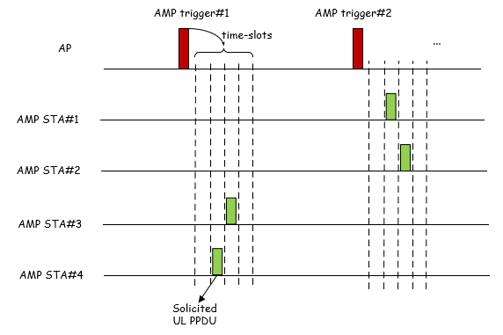
May 2025
Doc.: IEEE 802.11-25/0858r0
Random access procedure
AMP trigger based random access
Through AMP trigger based random access
AMP STA#1 and #2 select AMP trigger #2
AMP STA#3 and #4 select AMP trigger #1
Time-slot based random access
Through time-slot based random access
AMP STA#1 and #2 select 2nd and 3rd time-slot indicated by AMP trigger #2, respectively
AMP STA#3 and #4 select 3rd and 2nd time-slot indicated by AMP trigger #1, respectively
Slide 5
Chuanfeng He (OPPO)

Slide 6
May 2025
Doc.: IEEE 802.11-25/0858r0
Summary and Proposal
11bp supports the following random access mechanism
AMP trigger based random access
AMP STA selects an AMP trigger based on AMP trigger based random access mechanism.
Time-slot based random access[3]
AMP STA randomly selects a time-slot among time-slots indicated by the AMP trigger soliciting UL PPDU transmission from the AMP STA.
The detailed random access mechanisms are TBD(e.g. random selection among AMP triggers or time-slots)
Slide 6
Chuanfeng He (OPPO)

Slide 7
May 2025
Doc.: IEEE 802.11-25/0858r0
Straw Poll #1
Do you agree with the following text:
802.11bp supports a random access mechanism, which includes:
AMP STA selects an AMP trigger for solicited UL PPDU transmission based on AMP trigger based random access mechanism.
The details of AMP trigger based random access mechanisms are TBD.
Yes
No
Abstain
Slide 7
Chuanfeng He (OPPO)

Slide 8
May 2025
Doc.: IEEE 802.11-25/0858r0
Straw Poll #2
Do you agree with the following text:
802.11bp supports a random access mechanism, which includes:
AMP STA randomly selects a time-slot among time-slots indicated by an AMP trigger soliciting UL PPDU transmission from the AMP STA.
Yes
No
Abstain
Slide 8
Chuanfeng He (OPPO)

Slide 9
Reference
May 2025
Doc.: IEEE 802.11-25/0858r0
IEEE 802.11-24/1613r7, Specification framework for tgbp
IEEE 802.11-25/0334r1, Channel access for Active Tx non-AP AMP STAs – follow up, Huawei
IEEE 802.11-25/0340r0, Trigger based TDM multiple access, OPPO

