Slide 1
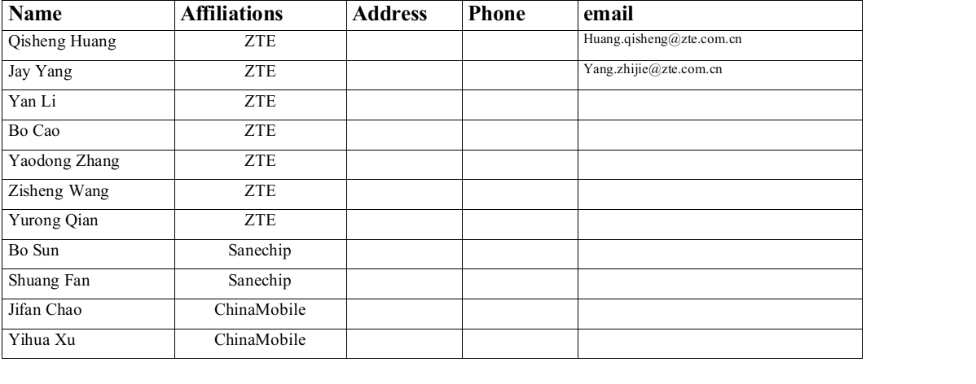
Subchannel Beam Training for IMMW Communication

Slide 2
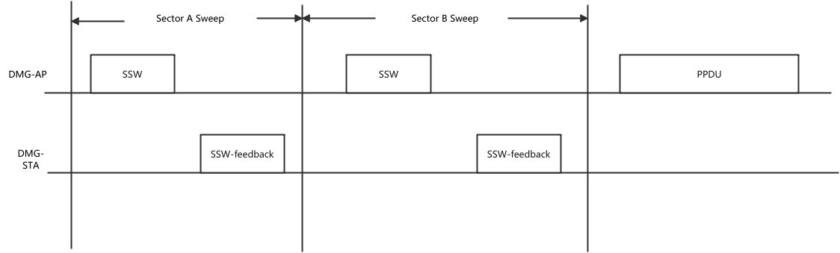
Recap of Previous Beam Sweeping Procedure
Note：There may be extra beam refinement procedure defined in 11ay.

Slide 3
Millimeter Wave Communication Overview
Key Characteristics of mmWave
  Line-of-Sight (LoS) Transmission: Millimeter wave (mmWave) primarily relies on LoS transmission.
  Dynamic Environments: Optimal propagation path can change with environmental variations (e.g., door/window opening/closing).
  Periodic Scanning: Necessary to optimize the link in mmWave communication.
Beam Scanning and Data Transmission:
  Time-Division Multiplexing: Beam scanning and data transmission are performed in a time-division manner.
  Scanning Process: Involves multiple sectors and occupies data transmission time.
  Impact of Frequent Scanning: Reduces data transmission time, increasing service delay and reducing system throughput.

Slide 4
Motivation
Main Purpose: Reducing Service Delay in mmWave Beam Scanning
Solution:
  Use a sub-channel for simultaneous beam refinement and data communication.
Implementation:
  Select a sub-channel within the mmWave bandwidth for beam calibration.
  Enables concurrent data transmission and beam calibration (sector measurement and alignment).
  Minimal impact: Only a small portion of bandwidth is used for calibration.
Key Consideration:
  Frequency beam squint effect: Choosing sub-channels with smaller center frequency differences reduces beam calibration errors.

Slide 5
Motivation
Main Purpose: Convert frequency domain overhead to time domain

Slide 6
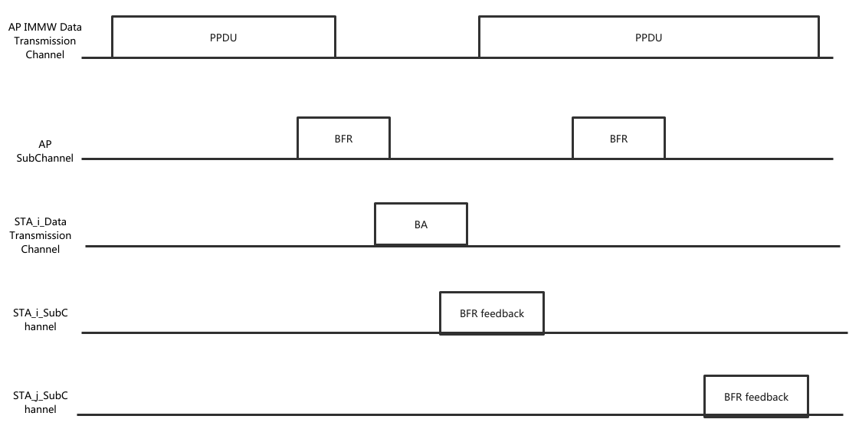
Mode 1: Independent Link for Scanning
Key features:
  Mode Description: Uses an independent link to perform sub-bandwidth scanning.
  Simultaneous Operations:
    Beam scanning and data transmission can occur concurrently.
    AP can send/receive beam calibration frames via the sub-channel while transmitting/receiving PPDU data packets via the main channel to/from STA.

Slide 7
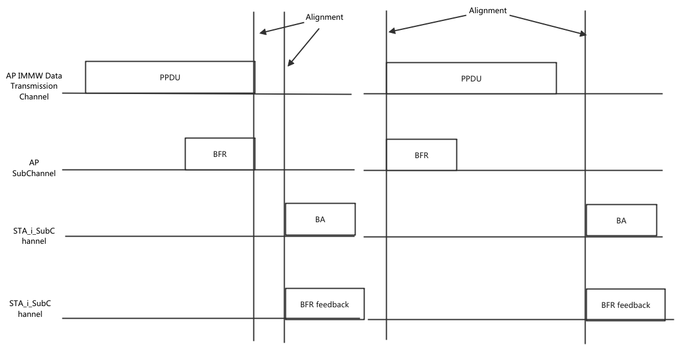
Mode 2: Shared RF Front-End
Key features:
  Synchronization Requirement:
    Main channel and beam calibration sub-channel must be synchronized
    If the main channel is transmitting/receiving, the sub-channel must also be transmitting/receiving.
  Alignment Methods:
    Header Alignment: Beam calibration frames aligned with the header of the PPDU on the main channel.
    Tail Alignment: Beam calibration frames aligned with the tail of the PPDU on the main channel.

Slide 8
Summary
Frequent beam scanning in millimeter wave (mmWave) systems increases service delays, impacting performance in latency-sensitive applications.
Therefore this proposal utilize a dedicated sub-channel within the mmWave bandwidth for beam calibration
  Provides detailed analysis and design of scanning and feedback frame interactions specific to each work mode.
  Designs of sub-channel scanning modes are tailored to current device capabilities, optimizing for efficiency and compatibility.

Slide 9
Staw Poll
Do you agree to set up subchannel for beam training in IMMW
  The specific position of the subchannel is TBD.

Slide 10
THANK YOU ☺

