Slide 1
IMMW Tone Plan Discussions
Date: 2025-05-12
Authors:

Slide 2
Introduction
Integrated mmWave (IMMW) PAR [1] defines the scope to leverage or reuse existing 802.11 OFDM PHY
Upclocking of sub-7GHz OFDM PHY is a popular solution [2~6]
In March meeting, we proposed the potential IMMW PHY PPDU format and preamble design [7]
In this presentation, we share some analysis on IMMW PHY tone plan comparison

Slide 3
Recap: IMMW SU PPDU [7]
LSTF | LLTF | U-SIG | IMMW SIG | IMMW STF | IMMW LTF | IMMW-Data | PE
  L-STF/IMMW-STF
    Same tone plan as sub-7GHz definition
      Reuse the same logic for packet detection, CFO, timing, AGC, etc.
    Upclock to wider BW → period of 0.8us/Nx
  LLTF/U-SIG/IMMW-SIG
    Same as sub-7GHz definition with legacy 20MHz tone plan
    Nx upclocking to wider BW
      Tone spacing of 312.5kHz * Nx; GI shrinks to 0.8us/Nx
  IMMW-STF/LTF/Data
    Nx upclocking from VHT/EHT tone plan
      Tone spacing of 78.125KHz/312.5kHz * Nx
      GI shrinks to 0.8us/Nx or 1.6us/Nx or 3.2us/Nx

Slide 4
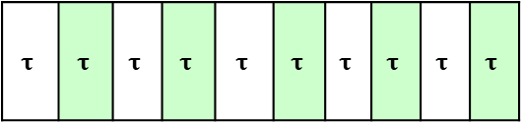
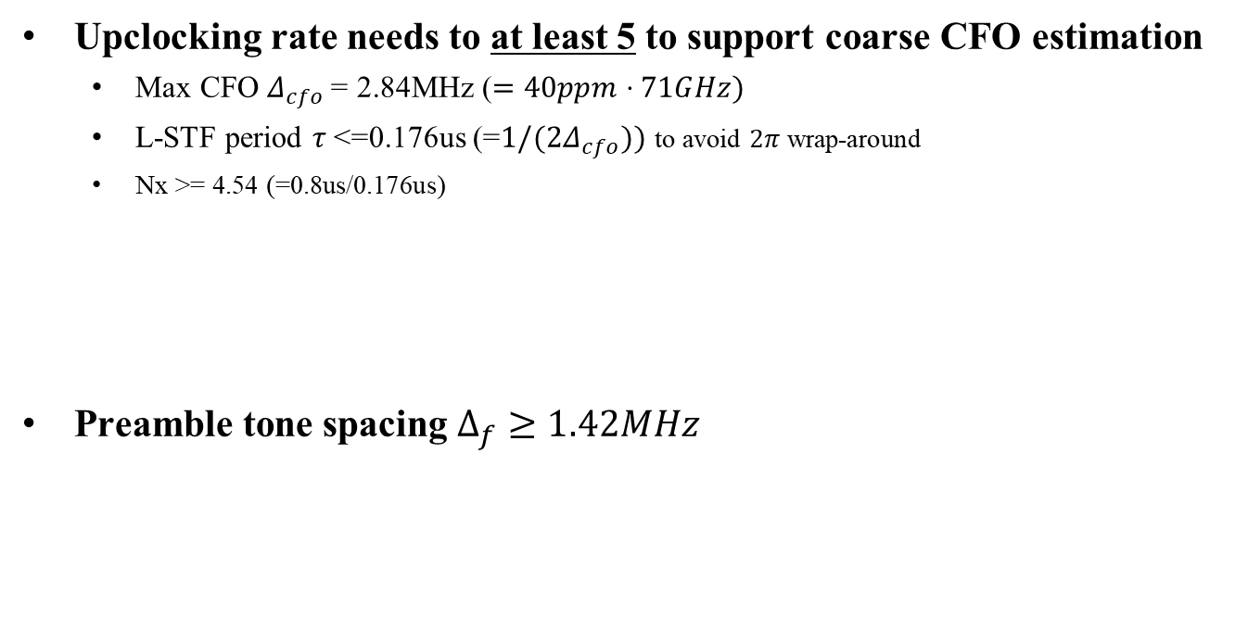
L-STF/IMMW-STF
Upclocking rate needs to at least 5 to support coarse CFO estimation
  Max CFO $Δ_{cfo }$= 2.84MHz ($=40ppm⋅71GHz)$
  L-STF period $τ$<=0.176us (=$1/(2Δ_{cfo}))$ to avoid $2π$ wrap-around
  Nx >= 4.54 (=0.8us/0.176us)
Preamble tone spacing $Δ_{f}≥1.42MHz$
$$τ$$ | $$τ$$ | $$τ$$ | $$τ$$ | $$τ$$ | $$τ$$ | $$τ$$ | $$τ$$ | $$τ$$ | $$τ$$

Slide 5
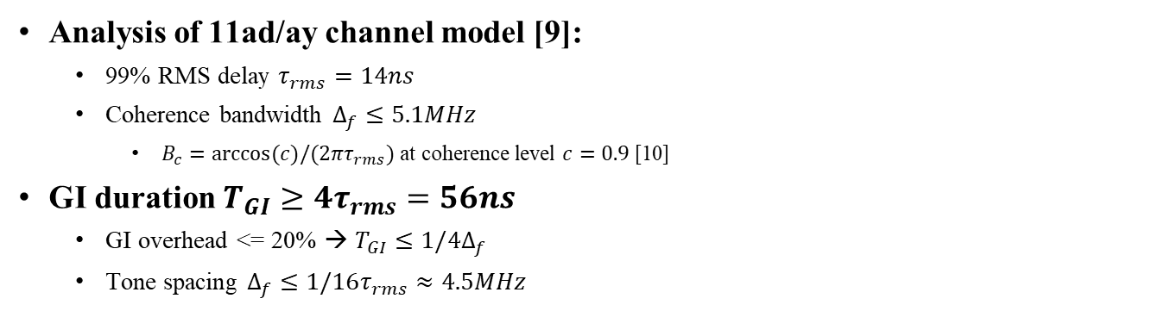
Guard Interval
Analysis of 11ad/ay channel model [9]:
  99% RMS delay $τ_{rms}=14ns$
  Coherence bandwidth $Δ_{f}≤5.1MHz$
    $B_{c}=arccos(c)/(2πτ_{rms})$ at coherence level $c=0.9$ [10]
GI duration $T_{GI}≥4τ_{rms}=56ns$
  GI overhead <= 20% → $T_{GI}≤1/4Δ_{f}$
  Tone spacing $Δ_{f}≤1/16τ_{rms}≈4.5MHz$

Slide 6
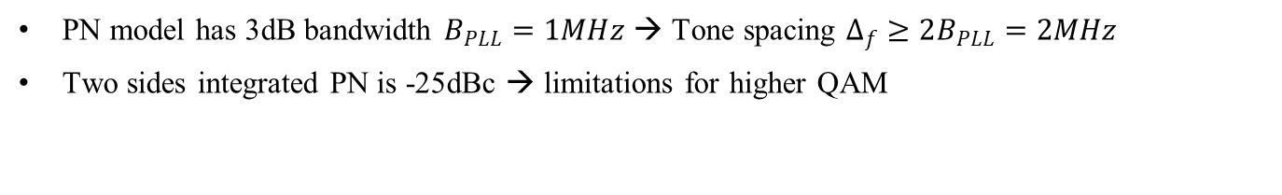
Phase Noise
Model [8]
  PSD(0) = -90 dBc/Hz
  Pole frequency fp = 1 MHz
  Zero frequency fz = 100 MHz
  Corresponding PSD(infinity) = -130 dBc/Hz
PN model has 3dB bandwidth $B_{PLL}=1MHz$ → Tone spacing $Δ_{f}≥2B_{PLL}=2MHz$
Two sides integrated PN is -25dBc → limitations for higher QAM

Slide 7
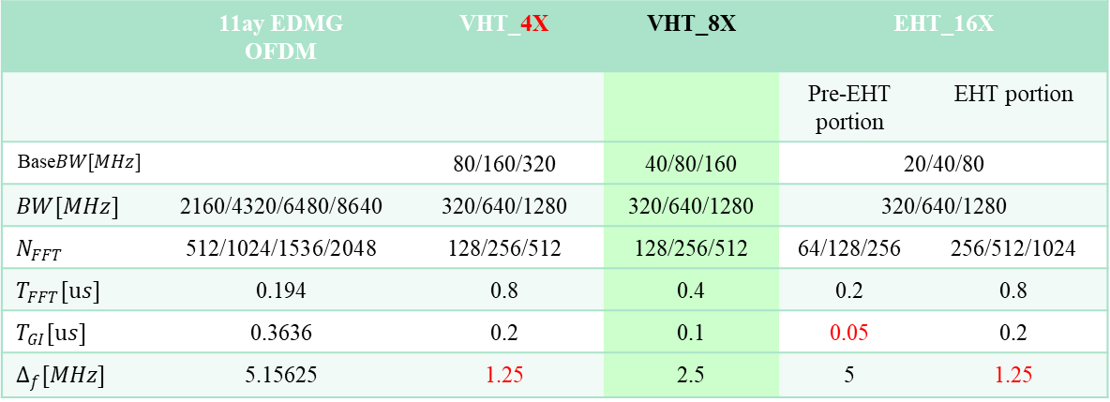
IMMW OFDM PHY
Requirements:
  Tone spacing range [2MHz, 5MHz]
  Upclock rate: Nx >= 5
 | 11ay EDMG OFDM | VHT_4X | VHT_8X | EHT_16X
 |  |  |  | Pre-EHT portion | EHT portion
Base$BW[MHz]$ |  | 80/160/320 | 40/80/160 | 20/40/80
$$BW[MHz]$$ | 2160/4320/6480/8640 | 320/640/1280 | 320/640/1280 | 320/640/1280
$$N_{FFT}$$ | 512/1024/1536/2048 | 128/256/512 | 128/256/512 | 64/128/256 | 256/512/1024
$$T_{FFT}[us]$$ | 0.194 | 0.8 | 0.4 | 0.2 | 0.8
$$T_{GI}[us]$$ | 0.3636 | 0.2 | 0.1 | 0.05 | 0.2
$$Δ_{f}[MHz]$$ | 5.15625 | 1.25 | 2.5 | 5 | 1.25

Slide 8
Performance Comparison: PN
256QAM (MCS 8/9): Difficult for VHT_4x and EHT_16x to support
64QAM (MCS 6/7): up to 1.5dB loss for VHT_4x and EHT_16x

Slide 9
Summary
Discussed the impact of upclocking sub-7GHz OFDM
  L-STF period limit due to coarse CFO → at least 5x upclock
  GI requirement and channel coherence BW → <=5MHz tone spacing
  Phase noise PLL bandwidth → at least 2MHz tone spacing
Compare three tone plans
  VHT_4x, VHT_8x, EHT_16x
  VHT_8x is the best fit among the three

Slide 10
SP
Do you agree that the IMMW OFDM PHY is defined based on VHT tone plan with 8 times upclocking?

Slide 11
Reference
[1] P802.11bq_PAR, https://www.ieee802.org/11/PARs/P802.11bq_PAR.pdf
[2] 11-22-1872-00-0uhr-considerations-on-phy-designs-for-mmwave-band
[3] 11-22-1395-00-0uhr-thoughts-on-high-frequency-band
[4]11-23-0066-02-0uhr-thoughts-on-utiliizing-mmwave
[5] 11-23-1878-01-immw-high-level-design-considerations-of-immw
[6] 11-23-1968-00-immw-discussion-on-general-direction-of-integrated-mmWave
[7] 11-25-0360-00-00bq-High-level-thoughts-on-IMMW-PHY-Design
[8] 11-09-0296-16-00ad-evaluation-methodology
[9] 11-15-1150-09-00ay-channel-models-for-ieee-802-11ay
[10] Debaenst W, Feys A, Cuiñas I, García Sánchez M, Verhaevert J., RMS Delay Spread vs. Coherence Bandwidth from 5G Indoor Radio Channel Measurements at 3.5 GHz Band. Sensors (Basel). 2020 Jan 29.

