Slide 1
Some considerations for
MLO-based BFT Announcement
Date: 2025-05-12
Authors:
Name | Affiliation | Address | Phone | Email
Hongwon Lee | LG Electronics | 19, Yangjae-daero 11gil, Seocho-gu, Seoul 137-130, Korea |  | hongwon.lee@lge.com
Insun Jang |  |  |  | insun.jang@lge.com
Eunsung Park |  |  |  | esung.park@lge.com
Jinsoo Choi |  |  |  | js.choi@lge.com
Dongju Cha |  |  |  | dongju.cha@lge.com
Insik Jung |  |  |  | insik0618.jung@lge.com
HanGyu Cho |  |  |  | hg.cho@lge.com
Sanggook Kim |  | 10680 Treena St, San Diego CA 92131 , USA |  | sanggook.kim@lge.com

Slide 2
Introduction
Generally, 11bq focuses on an MLD with which at least one STA operating on a mmWave bands is affiliated [5]
We discussed how Beamforming Training (BFT) can be performed using sub-7GHz signaling [5]
In this contribution, we would like to examine a few BFT examples to derive key insights for designing the BFT information announcement frame
With this, we share our thoughts on how to design the MLO-based Beamforming Training (BFT) Announcement frame
For convenience, we call STAs (or APs) operating on mmWave bands mSTA (or mAPs) and also call STAs (or APs) operating on sub-7GHz bands sSTA (or sAPs)

Slide 3
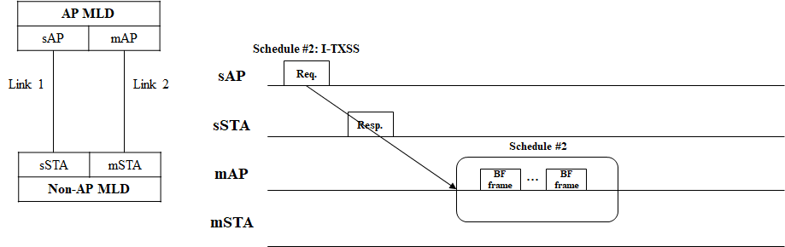
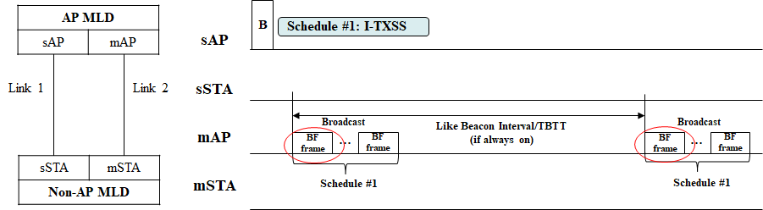
Recap: MLO-based Beamforming Training [5]
Dynamic BFT
  Dynamic BFT schedule(s) based on Request/Response frame exchanges or an announced frame
(Semi-) Static BFT
  It would be similar to broadcast I-TXSS, which may be ON and OFF

Slide 4
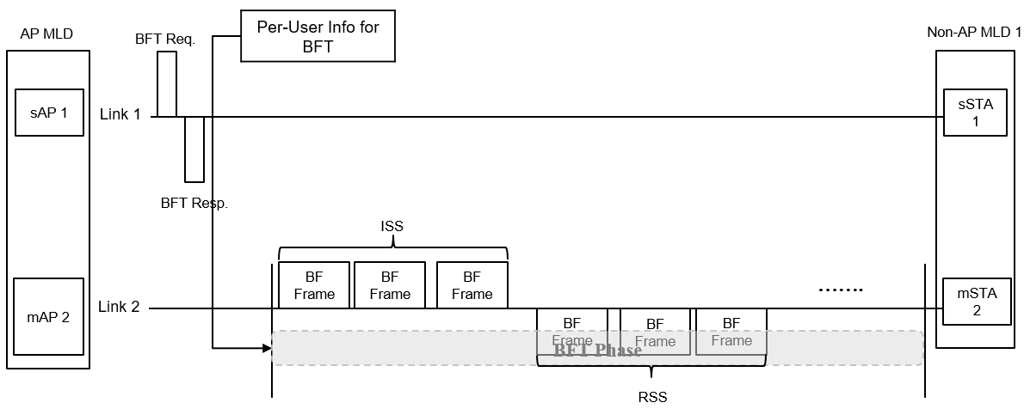
BFT example – scheduling for Individual STA
This is a simple example for signaling BFT information to a non-AP MLD
BFT information can be included in a signaling frame (e.g., Request/Response and/or Announcement) over a sub-7GHz link
For convenience, this kind of information can be treated as per-user information (Per-User Info) for BFT in this contribution

Slide 5
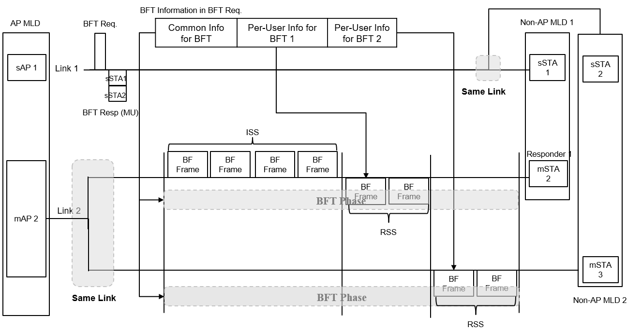
BFT example – scheduling for multiple STAs
We can consider one-shot scheduling for multiple non-AP MLDs performing BFT on the same link
In this case, both Common Info and Per-User Info for BFT can be included in the BFT Request (or BFT Announcement)

Slide 6
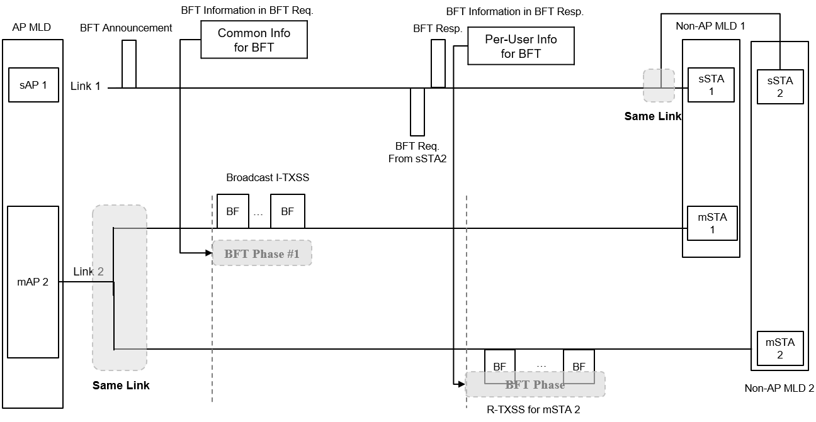
BFT example – Broadcast I-TXSS
Broadcast I-TXSS can be performed for non-specified multiple non-AP MLDs
One or more non-AP MLDs can request R-TXSS using this Broadcast I-TXSS, as needed or on demand
Broadcast I-TXSS may be performed periodically

Slide 7
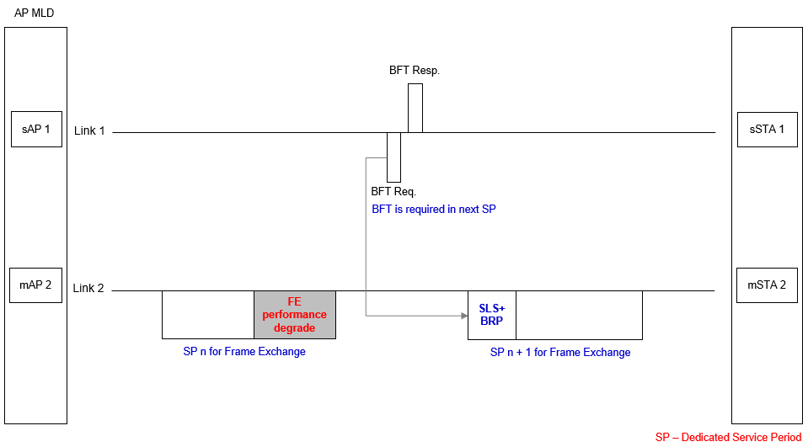
BFT example – on demand
In some cases, BFT is required during the frame exchange due to environment changes such as mobility, channel status, and so on
In this case, full or partial BFT is required

Slide 8
Considerations for designing
BFT Announcement in sub-7GHz
Unified frame design for BFT Announcement
  Different types of BFT procedures (e.g., SLS Only, ISS Only, RSS Only, Broadcast I-TXSS, BRP Only, Full(one-shot) BFT(SLS + BRP) and so on) can be indicated using the unified BFT announcement frame [6]
    In the initial phase, one-shot BFT for one or more users may be performed to find beam pattern each other
    If a user has BFT information obtained in the previous BFT phase, partial BFT(e.g. R-TXSS Only, BRP Only, etc.) may be possible
    BFT may be required after initialization in certain cases, such as following environmental changes, and it should be decided which BFT procedures are performed
    Scalability to support multiple users
  Common Information for multiple users (e.g., Common BFT information for the same BFT schedule and/or a common BFT schedule for broadcast I-TXSS)
  User-Specific Information for each user (e.g., specific BFT sub-schedules for each user, such as RSS)
Periodicity for (semi-) static BFT
  In certain cases, periodic BFT(e.g. Broadcast I-TXSS) may be performed for non-specified multiple users

Slide 9
Conclusion
This contribution provides several examples for MLO-based Beamforming Training (BFT)
  Through these examples, we could derive some discussion points outlined below
We discussed several aspects to designing BFT Announcement(or Request/Response) procedure
  Unified frame design for BFT Announcement
  Scalability to support multiple users
  Periodicity

Slide 10
Straw Poll 1
Do you support the following text in 11bq?
  11bq defines a mechanism for an MLD to perform a beamforming training procedure in a mmWave band, assisted by its affiliated STA in sub-7GHz band
    NOTE1: The beamforming training procedure means a process which finds an optimized direction to apply analog beamforming
    NOTE2: The beamforming training procedure includes a Sector Level Sweep which finds the best transmit or receiver sector

Slide 11
Straw Poll 2
Do you support the following text in 11bq?
  11bq defines new frames or reuses/enhances existing frames, where a STA affiliated with an MLD and operating in a Sub-7GHz band indicates information to facilitate beamforming training(BFT) for a mmWave band
    Details are TBD

Slide 12
Straw Poll 3
Do you support the following text in 11bq?
  11bq defines one or more BFT types (e.g., BFT for TX sectors, BFT for RX sectors) and allows the inclusion of the BFT type in the frame that carries information to facilitate beamforming training (BFT)

Slide 13
Straw Poll 4
Do you support the following text in TGbq?
  11bq defines new frames or reuses/enhances existing frames, where a STA affiliated with an MLD and operating in a Sub-7GHz band indicates common and user specific beamforming training information to its associated STA(s) affiliated with MLD(s) for beamforming training on a link in a mmWave band
    Common beamforming training information is same information for all associated STA(s) affiliated with MLD(s)
    User specific beamforming training information is information for each associated STA(s) affiliated with MLD(s)

Slide 14
Straw Poll 5
Do you support the following text in TGbq?
  11bq defines a mechanism where a STA, that is affiliated with an MLD and operating in a Sub-7GHz band, announces a periodic duration to its associated STA(s) affiliated with other MLD(s) for beamforming training on a link in a mmWave band

Slide 15
References
[1] IEEE P802.11-REVme™/D7.0
[2] 24/1312, Draft P802.11bq PAR
[3] 11-23/1905, High Level Thoughts on IMMW
[4] 11-23/1968, Discussion on general direction of integrated mmWave
[5] 11-25/431, MLO-based Scheduling for IMMW
[6] 11-25/xxx, Discussion on BFT Types for 11bq

