Slide 1
Coexistence of Features with Operating Mode Switching Operations
Date: 2025-05-01
Authors:

Slide 2
Abstract
Some UHR features introduced in TGbn involve operating mode switching operations, e.g., [1]
DBE (Dynamic Bandwidth Expansion): switching between BSS bandwidth and DBE bandwidth
DPS (Dynamic Power Save): switching between low capability mode and high capability mode
DSO (Dynamic Sub-band Operation): switching between primary sub-band and DSO sub-band
NPCA (Non-Primary Channel Access): switching between BSS Primary channel and NPCA Primary channel
This contribution presents rules and examples for how a STA can enable/disable/activate/adjust multiple features that require operating mode switching operations, e.g.,
some features have conflicts with each other or introduce extra complexity if running at the same time, e.g., DSO should not be enabled during NPCA operations, and vice versa.
some features can be enabled/adjusted together to simplify the procedures and improve efficiency without introducing too much overhead/complexity.
some features can be used to enable/disable/adjust other features.

Slide 3
Recap: UHR Features That Involve Operating Mode Switching Operations [1]
DBE: enables a UHR AP to modify (expand/reset) its Dynamic UHR operating BSS bandwidth
The primary channel does not change as part of the dynamic BW expansion
DPS: allows a UHR STA (mobile AP or non-AP STA) to transition from a low capability (LC) mode to a high capability (HC) mode upon transmission/reception of ICF
LC: default mode: 20 MHz/1 SS/non-HT PPDU; parameterized mode: up to UHR PPDUs with parameters of maximum BW/NSS/MCS
If ICF-Required is 1, the AP shall initiate any frame exchange with a DPS STA by sending an ICF
DSO: enables a UHR AP to allocate certain available part of its operating BW to non-AP STAs
TBD: only allow one DSO sub-band; DSO only for 80MHz/160MHz STAs or also for 20MHz STAs
NPCA: enables a STA to access the secondary channel while the primary channel is busy
at most one NPCA Primary channel; NPCA is not allowed if the BSS BW <= 40 MHz

Slide 4
Proposal: Enable/Adjust Multiple Features That Involve Operating Mode Switching Operations (1/2)
Operating mode switching operations are in different levels: scheduled/dynamic
DBE: switching operations are announced in advance for multiple Beacon intervals, not a TXOP level change
DPS, DSO, NPCA: switching operations are initiated by ICF/ICR, on a per-TXOP basis
For features with scheduled/dynamic operating mode switching operations:
Multiple of such features can be enabled/adjusted
One of such features can be used to enable/adjust another feature
For example, when DBE is scheduled to be activated/terminated, the following dynamic operations can be enabled or certain parameters can be adjusted
DPS: Enablement/disablement; Low/high capability mode; ICF-Required
DSO: Enablement/disablement; DSO sub-band
NPCA: Enablement/disablement; NPCA Primary channel

Slide 5
Proposal: Enable/Adjust Multiple Features That Involve Operating Mode Switching Operations (2/2)
Similarly, when OMI/OMN is used to reduce the operating bandwidth:
DPS, DSO, or NPCA may be disabled,
Parameters can be adjusted, e.g., low/high capability mode, DSO sub-band, or NPCA Primary channel
The enablement/disablement/adjustment can be
implicit: capability mode/DSO sub-band/NPCA Primary channel outside of operating mode/BW
explicit: signaled in DPS/DSO/NPCA procedure/frame/element/field

Slide 6
Examples: DBE and DPS
DBE is activated, and then DPS is enabled with certain DPS parameters
DPS is already enabled.
DBE is activated, and then DPS parameters are adjusted

Slide 7
Examples: DBE and NPCA
DBE is activated, and then NPCA is enabled with certain NPCA parameters
Other examples not shown here: when DBE is activated, NPCA parameters can be adjusted

Slide 8
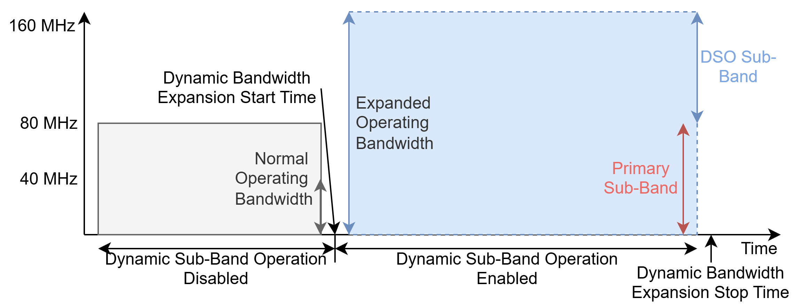
Examples: DBE and DSO
DBE is activated, and then DSO is enabled with certain DSO parameters
Other examples not shown here: when DBE is activated, DSO parameters can be adjusted

Slide 9
Conclusion
This contribution presents discussions and proposals on the coexistence of multiple features that require operating mode switching operations.
Long-term/scheduled operations, e.g., DBE, can be used to enable, disable, or adjust the parameters of short-term/dynamic operations, e.g., DPS, DSO, and NPCA
When DBE is activated, other features such as DPS, DSO, and NPCA can also be enabled/adjusted within the DBE bandwidth, subject to other requirements for each feature.
Similarly, when DBE is terminated, DPS, DSO, and NPCA can be disabled/adjusted within the BSS bandwidth.

Slide 10
References
[1] Specification Framework for TGbn, Ross Jian Yu (Huawei), https://mentor.ieee.org/802.11/dcn/24/11-24-0209-14-00bn-specification-framework-for-tgbn.docx
[2] IEEE P802.11bn/D0.2, March 2025
[3] PDT-MAC-DBE, Binita Gupta (Cisco Systems), https://mentor.ieee.org/802.11/dcn/25/11-25-0503-03-00bn-pdt-mac-dbe.docx

Slide 11
Straw Polls
SP1: Do you agree to amend [Motion #365] to include the following:
If DBE is enabled and the DBE bandwidth is larger than 40 MHz, an AP may allow the use of NPCA within its BSS.
When DBE is activated or terminated, an NPCA AP may change the NPCA parameters within the DBE bandwidth or BSS bandwidth.
Reference [1] Specification Framework for TGbn, 24/0209r14, [Motion #365]
An AP shall not allow the use of NPCA within its BSS if the BSS operating bandwidth is less than or equal to 40 MHz.
Results: Y, N, A

Slide 12
Straw Polls
SP2: Do you agree to amend [Motion #332] to include the following:
If both DSO and DBE are enabled, a DSO STA can be allocated a DSO sub-band that is outside of the non-AP STA's current operating bandwidth and within the associated AP’s DBE bandwidth.
When DBE is activated or terminated, a DSO AP may change the DSO parameters within the DBE bandwidth or BSS bandwidth.
Reference [1] Specification Framework for TGbn, 24/0209r14, [Motion #332]
TGbn defines a mechanism where a non-AP STA can be allocated frequency resources dynamically (i.e., on a per-TXOP basis) outside of the non-AP STA's current operating bandwidth and within the associated AP's BSS bandwidth.
Results: Y, N, A

Slide 13
Straw Polls
SP3: Do you agree to add the following texts to TGbn SFD:
When DBE is activated or terminated, a DPS STA may enable/disable DPS and/or adjust DPS parameters within the DBE bandwidth or BSS bandwidth.
Results: Y, N, A

Slide 14
Backup

Slide 15
Backup: DPS
Reference [1] Specification Framework for TGbn, 24/0209r14
[Motion #9] TGbn defines a power save mode for a STA that is a UHR Mobile AP or a UHR non-AP STA wherein the STA may transition from a lower capability mode to a higher capability mode upon reception of an initial control frame
Lower capability mode (e.g., 20 MHz BW, one SS, limited data rates, PPDU format)
Higher capability mode (e.g., operating BW, NSS and MCSs, with at least one higher capability than that in the lower power capability mode)
Initial Control frame is TBD
Whether that applies for a non-mobile AP is TBD

Slide 16
Backup: NPCA
Reference [1] Specification Framework for TGbn, 24/0209r14
[Motion #11] TGbn defines a mode of operation that enables a STA to access the secondary channel while the primary channel is known to be busy due to OBSS traffic or other TBD conditions.
The mode of operation shall not assume that the STA is capable to detect or decode a frame and obtain NAV information of the secondary channel concurrently with the primary channel.
A BSS shall only have a single Non-Primary Channel Access (NPCA) primary channel (name TBD) on which the STA contends while the primary channel of the BSS is known to be busy due to OBSS traffic or other TBD conditions.
[Motion #130] An AP that is capable of NPCA announces at most one NPCA Primary channel
NPCA Primary channel is in AP's BSS operating channel width
NPCA Primary channel is not a punctured 20 MHz subchannel (as indicated in EHT Operation element)
Details on signaling is TBD
[Motion #365] An AP shall not allow the use of NPCA within its BSS if the BSS operating bandwidth is less than or equal to 40 MHz.

Slide 17
Backup: DSO
Reference [1] Specification Framework for TGbn, 24/0209r14
[Motion #332] TGbn defines a mechanism where a non-AP STA can be allocated frequency resources dynamically (i.e., on a per-TXOP basis) outside of the non-AP STA's current operating bandwidth and within the associated AP's BSS bandwidth.

Slide 18
Backup: DBE
Reference [1] Specification Framework for TGbn, 24/0209r14
[Motion #334] 11bn defines a mechanism for dynamic bandwidth expansion (DBE) that enables a UHR AP to modify (expand/reset) its Dynamic UHR operating BSS bandwidth for UHR STAs that support the DBE operation
The dynamic bandwidth change is signaled using management frames and is announced for multiple beacon intervals in advance, and the AP shall stay on the expanded bandwidth until a subsequent dynamic bandwidth change occurs
The primary channel does not change as part of the dynamic BW expansion.
TBD on DBE signaling details

