Slide 1
Additions to Specification Framework Document
Date: 2025-05-13
Authors:

Slide 2
Outline
May 2025
Blue-Green Spectrum Operation
Multi-Wavelength Operation
Localization Capability
Integration of the IEEE Std. 802.11 Baseband with Optical Frontends

Slide 3
Blue-Green Spectrum Operation
May 2025
We propose the following text to become part of the 802.11br SFD text:
3.2 Definitions specific to IEEE Std 802.11
Insert the following definition in alphanumeric order as follows:
Enhanced light communications station (ELC STA): A station (STA) that should be capable of operating in the light band with wavelengths
in the range 800 nm to 1000 nm and may be capable of operating in the light bands with wavelengths in the ranges of 400 nm to 600 nm and/or 1200 nm to 1600 nm.

Slide 4
Blue-Green Spectrum Operation Contd.
May 2025
We propose the following text to become part of the 802.11br SFD text:
4.3.31 Enhnaced Light communication (ELC) STA
An ELC STA operates in the light band with wavelengths in the range of 800 nm to 1000 nm. In addition, an ELC STA may operate in the light bands with wavelengths in the range of 400 nm to 600 nm and/or 1200 nm to 1600 nm.
33.2.3.5.3 Wavelength-division multiplexing
An ELC optical RX antenna may additionally compared to an LC optical RX antenna be sensitive to light in one of the following wavelength ranges:
— 400 nm to 500 nm
— 500 nm to 600 nm
— 400 nm to 600 nm
An ELC PHY may have at least one receive chain with an ELC optical RX antenna sensitive to light in the
400 nm to 600 nm range or at least two receive chains with one receive chain with an ELC optical RX
antenna sensitive to light in the 400 nm to 500 nm range and the other receive chain with an ELC optical RX
antenna sensitive to light in the 500 nm to 600 nm range.

Slide 5
Blue-Green Spectrum Operation Contd.
May 2025
We propose the following text to become part of the 802.11br SFD text:
33.2.3.6 Receive specification
The minimum receive sensitivity of an LC PHY shall be –7 dBmopt measured as the average incident
optical power in the range 400 nm to 600 nm at the LC optical RX antennas.

Slide 6
Multi-Wavelength Operation
May 2025
We propose the following text to become part of the 802.11br SFD text:

Slide 7
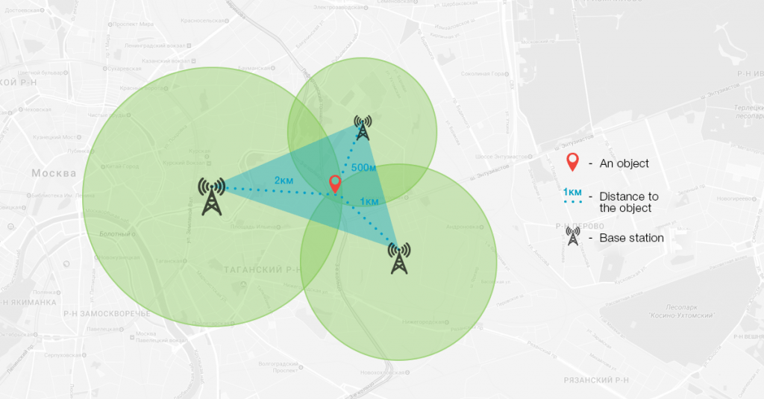
Localization Capability
May 2025
Combining data transmission with localization capability can be a great value add in certain use cases
For maximum accuracy we would require a trilateration type technique
This necessitates ranging capability even when not connected to AP i.e., based on beacon signaling or a trigger request similar to the WiFi Round Trip Time approach introduced by TGmc

Slide 8
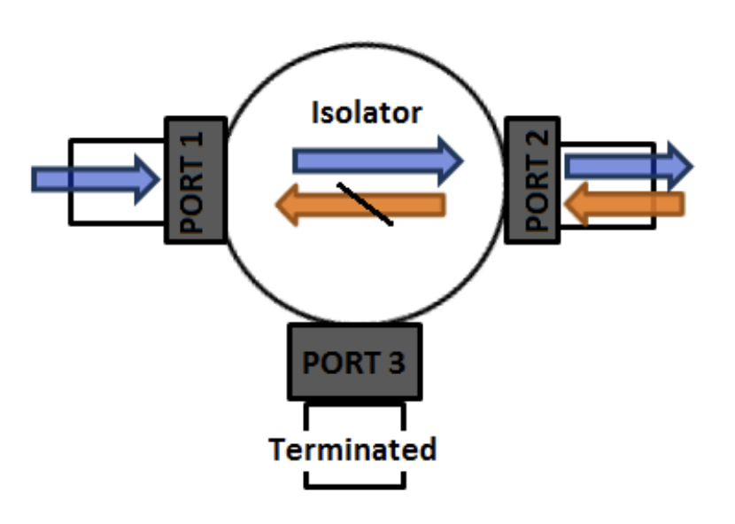
Integration of the IEEE Std. 802.11 Baseband with Optical Frontends
May 2025
New carrier frequency support – (40+delta) MHz, (80+delta) MHz, (160+delta) MHz (also 5 MHz and 10 MHz for backwards compatibility?)
Eliminates need for external up and down conversion
Exposed dedicated RX pins or alternatively expose digital signaling to reduce external component count for TX and RX antenna separation
We want to eliminate the need for external components required for antenna connection i.e., circulators, switches and isolators

Slide 9
Straw Poll 1
Propose to include the 400 nm – 600 nm optical window subdivided into two operational wavelength ranges – 400 nm to 500 nm and 500 nm to 600 nm into the baseline TGbr draft.
(Yes/No/A) 3/2/9

Slide 10
Straw Poll 2
Propose to include the ability to do uplink and downlink communication on two separate and different wavelengths/wavelength ranges into the baseline TGbr draft.
(Yes/No/A) 6 / 2 / 7

Slide 11
Straw Poll 3
Propose to include new carrier frequencies that allow for baseband signals to be output from WiFi DSP chipsets that support Light Communication into the baseline TGbr draft.
Withdrawn

Slide 12
References
May 2025
[1] Slide 4, images from C. Williamson and R. Hollins, "Measured IOPs of Jerlov water types," Appl. Opt. 61, 9951-9961 (2022).
[2] Slide 4, images from Eyvind Aas, Niels Kristian Højerslev, Jo Høkedal, Kai Sørensen, Optical water types of the Nordic Seas and adjacent areas, Oceanologia, Volume 55, Issue 2, 2013, Pages 471-482, ISSN 0078-3234, https://doi.org/10.5697/oc.55-2.471. (https://www.sciencedirect.com/science/article/pii/S0078323413500261)
[3] Slide 6, image from https://www.loccate.com/blog/identify-location-without-gps/
[4] Slide 7, image from https://encrypted-tbn0.gstatic.com/images?q=tbn:ANd9GcQnqC1sSGBjEYy9Ua_kRD-yJ0MnhjUjLTfiPg&s https://valvo.com/wp-content/uploads/2017/12/ISOLATOR.pdf

