Slide 1
Channel access for Backscatter non-AP AMP STAs – way forward
Date: 11 May 2025
Name | Affiliation | Address | Phone | Email
Rojan Chitrakar | Huawei | Singapore |  | rojan.chitrakar@huawei.com
Lei Huang
Ian Bajaj
Notes:
Jul 12, 2010
Page 1

Slide 2
Selected relevant motions
MM-12: 11bp supports a mode of operation in which a sub-set of the logical interface of the UHF RFID Standard is used for backscattering communication.
Applicable UHF commands are carried in 802.11bp frames.
Applicable to both mono-static & bi-static backscattering.
The sub-set of the logical interface to be reused is TBD.
NOTE – The logical interface of the UHF RFID Standard is defined by the EPC® Radio-Frequency Identity Generation-2 UHF RFID Standard.
PM-9: The AMP Downlink PPDU in 2.4 GHz shall support the following data rates:
1 Mb/s (for non-Backscatter STAs only)
250 kb/s.
PM-17: 11bp defines the following data rates for AMP uplink transmissions at 2.4GHz
250kbps and 1Mbps for both backscatter and non-backscatter uplink transmission;
4Mbps for non-backscatter uplink transmission only. Mandatory or optional is TBD

Slide 3
Discussions
The simplest forms of backscatter non-AP AMP STAs (e.g., sticker form tags similar to passive RFID tags) are likely to be hardware limited [2], [3]:
Small Capacitor size (~100 pF); versus (~100 nF) for active Tx non-AP AMP STAs
Operations outside of excitation periods will be very limited. Tags may only be able to retain few essential context across TXOPs.
Long wakeup settling time (~ 1ms)
Less time within TXOP for actual communication
Clock accuracy of ~10⁵ ppm; versus ≤ 10⁴ ppm for active Tx non-AP AMP STAs
Synchronization (e.g., to slot boundary) will be a lot more challenging.
Such non-AP AMP STAs can be expected to also support the UHF RFID standard [2].
“Enhanced” backscatter non-AP AMP STAs are being studied for range extension and such STAs may have higher hardware capabilities. [4], [5]

Slide 4
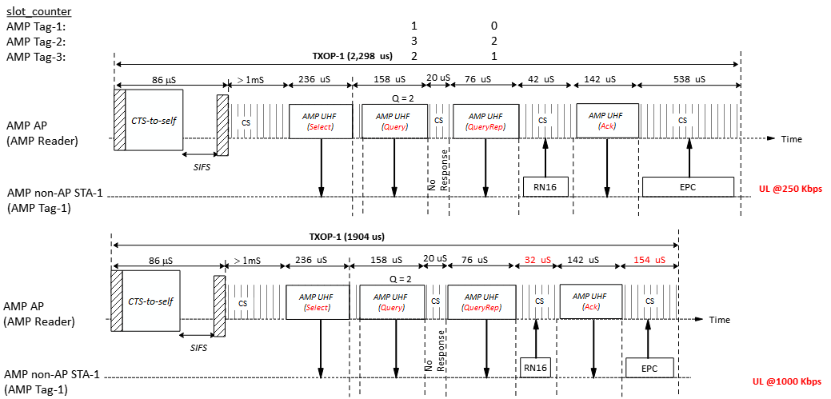
An Example based on the UHF commands
Notes:
Select (min size) 44 bits Query 22 bits QueryRep 4 bits ACK 18 bits

Slide 5
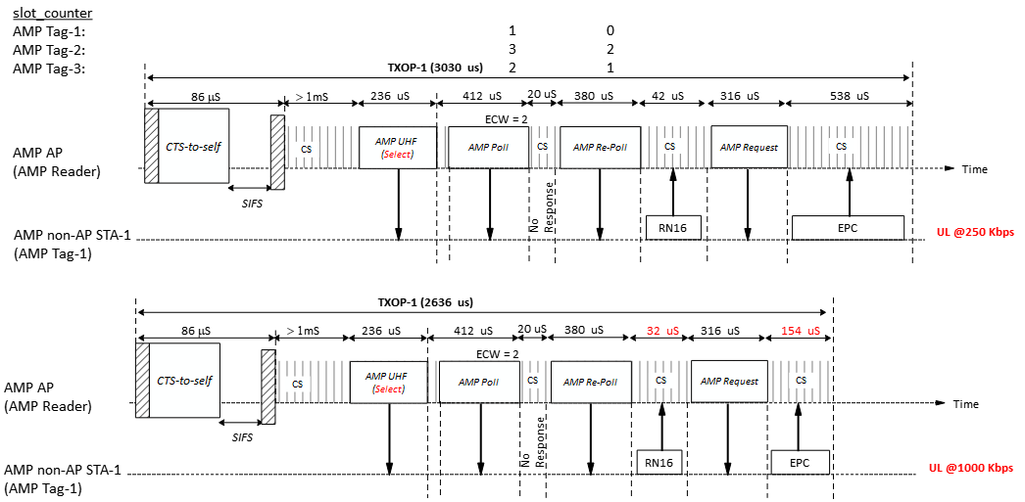
An Example using unified AMP frames [6]
We could consider using unified AMP frames for both backscatter and Active Tx but this leads to higher air-time overhead since the UHF commands are very compact.
Notes:
Poll = 10 Octets, Re-Poll = 9 Octets, Request = 7 Octets

Slide 6
Recommendations
Channel access for “tag form” backscatter non-AP AMP STAs are based on the UHF RFID standard and such STAs support at least the following as defined by the UHF RFID Standard [2]:
Sessions and flags: 1) Inventoried flags for S0, S1, S2, S3 sessions; 2) Selected flag (SL)
Tag memory structure: EPC is mandatory. TID and USER memory may be optionally supported.
Tag states: ready, arbitrate, reply and acknowledge are mandatory; other states may be supported based on the UHF commands supported.
UHF commands: Select, Query, QueryRep, ACK, NAK, Req_RN, Read, Write, Authenticate.
Extension frame can be used to define AMP specific operations for the AMP backscatter communication.
Channel access for Active Tx non-AP AMP STAs [6] may be reused for “Enhanced” backscatter non-AP AMP STAs.

Slide 7
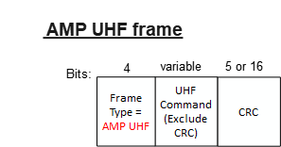
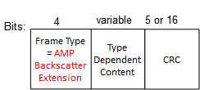
AMP frames for backscatter communication
We propose that AMP frames for backscatter communication be as simple as possible and contains:
A Frame Type field: indicates the type of the frame
Type Dependent Content field: the content depends on the frame type
CRC field: Either the 5-bits or 16-bits CRC as defined by the UHF RFID Standard but also convers the Frame Type field.
The AMP UHF frame can be used to encapsulate UHF commands.
The Type Dependent Content field carry the UHF Command as defined in the UHF RFID Standard but excluding the CRC field.
CRC field: Either the 5-bits or 16-bits CRC as defined by the UHF RFID Standard but also convers the Frame Type field.
Example frames:
The AMP Backscatter Extension frames can be used for AMP specific operations for the AMP backscatter communication.

Slide 8
SP 1
Do you agree to add to the 11bp SFD:
11bp supports a uplink channel access mechanism for backscatter non-AP AMP STA that is based on the UHF RFID Standard.
The uplink channel access is initiated by an AMP AP by transmitting an AMP frame carrying a UHF command.

Slide 9
SP 2
Do you agree to add to the 11bp SFD:
11bp defines one AMP frame type to carry a UHF command.
The frame consists of a Frame Type field, a Type-dependent Content field and a CRC field
The UHF command is carried in the Type-dependent Content field
The UHF commands supported by 11bp is TBD
NOTE – The UHF commands are defined by the EPC® Radio-Frequency Identity Generation-2 UHF RFID Standard.

Slide 10
SP 3
Do you agree to add to the 11bp SFD:
11bp shall support the following UHF commands: Select, Query, QueryRep, ACK, NAK, Req_RN, Read, Write, Authenticate
Other UHF commands supported by 11bp is TBD
NOTE – The UHF commands are defined by the EPC® Radio-Frequency Identity Generation-2 UHF RFID Standard.

Slide 11
SP 4
Do you agree to add to the 11bp SFD:
11bp defines one AMP frame type to carry AMP specific content for backscattering.
The frame consists of a Frame Type field, a Type-dependent Content field and a CRC field.
The AMP specific content is carried in the Type-dependent Content field.
The AMP specific content is TBD.

Slide 12
References
[1] 25/0335r0, Channel access for Backscatter non-AP AMP STAs – follow up (Rojan Chitrakar et. al.)
[2] EPC® Radio-Frequency Identity Generation-2 UHF RFID Standard V3.0 (GS1)
[3] 11-24/1237, AMP Tag Requirements for Close-range Mono-Static Backscattering (Rui Cao et. al)
[4] Long-Range Backscatter Device Capabilities (Nelson Costa et. al)
[5] 11-25/0307, UL Monostatic and Bistatic Range Extension Considerations (Dror Regev)
[6] 11-25-0817r0, Random access for Active Tx non-ap AMP STAs (Rojan Chitrakar et. al.)

